Slide 1
WWI – The WAR

Slide 2
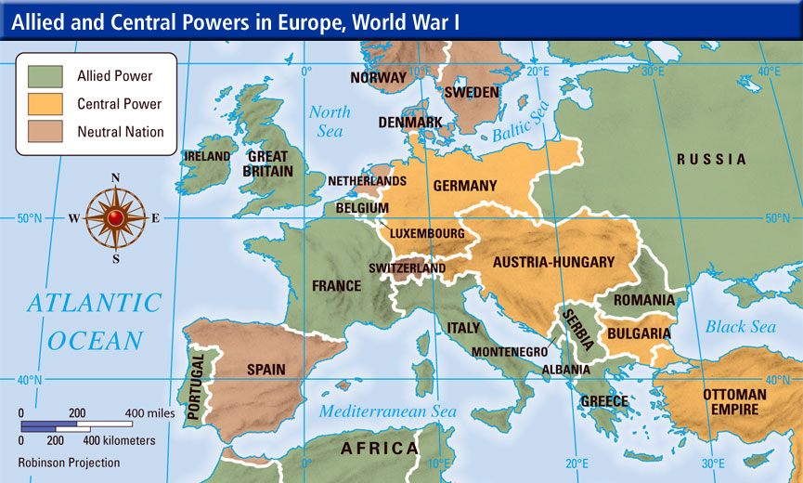
Two Sides Emerge
(Italy flip-flops from Triple Alliance over to the Allied Powers.)
Allied Powers
Great Britain
France
Russia
Italy (wanted control of Italia-populated lands in AH)
Japan (wanted German-controlled territory in China)
Central Powers
Austria-Hungary
Germany
Ottoman Empire

Slide 3
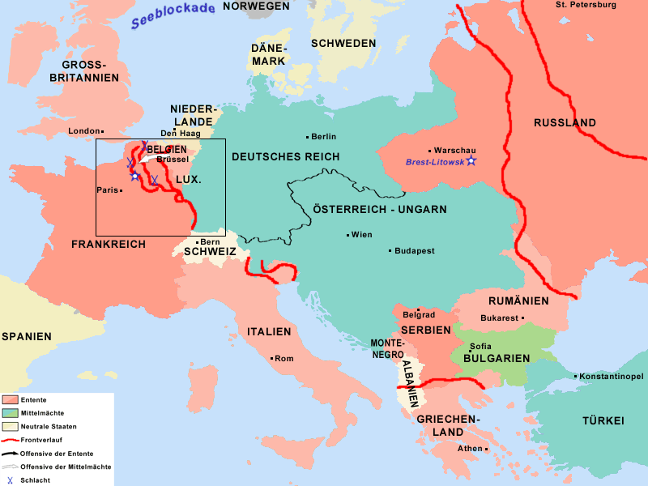
Three-Front War
Western Front
Between France and Germany
Eastern Front
Between Russia and Germany
Sea
Between Britain and Germany

Slide 4
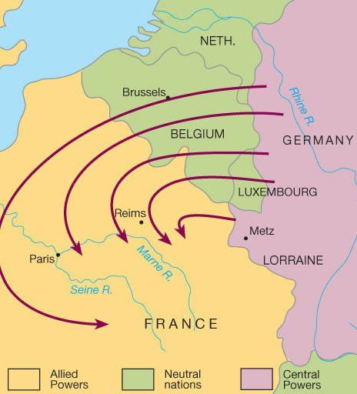
The Schlieffen Plan
Named after General Alfred Graf von Schlieffen
German military plan to win war:
First, head west and defeat France
Second, head east and defeat Russia
War over!
…….WRONG
Thought it would work because Russia was behind rest of Europe in railroad development (supplies, troops, etc.)

Slide 5
The Western Front
Reputation for slaughter
German dominance early on – moving into France
Close to Paris – defeated at the Battle of the Marne
Allies rushed soldiers from Paris to frontlines – forced Germans to retreat
MAJOR victory for Allies – ruined the Schlieffen Plan!!!
Development of trench warfare
Each side was only gaining miles of territory – “fighting for inches”
Modern warfare tech was too advanced for trenches – resulted in mass casualties

Slide 7
Trench Warfare
500 mile-long network
System of defense, not offense
BRUTAL living conditions
Mud, disease, rats, bodies, odor of human flesh
Trench foot – foot infections
Covered in barbed wire – prevented troops from advancing
Resulted in a stalemate
No side really gained any ground – just lost thousands of men
Modern tech was more effective than primitive war tactics
At Verdun in 1916, 750,000 men lost their lives and the Western front had moved FOUR MILES……FOUR. MILES.

Slide 9
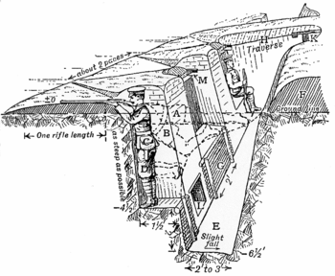

Slide 10
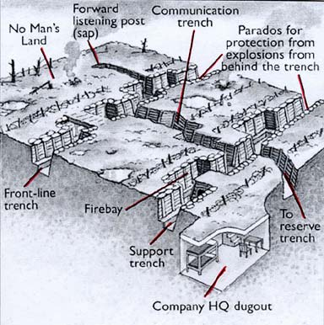

Slide 11
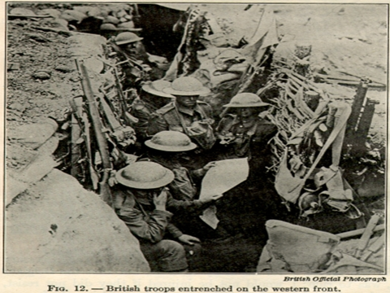
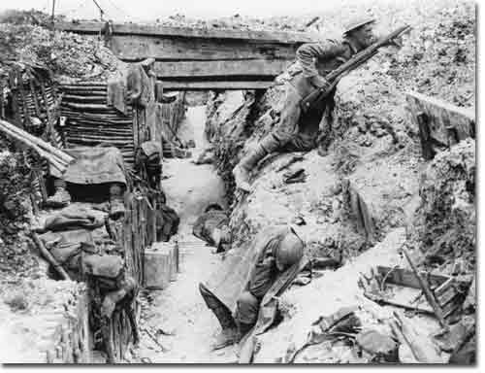
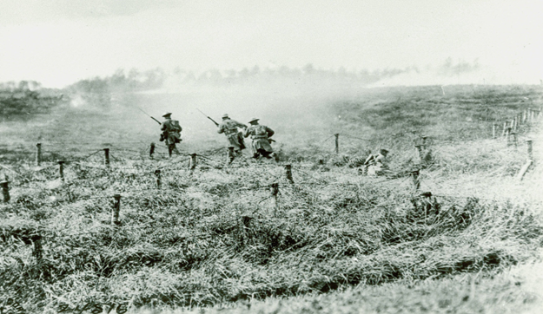
No Man’s Land

Slide 12
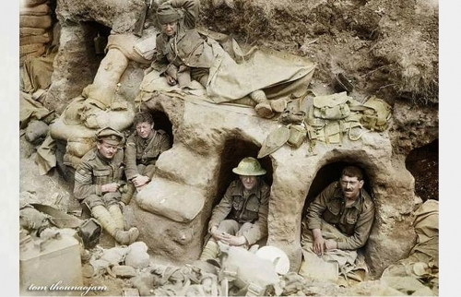
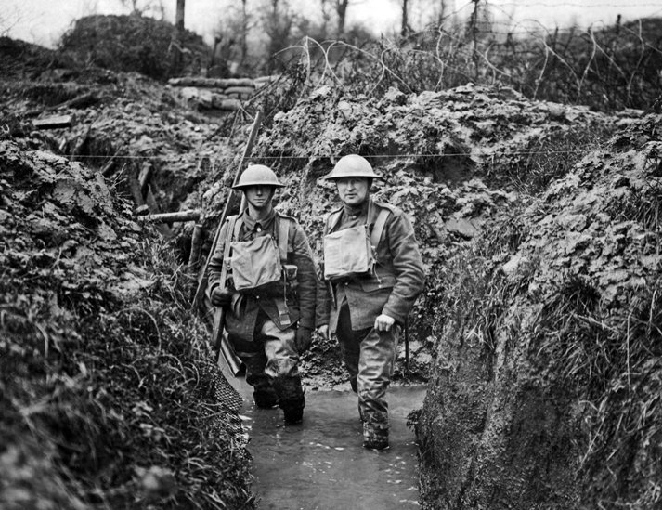
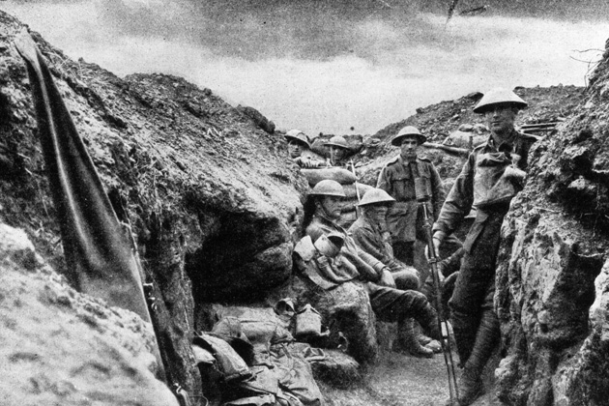
Life in the trenches

Slide 13
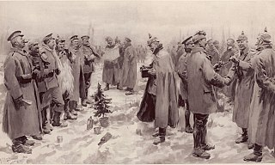
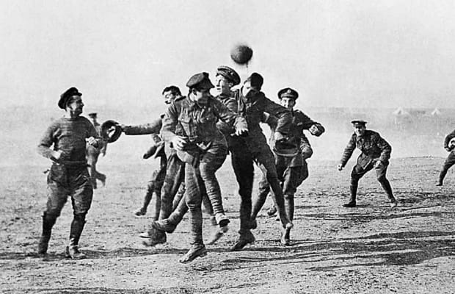
Western Front
Christmas Truce of 1914
Both sides stopped fighting to celebrate holiday
Men would gather in no mans land
Trade food, souvenirs, even play soccer
High number of casualties resulted in need for battlefield care
Ambulances to hospitals
Mobile x-ray units
Creation of blood banks
Development of plastic surgery to fix disfiguring injuries
Prosthetic limbs

Slide 14
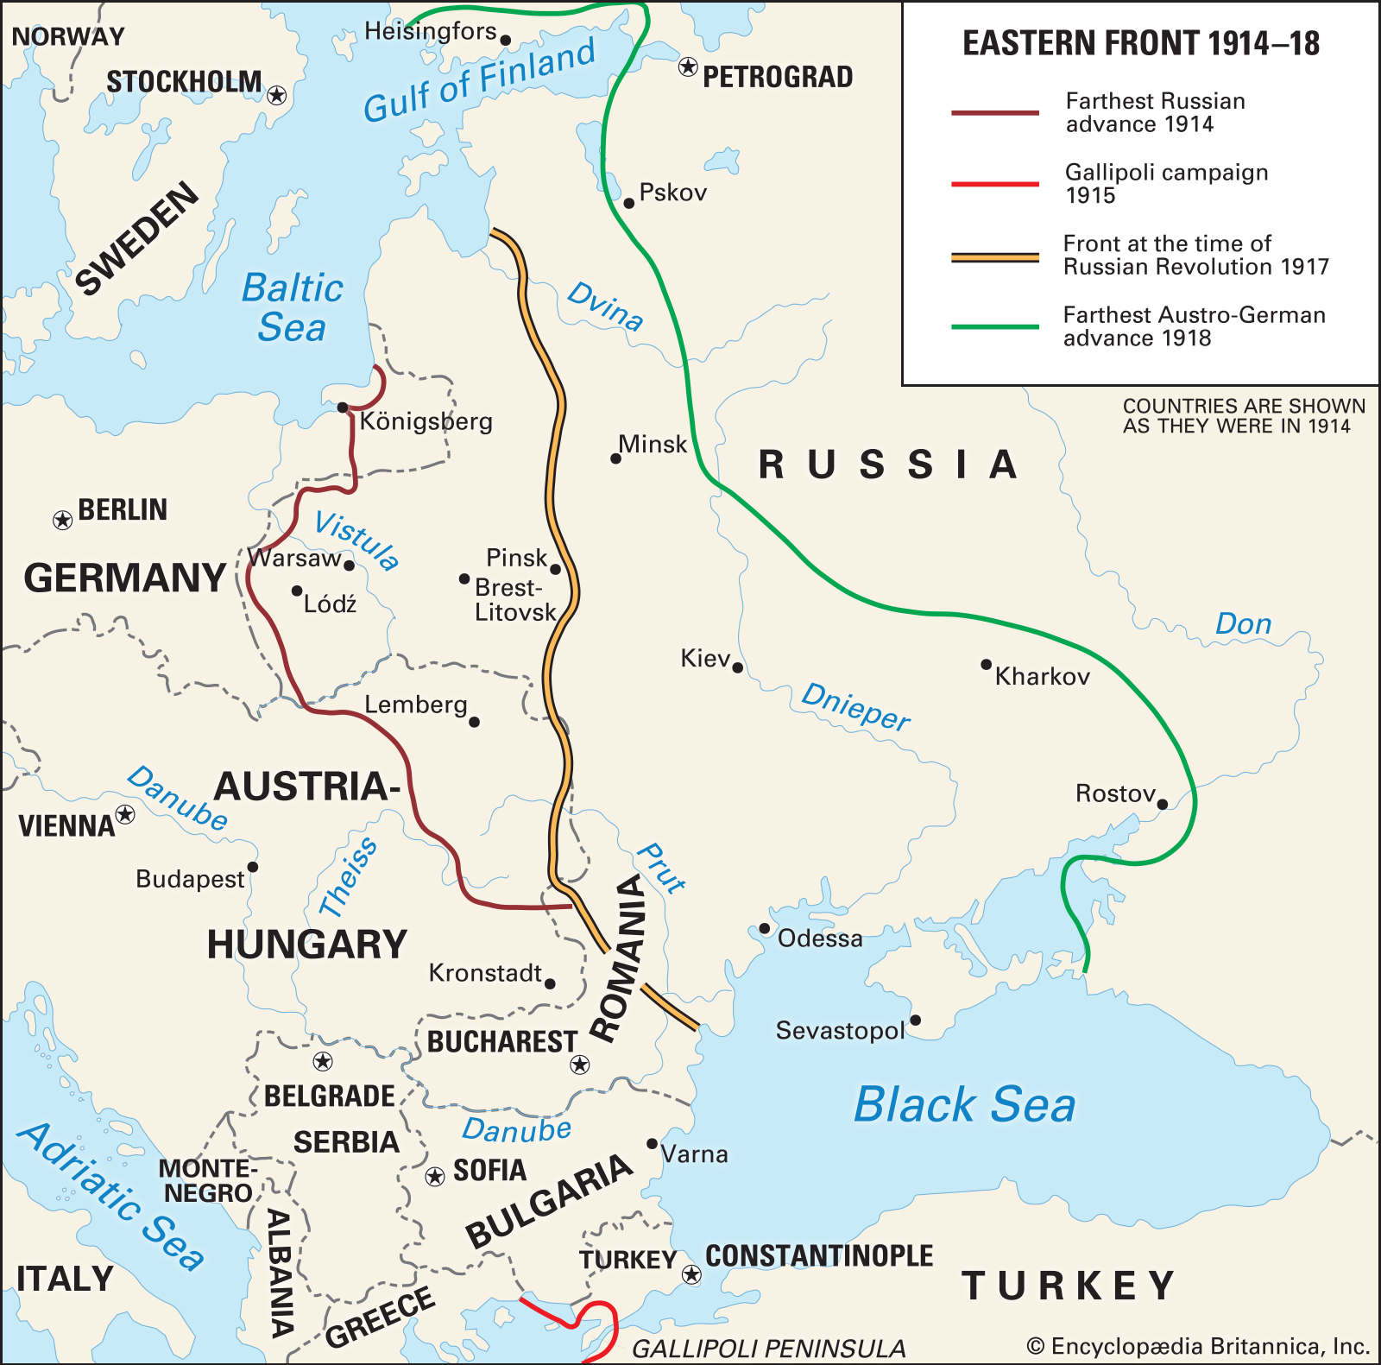
Eastern Front
Russians & Serbs vs. Germans and Austro- Hungarians
More mobile, but slaughter and stalemate common
Germany more dominant – industrialization
Russia late to industrial game – shortage of timely supplies
Russia had strength in numbers – kept replenishing army and kept Germans occupied

Slide 15
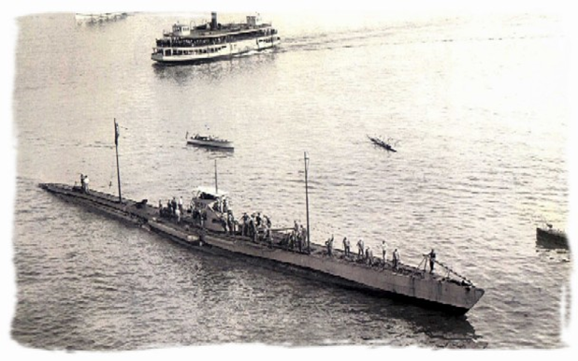
War at Sea
“Third” front
British vs. Germany
British navy = super powerful
Britain strategically cut Germany off from colonies
No colonies, no raw materials
Germany introduces U-Boats
Patrolled seas to cut Britain off from supplies

