Slide 1
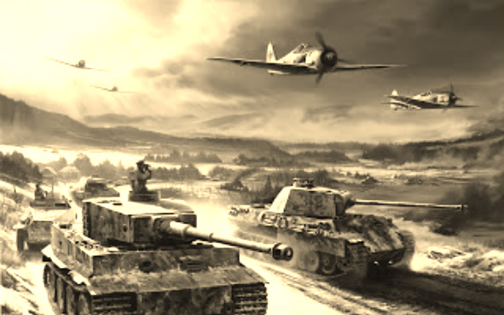
World War II
United States Involvement
Fighting Continues

Slide 2
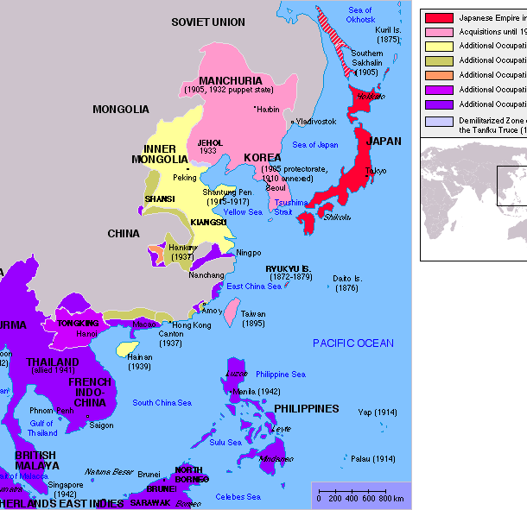
Meanwhile in the Pacific…
Japan is building an empire
Takes over SE Asia – Roosevelt cuts off oil shipments
Attacks British and Dutch colonies
Plans attack on America….

Slide 3
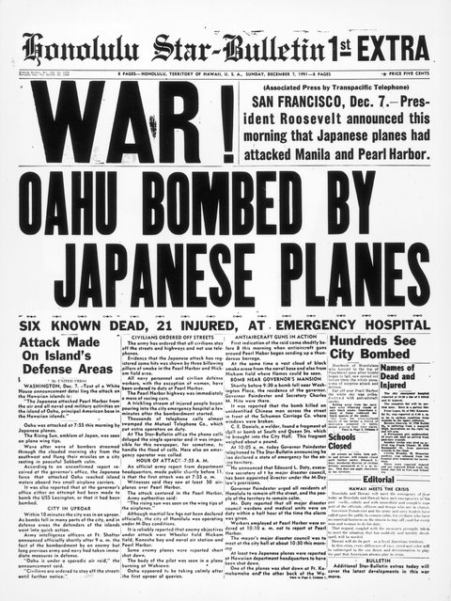
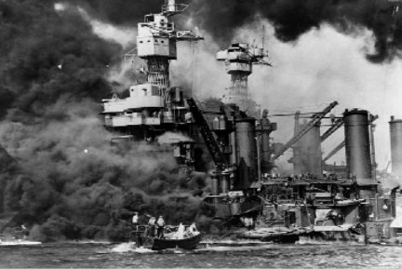
A Date Which Will Live In Infamy
December 7th, 1941 – Japan attacks US Naval base at Pearl Harbor, HI
In 2 hours,
19 ships sunk or damaged
More than 2,300 Americans killed
Over 1,100 wounded
United States officially declares war on Japan and its allies (Axis powers)

Slide 4
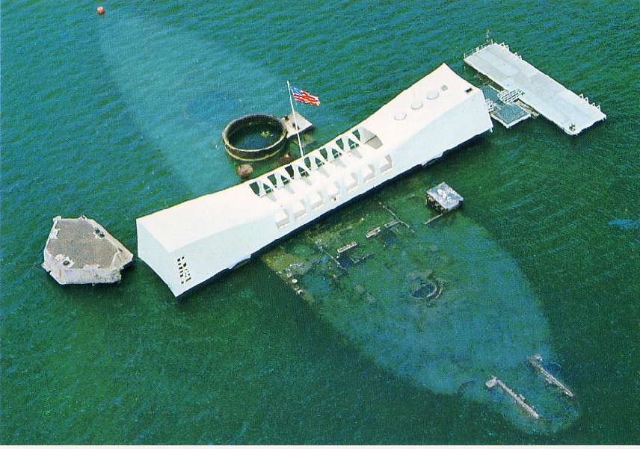
USS Arizona Memorial

Slide 5
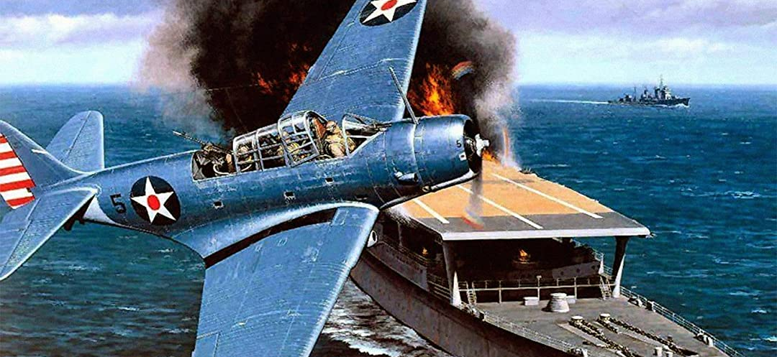
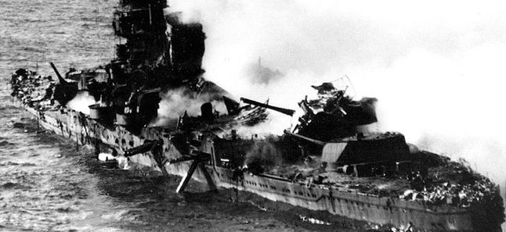
War in the Pacific Rages On
Japan takes U.S., British, French, and Dutch territories in Pacific
Very strong early in war
U.S. wants to avenge Pearl Harbor
Battle of Midway (June 4-7, 1942)
Japanese targets Midway Island
Allied forces decode plans for attack
American planes surprise Japanese
332 Japanese planes, 4 aircraft carriers destroyed
Major turning point of war in the Pacific

Slide 6
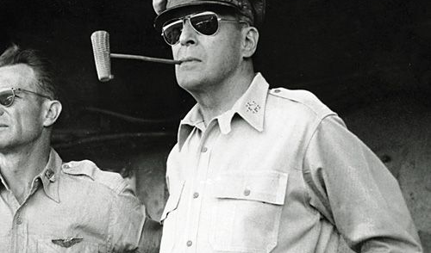
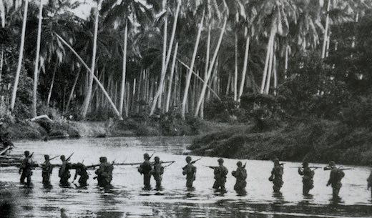
Allied Offensive
Douglas MacArthur
Commander of Allied forces in Pacific
“Island Hopping”
Taking weaker Japanese islands, prepare to attack bigger ones
Battle of Guadalcanal
August 7 1942 – February 1943
First major target – Japanese building huge air base
Japanese lose 24,000 of 36,000 soldiers – “the Island of Death”

Slide 7
Allies Turn to Europe/North Africa
Stalin wants Roosevelt and Churchill to open 2nd front against Germany (similar to WWI)
Instead, U.S. and Britain strike North Africa
Defeat Germans in May 1943
Battle of Stalingrad
August 23, 1942
German Luftwaffe destroys Russian city, takes 90% control
By November, outside Russian forces enclose city
Trap Germans, winter falls, 90k of 330k German soldiers survive, and surrender

Slide 8
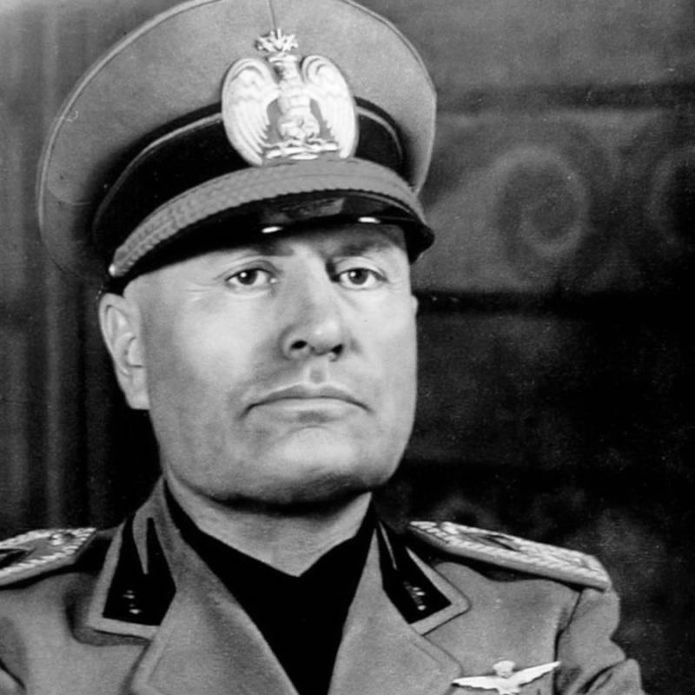
Invasion of Italy
Stalin still wants US and Britain to invade France, instead invade Italy
July 10, 1943 - Allied forces take Sicily
Begins fall of Mussolini
June 4, 1944 – Allies take Rome
Fighting continues in Italy until German surrender
April 27, 1945
Italian resistance fighters ambush German trucks
Find Mussolini disguised as German soldier
Kill him, publicly display body in downtown Milan

