Slide 1
World War II
Rise of the Axis Powers

Slide 2
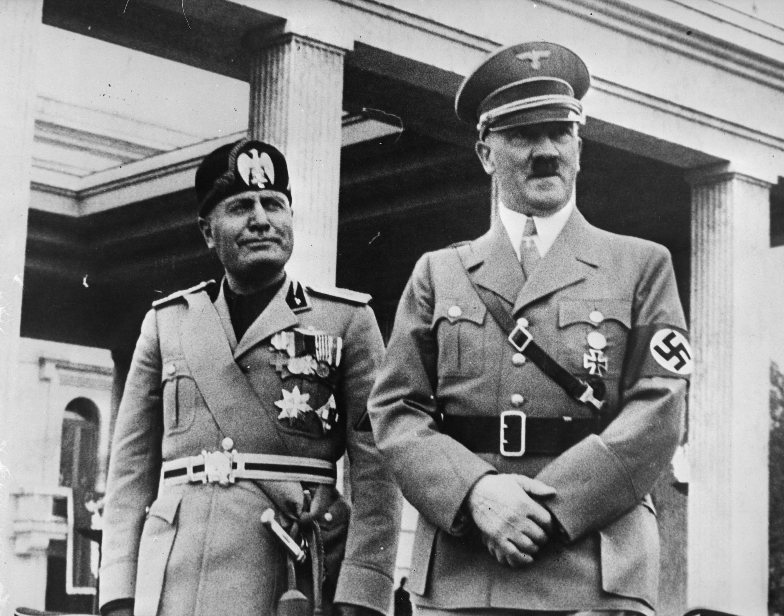
What is Fascism?
Political philosophy
Emphasized loyalty to the state and obedience to its leader
Extreme nationalism and militarism
Denial of individual rights – dictatorial one-party rule
WHY??????
Promised revival of economy
Punish enemies responsible for misfortunes
Restore order and national pride
Took advantage of suffering majority

Slide 3
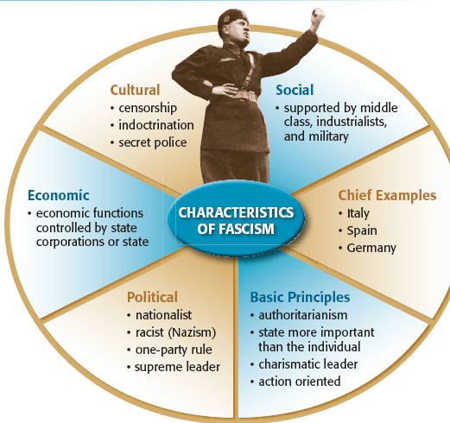

Slide 4
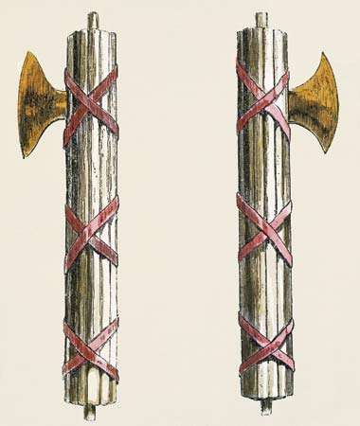
Totalitarianism
FASCISM
COMMUNISM
Hitler/Mussolini
Capitalism private/corporate/Has Class System
Gestapo/OVRA
Nazi/Fascist
Glorifies War
Anti-Semite/none until alliance
DICTATOR
ECONOMY
SECRET POLICE
ONE POLITICAL PARTY
WAR
RACIAL PREJUDICE
Stalin
State Nationalism
KGB
Communist
Denounces War
Officially Banned

Slide 5
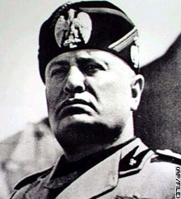
Fascism in Italy
Fueled by failure to win territory in 1919 peace treaty
Rising unemployment and inflation
Democratic government proves ineffective
Benito Mussolini
Promised to revive economy and rebuild armed forces
“Black Shirts” attack Communists and Socialists
Middles classes and aristocracy fear a worker’s revolt
End up supporting Fascists
October 1922 – 30,000 fascists march on Rome and demand that Mussolini take charge
Widespread violence – takes charge “legally”

Slide 6
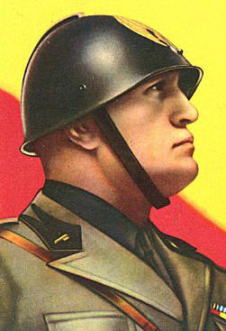
“Il Duce” – “the leader”
Factors in Rise to Power
Anger over Treaty of Versailles
Fear of communism
Appeal to nationalism
Weak coalition government
Lack of democratic tradition
Charisma of Mussolini
Manipulation of press
Willing to use violence
Popularity of fascist party
“War is to the male what childbearing is to the female.”
- Benito Mussolini

Slide 7
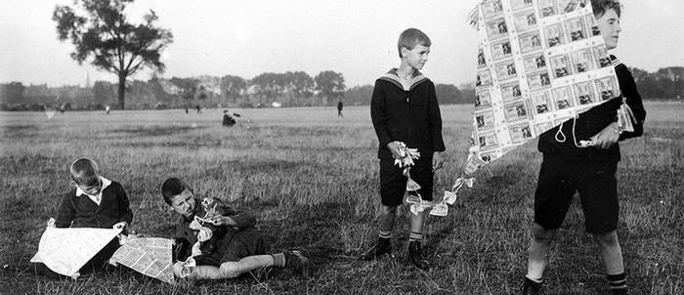
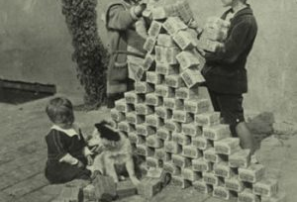
Current State of Germany
Weimar Republic established in 1919
Very weak – no democratic tradition
Many political parties
No public confidence
Massive economic problems
Started printing more and more money to pay war expenses
Money lost value – hyperinflation
Loaf of bread prices
1918 – less than 1 mark
1922 – 160 marks
1923 - 200 billion marks!!!
Early financial support from U.S.
By 1929 – Germany back to full production

Slide 8
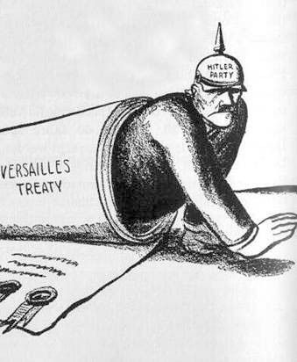
Fascism in Germany
Citizens desire strong leader
Germans angered over terms of Treaty of Versailles
Payment of reparations
Seizure of German industrial lands (RHINELAND)
Discontent with democratic Weimar Republic
Charismatic leader Adolf Hitler appeals to many Germans

Slide 9
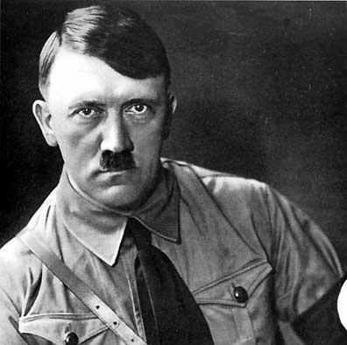
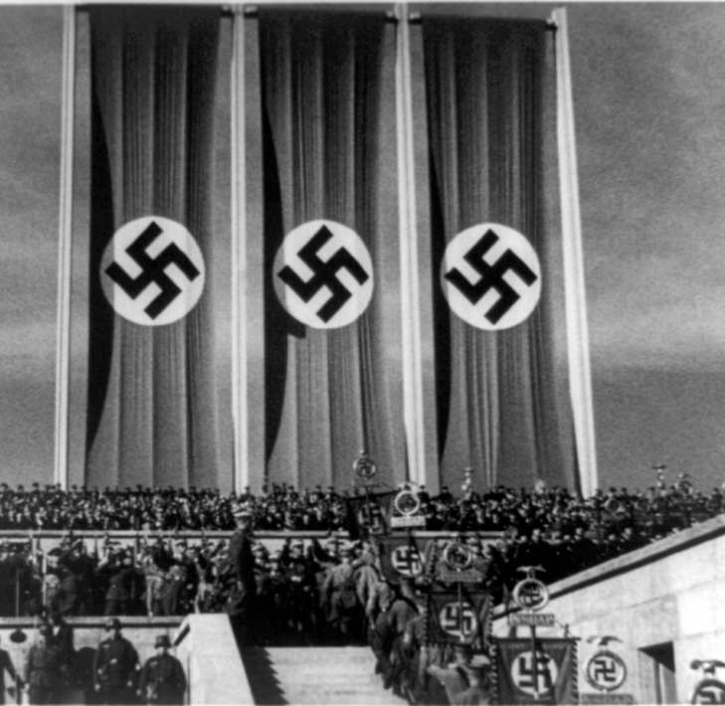
Adolf Hitler
Austrian who joins Nationalist Socialist German Workers Party in 1919 (Nazi for short)
Symbol Swastika
Private militia – storm troopers (Brown shirts)
Inspired by Mussolini and Italian Fascists
Writes Mein Kampf (My Struggle) in prison

Slide 10
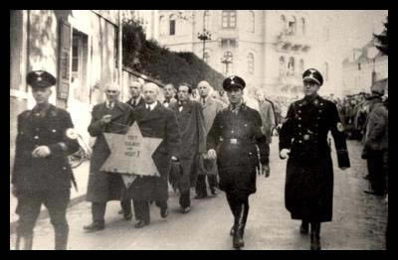
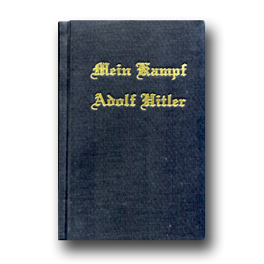
Mein Kampf
Germans were “Aryans”
All other races (Jews, Gypsies, and Slavs were inferior)
Lebensraum – Living space
Aimed to conquer eastern Europe

Slide 11
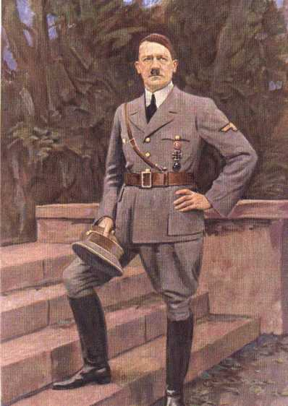
Adolph Hitler
Factors in Rise to Power
Anger over Treaty of Versailles
Anger of Allied seizure of Ruhr Valley –industrial site
Fear of communism
Appeal to nationalism
Weak coalition government
Lack of democratic tradition
Charisma of Hitler
Manipulation of press
Willing to use violence
Nazi Party very popular after beginning of depression
Offers scapegoat for German problems

Slide 12
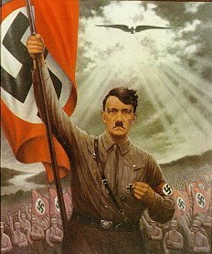
Hitler seeks total control
Hitler named Chancellor in 1933
Hitler makes Germany a totalitarian state
SS (Schutzstaffel, or protection squad) and Gestapo (Nazi secret police) – Total Obedience!
Government controlled economy
Propaganda
Films, radio, newspapers, and paintings
Books burned
Churches forced to praise Nazis
Children join the Hitler Youth or League of German Girls

Slide 13
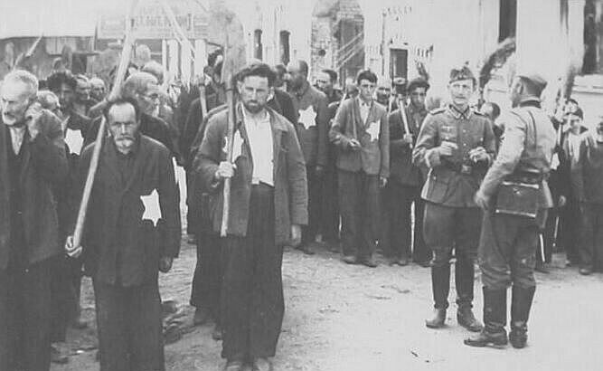
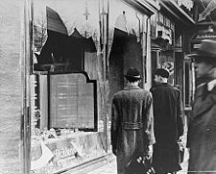
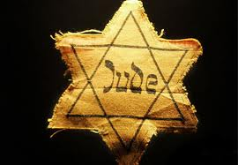
Anti-Semitism
Hatred of Jews
Jews become scapegoats
Nazis pass laws limiting rights of Jewish citizens
Kristallnacht: “Night of Broken Glass”
Nov. 9, 1938
Jewish synagogues, homes, and businesses destroyed

Slide 14
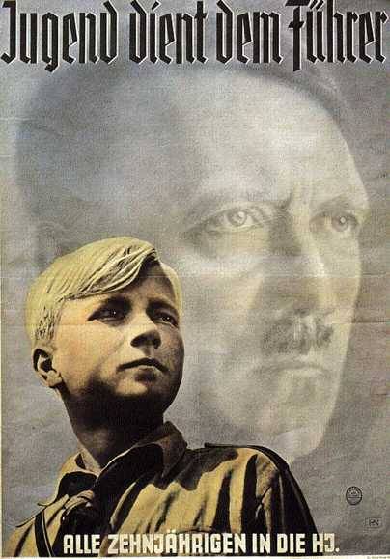
The text of this 1940 poster reads: "Youth Serves the Führer. All 10-year-olds into the Hitler Youth." Membership in the Hitler Youth had become mandatory in 1936.

Slide 15
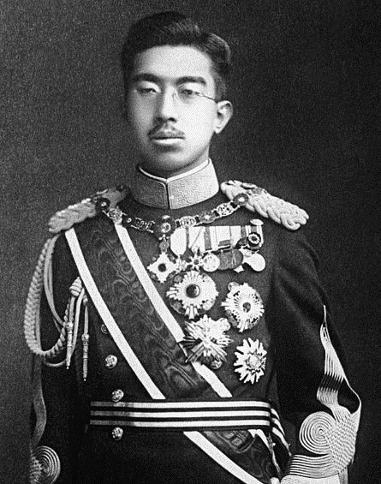
Different Form of “Fascism” in Japan
Democratic throughout most of 1920s
Great Depression in 1929 – many people blamed government
Did not want new government, but military control
Emperor Hirohito
Symbol of power
Did not have control of government

Slide 16
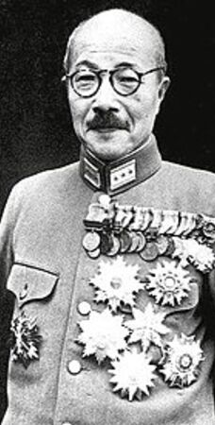
Rise of Military Power
Japan turns to imperialism to acquire land and resources for growing empire
1931 – Japan invades Manchuria in China w/o government approval
Hideki Tojo
Head of Japanese Military
Most powerful individual in Japan
Becomes Prime Minister in 1941
State Shinto
Race-based political ideology similar to Germans
Japanese were a master race, determined to rule Asia

