Slide 1
World War II
War Breaks Out

Slide 2
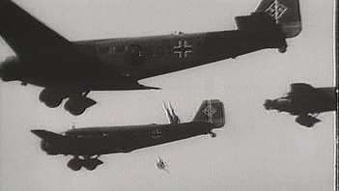
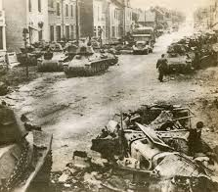
German Blitzkrieg
September 1st, 1939 – Hitler invades Poland
Officially marks beginning of WWII
Blitzkrieg
“lightning war”
New military strategy
Air strikes, fast tanks, artillery, followed by soldiers
Quickly overwhelmed enemies
Blitzkrieg made possible by Hitler secretly rearming Germany
September 3rd, 1939 – France and Great Britain declare war
Too late – Western half of Poland has already fallen to Nazis

Slide 3
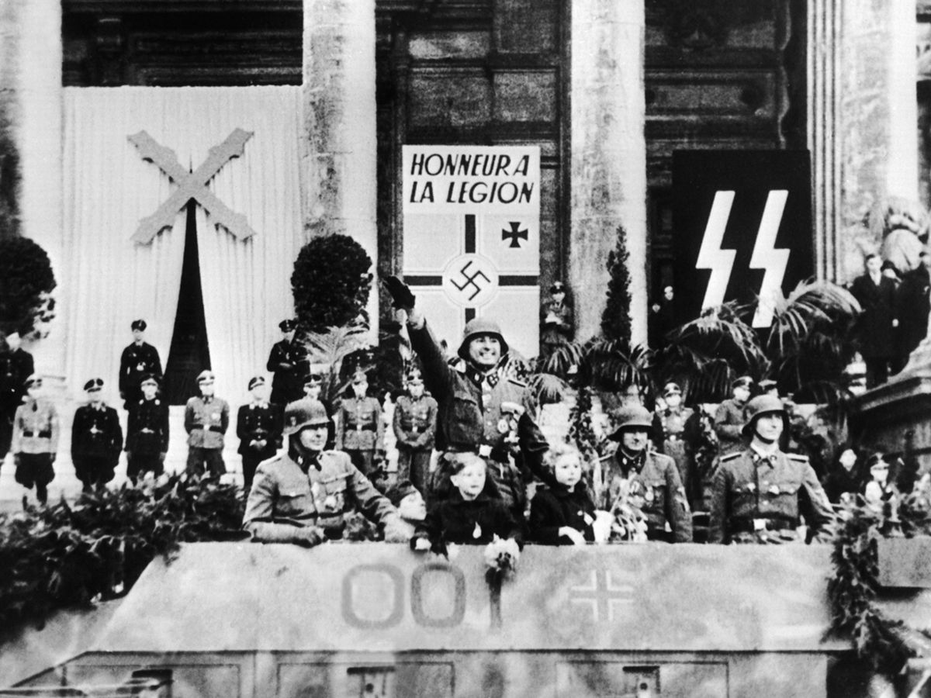
Germans and Soviets Advance
Stalin and forces seize eastern Poland shortly after Hitler invades
November 1939 - Soviets take Finland
Nothing happens – “sitzkreig” or “phony war”
April 1940 - Germany takes Denmark and Norway
Germans strategically builds bases on coasts of Norway and Denmark to attack Great Britain
May 1940 – Hitler and Nazis sweep through Netherlands, Belgium, and Luxembourg
Preparing to strike France

Slide 5
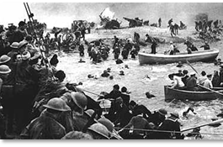
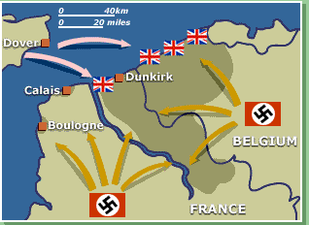
France Falls to Nazis
May 1940 – Germany traps France and allied forces and forces retreat to beaches of Dunkirk
“Miracle of Dunkirk” – Great Britain sends fleet to rescue soldiers, including amateur civilian crafts from May 26th to June 4th
338,000 wounded soldiers returned safely
French resistance crumbles after Dunkirk
Nazis take over northern France, leave southern France to a puppet government
By 1941, all of continental Europe is under Axis control
Charles de Gaulle
French general that sets up exiled government in London
Vows to reconquer France

Slide 6
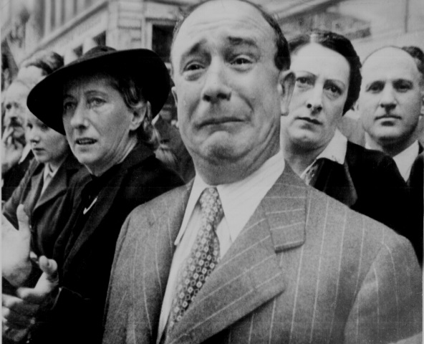
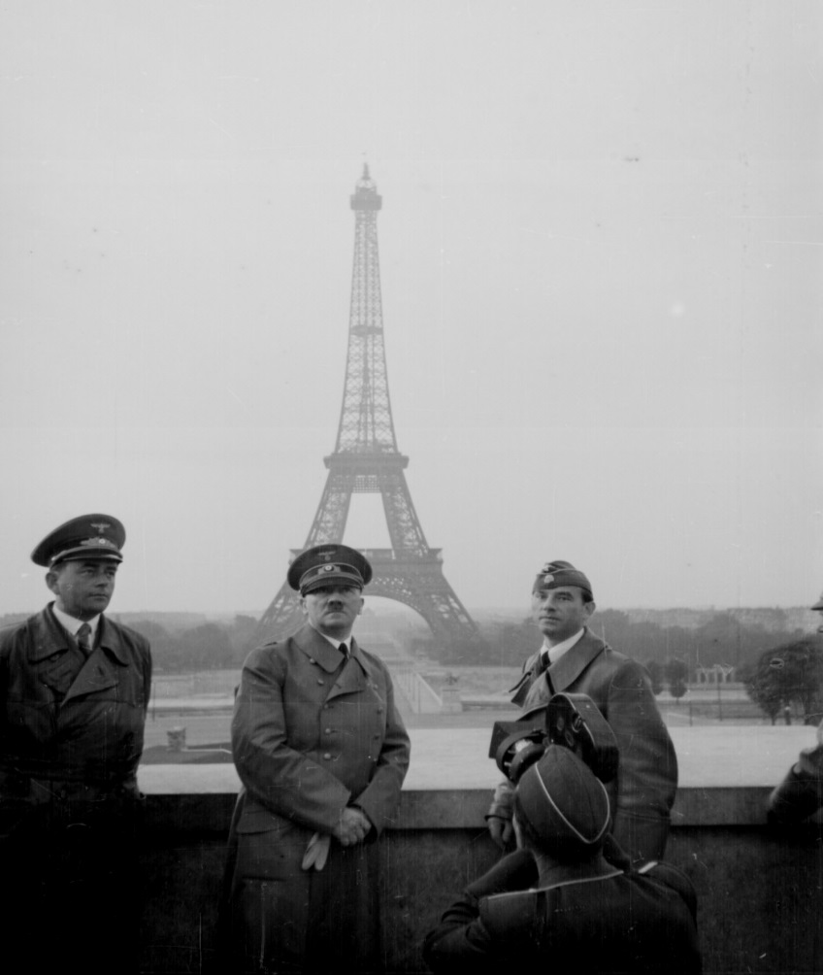
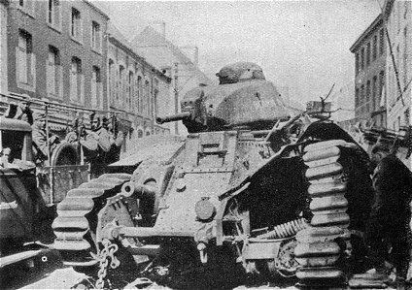
"A Frenchman weeps as German soldiers march into the French capital, Paris, on June 14, 1940, after the Allied armies had been driven back across France."

Slide 8
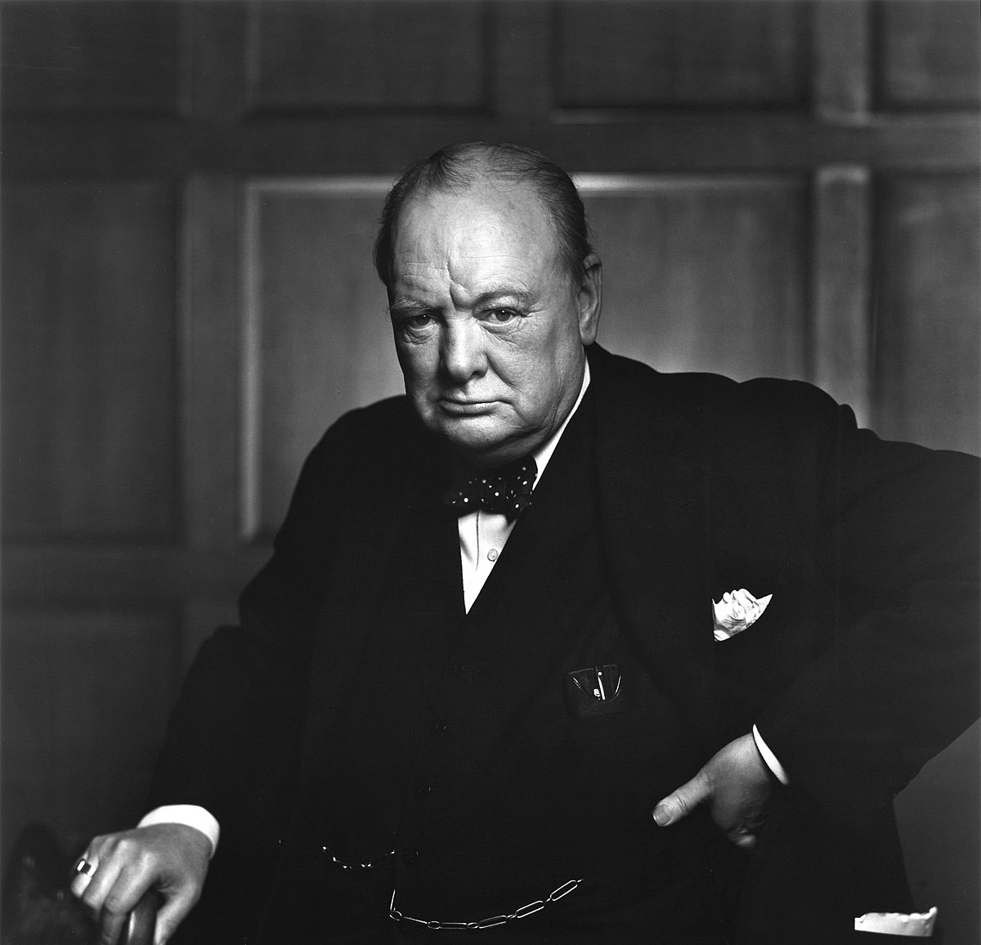
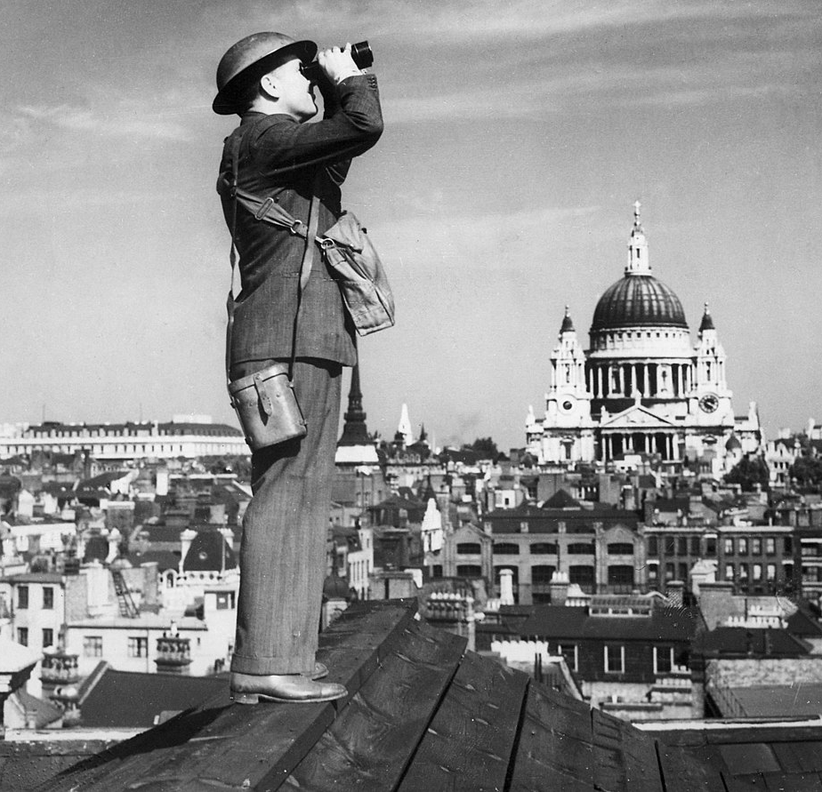
Battle of Britain
Britain stands alone against Axis powers
New prime minister ‘ Winston Churchill
“We shall fight on the beaches, we shall fight on the landing grounds, we shall fight in the fields and in the streets….we shall never surrender!”
Summer of 1940 – Germany’s Luftwaffe (air force) started bombing Great Britain
September 7th, 1940 – bombing cities, especially London
Britain took heave damage and loss of life, but successfully resisted Hitler’s attack
Use of radar to detect planes
Able to decode German messages using Enigma
Hitler ultimately called off attack because of British resistance

Slide 9
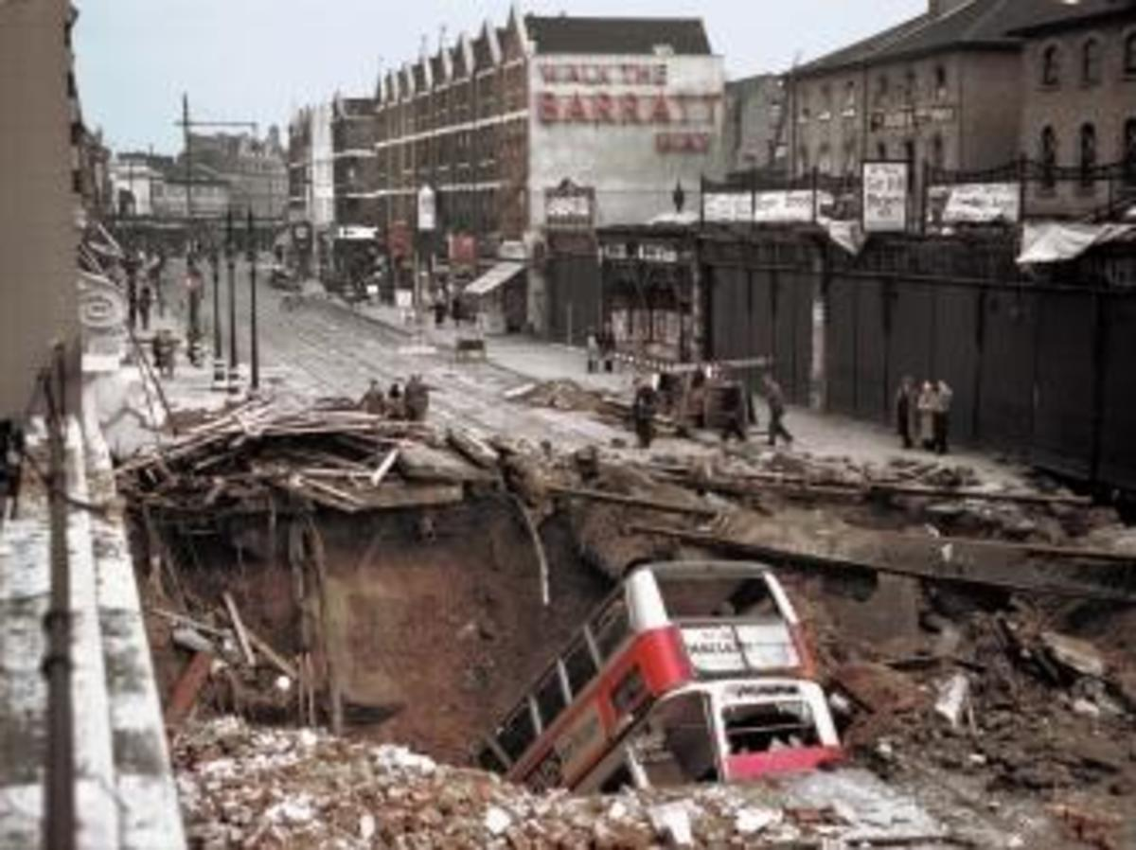
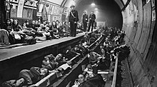
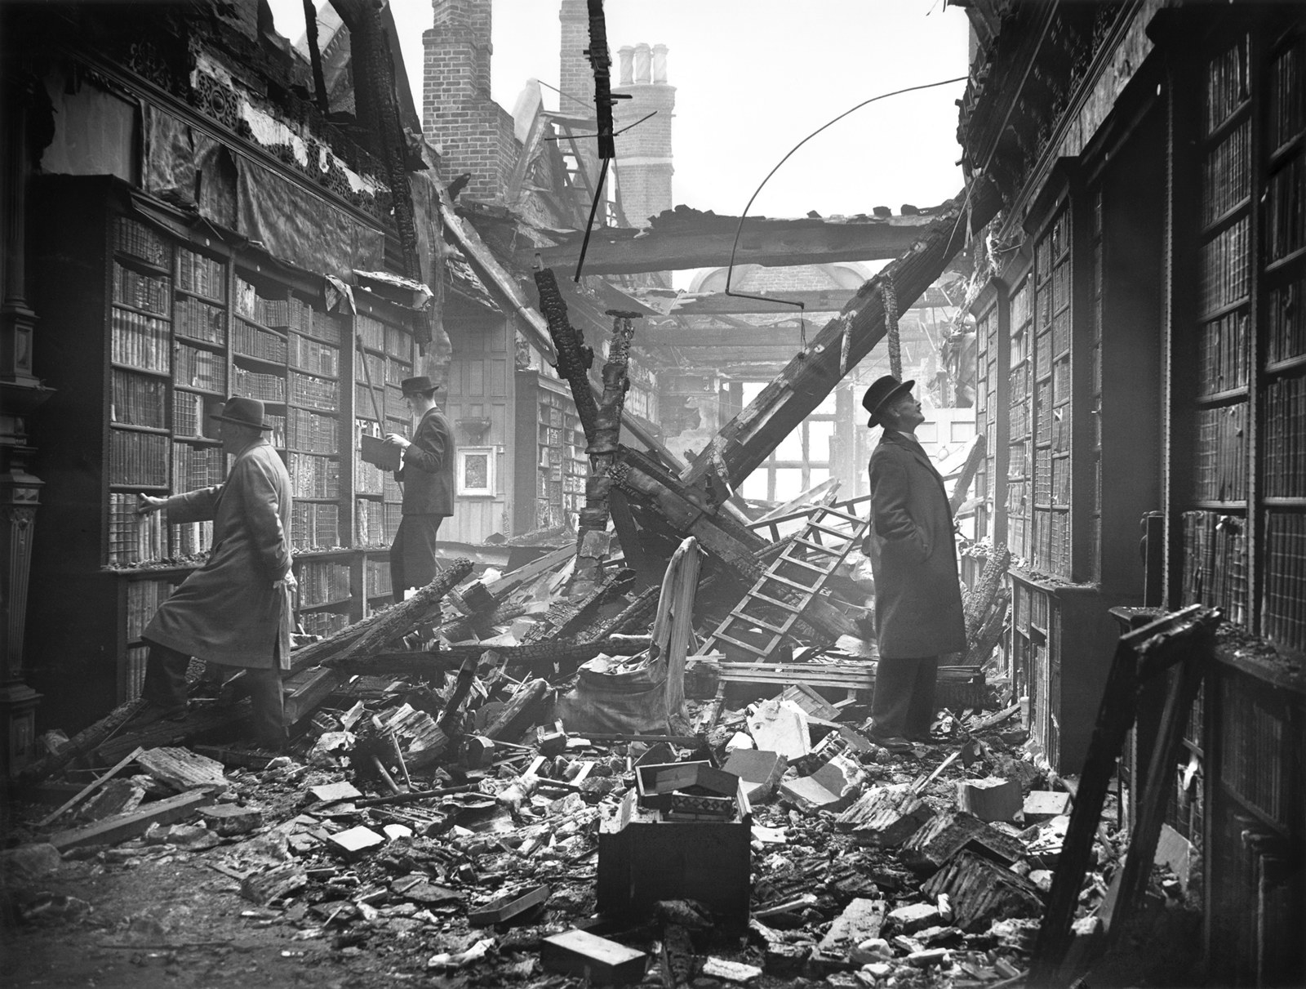

Slide 10
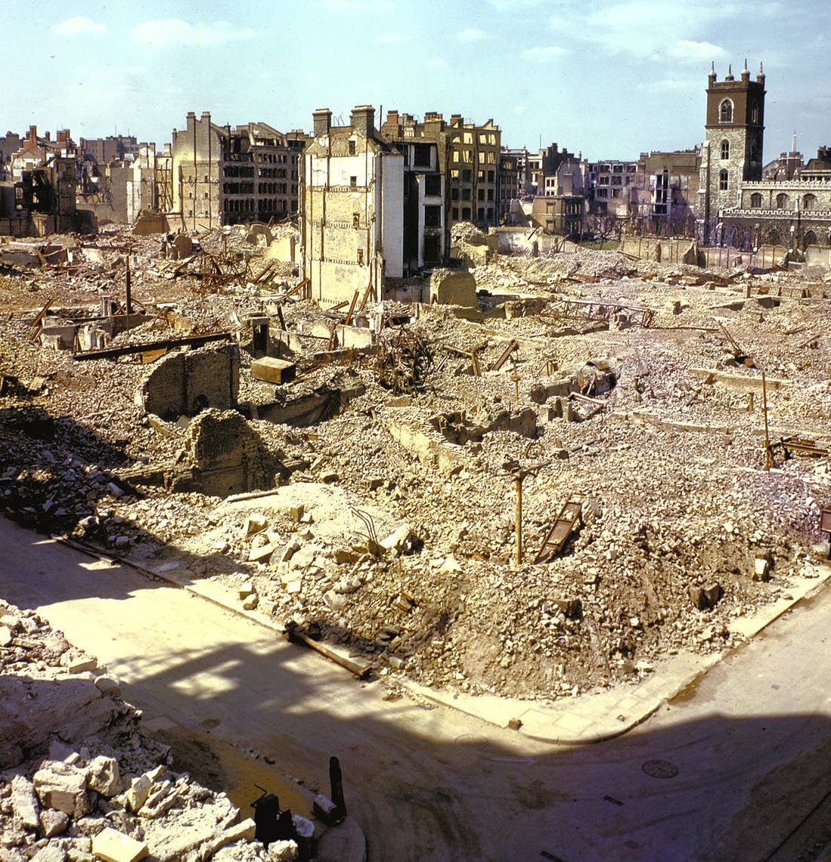
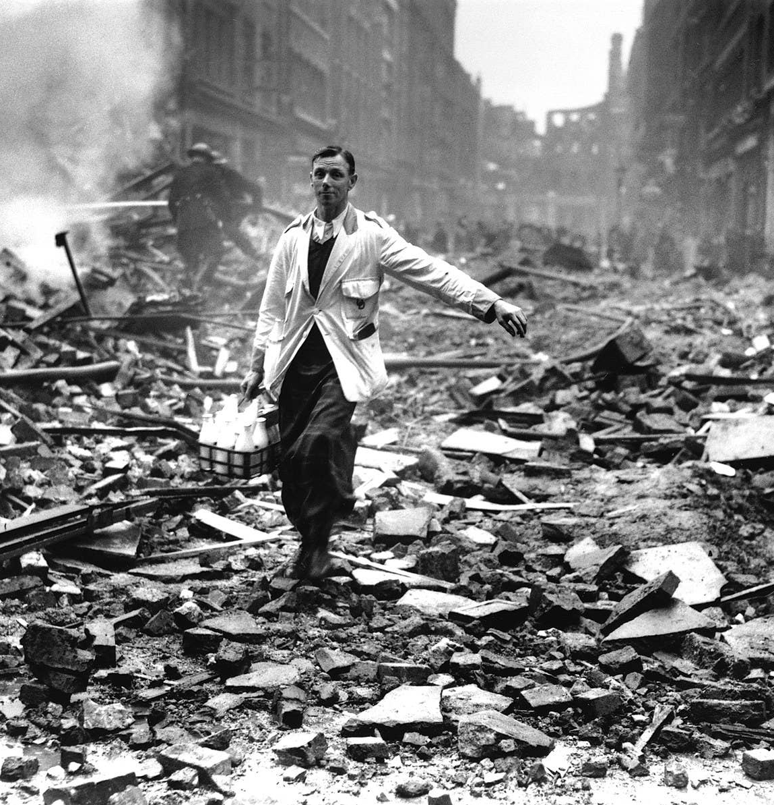

Slide 11
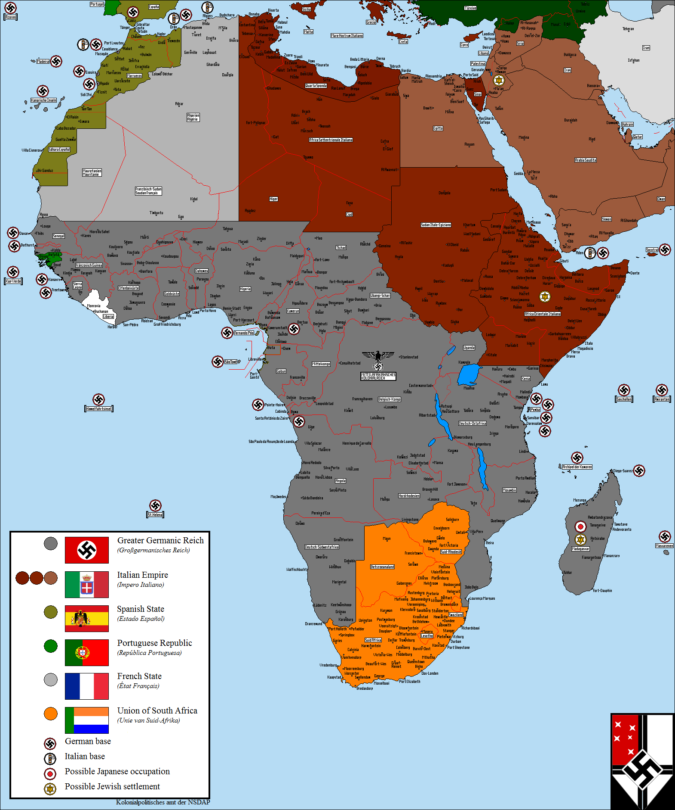
Mediterranean and Eastern Front
Italy takes control of northern Africa
Push British out of Egypt
British reinforcements arrive – India, Canada, Australia, New Zealand, South Africa
Disaster for Italians – Hitler helps Italy
Erwin Rommel brings tank force – defeats Allies

Slide 12
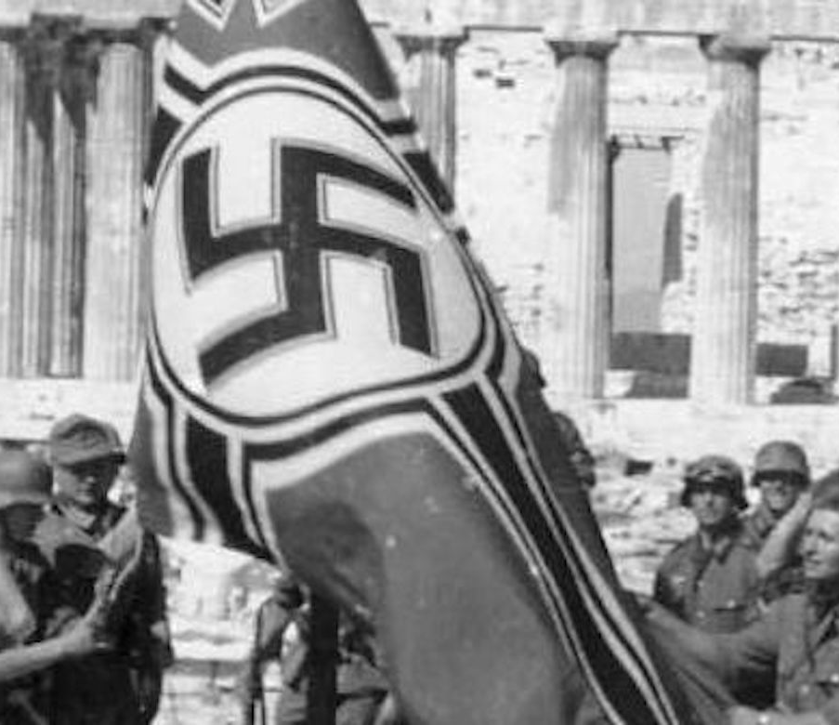
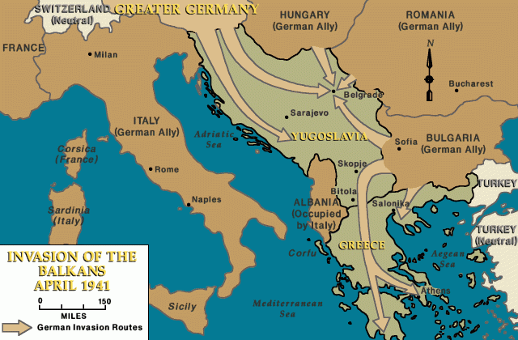
Mediterranean and Eastern Front
Germany expands to Balkans
Hitler convinces Bulgaria, Romania, and Hungary to join Axis powers
Yugoslavia and Greece (both pro-British) resist
Yugoslavia falls in 11 days
Greece falls in 17 days

Slide 13
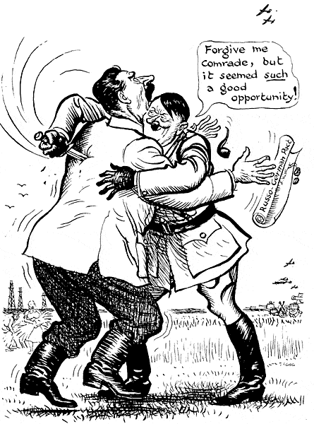
Hitler Invades Soviet Union
Remember Hitler and Stalin’s nonaggression pact?
Operation Barbarossa – plan to invade Soviet Union
June 22nd, 1941 – Hitler invades and catches Soviets by surprise
Largest land invasion in history
Leningrad
Hitler bombs food storage buildings – starve people
Over 1 million people die; Leningrad does not surrender
Moscow
Hitler turns to capital
Winter comes – Germany does not retreat (sound familiar??)
Germans lose 500,000 lives

Slide 14
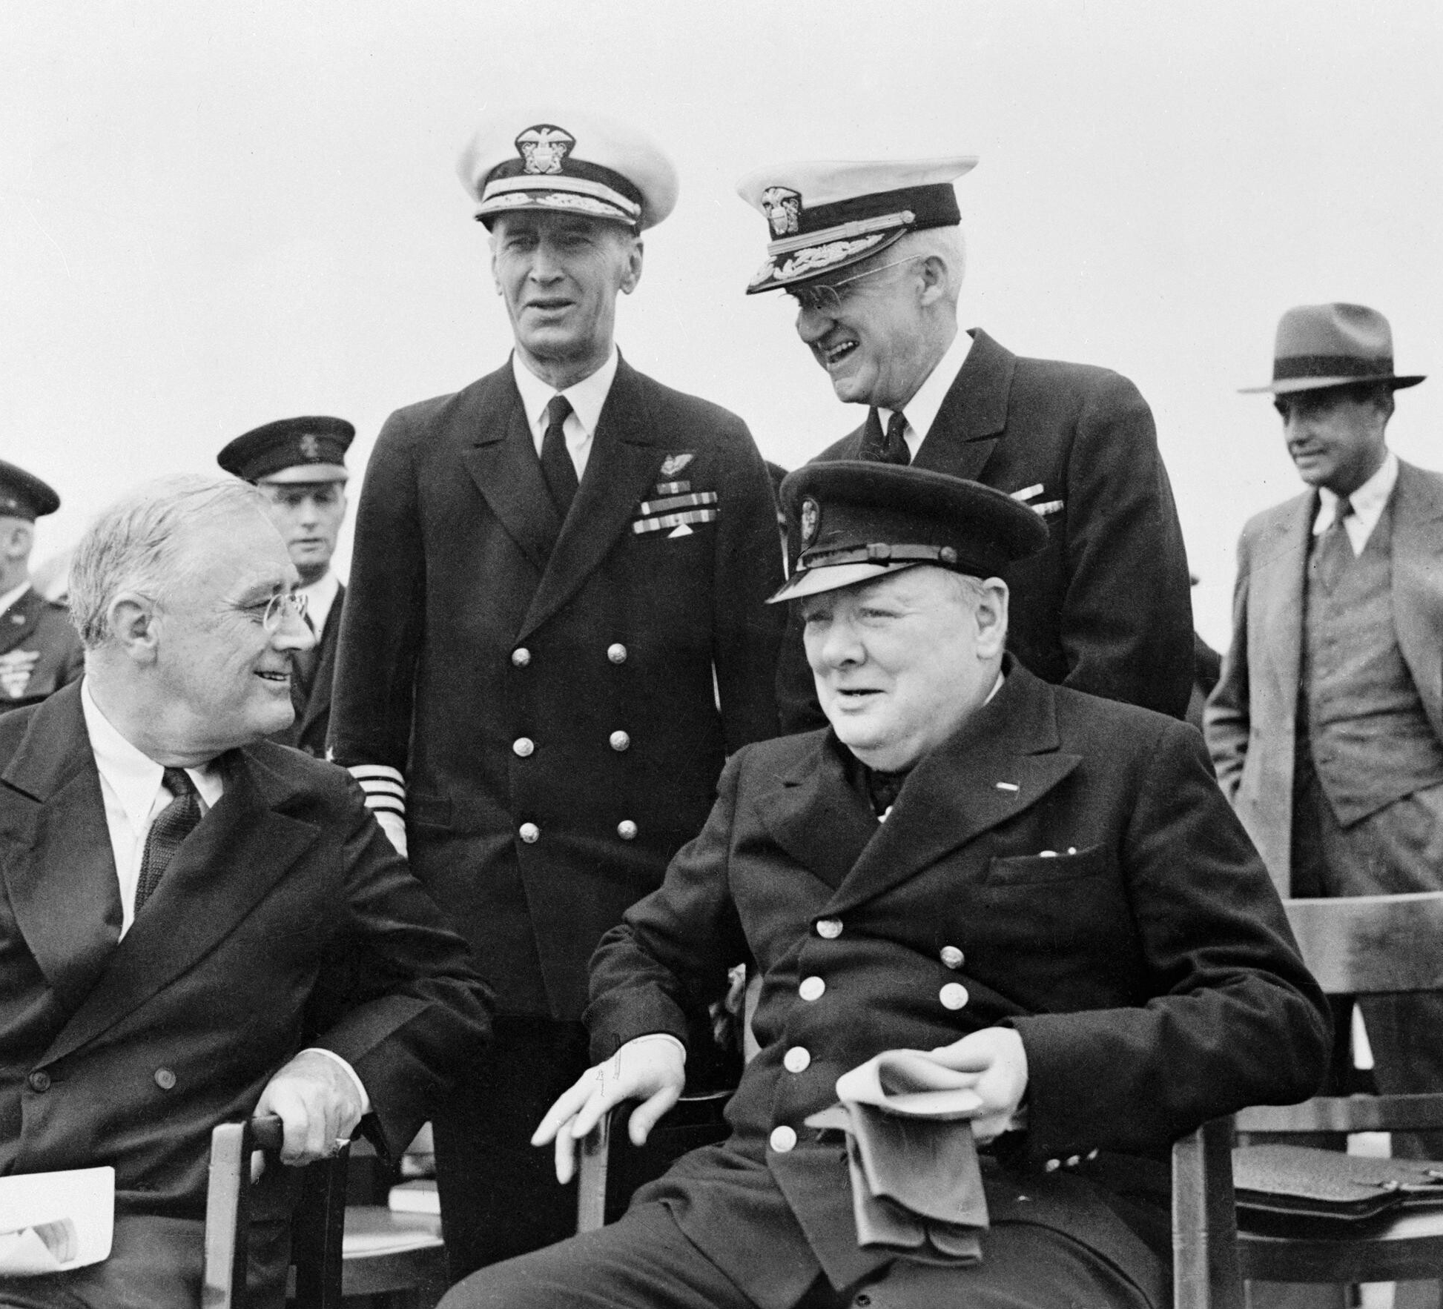
United States Reaction
Most Americans anti-war – passed neutrality acts
September 1939 – President Roosevelt allows Allied powers to purchase American firearms
March 1941 – Lend-Lease Act
President can lend or lease arms and other supplies to countries vital to US
US escort British ships – Hitler fires on them
Atlantic Charter
Secret meeting between Roosevelt and Churchill
No territorial gain
Free trade
People choose their own government
September 4, 1941 – German boat fires on US destroyer ship
Roosevelt orders to shoot German ships on sight
Unofficial naval war w/ Hitler

