Slide 1
Technology in World War I

Slide 2
Examining technology
We have studied the causes behind the conflict. However, no history of any war would be complete without an overview of the weapons of war in all forms. We do not intend to celebrate these weapons, but understand how war changed because of them.
“If you wish for peace, understand war” – Basil Liddell Hart

Slide 3
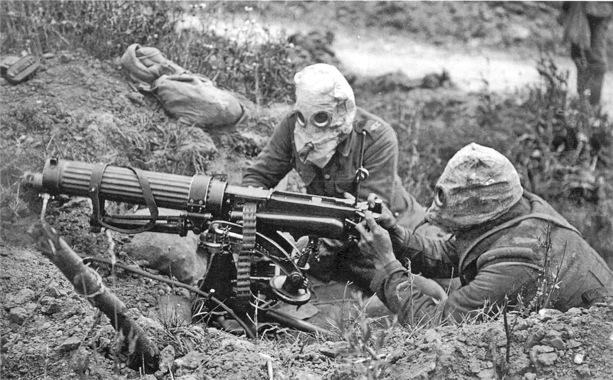
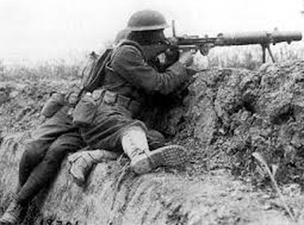
Machine Guns
Powerful guns
Can shoot multiple rounds at a time at a fast rate
Made it difficult for forces to advance
Guns became more advanced as war went on

Slide 4
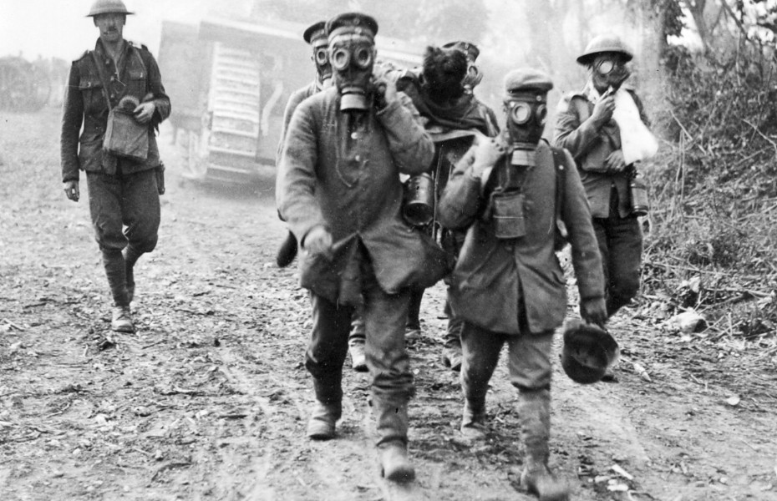
Poison Gas
First developed by German chemists
In response, French and British scientists made their own
French and British also developed methods of protection (gas masks)

Slide 5
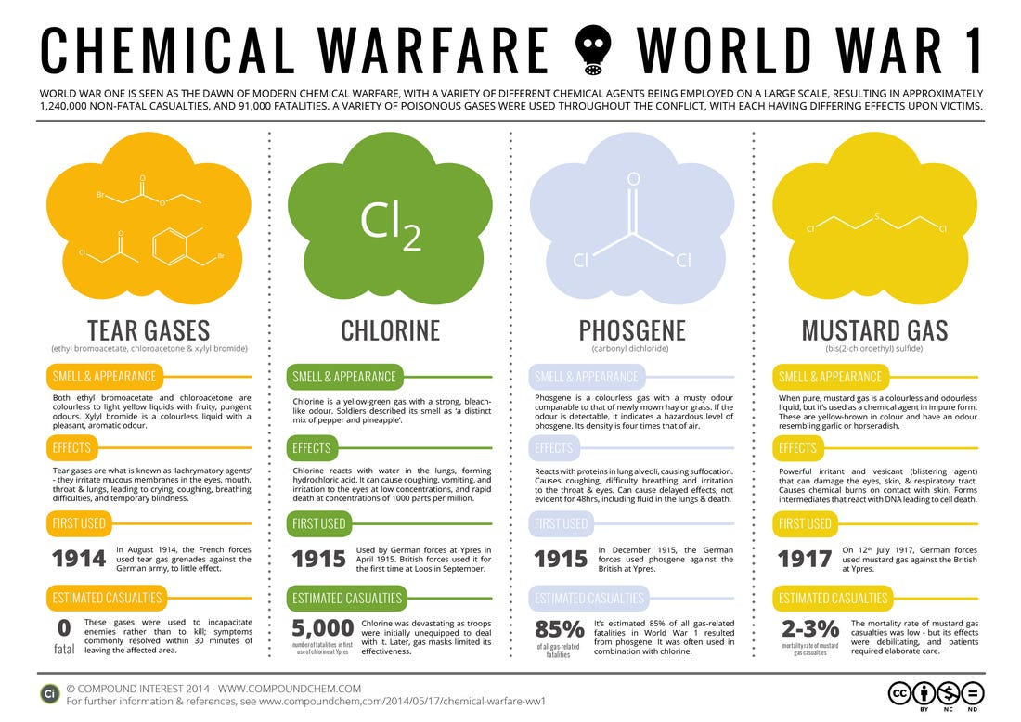

Slide 6
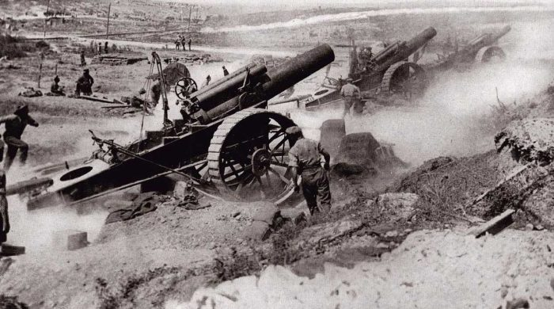
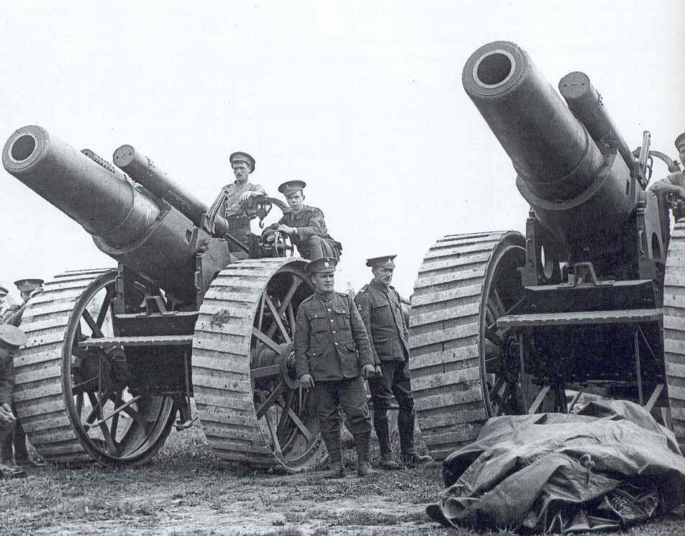
Artillery (Giant Cannons)
Guns that could shoot across great distances
Explosive filled projectiles
Created to combat deeper trenches

Slide 7
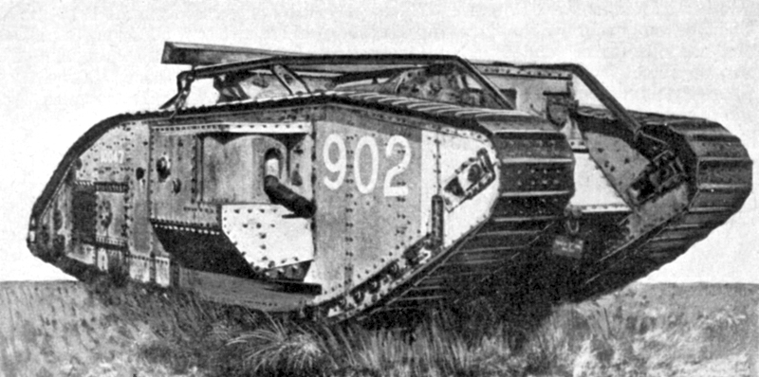
Tanks
Armored combat vehicle
Could cross many types of terrain
Introduced by the British in 1916

Slide 8
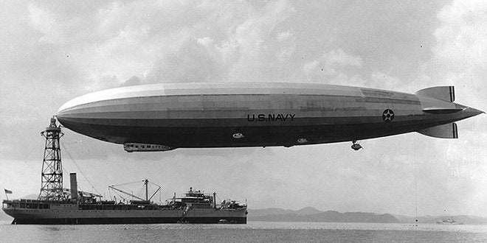
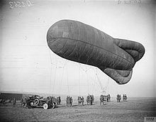
Zeppelins/Balloons
Used by both sides, but favored by Germans
Hydrogen-filled airships
Flew at night – used as scare tactic

Slide 9
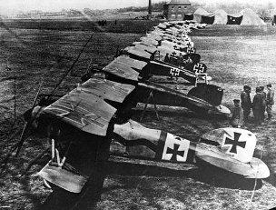
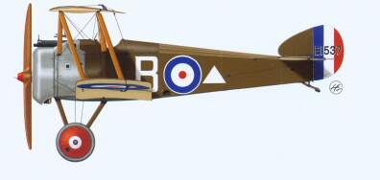
Planes
Used by both sides
Relatively new in 1914
Realized could be used as powerful military weapon
Constant advancements in technology throughout the war
Nearly 10,000 in use by end of war

Slide 10
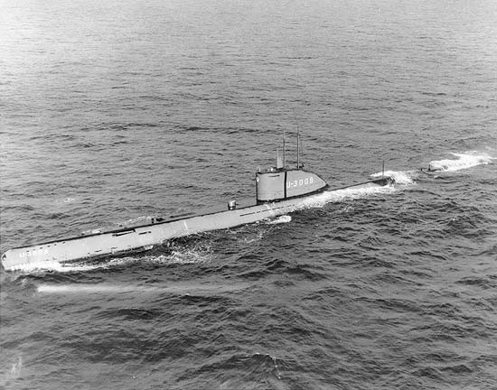
Submarines (U-Boats)
Introduced by the Germans in 1914
Torpedo – underwater missiles
Pivotal in bringing United States into war

Slide 11
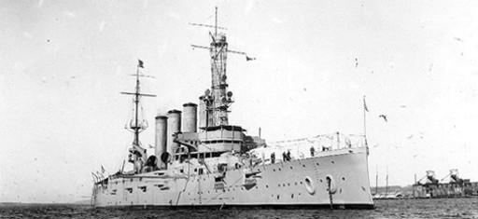
Battleships
Used heavily by British, but used by both sides
Variety of gun sizes

Slide 12
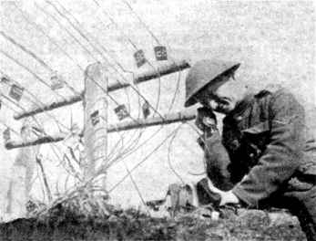
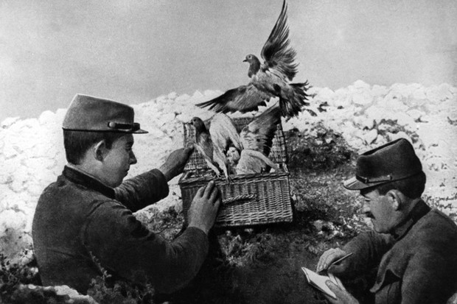
Communication
Telephones
Telegraph
Radio
Carrier Pigeons
Dogs!

Slide 13
How Did this impact war?
New technology did not expedite war
Killed more people more efficiently
Created arms race and competition among enemies

