Slide 1
World War I Propaganda

Slide 2
What is Propaganda?
Something designed to influence our opinions, emotions, attitudes and behavior to persuade us to believe in something or to do something
can be a poster, ad, song, movie, etc.
Propaganda has been used throughout history to influence public opinion, but reached an entirely new level during World War I

Slide 3
Propaganda Techniques
Emotional Appeal:
playing on a person’s emotions,
Especially fear
Explain what they want a person to do to help the cause.

Slide 4
Propaganda Techniques
Humor:
Capturing the viewer’s attention through the use of humor to promote the war effort.
The enemy is almost always the butt of the joke

Slide 5
Propaganda Techniques
Demonization:
Portraying the enemy as purely evil, menacing, murderous, and aggressive.
The enemy may be portrayed as a beast or the devil.

Slide 6
Propaganda Techniques
Name calling:
Propagandists use this technique to create fear and arouse prejudice
Use negative words to create an unfavorable opinion or hatred against a group and their beliefs, ideas or institutions

Slide 7
Propaganda Techniques
Catchy Slogans:
Involves using memorable phrases to foster support for the war.
For example “Remember the Alamo!” (not from WWI)

Slide 8
Propaganda Techniques
Patriotic Appeal:
Using patriotic language or symbols to appeal to people’s national pride

Slide 9
Propaganda Techniques
Symbols:
Using symbols that appeal to a person’s emotions
Patriotic symbols like flags, monuments, country animal
Other symbols: mothers, children, women, soldiers’ uniforms

Slide 10
Propaganda Techniques
Deception or twisting the truth:
Propagandist might use some element of truth to make an argument more persuasive.
For example: blaming the enemy for complete responsibility for the war and portraying one’s own country as the victim.

Slide 11
S.O.A.P.S.Tone
Subject
Occasion
Audience
Purpose
Speaker
Tone

Slide 12
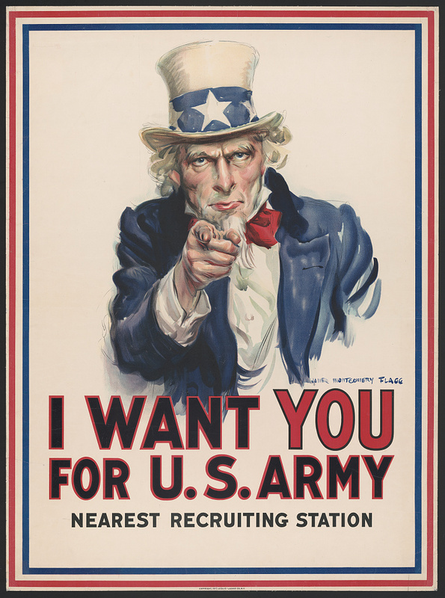
USA

Slide 13
USA

Slide 14
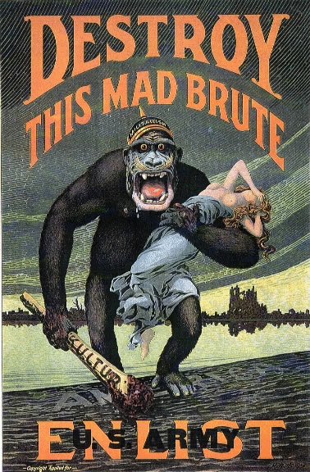
USA
(hat says “militarism”)

Slide 15
USA

Slide 16
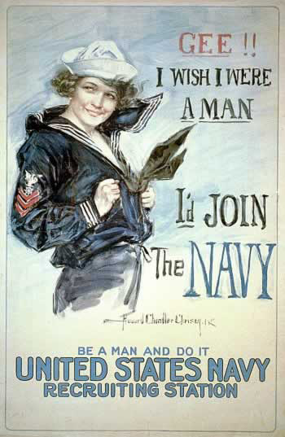
USA

Slide 17
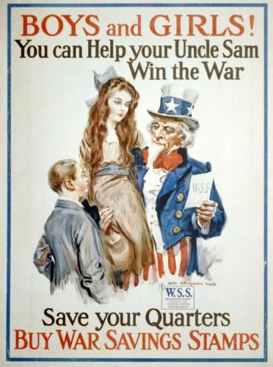
USA

Slide 18
British

Slide 19
Britain

Slide 20
British

Slide 21
British

Slide 22
British

Slide 23
Australia

Slide 24
Russian

Slide 25
French
Day of the Soldier
For our father to come home, please.

Slide 26
France
Day of the Regions Liberation
After the victory, with work, aid us.

Slide 27
France

Slide 28
France
The Help of War Fair of Saint Sulpice Franco- American Refugies Soldiers Reform invaded countries

Slide 29
France
Day of the Nations Orphans

Slide 30
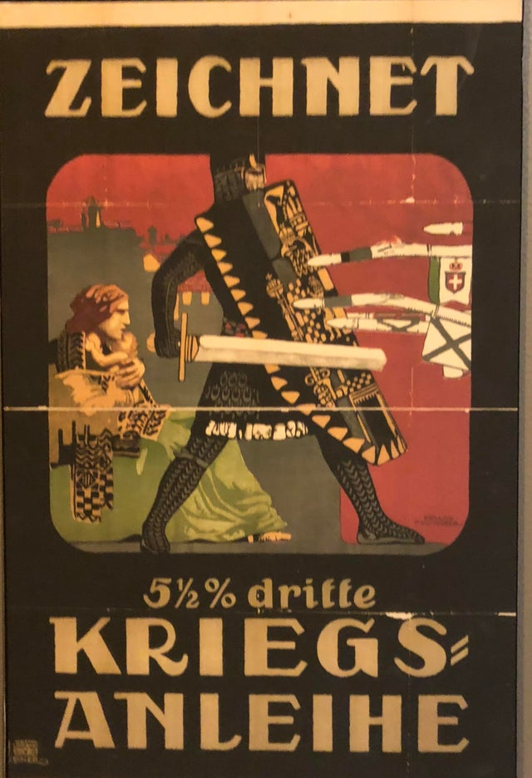
Austro-Hungarian
Encouraging people to buy war bonds

Slide 31
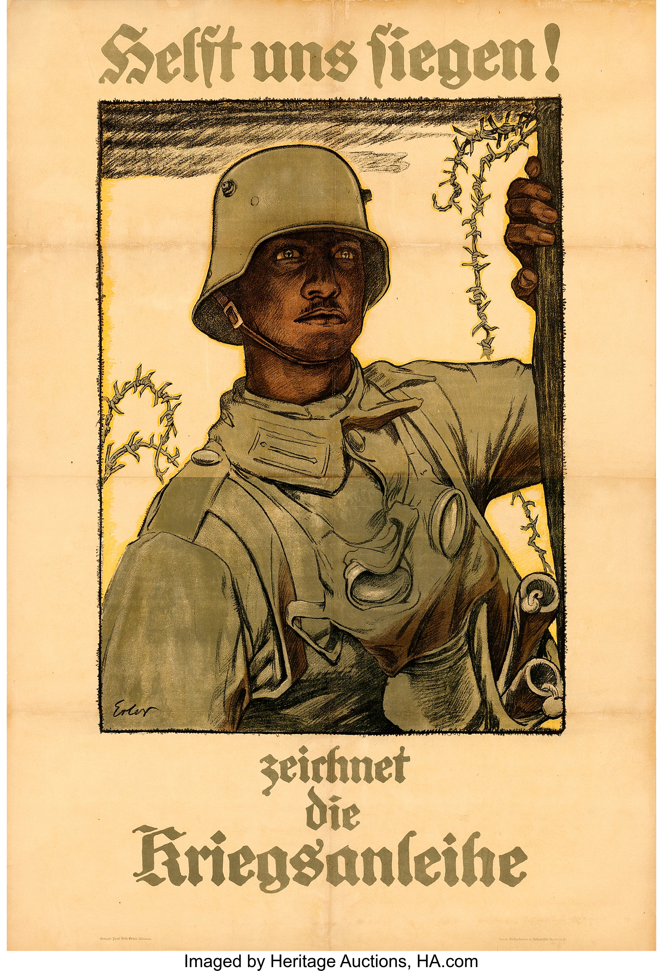
Germany
“Join the Fight!”

Slide 32
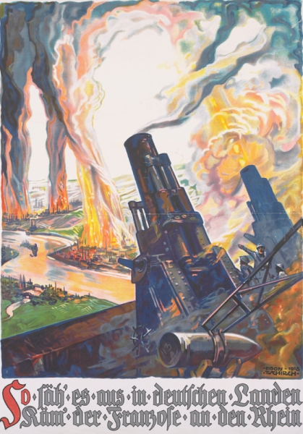
German
“This is how it would look in German lands if the French reach the Rhine”

Slide 33
German

