Slide 1
World War I
A Global Conflict

Slide 2
More Countries Involved
Italy
Joins Allies to take Italian-speaking land in Austria-Hungary
Japan
Joins Allies to take back German controlled land in China
Australia
Part of British Empire
India
Part of British Empire
New Zealand
Part of British Empire
These are just a few – colonies from all over the world become involved for resource and land control purposes!

Slide 3
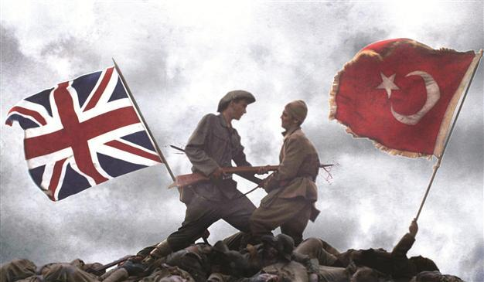
The Gallipoli Campaign
Planned Allied attack on the Dardanelles (location of Constantinople)
Plan was to defeat Turks – build supply line with Russia
Bloody stalemate takes place
Allies suffer about 250,000 casualties, ends in retreat
Major success for Central Powers

Slide 5
The US Enters the War: 1917
WHY?

Slide 6
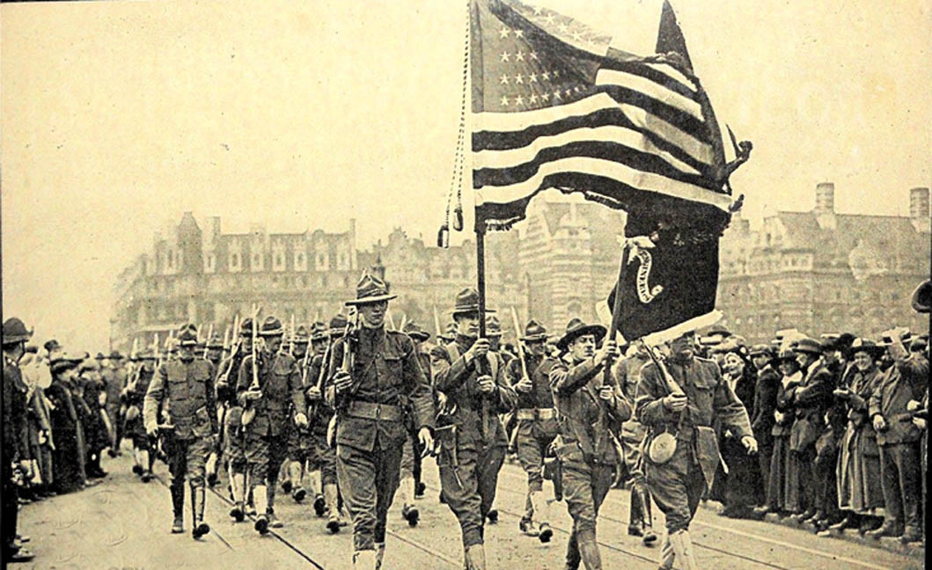
Variety of Reasons
Previous Alliances/Relationships
Shared common culture w/ GB, French support during American Revolution
Britain propaganda after Belgium invasion by Germans
Economic Interests
American trade with Allied powers, loaned money to Allied countries
Idealism
Belief in a better world if Allies win
Security
If Germany wins, would replace democratic Britain and threaten relationship with US
But the 2 major reasons were…..
Unrestricted Submarine Warfare
Zimmerman Note (Telegram)

Slide 7
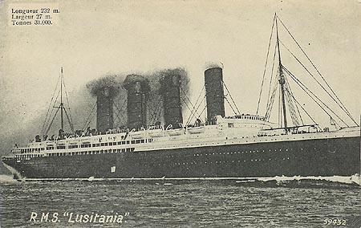
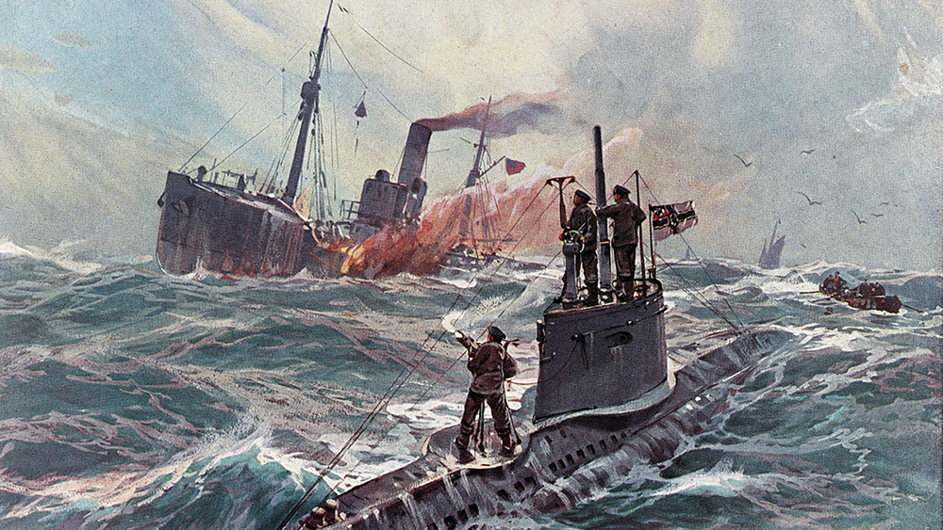
Unrestricted Submarine Warfare
Germany deploys submarines (U-Boats) and says they will sink without warning any ship in the waters around Britain
Sinking of the Lusitania
British passenger ship carrying 1,198 people, 128 Americans
Germans stopped, then returned
Sank 3 more American ships, President Woodrow Wilson outraged
Goal was to defeat Britain before US could mobilize

Slide 8
Zimmerman Note (Telegram)

Slide 9
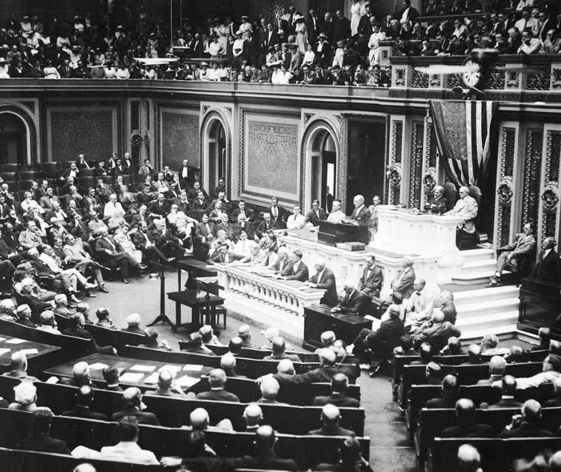
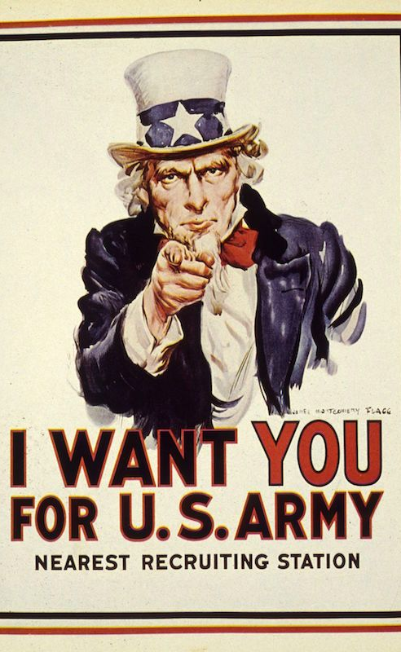
US Declares War
April 2, 1917 - President Woodrow Wilson declares war on Central Powers
Total war – countries used all resources for war effort
Governments employed propaganda
Mobilize the public support, dehumanize the enemy

Slide 10
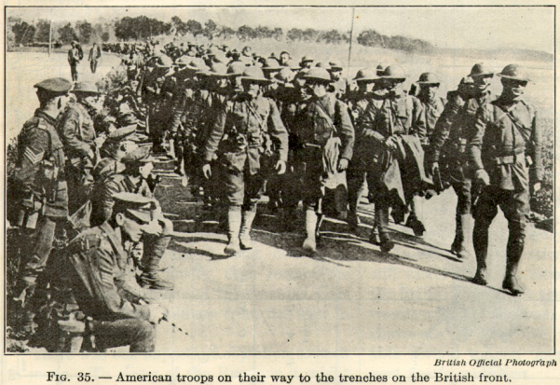

Slide 12
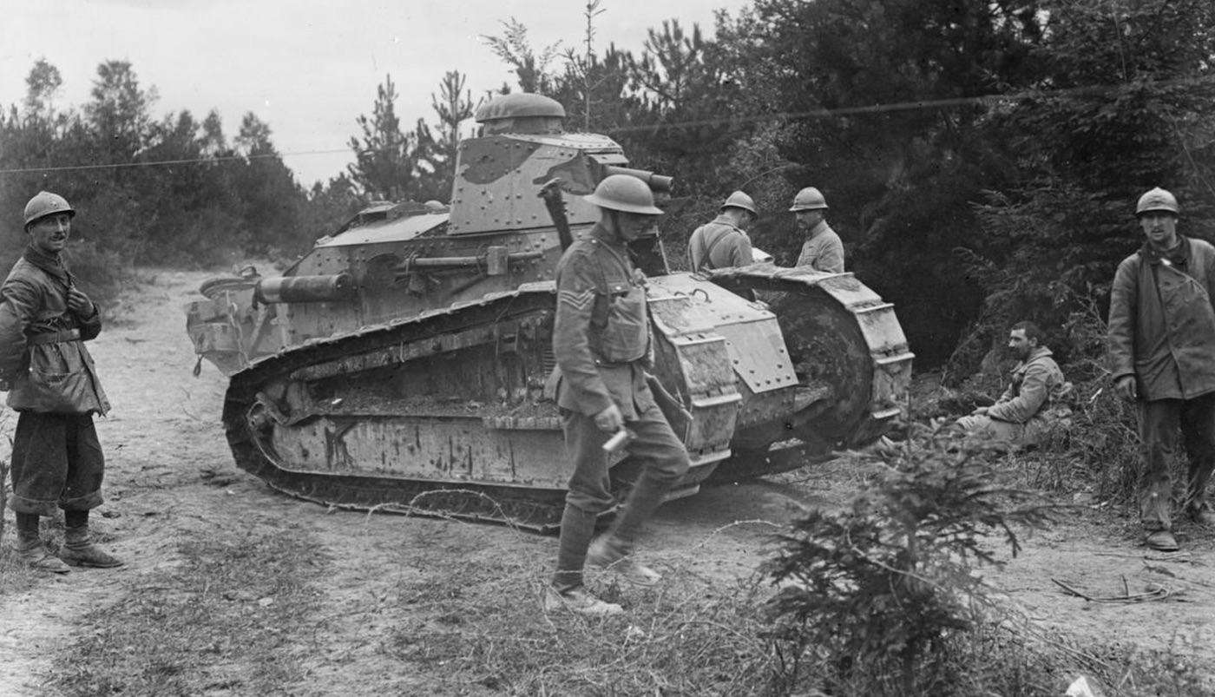
Hope for Central Powers?
Government instability in Russia
Lenin seizes power, signs treaty with Germany in 1918
This ends the war with Russia, elimination of Eastern Front
Meanwhile on the Western Front…
Germany sends all resources
Crush everything, within 40 miles of Paris…close to victory!
Second Battle of the Marne – strong Allied attack defeats weakened German military

Slide 13
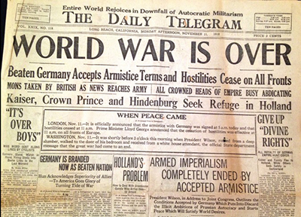
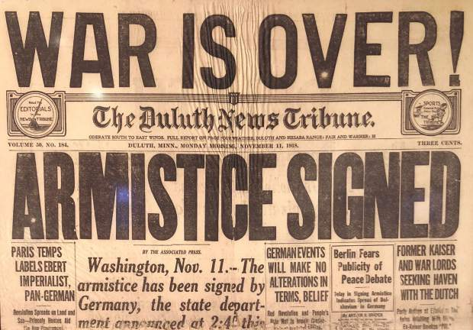
End of World War I
Victory for Allied Powers
Bulgarians and Ottomans surrendered
Revolution in Austria-Hungary
German unrest
Upset with Kaiser Wilhelm II
Steps down on November 9th, 1918
On November 11th, 1918 France and Germany sign an armistice
An agreement to stop fighting

