Slide 1
Totalitarianism
Complete and Total Control

Slide 2
We have seen authoritarianism before…
Highly concentrated centralized power
No democracy
One authority figure or figures
Full political power

Slide 3
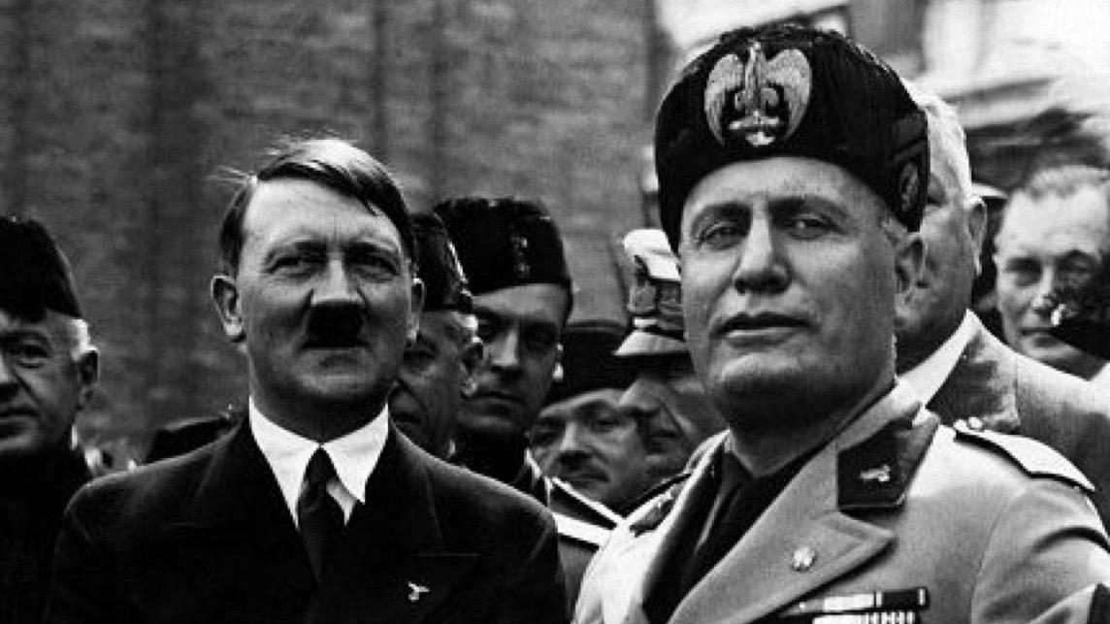
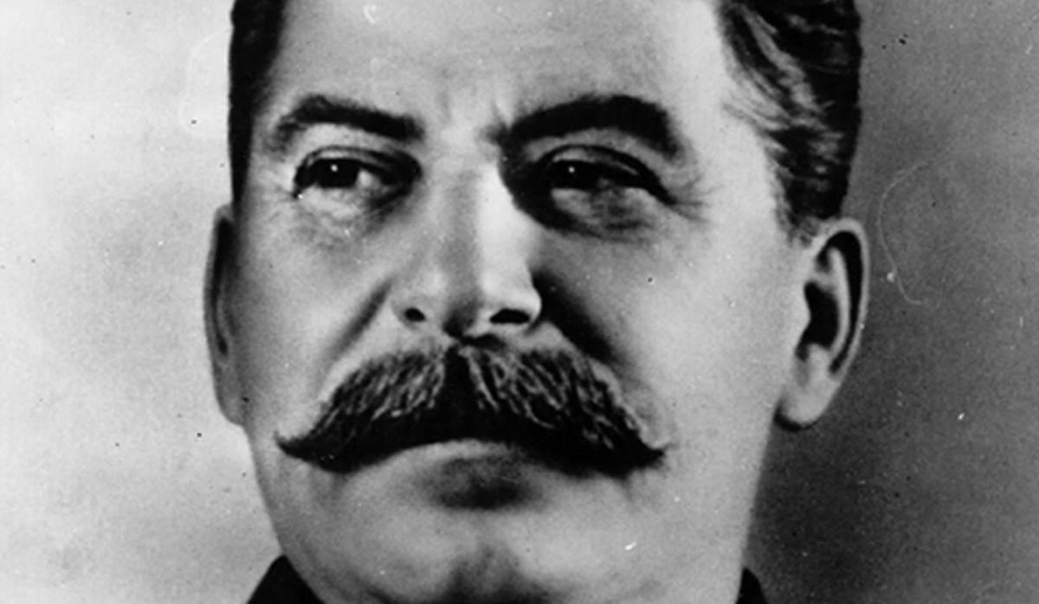
Totalitarianism
A heightened form of authoritarianism
Government in control over every aspect of public and private life
State FIRST
Anti-democratic/one party rule
Aggressive and militaristic
Powerful dictator unite people around proud heritage
Use threats and violence to achieve and hold power
Use of propaganda and censorship
Indoctrination of youth
State control of society

Slide 4
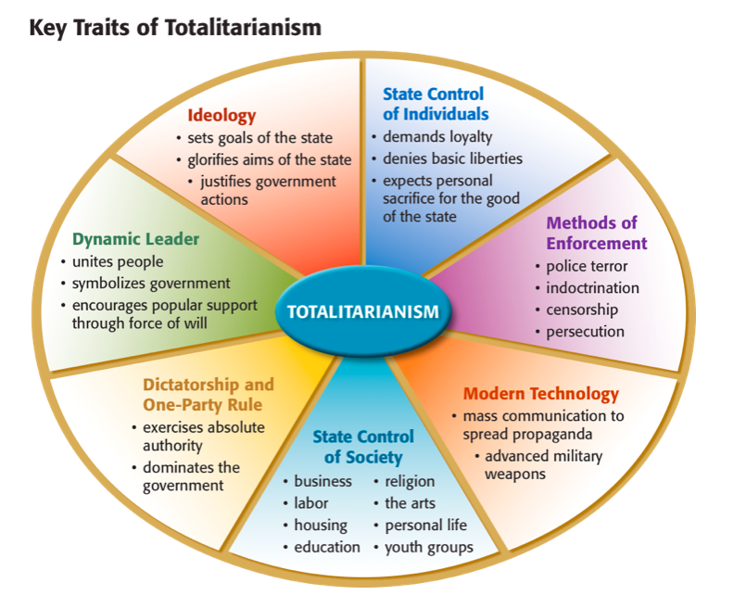

Slide 5
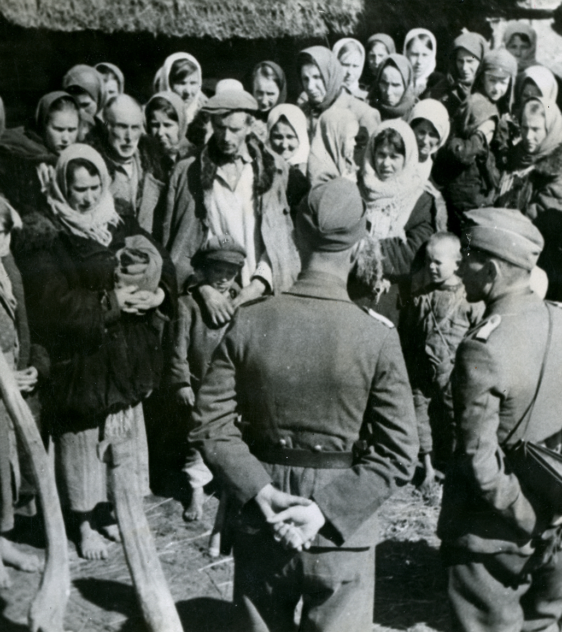
Police States
Secret police that monitored civilian activity
Swift punishments handed to “enemies of the state”
People that leaders blame when things go wrong
Soviet Union
NKVD (will later become KGB)
Italy
OVRA
Germany
Gestapo

Slide 6
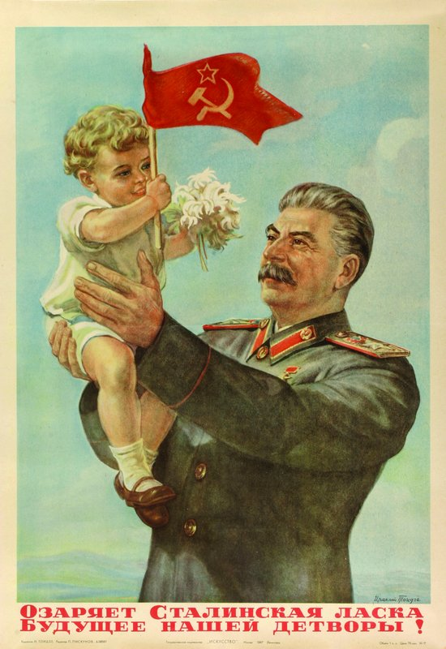
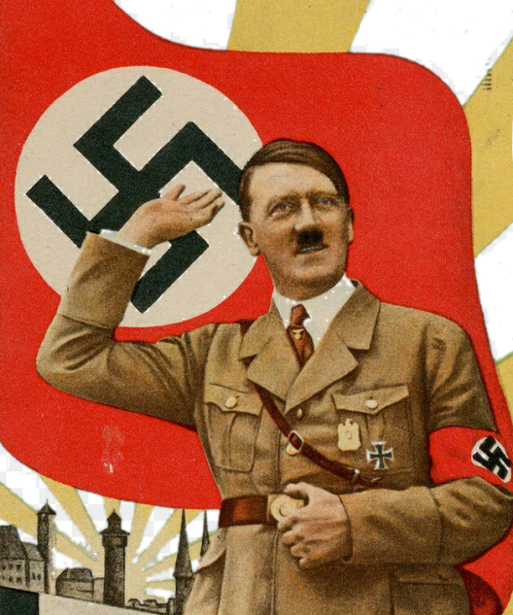
Propaganda
Biased or incomplete info to sway public opinion
Soviet Union
Prisoners believed Stalin could help them
Italy
Promoted Mussolini’s strength and power
Germany
Reich Ministry of Public Enlightenment and Propaganda

Slide 7
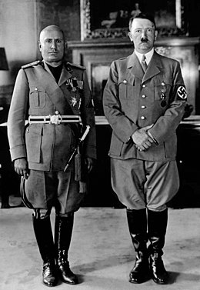
Why?
Totalitarianism spread because:
Strong, stable
End debate and uncertainty
Power and confidence
National pride

