Slide 1
The Rise of Joseph Stalin
And his totalitarian soviet union

Slide 2
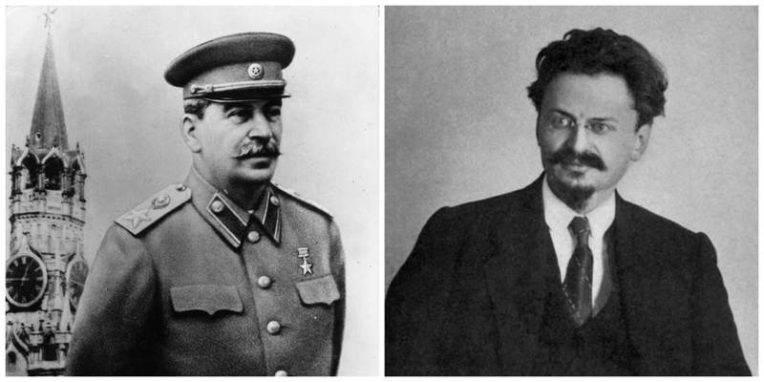
End of Lenin’s Rule
Lenin suffers stroke in 1922
Dies in 1924
Results in major competition for rule of Communist Party:
2 candidates:
Leon Trotsky
Leader of Red Army
Joseph Stalin
General secretary with rapid rise
Lenin on Stalin: “Comrade Stalin….has concentrated enormous power in his hands, and I am not sure that he always knows how to use that power with sufficient caution”

Slide 3
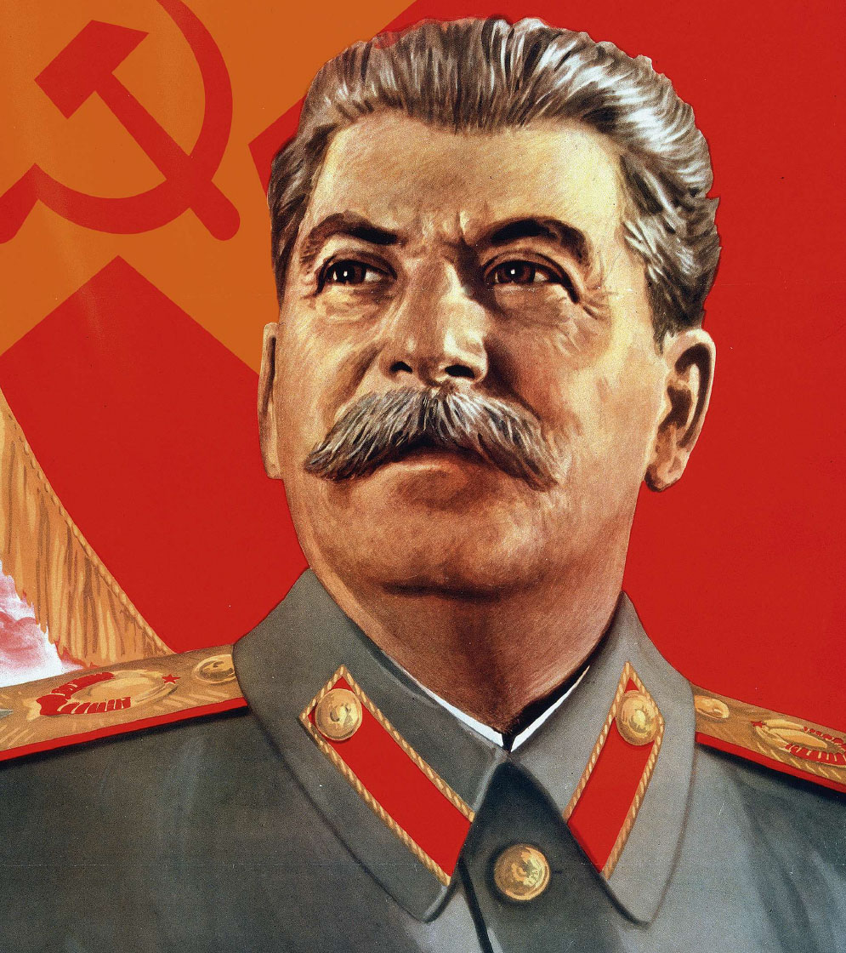
Stalin Takes Control
Moved his own supporters into positions of power
1928 – total command of Communist Party
1929 – forced Trotsky into exile
Begins a totalitarian state
Government that takes total, centralized, state control over every aspect of public and private life
We will focus more on totalitarianism tomorrow

Slide 4
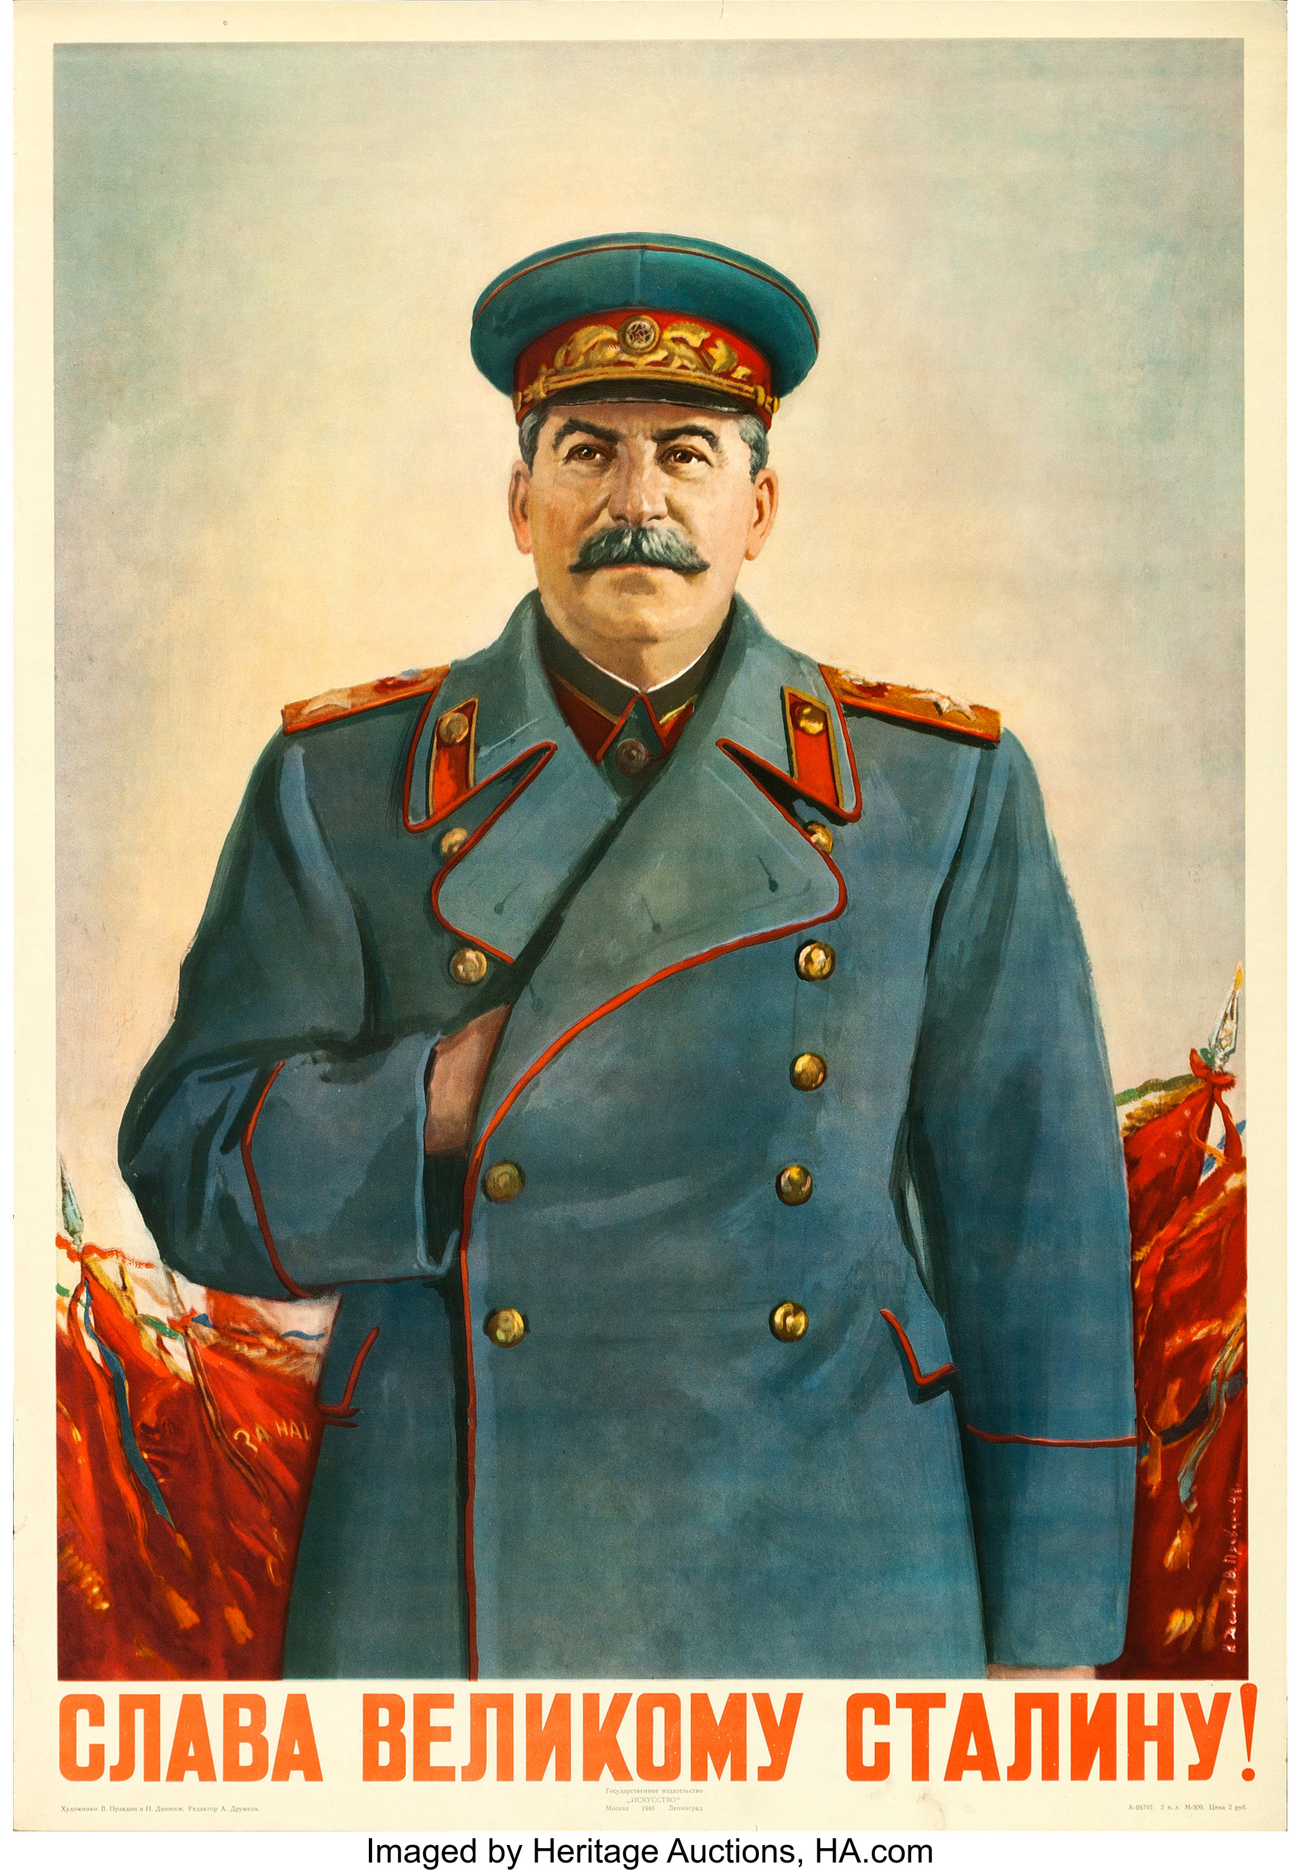
Stalin’s Totalitarian State
Began total and complete domination of Soviet Union
Eliminated his enemies, both real and imagined
Established totalitarianism through the following:
Police State
Propaganda and Censorship
Education and Indoctrination
Religious Persecution

Slide 5
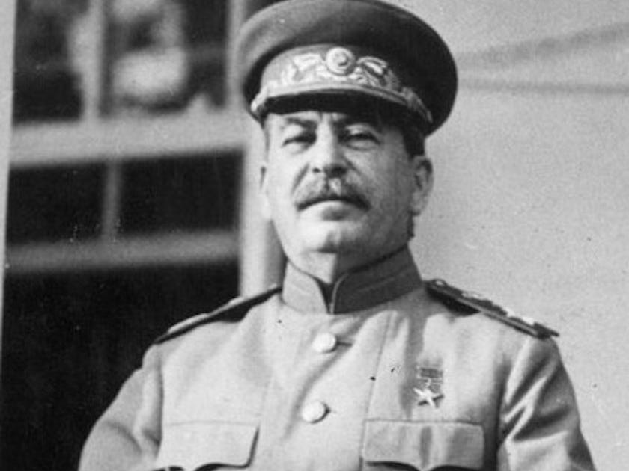
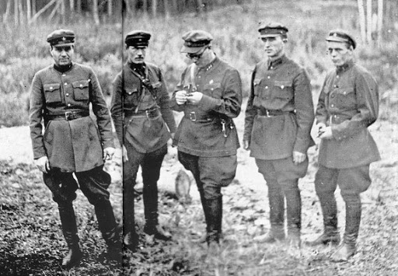
Police State
Used secret police to control people and prevent dissention
People’s Commissariat for Internal Affairs (NKVD)
Ends up becoming the KGB
Swift punishments that included death, prison, forced labor, and exile
Used internment camps (prison or detention) for anyone posing a threat or were accused of posing a threat
Called gulags
Great Purge
1937 - 1938 – campaign of terror directed at anyone threatening Stalin’s power
Responsible for an estimated 8 to 13 million deaths

Slide 6
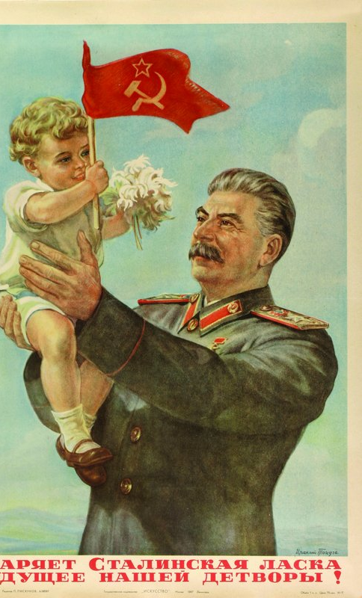
Russian Propaganda and Censorship
Government controlled all media outlets, including newspapers, radio, and movies
Censored everything that did not conform to views of the state
Massive propaganda campaigns
So successful that gulag prisoners wrote to Stalin for help!

Slide 7
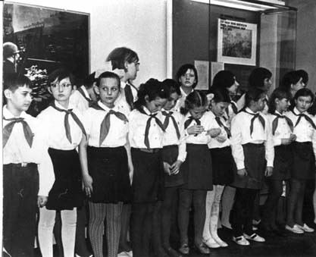
Education and Indoctrination
Total control of education, from nurseries through college
Question teachings? Fired, kicked out of school, or imprisonment
State supported youth groups trained future party leaders

Slide 8
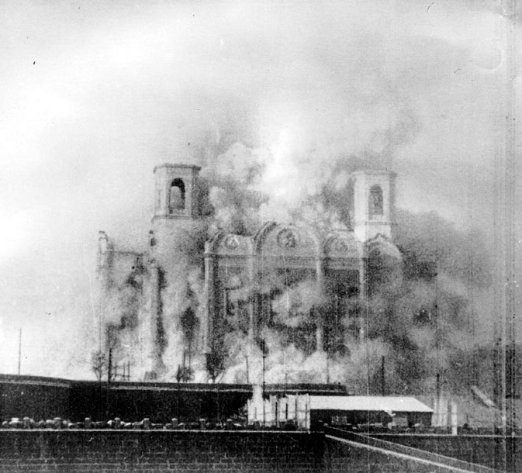
Religious Persecution
Replaced religious teachings with communist teachings
Propaganda attacked religion
Churches and synagogues destroyed
Religious leaders killed or sent to labor camps

Slide 9
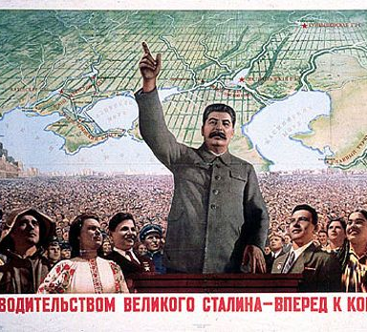
Stalin Creates Command Economy
Command Economy – a system in which the government makes ALL economic decisions
Leaders identify needs, and determine how to fulfill them

Slide 10
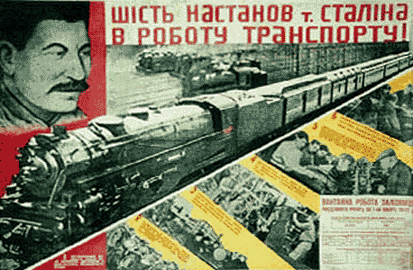
Five-Year Plans
Stalin’s plans for the development of the Soviet Union’s economy
Impossibly high goals to increase output of steel, coal, oil, and electricity
To reach goals, consumer good production was limited
Left people w/o housing, food, clothing, etc.
Tough methods worked – industrialization up 25%

Slide 11
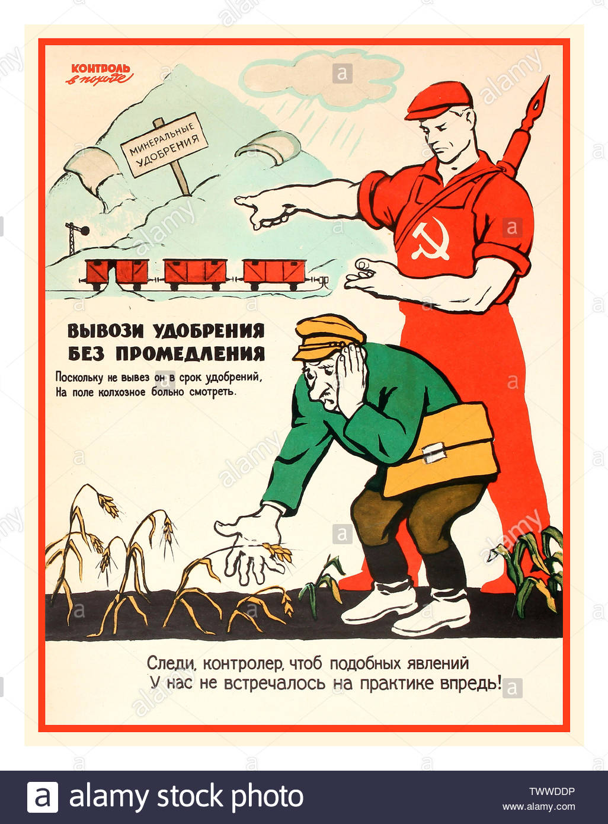
A New Agricultural Revolution
Government takes over 25 million farms in 1928
Combined into large government farms, called collective farms
Peasants resisted – led to lack in production
Great Famine
In Soviet-controlled Ukraine, wealthy peasants resisted fiercely
Stalin orders mass starvation
1932-1933, 4 million Ukrainians died

Slide 12
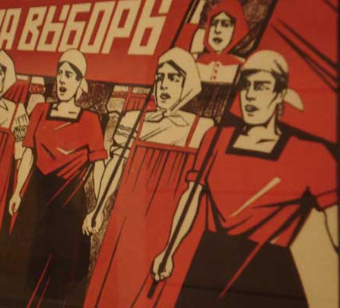
Daily Life Under Stalin
Pros
Better educated
Mastered new skills
Cons
Freedoms limited
Goods in short supply
Dissent prohibited
Women’s Rights
Laws passed granting women equal rights
Joined labor force during Five-Year Plans
75% of Soviet doctors were women
Motherhood considered a patriotic duty

