Slide 1
The Renaissance

Slide 2
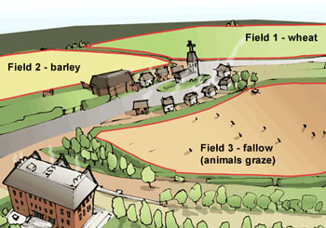
The End of the Middle Ages
Increase in food supply
caused by better ways of farming (three-field system) & warmer climate
increase in food supply made people healthier & able to live longer
population increased

Slide 3
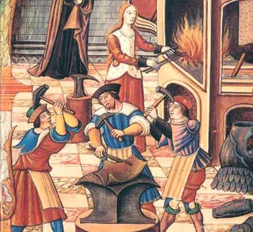
The End of the Middle Ages
2. Development of Guilds
Guilds - organizations of workers who fought for better work conditions, trained workers, and set prices
Guilds influenced the town government & economy

Slide 4
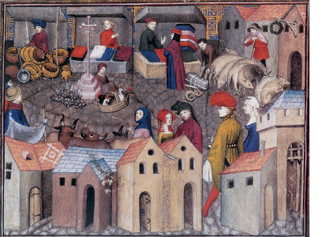
The End of the Middle Ages
3. Expanding Trade
Quality of goods increased with guilds
Business and trade increased – no longer needed self-sufficient manors

Slide 5
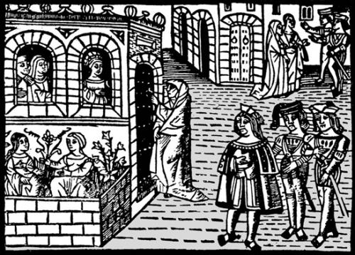
The End of the Middle Ages
4. Urbanization
The movement of people to urban areas (or cities)
People began returning to cities as trade grew and jobs increased

Slide 6
The Renaissance 1300-1600 AD
A “rebirth” of learning, art, and culture
New Outlooks on Life & Art
Humanism – an intellectual movement that focused on human potential and achievements
Concerned with secular matters rather than the spiritual promise of salvation
Realism – focus on a realistic portrayal of life in art
Focus on what is real, rather than on what is ideal

Slide 7
Art from the Middle Ages focused on idealism
Idealistic Art of the Middle Ages

Slide 8
Renaissance art focused on realism
Realistic Art of the Renaissance

Slide 9
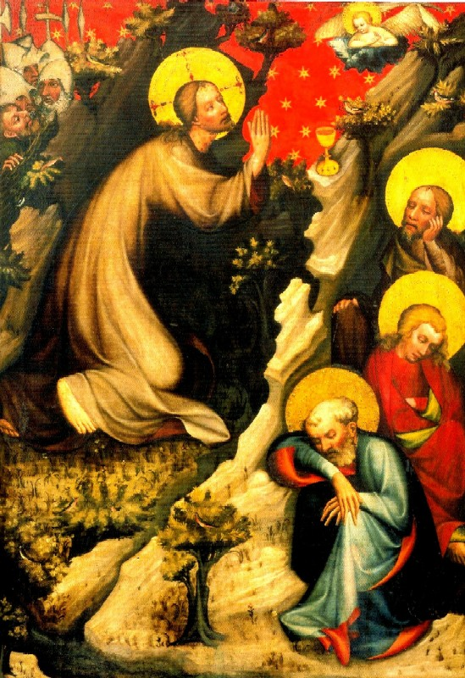
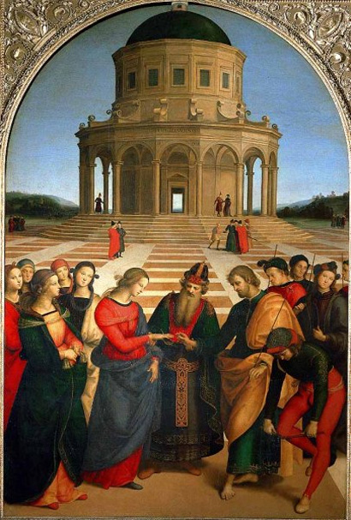
Realism of the Renaissance
Middle Ages
Renaissance

Slide 10
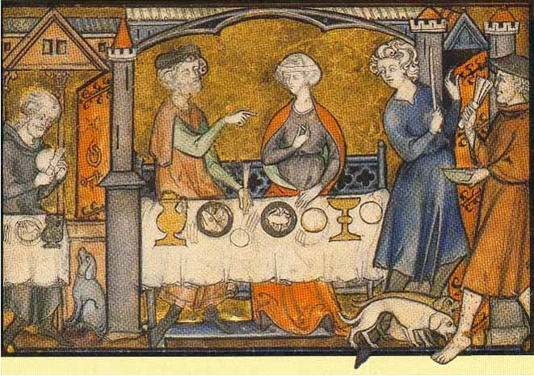
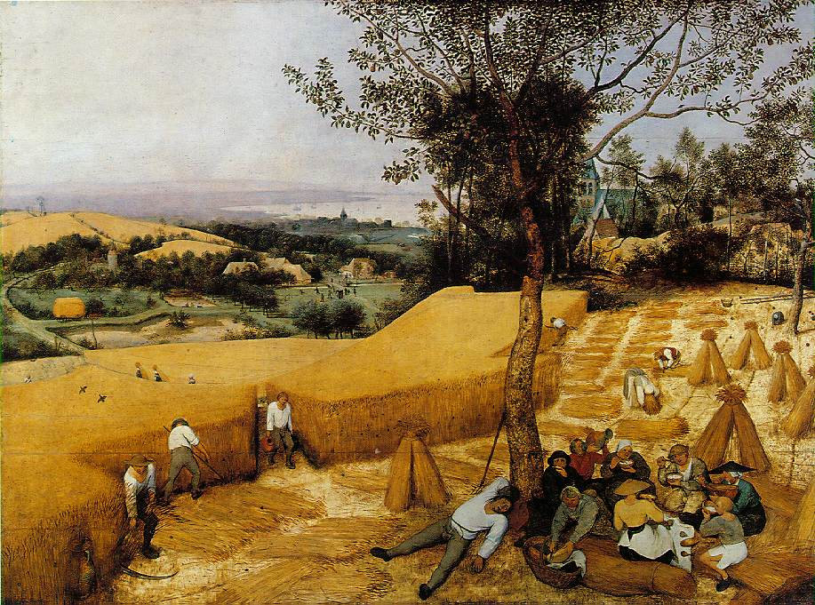
Realism of the Renaissance
Middle Ages
Renaissance

Slide 11
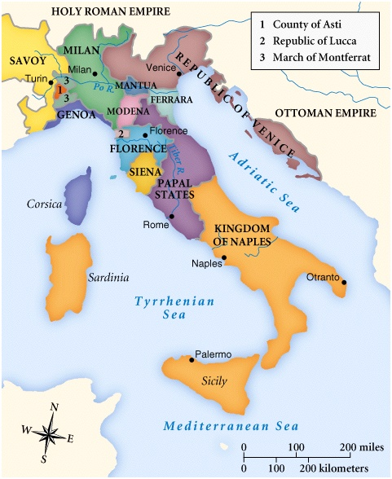
The Renaissance began in Italy
Italy had
Urban city-states
A wealthy merchant class who
were active role in politics
placed importance on individual merit and achievement
supported the arts
The influence of Greece and Rome
looked down on art of Middle Ages
geographically & culturally close to ancient Greece and Rome

Slide 12
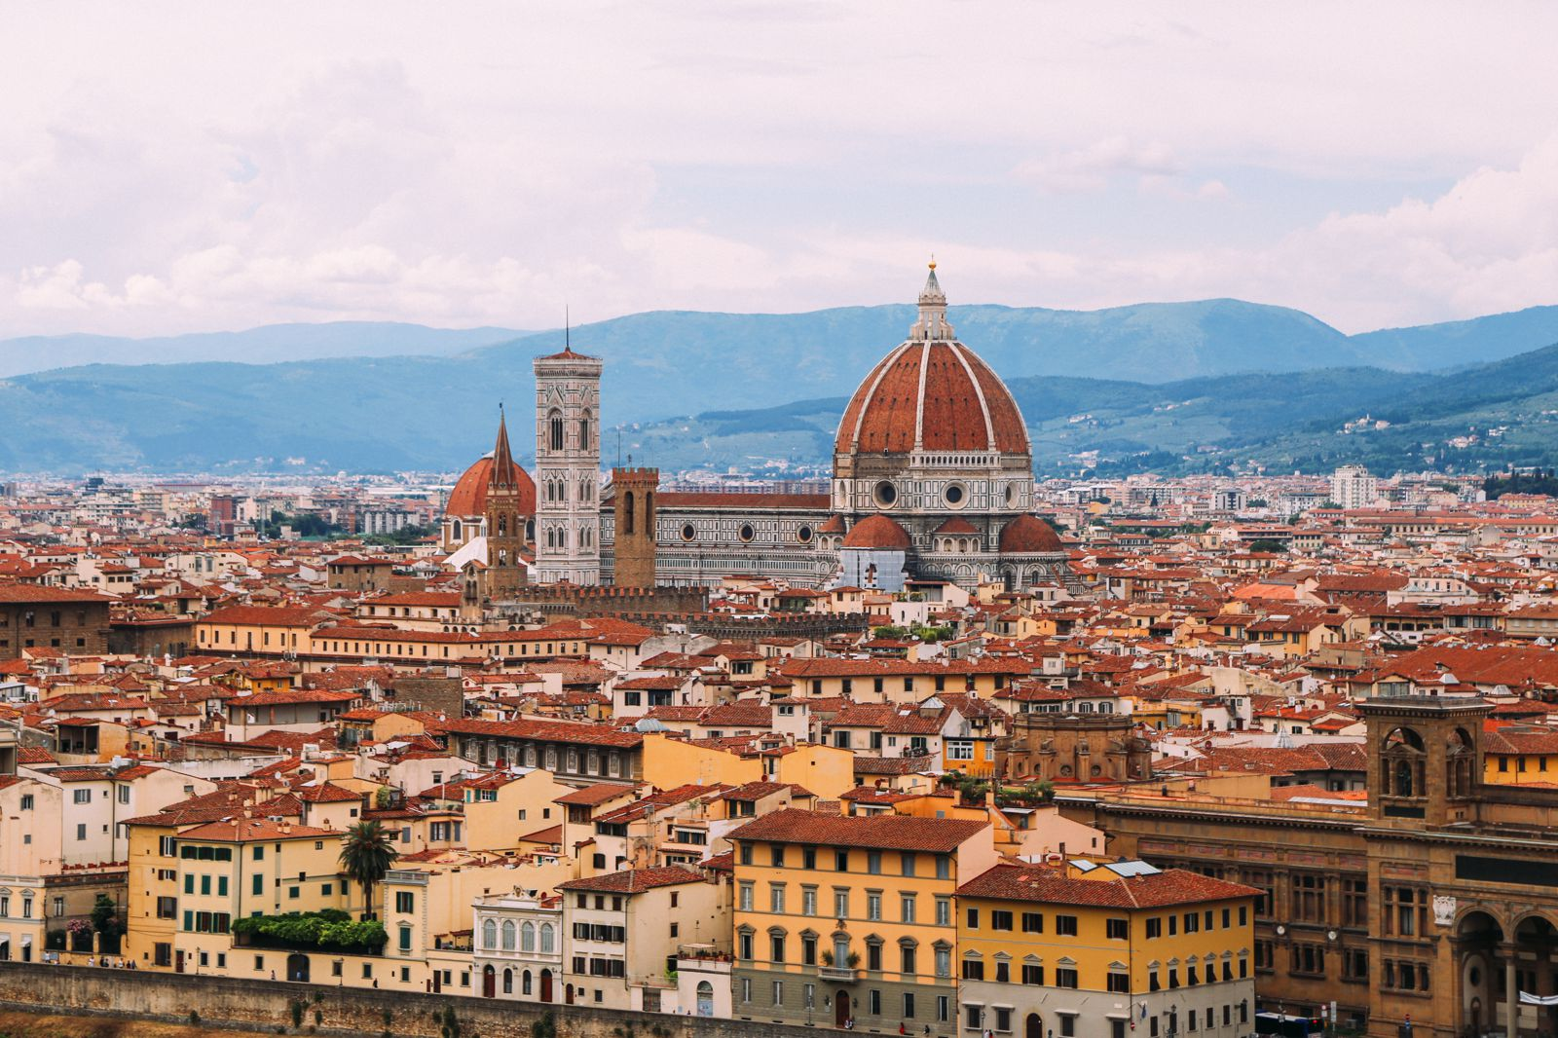

Slide 13
The Medici
Florence
Banking family
Controlled government by giving loans
Lorenzo de Medici-ruled as dictator but kept appearance of elected government
Generous patron of the arts
Patron – individual that financially supports artist

Slide 14
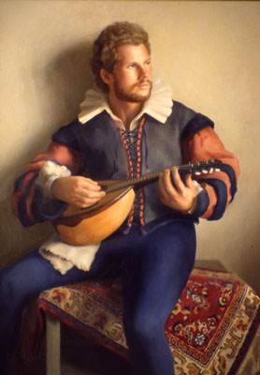
The Renaissance Man
People believed that an individual should be creative and strive to do well in all things
Dancing
Singing
Playing music
Writing poetry
Education – the educated were
expected to create art

Slide 15
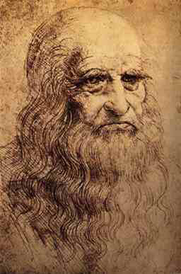
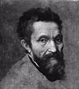
Renaissance Art
A focus on perspective and realism
Leonardo da Vinci
painter, sculptor, inventor, scientist
Mona Lisa
Last Supper
Michelangelo
Sculptor, painter, architect, poet
Sistine chapel
The David

Slide 16
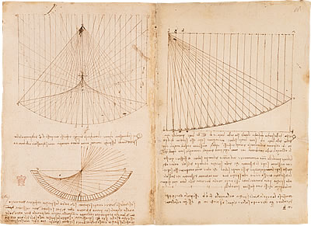
Leonardo’s Notebooks

Slide 17
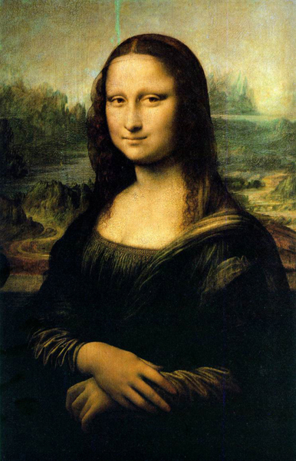
Leonardo da Vinci The Mona Lisa
https://www.youtube.com/watch?v=A_DRNbpsU3Q

Slide 18
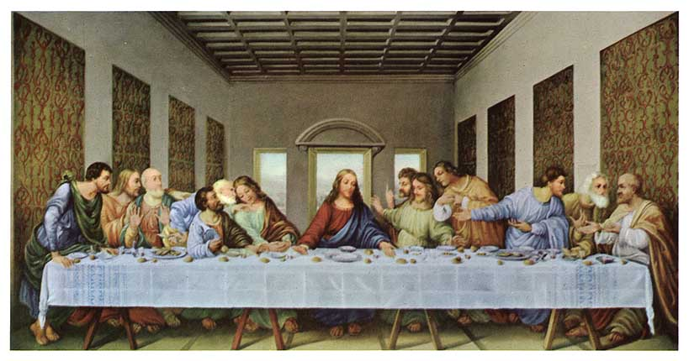
Leonardo da Vinci The Last Supper

Slide 19
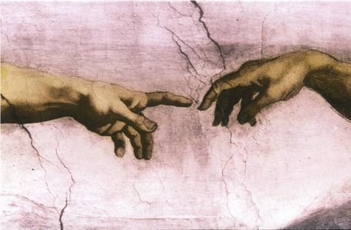
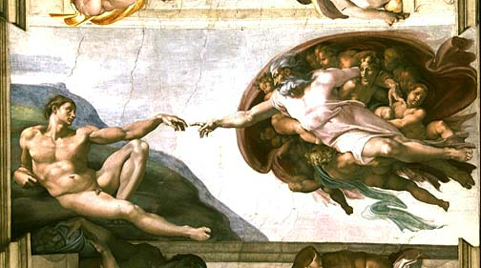
Michelangelo The Sistine Chapel

Slide 20
https://www.smithsonianmag.com/videos/category/history/pouncing-on-the-sistine-chapelpouncing-on-th/

Slide 21
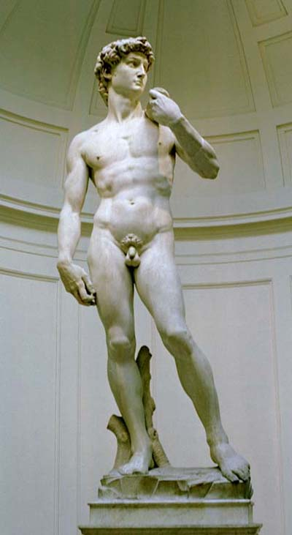
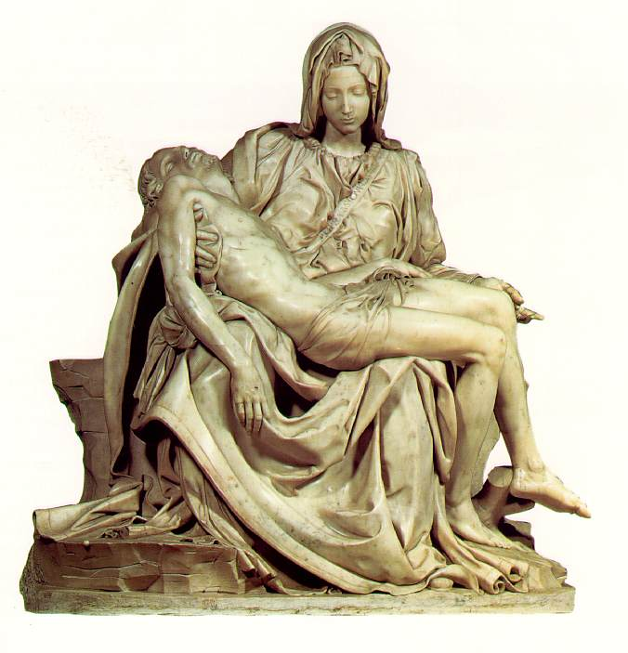
Michelangelo The David & Pietà

Slide 22
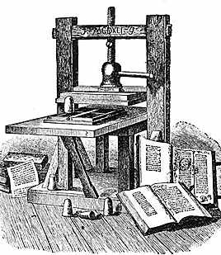
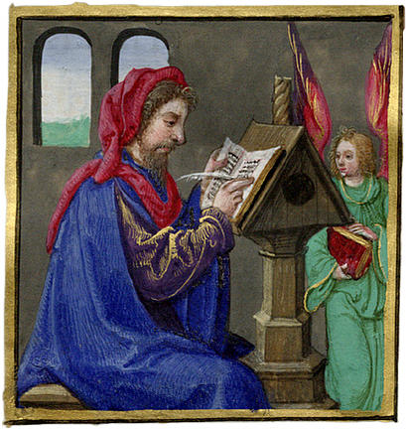
Renaissance Literature
Focus on humanism & the individual, the limits of human existence rather than spiritual ideals
Guttenberg (1440)
Developed the printing press, making it possible to produce books quickly and cheaply
As books became easier to produce and cheaper, more people learned to read and had access to knowledge

Slide 23
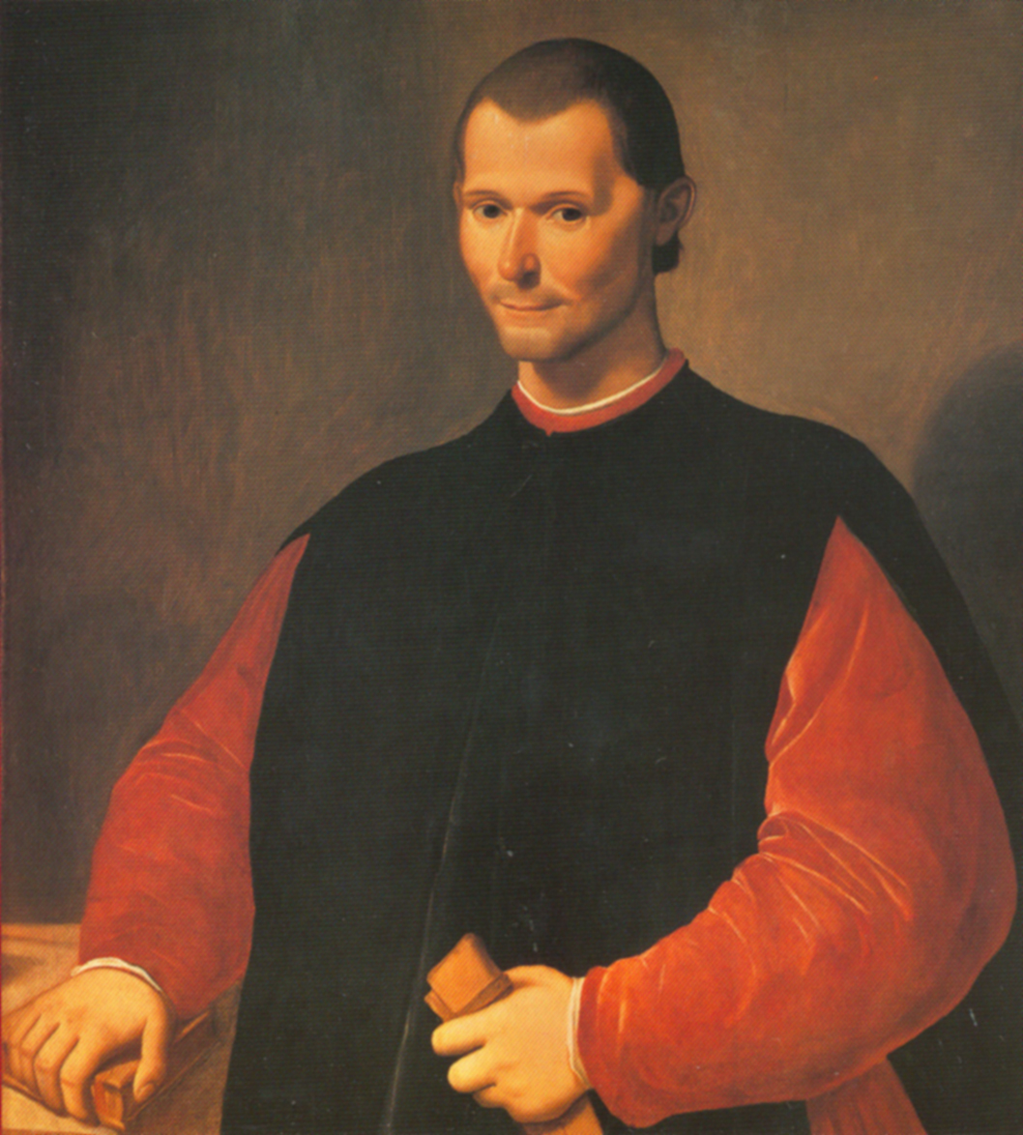
Renaissance Literature
Machiavelli
His most famous book, The Prince
Examined the imperfection of human beings
Wrote that most people are selfish & corrupt
Concerned with what is politically effective, not what is morally right

Slide 24
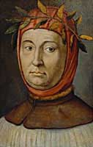
Renaissance Literature
Petrarch
Italian poet
“father of humanism”
first writer to refer to the “Dark Ages” of Medieval Europe
“Nothing is wonderful but the soul, which, when great itself, finds nothing great outside itself.”

Slide 25
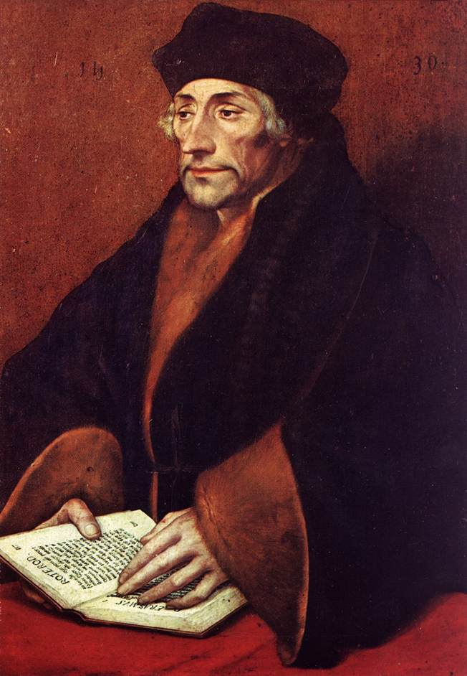
Renaissance Literature
Erasmus
Christian humanist – critical of church’s failure to inspire people to lead a moral life
believed Christianity came from your heart, not a set of ceremonies or rules
thought all should study the Bible, not just Catholics & priests

Slide 26
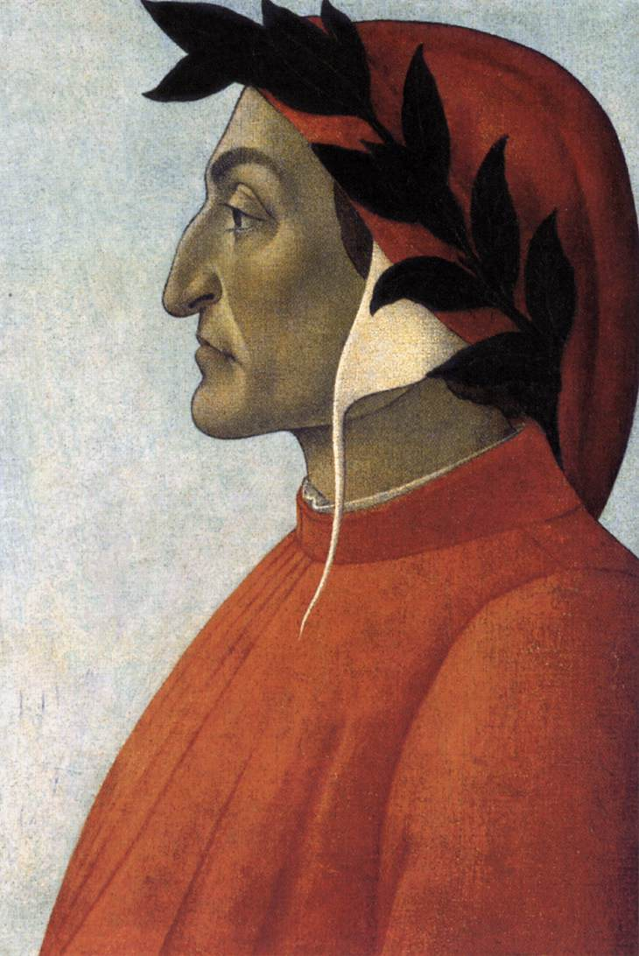
Renaissance Literature
Dante
wrote The Divine Comedy describing man’s journey through heaven & hell
one of the first writers to describe such a serious topic in the Italian language, not Latin

