Slide 1
The Holocaust
How did it happen?

Slide 2
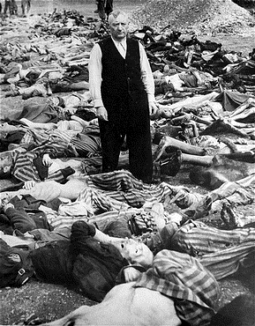
Defining the Holocaust
HOLOCAUST (Heb., sho'ah) which originally meant a sacrifice totally burned by fire
the annihilation of the Jews and other groups of people of Europe under the Nazi regime during World War II
GENOCIDE: the systematic extermination of a nationality or group

Slide 3
Cold Hard Facts
Casualties of the Holocaust:
63% of Jewish population in Europe killed
91% of Jewish population in Poland killed

Slide 4
6 million Jews 5 million people 1933 - 1945

Slide 5
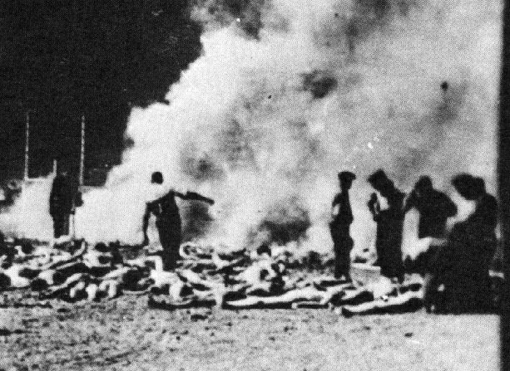
They were shot, starved, gassed and burned…

Slide 6
How did the Holocaust Happen?
The Power of Words
The Stages of Isolation
The Bystander versus the Collaborator
Anti-Semitism

Slide 7
The Power of Words…
“The great masses of the people will more easily fall victims to a big lie than a small one”
“How fortunate for leaders that men do not think”
The victor will never be asked if he told the truth”
The personification of the devil as the symbol of all evil assumes the living shape of the Jew”
What do all these quotes have in common?

Slide 8
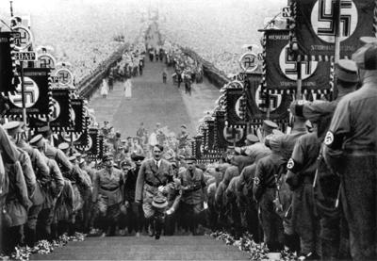
All Quotes of Adolf Hitler…

Slide 9
European Jewish Population in 1933 was 9,508,340

Slide 10
Estimated Jewish Survivors of Holocaust: 3,546,211

Slide 11
The Stages of Isolation
The Holocaust was a progression of actions
leading to the annihilation of millions by:
1: Stripping of Rights
2: Segregation
3: Concentration
4: Extermination

Slide 12
Stage 1: Stripping of Rights
1935: Nuremberg Laws stated that all JEWS were :
stripped of German citizenship
fired from jobs & businesses boycotted
banned from German schools and universities
Marriages between Jews and Aryans forbidden
Forced to carry ID cards
Passports stamped with a “J”
forced to wear the arm band of the Yellow “Star of David”
Jewish synagogues destroyed
forced to pay reparations and a special income tax
Notes:
Reparations of 1 billion Reichmarks after Kristallnacht

Slide 13
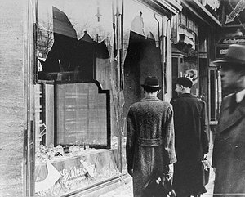
Kristallnacht
“night of the broken glass”
November 9, 1938
Nazi destruction of Jewish homes, businesses, and synagogues
Over 30,000 Jews sent to concentration camps

Slide 14
Stage 2: Segregation
GHETTOS
Jews were forced to live in designated areas called “ghettos” to isolate them from the rest of society
Nazis established 356 ghettos in Poland, the Soviet Union, Czechoslovakia, Romania, and Hungary during WWII
Ghettos were filthy, with poor sanitation and extreme overcrowding
Disease was rampant and food was in such short supply that many slowly starved to death
Warsaw, the largest ghetto, held 500,000 people and was 3.5 square miles in size

Slide 15
Nazi ghettos were a preliminary step in the annihilation of the Jews, as the ghettos became transition areas, used as collection points for deportation to concentration & death camps

Slide 16
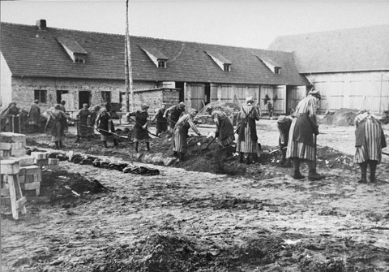
Stage 3: Concentration Camps
essential to Nazi’s systematic oppression and eventual mass murder of enemies of Nazi Germany (Jews, Communists, homosexuals, opponents)
Slave labor “annihilation by work”
Prisoners faced undernourishment and starvation
Prisoners transported in cattle freight cars
Camps were built on railroad lines for efficient transportation

Slide 18
Life in the Camps
possessions were confiscated
heads were shaved
arms tattooed
Prison uniforms
Men, women and children were separated
Survival based on trade skills / physical strength
Unsanitary, disease ridden and lice infested barracks
inhumane medical experiments

Slide 19
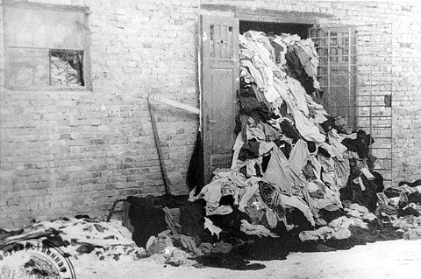

Slide 20
Stage 4: Extermination
Einsatzgruppen (mobile killing units) had began killing operations aimed at entire Jewish communities in the 1930s
DEATH FACTORIES: Nazi extermination camps fulfilled the singular function of mass murder
Euthanasia program: Nazi policy to eliminate “life unworthy of life” (mentally or physically challenged) to promote Aryan “racial integrity”

Slide 21
“FINAL SOLUTION”
Wannsee Conference (Berlin -1942 ) established the “complete solution of the Jewish question”
called for the complete and mass annihilation and extermination of the Jews as well as other groups
Zyklon B gas became the agent in the mass extermination

Slide 22
Gas Chambers & Crematoriums
Prisoners were sent to gas chambers disguised as showers
Zyklon B gas used to gas people in 3 – 15 minutes
Up to 8000 people were gassed per day at Auschwitz-Birkenau, the largest death camp with 4 operating gas chambers
Gold fillings from victims teeth were melted down to make gold bards
Prisoners moved dead bodies to massive crematoriums

Slide 24
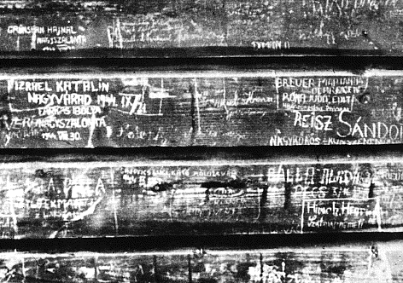
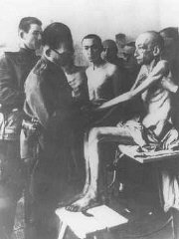
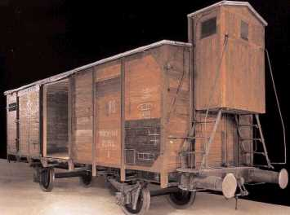

Slide 25
Nazis confiscated property of prisoners in storerooms nicknamed “Kanada” because the sheer amount of loot stored there was associated with the riches of Canada

Slide 26
Nearing the End of the War
By 1945, the Nazis’ began to destroy crematoriums and camps as Allied troops closed in
Death Marches (Todesmarsche): Between 1944-1945, Nazis ordered marches over long distances. Approximately 250 000 – 375 000 prisoners perished in Death Marches
On January 27, 1945, the Soviet army entered Auschwitz (largest camp) and liberated more than 7,000 remaining prisoners, who were mostly ill and dying.

