Slide 1
The Middle Ages
Feudalism and Manorialism

Slide 2
Feudalism- POLITICAL
Feudalism loosely organized system of rule in which powerful local lords provided land (fief) in exchange for service and loyalty (fealty)
Fealty Pledge: Ceremony used to establish “contract” of political feudalism.
Complex system due to multiple loyalties (liege [superior] lord)

Slide 3
Remember from your Vocab. Cards-
Lord: landowner
Fief: land granted
Vassal: person receiving the land

Slide 4
Feudal Social Structure in Europe
A political and social system based on the exchange of loyalty, land, protection, and military service.

Slide 6
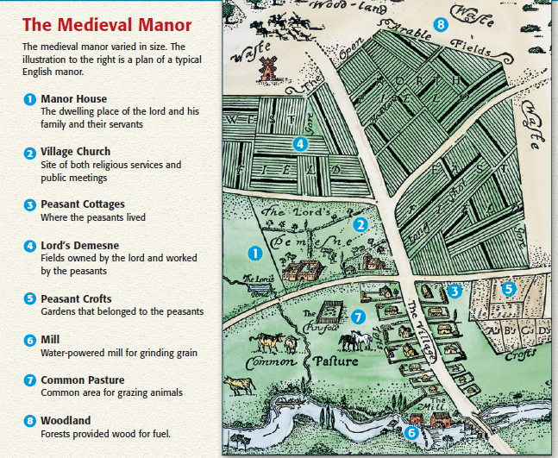
Manorialism-ECONOMIC

Slide 7
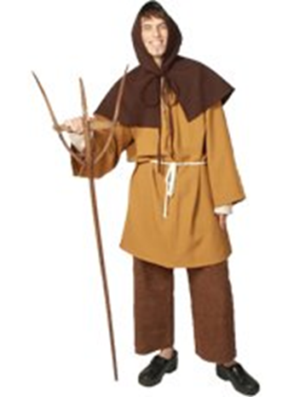
Serfs and Peasants
Person who may have owned a small plot of land or worked as tenant farmer
TAXES!!!
Peasants legally bound to live on a lord’s estate
Harsh life
Disease
35 years
Married by 12 (girls)
No meat
Yearly baths

Slide 8
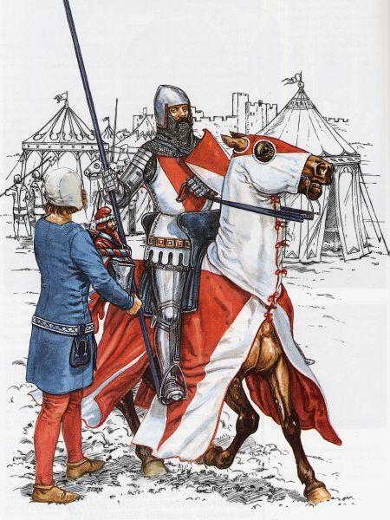
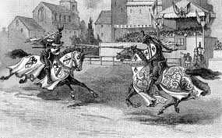
The Knight
Highly trained- military force
Chivalry: Church enforced
Protection of the defenseless
Courtesy towards women
Bravery
Loyalty
Weapons: Sword, axe, lance, armor and shield

Slide 9
Women- Two different worlds
Notes:
The peasant women really had more freedom. It was not an easy life because they had to work the fields and complete all the domestic tasks, but they were somewhat independent. However, non-peasant women were restricted in their rights by a society run by men. Women were required to “know their place” in society. And that place was determined by men.

Slide 10
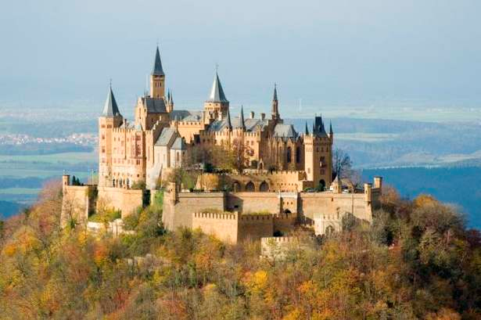
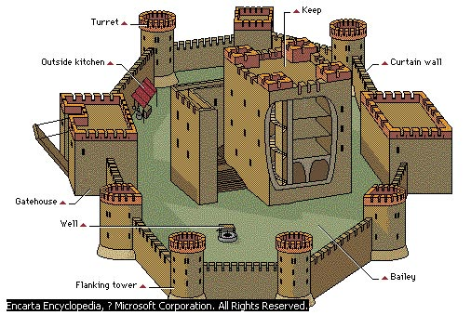
Castles and Defense
Fortified homes
Refuge in warfare

Slide 12
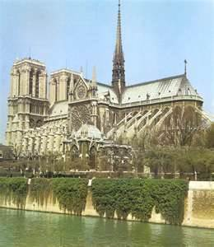
Religion
Central to life
Organizing body in Europe
Monasteries minister to growing rural populations
Local priest
Sacraments=salvation
Religious holidays=time off work for peasants

Slide 13
Church Power
Life=short and brutal
Church=salvation
Salvation=hope
Hope=willingness to follow
Follow=tithe
Tithe=Wealth
CHURCH=POWER

