Slide 1
The Crusades

Slide 2
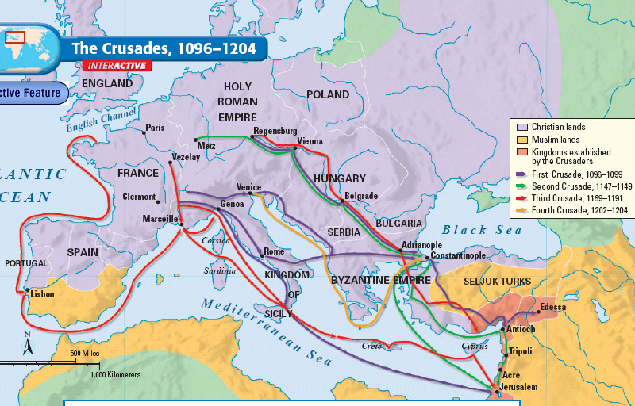
Why did Christians go to Jerusalem during the Middle Ages?
Notes:
2

Slide 3
The Crusades
Pope Urban II issued a call to Christians for a Crusade (a holy war) to regain control of the Holy Land
In 1095, the Islamic Empire invaded & took the holy city of Jerusalem
Over the next 300 years, Christians fought Muslim armies in 9 different Crusades
Notes:
3

Slide 4
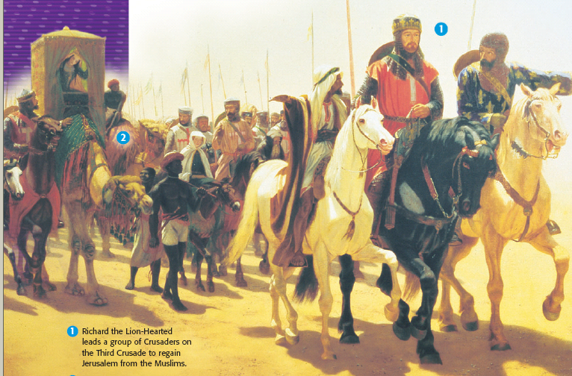
Why did Christians go on the Crusades?
Merchants wanted access to trade routes
The Pope wanted to unite Roman Catholic & Eastern Orthodox Christians & regain holy lands from Muslims
Knights wanted to support the Church; Many hoped to gain land & wealth
Notes:
Others who participated in the Crusades were younger sons who, unlike eldest sons, did not stand to inherit their father’s property. They were looking for land and a position in society, or for adventure. In the later Crusades, merchants profited by making cash loans to finance the journey. They also leased their ships for a hefty fee to transport armies over the Mediterranean Sea. In addition, the merchants of Pisa, Genoa, and Venice hoped to win control of key trade routes to India, Southeast Asia, and China from Muslim traders.
4

Slide 5
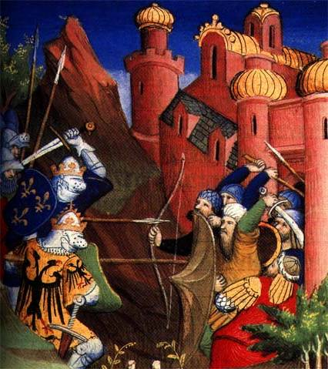
The Crusades
Christian soldiers took back Jerusalem during the First Crusade
But, Muslims took back Jerusalem & kept it during the Second & Third Crusades
More Crusades were fought, but Christians never regained the Holy Lands
Notes:
5

Slide 6
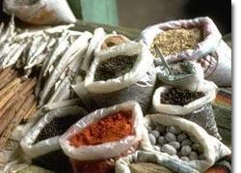
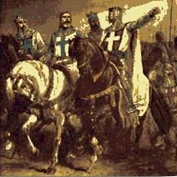
Effects of the Crusades
The Crusades brought cultural diffusion & introduced new ideas into Western Europe
Increased desires for luxury goods like silk, cotton, sugar, & spices
Introduced technologies like compass, astrolabe, ship designs, & gunpowder
Introduced ideas like Arabic numbers, chemistry, algebra, telescope
Notes:
6

