Slide 1
Supply
Supply
The schedule of quantities that would be offered for sale at all possible prices that could prevail in the market. (NOT A SPECIFIC NUMBER)
Quantity Supplied
Amount offered for sale at a given price. (SPECIFIC NUMBER)
Law of Supply
The law of supply states that, other things equal (Ceteris Paribas), the quantity supplied of a good rises when the price of the good rises.
In other words: Low price = Low quantity High price = High quantity

Slide 2
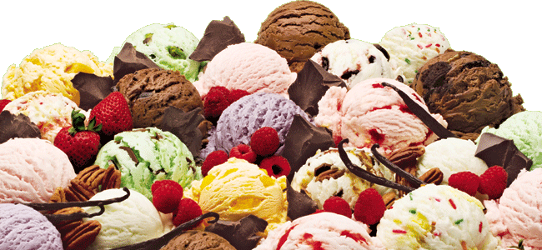
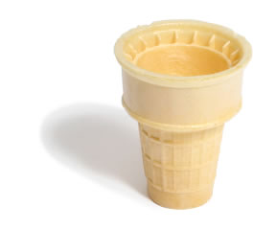
Supply Schedule
Table that shows the relationship between the price of the good and the quantity supplied.
Supplied

Slide 3
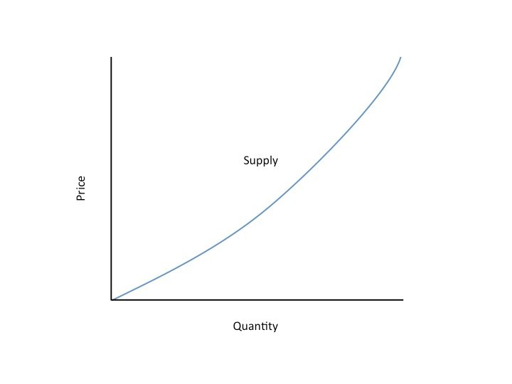
Supply Curve
Supply Curve
The graph of the relationship between the price of a good and the quantity supplied.

Slide 4
The supply curve slopes upwards from left to right (a positive slope), indicating the Law of Supply.
Price of
Ice-Cream
Supplied
Cone
$3.00
2.50
1. An
increase
in price
...
2.00
1.50
1.00
0.50
0
1
2
3
4
5
6
7
8
9
10
11
12
Quantity of
Ice-Cream Cones
2.
...
increases quantity of cones supplied.

Slide 5
Shifts and Changes in Supply cont.
Changes in Quantity Supplied (Qs)
If there is a change in PRICE for the product, then there is a change in the QUANTITY SUPPLIED (Qs) for that product.
This a movement ALONG the supply curve.

Slide 6
Change in Quantity Supplied
Price of Ice-Cream Cone
S
B
$3.00
A rise in the price of ice cream cones results in a movement along the supply curve.
A
1.00
Quantity of Ice-Cream Cones
0
1
5

Slide 7
Shifts and Changes in Supply cont.
Change in Supply
# of producers
Government action ( taxes, subsidies and regulations )
Resource prices
Expectations
Education
Technology changes
A shift in the supply curve, either to the left or right.
Causes a change that alters the quantity supplied at every price.

Slide 8
Again, an increase is always to the right and a decrease is always to the left.
Price of
Ice-Cream
Supply curve,
S
3
Supply
Cone
curve,
S
1
Supply
Decrease
curve,
S
2
in supply
Increase
in supply
0
Quantity of
Ice-Cream Cones

Slide 9
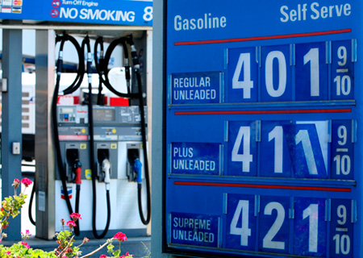
Essential Question 4
How are prices established in a perfectly competitive market?

Slide 10
Prices: Supply and Demand Combined
Why are prices good?
Neutral
They don’t favor the buyer or seller
Flexible
Reacts to change and adjusts
Efficient
Make decisions easily
Keeps shortages from occurring

Slide 11
Prices: Supply and Demand Combined cont.
What happens without prices?
Rationing
Government decides what is a fair amount
High administrative costs
Bureaucracy
Diminished incentive
Waste

Slide 12
Prices: Supply and Demand Combined cont.
How are prices determined?
What are you trying to reach?
Market Equilibrium
Situation in which prices are relatively stable and
Qs = Qd
Equilibrium Price
The price that balances Qs and Qd.
On a graph, it is the price at which the supply and demand curves intersect.
Equilibrium Quantity
The Qs and the Qd at the equilibrium price.
On a graph it is the quantity at which the supply and demand curves intersect.

Slide 13
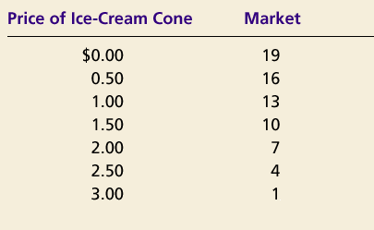
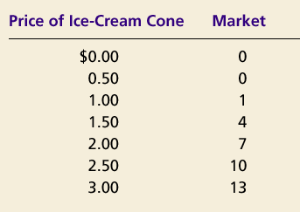
Prices: Supply and Demand Combined cont.
Demand Schedule
Supply Schedule
At $2.00, the quantity demanded is equal to the quantity supplied!

Slide 14
Prices: Supply and Demand Combined cont.
Price of
Ice-Cream
Cone
Supply
Equilibrium price
Equilibrium
$2.00
Equilibrium
Demand
quantity
0
1
2
3
4
5
6
7
8
9
10
11
12
13
Quantity of Ice-Cream Cones

Slide 15
Shifts and the Equilibrium Price
Shifts in Curves VS Movements along Curves
S VS Qs
A shift in the supply curve is called a change in supply.
A movement along a fixed supply curve is called a change in quantity supplied.
D VS Qd
A shift in the demand curve is called a change in demand.
A movement along a fixed demand curve is called a change in quantity demanded.

Slide 16
Shift in Supply
Price of
Ice-Cream
1. An increase in the
Cone
price of sugar reduces
S₂
the supply of ice cream. . .
S₁
$2.50
2.00
Initial equilibrium
2. . . . resulting
in a higher
price of ice
cream . . .
Demand
0
4
7
Quantity of
3.
. . .
and a lower
Ice-Cream Cones
quantity sold.

Slide 17
Shift in Demand
Price of
Ice-Cream
1. Hot weather increases
Cone
the demand for ice cream . . .
Supply
$2.50
New equilibrium
2.00
2. . . . resulting
in a higher
price . . .
D
D
0
7
10
Quantity of
3.
. . .
and a higher
Ice-Cream Cones
quantity sold.

