Slide 1
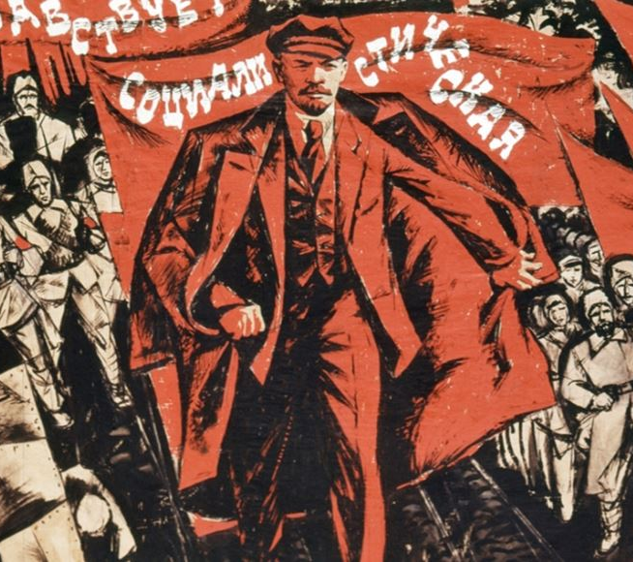
Russian Revolution Part 2

Slide 2
Back to Czar Nicholas….

Slide 3
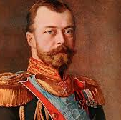
Uprisings
erupted in 1917
among the lower working classes, strikes broke out
objected to involvement in WWI
Czar Nicholas II ordered troops to put down the uprisings and shoot at protestors

Slide 4
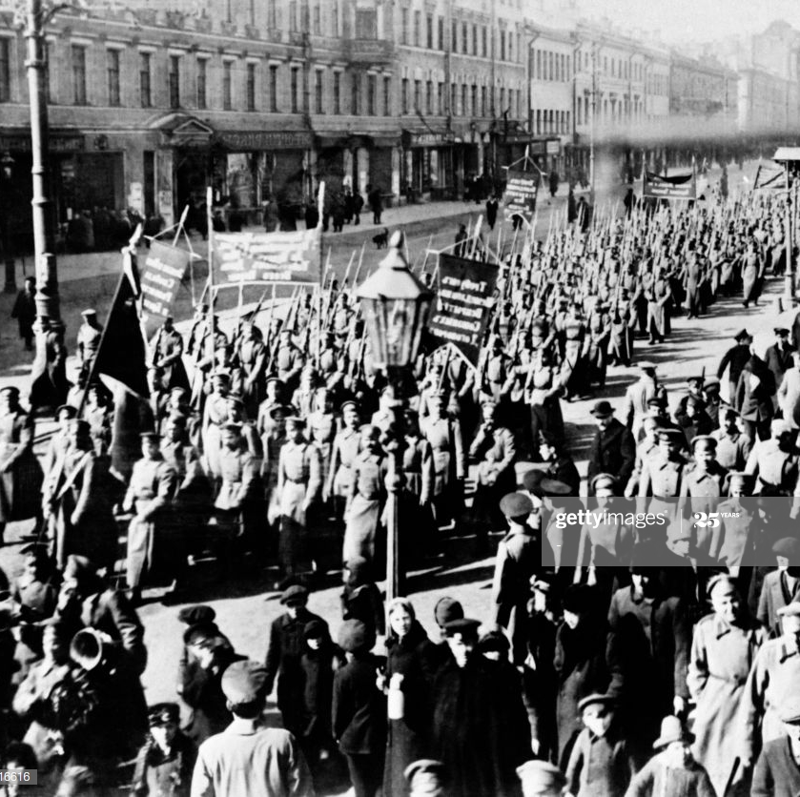
March Revolution
1917
City-wide strike by textile workers
Riots over shortages of bread and fuel
Soldiers sided with the people!
Czar Nicholas abdicates
Incapable of dealing with the problems
He and his family are brutally executed a year later

Slide 5
Provisional Government
Government in hands of Duma (Parliament)
Provisional (temporary) government takes over
led by Alexander Kerensky
Russia stays in World War I
Russian people continued to suffer

Slide 6
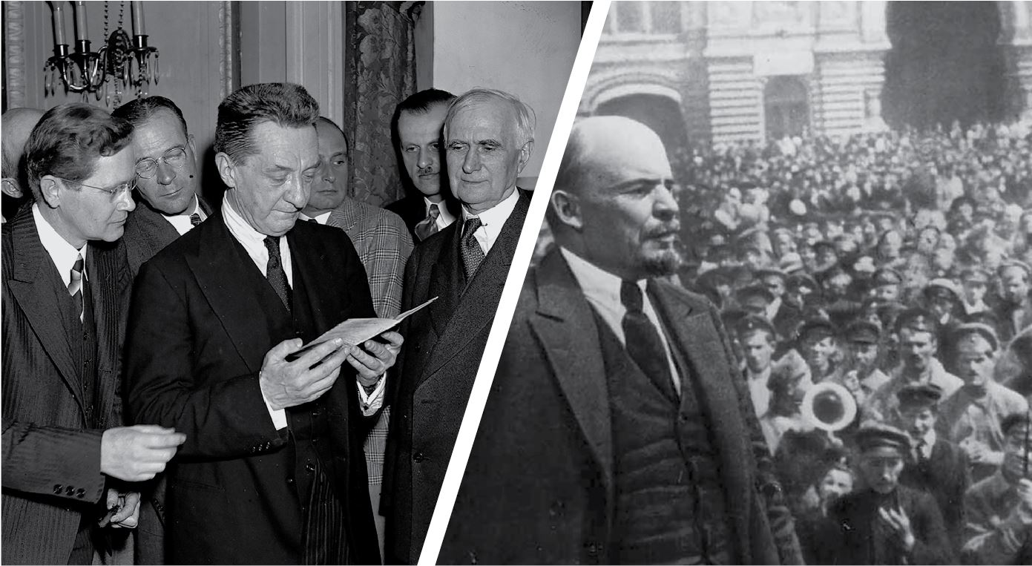
Another Weak Government
Alexander Kerensky. Why not Lenin?
Decided Russia would continue fighting in WWI
Unrest increases
Soviets (local councils of workers, peasants and soldiers) more influential than provisional government

Slide 7
Rise of the Bolsheviks
Vladimir Lenin:
Bolsheviks- Radical group of Marxists in Russia
Vladimir Lenin led this group
opposed Czarist regime
fled from Russia in the early 1900s to avoid arrest

Slide 8
Out of Exile
Lenin returned in 1917 with support of Germany
Goal for Germany was create chaos in Russia so they pull out of WWI
November 1917 – Bolsheviks overthrow Kerensky and provisional government

Slide 9
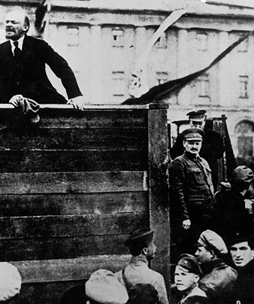
The Second Revolution: Bolshevik Revolution
Exiled Lenin returns to Russia
Gains control of soviets in major cities
Slogan- “Peace, Land, and Bread!”
Gave factory control to people
Farmland to peasants
Provisional government topples
March 1918 - Treaty of Brest-Litovsk with Germany ends WWI (Humiliating LOSS)

Slide 10
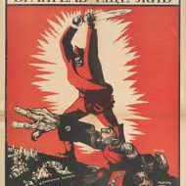
Civil War 1918 - 1920
Had to get rid of enemies
Bolsheviks (Reds) v. the White Army
White Army
Supporters of the czar, those who wanted democratic gov’t, socialists who disagreed with Lenin. Never united or in agreement
Red Army led by Leon Trotsky
14 million died
Red Army victorious (expertly led)

Slide 11
Results of the Russian Revolution
leaders never forgot the way Western nations sided with the anti-Communists
start of mistrust between the West and Communist East
transfer of power in Russia from aristocrats to leaders from the lower classes

Slide 12
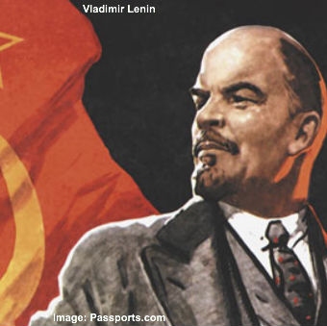
Lenin Restores Order
War and revolution destroyed the economy
Trade at a standstill
New Economic Policy (NEP)
Allowed peasants to sell surplus goods
Gov’t kept control of major industries, banks, and means of communication
Small factories, businesses and farms allowed to operate under private ownership
Gov’t encouraged foreign investment
By 1928 had recovered to pre-WWI level(factories and farms)

Slide 13
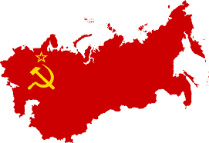
USSR – Union of Soviet Socialists Republics
established in 1922 by the Communist Party (formerly the Bolsheviks)
Lenin saw nationalism as a threat – organized self-governing republics under one central government
In reality, Communist party held all of the power
Established dictatorship of the Communists, not “of the proletariat” as Marx wanted
Worldwide movement starts

