Slide 1
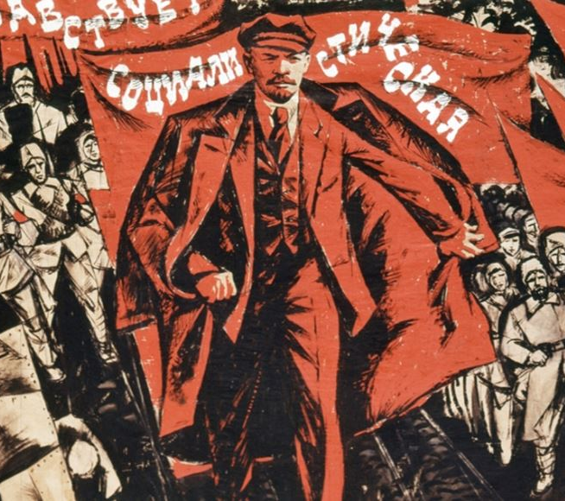
Russian Revolution (Part 1)

Slide 2
Russian Revolution
Element: Determine the causes and results of the Russian Revolution from the rise of the Bolsheviks under Lenin to Stalin’s first Five Year Plan.

Slide 3
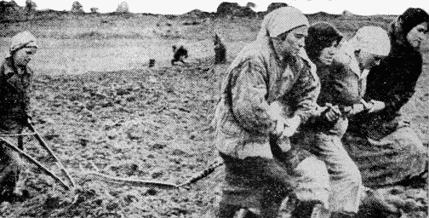
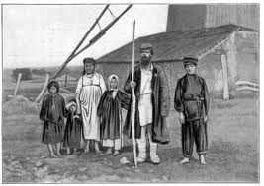
Czarist Russia
lagged behind the rest of Europe
technology was not as advanced
lacked modern industrialization
entered World War I and was not prepared for war
the nation was poor
many peasants were starving

Slide 4
Autocratic Rule
Alexander III
Czar from 1881 – 1894
Strict censorship
Russification
Could not use language other than Russian
Tried to eliminate minorities and “russify” everyone
Made jews the target of persecution – destroyed buildings
50 years before Hitler!!

Slide 5
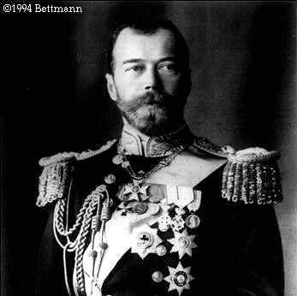
Russian Society under the Czar
Czar Nicholas II –absolute power
all documents were censored
Russian was the only legal language in the empire
Secret Police sent violators to Siberia

Slide 6
Nicholas II
Good, kind man but ineffective ruler
Out of touch with the people he ruled
Had never shown leadership skills or a particular desire to rule
Was mild-mannered, even meek
Lacked the personality of a leader
Avoided direct involvement with any opposition; simply ordered his security forces to get rid of any problem as they saw fit

Slide 7
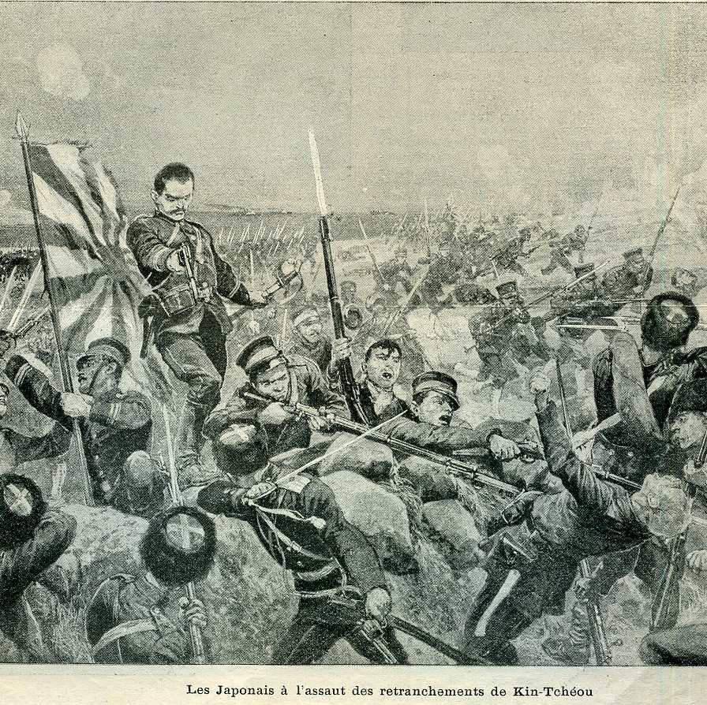
Crises at Home & Abroad
First Crisis: Russo-Japanese War
1904 - 1905
Competed with Japan for control of Korea and Manchuria (in China)
Russia broke the agreement with Japan
Repeated Russian losses when Japan attacked Russian ports
Sparked unrest at home

Slide 8
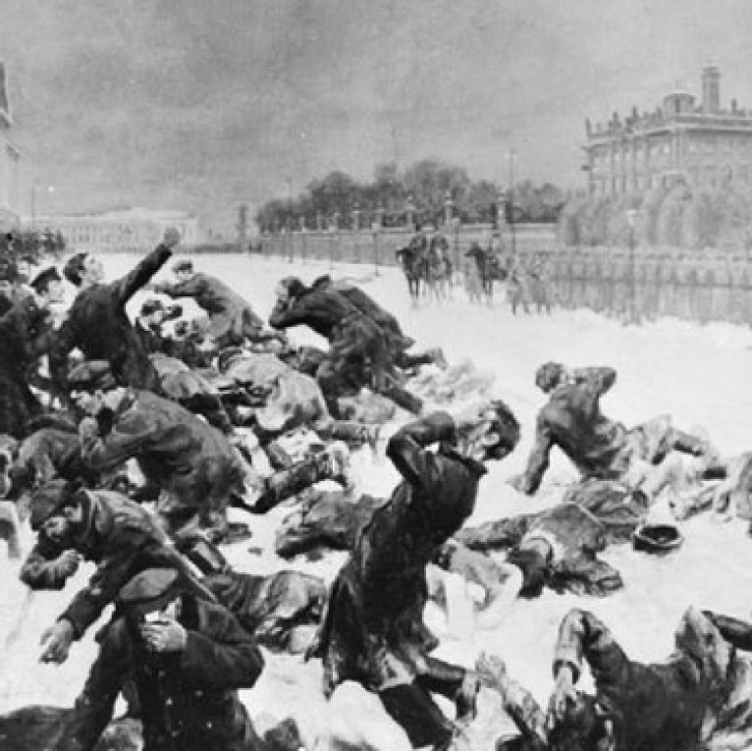
Crises at Home & Abroad
Second Crisis: Bloody Sunday on Jan. 22, 1905
200,000 workers and their families marched on the czar’s Winter Palace
Asked for better working conditions, more personal freedom, and elected national legislature
Soldiers fired on the crowd. Several hundred killed over 1,000 wounded.
A wave of strikes and violence spread
Nicholas II approved the Duma (Parliament), become like Britain. But dissolved it after 10 weeks, he did not want to share power.

Slide 9
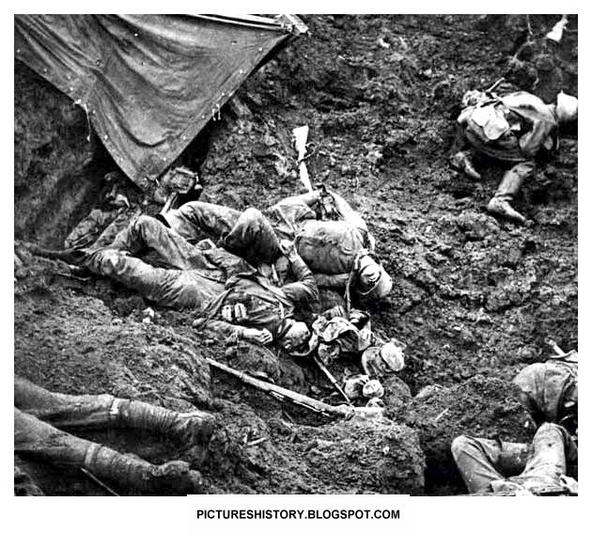
Impact of World War I
Russia Enters in 1914
exhausted more money and food away from Russia’s citizens to support the war effort
millions of Russians, both soldiers and civilians, suffered and died
the czar became more unpopular
people of all classes began calling for change in the Russian government

Slide 10
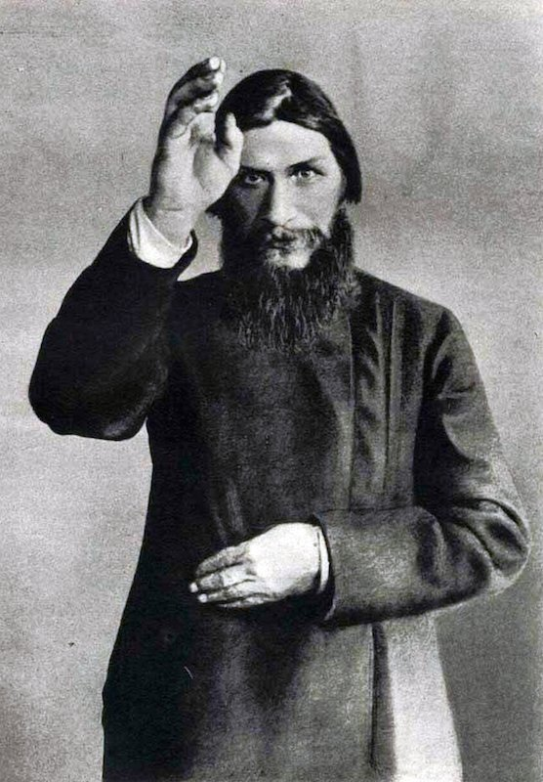
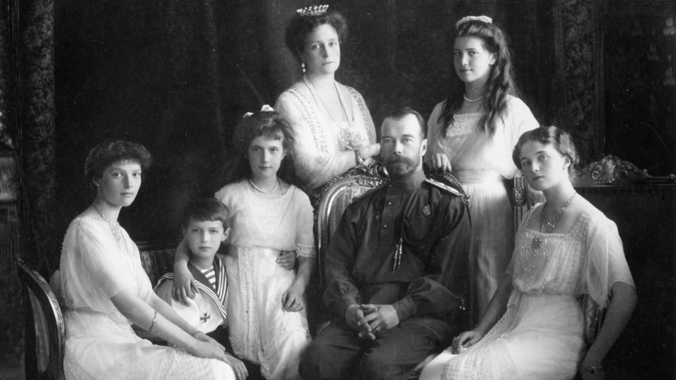
The Romanovs and Rasputin
Nicholas traveled to warfront to help morale
Wife Alexandria influenced by Rasputin
Mysterious holy man
Claimed to have magical healing powers
Helped ease Czar’s son Alexi’s hemophilia symptoms
Was allowed to make political decisions
Even prophesied that WWI would be a disaster for Russia!
Murdered by a group of nobles in 1916

Slide 11
Revolution Momentum in Russia

Slide 12
Industrialization leads to problems
Factory work consisted of terrible working conditions, child labor, low wages, and no unions
Revolutionary movements were starting

Slide 13
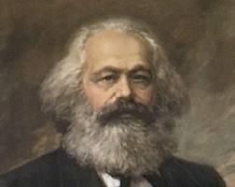
Karl Marx…..remember him?
Communism- a system in which all private property is owned by the community and shared by all.
He believed wealth should not be in the hands of a few.
The proletariats or working class should revolt and rule the country.

Slide 14
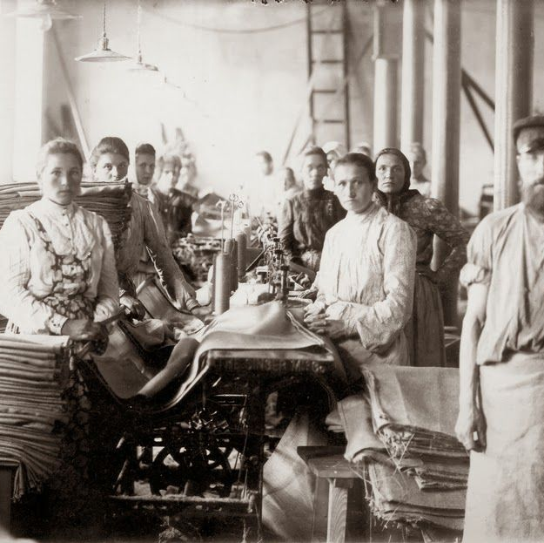
Revolutionary Movement Grows
Growth of factories brought new problems : grueling working conditions, 14 hr work days, low wages and child labor
Government outlawed trade unions but some strikes took place
A group following the teachings of Marx gained a following

Slide 15
Russian Marxists
Believed that the industrial class of workers, the proletariat, would overthrow the czar
1903 - a split occurred over tactics:
Mensheviks: more moderate, wanted popular support for change
Bolsheviks: Radical, would sacrifice everything for a change
Led by Lenin

