Slide 1
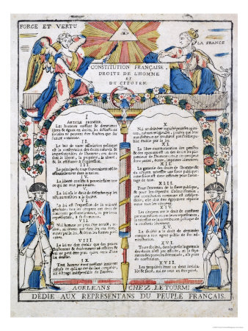
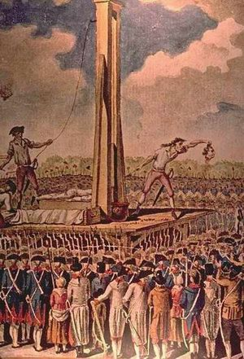
Reform and the Reign of Terror

Slide 2
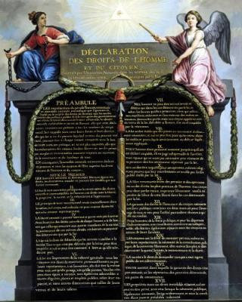
Initial Reforms
National Assembly enacts the Declaration of the Rights of Men and the Citizen in Aug. 1789
“All men are born and remain free and equal in rights”
“The aim of all political association is the preservation of the natural and imprescriptible rights of man. These rights are liberty, property, security, and resistance to oppression”
“ Law is the expression of the general will. Every citizen has a right to participate personally, or through his representative, in its foundation.”

Slide 3
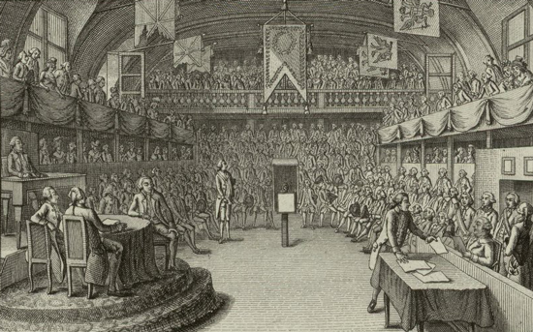
New Government
Legislative Assembly established Oct. 1791-Sept. 1792
Constitution of 1791
Constitutional monarchy
End of feudal privileges

Slide 4
Division within the Legislative Assembly
Radicals: wanted to drastically change the government, no monarchy
Sat on the left, therefore “left-wing”, also called liberals
Moderates: wanted some change, but not as drastically as radicals
Sat in the center, therefore “centerist”
Conservatives: wanted few changes, wanted to keep limited monarchy
Sat on the right, therefore “right-wing”

Slide 5
Differing Factions

Slide 6
Church in France
The Civil Constitution of the Clergy 1790
Sold land, paid off debt
Under state control
Creates divisions in France

Slide 7
Intranationational Conflict
Intranational: within a country
Conflicts between radical revolutionaries from the cities and conservative priests and peasants from the countryside
Between three main groups:
Émigrés, Sans-Culouttes, and Jacobins

Slide 8
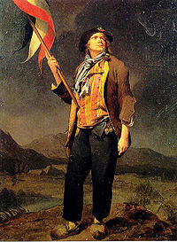
Émigrés
Those who had fled France, wished to restore Old Regime, conservative, royalists
Sans-Culottes
Radicals from the lower class, militant and violent
Jacobins
Radical, middle class, left-wing, implemented the Reign of Terror, somewhat supported the Sans-culottes

Slide 9
International Conflict
International: between countries
France declares war on Prussia, Russia and Austria in April 1792
Monarchs of Prussia and Austria wanted to reinstate monarchy
Britain, the Netherlands and Spain declare war on France in 1793

Slide 10
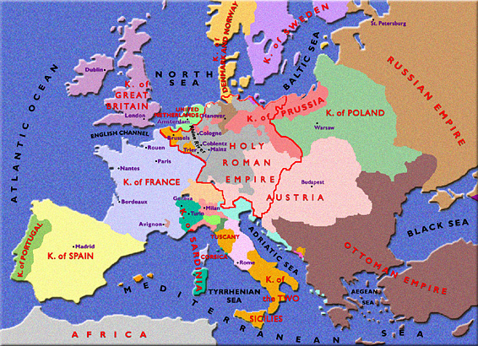
Map of Europe, 1793

Slide 11
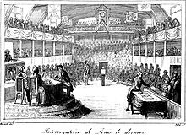
The National Convention
First ruling body of the First French Republic
Lasted from Sept. 1792 to Oct. 1795
First governing body elected by universal male suffrage
Suffrage: the right to vote
Created the Committee of Public Safety

Slide 12
Committee of Public Safety
Had absolute power to protect revolution
Initiated the Reign of Terror
Prepared France for war
Led by Maximilien Robespierre

Slide 13
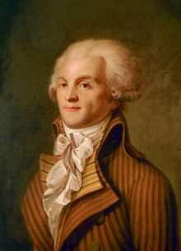
The Reign of Terror
Lasted from July 1793-July 1794
40,000 killed by guillotine
Mainly those who opposed the revolution
King Louis XVI killed on Jan. 21, 1793
Ended with death of Robespierre by guillotine in 1794

Slide 14
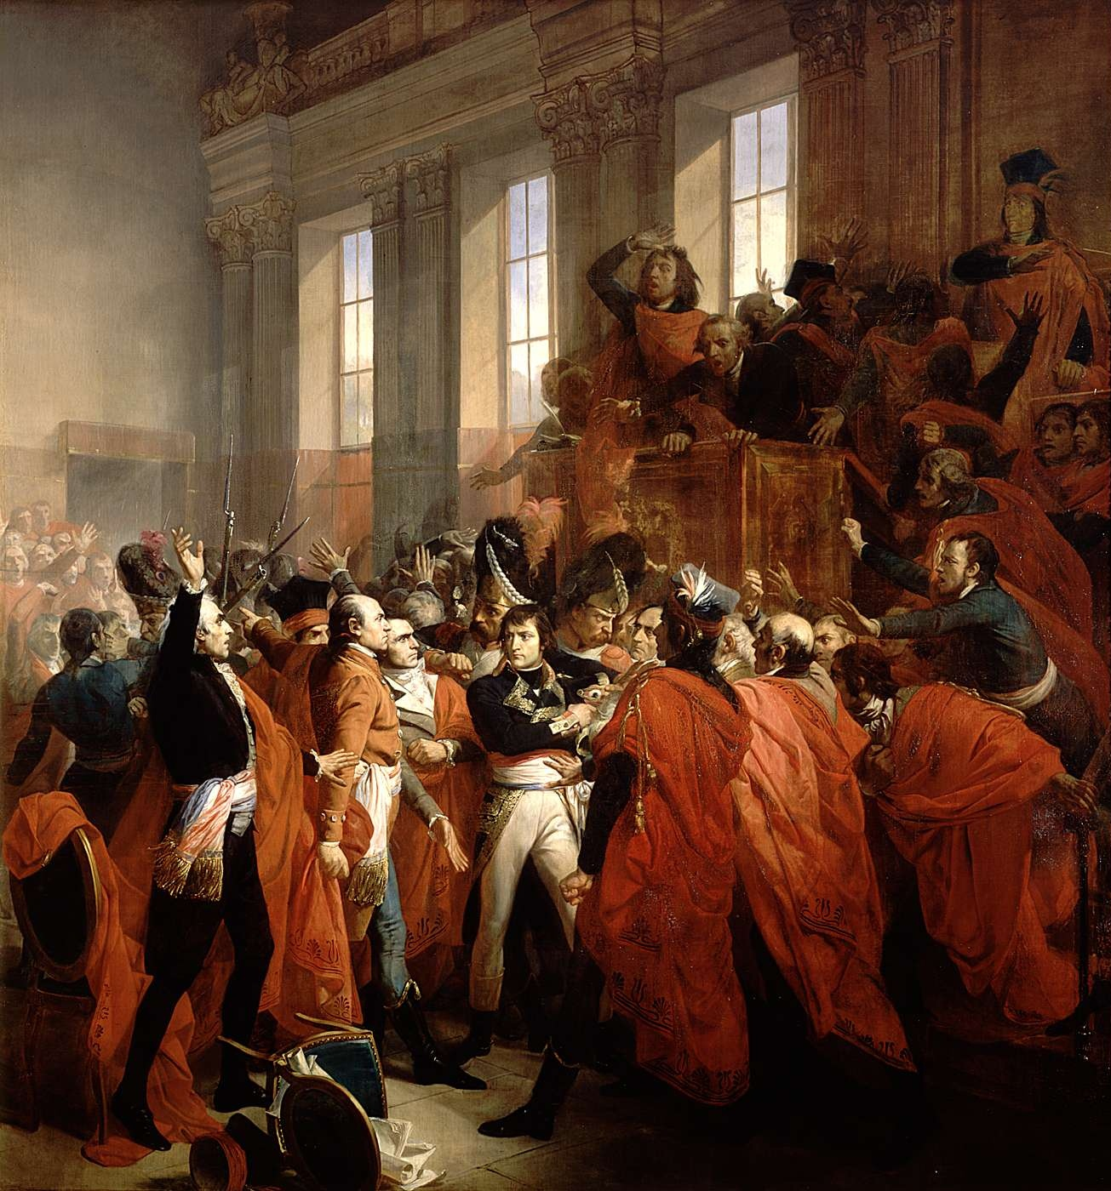
Reaction to Reign of Terror
The Constitution of 1795 enacted
Established the Directory
5 governing leaders and a bi-cameral legislature
Lasted from 1795-1799
Moderate rule
Weak rule, turned to military genius Napoleon Bonaparte for help

