Slide 1
Prices: Supply and Demand Combined cont.
Surplus
When price > equilibrium price, then quantity supplied > quantity demanded.
There is excess supply or a surplus.
Suppliers will lower the price to increase sales, thereby moving toward equilibrium.
How did American car companies respond to the recession?

Slide 2
Prices: Supply and Demand Combined cont.
Price of
Ice-Cream
Supply
Cone
Surplus
$2.50
2.00
Demand
0
4
7
10
Quantity of
Quantity
Quantity
Ice-Cream
demanded
supplied
Cones

Slide 3
Prices: Supply and Demand Combined cont.
Shortage
When price < equilibrium price, then quantity demanded > the quantity supplied.
There is excess demand or a shortage.
Suppliers will raise the price due to too many buyers chasing too few goods, thereby moving toward equilibrium.

Slide 4
Prices: Supply and Demand Combined cont.
Price of
Ice-Cream
Supply
Cone
$2.00
1.50
Shortage
Demand
0
4
7
10
Quantity of
Quantity
Quantity
Ice-Cream
supplied
demanded
Cones

Slide 5
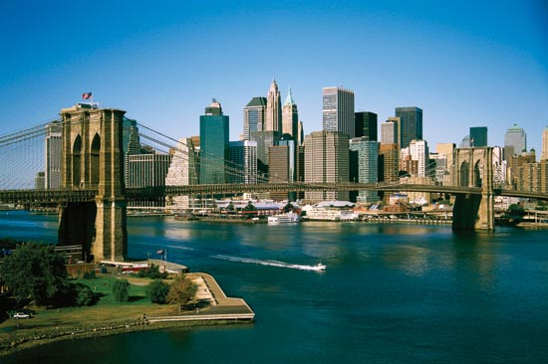
Essential Question 5
How do price floors and ceilings alter price and quantity?

Slide 6
Price Ceilings and Floors Tampering with the Laws of Economics
Price Ceiling
Maximum legal price that can be charged
Causes a Black Market to form
Why are scalpers able to make money at a football game?
Price Floor
Lowest legal price to be paid for a good
Why could the minimum wage be considered a bad thing?
Notes:
Encourages black market. Because of the shortage, it creates the incentive to develop a ‘black market’ where people illegally trade the good. People could buy the good at the low maximum price and then resell to those customers who were unable to buy. This is potentially quite lucrative as some of those customers who missed out may be willing to pay a very high price

Slide 7
Effects of a Price Ceiling
Price
Supply
$7
$5
Shortage
Demand
0
4
7
10
Quantity
Quantity
Quantity
supplied
demanded

Slide 8
Effects of a Price Floor
Price of
Corn
Supply
Surplus
$3
$1
Demand
0
4
7
10
Quantity of
Quantity
Quantity
Corn
demanded
supplied

