Slide 1
Productivity
Productivity is the ratio of inputs to outputs
For example, a company may ask, how many minutes does it take to produce one unit of a good? If the number of inputs (minutes) decreases while the unit of output (the good) remains the same, productivity increases
What increases productivity?
Investment in Human Capital and Technology
How did agricultural output change when farmers moved from animal powered plows to modern tractors?
How much more productive are you when you feel great versus when you are sick with a fever?

Slide 2
Oven Productivity

Slide 3
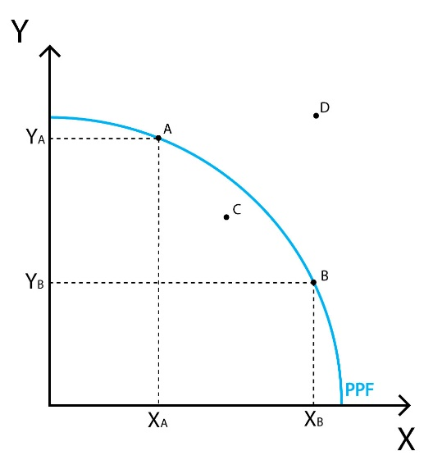
Principle #2: The Cost of Something Is What You Give Up to Get It.
The production possibilities frontier is a graph that shows the combinations of output that the economy can possibly produce given the available factors of production and the available production technology.
Notes:
14

Slide 4
Where do we get the info for the PPC?
Combination | Desks (X axis) | Trumpets (Y axis)
A | 0 | 18
B | 2 | 15
C | 7 | 10
D | 14 | 6
E | 20 | 0

Slide 5
The Production Possibilities Frontier
Quantity of
Computers
Produced
3,000
D
2,200
C
2,000
A
Production
possibilities
B
frontier
1,000
0
300
600
700
1,000
Quantity of
Cars Produced
Copyright©2003 Southwestern/Thomson Learning

Slide 6
Principle #2: The Cost of Something Is What You Give Up to Get It.
Concave shape of curve illustrates the concept of increasing opportunity costs
Not all resources are easily transferable

Slide 7
Principle #2: The Cost of Something Is What You Give Up to Get It.
Concepts Illustrated by the Production Possibilities Frontier
Efficiency
Tradeoffs
Opportunity Cost
Economic Growth
Increasing standards of living
Capital Investments
Human VS. Physical
Notes:
21

Slide 8
A Shift in the Production Possibilities Frontier
Quantity of
Computers
Produced
4,000
3,000
2,100
E
2,000
A
0
700
750
1,000
Quantity of
Cars Produced
Copyright © 2004 South-Western

