Slide 1
New Nations in Africa

Slide 2
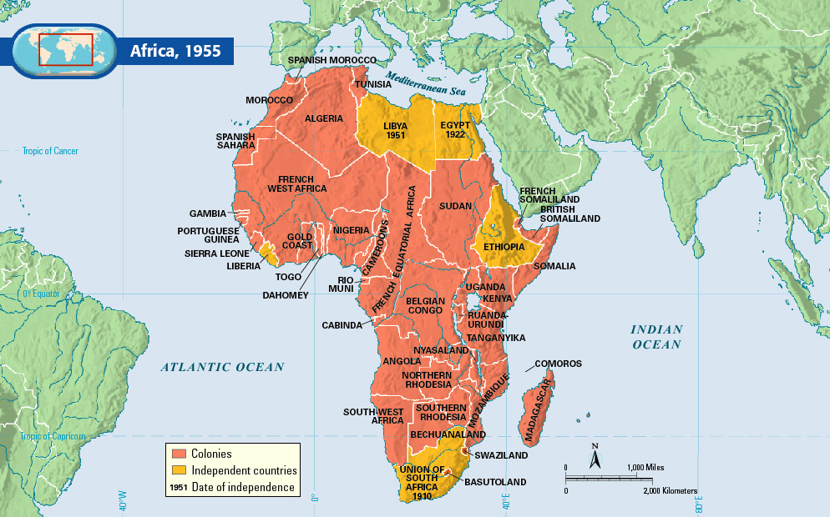

Slide 3
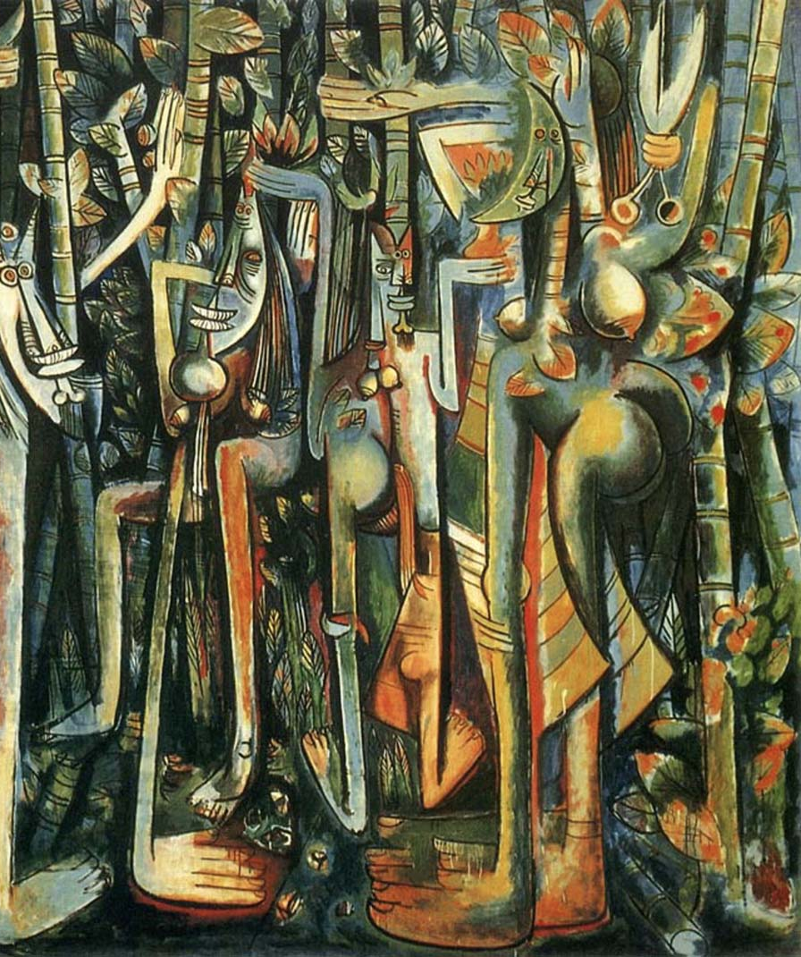
Effects of WWII
Many African soldiers fought alongside Europeans during WWII
Fueled unwillingness to accept colonial domination after war
Negritude Movement – movement celebrating African culture, heritage, and values

Slide 4
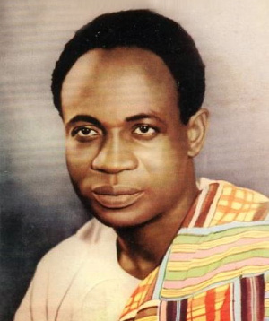
Gold Coast becomes Ghana
British colony becomes first colony south of the Sahara desert to achieve independence
Kwame Nkrumah – leader of largely non-violent movement
Gained independence in 1957, Nkrumah becomes “president for life”
Held first democratic election in 2000

Slide 5
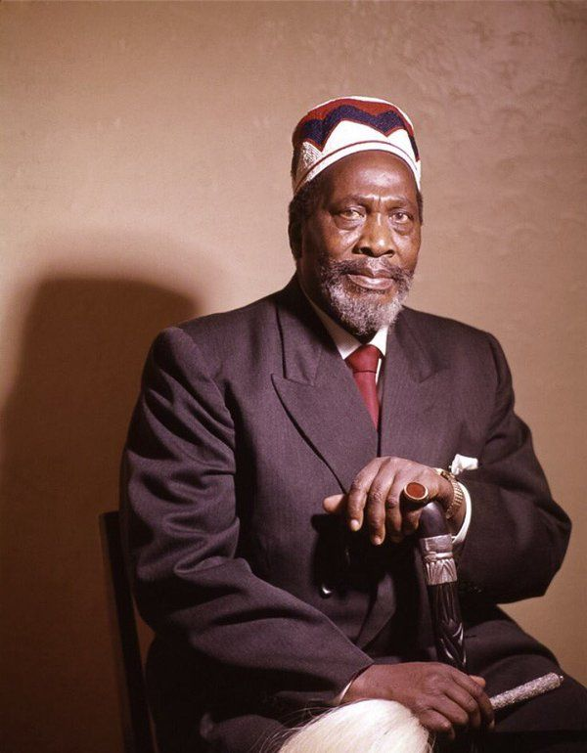
Kenya Claims Independence
Gained independence in 1963
Fighting with British took place because of prized farmland
British forced to accept self-government for two reasons
Leadership of Jomo Kenyatta
Mau Mau – secret society that used guerilla tactics

Slide 6
Additional Colonies Gain Independence
France
Senegal and Ivory Coast gain independence
Algeria – National Liberation Front fights and wins independence in 1962
Belgium
No intentions of letting colonies go
Congo becomes independent through violent protests
Mobutu takes control and builds dictatorship in Congo
Portugal
Guinea-Bissau, Angola, Mozambique all gain independence

Slide 7
South Africa
Colonized first by the Dutch and then the British, South Africa had been dominated by white minority rule.
White South Africans became known as Afrikaners and, despite the country being decolonized after WWII, held the majority of the wealth and power in the nation.
Over the next decades, Afrikaners instituted policies to retain their status under a system called Apartheid (“Apartness”).

Slide 8
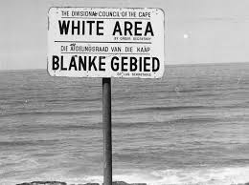
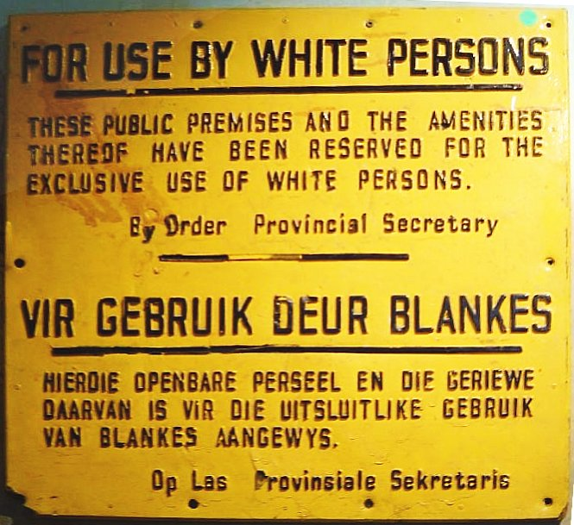
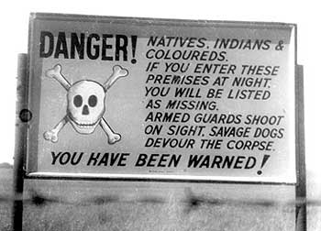

Slide 9
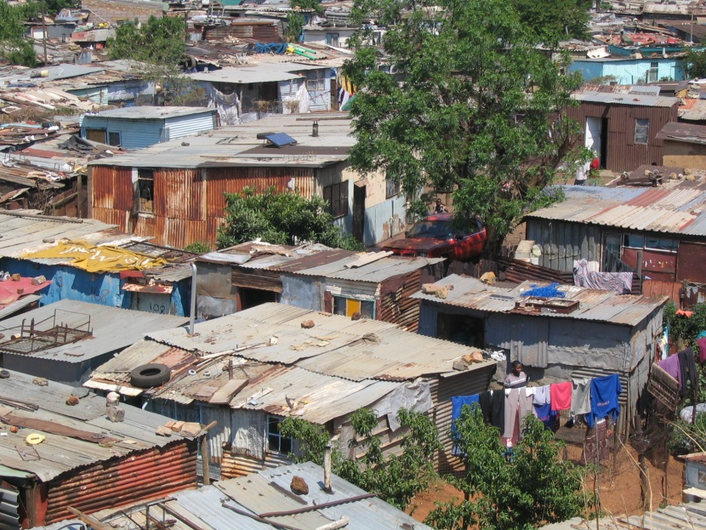
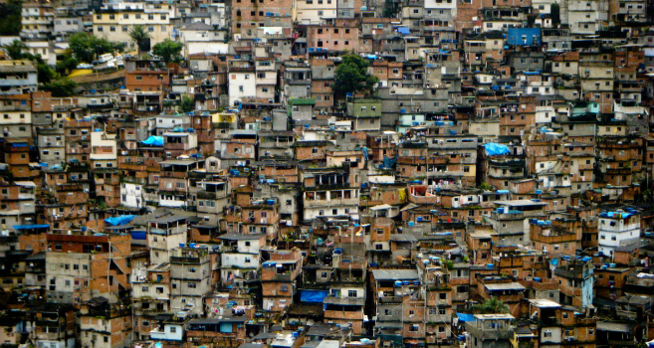
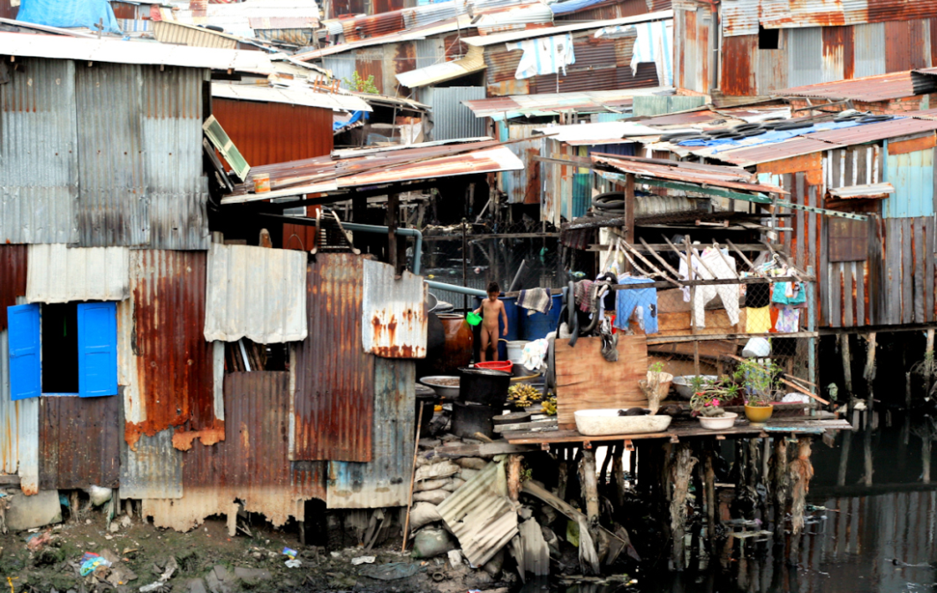
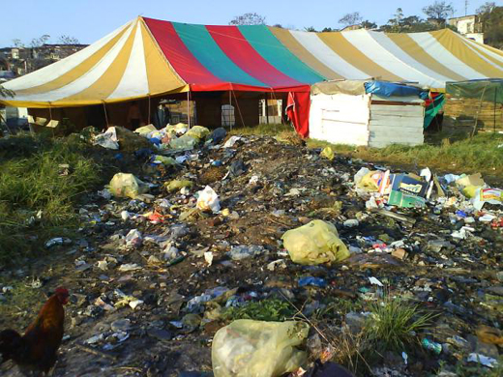

Slide 10
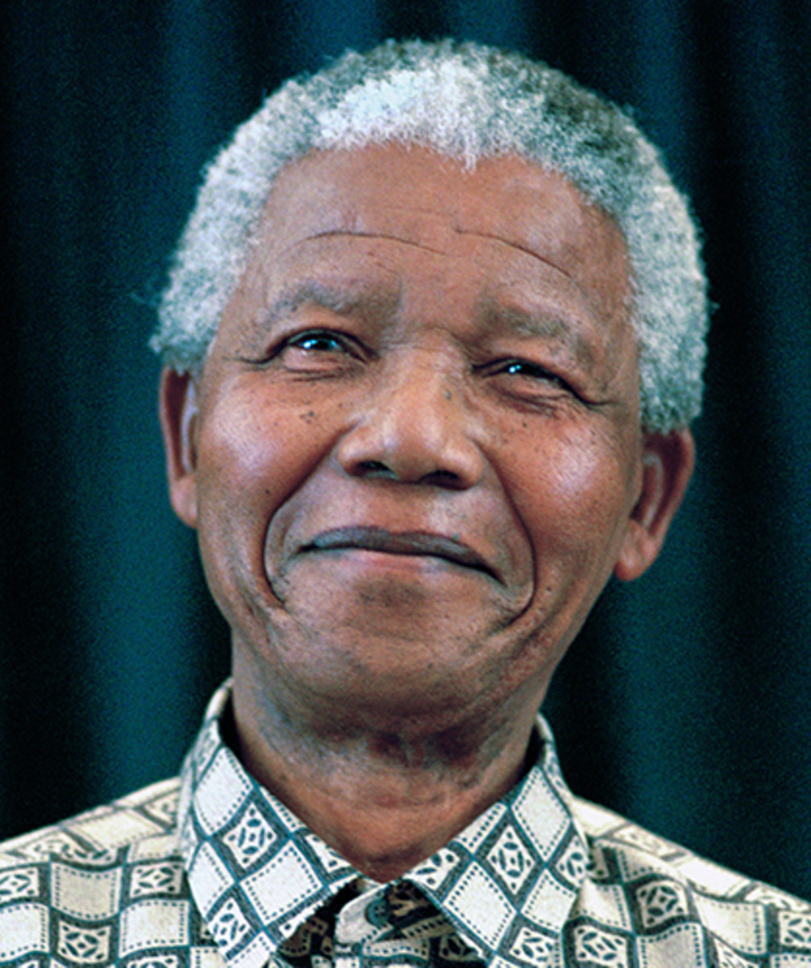
African National Congress (ANC)
Formed in 1912 by black South Africans
Designed to fight for freedom and rights
Organized strikes and boycotts
Most influential and famous leader was Nelson Mandela

Slide 11
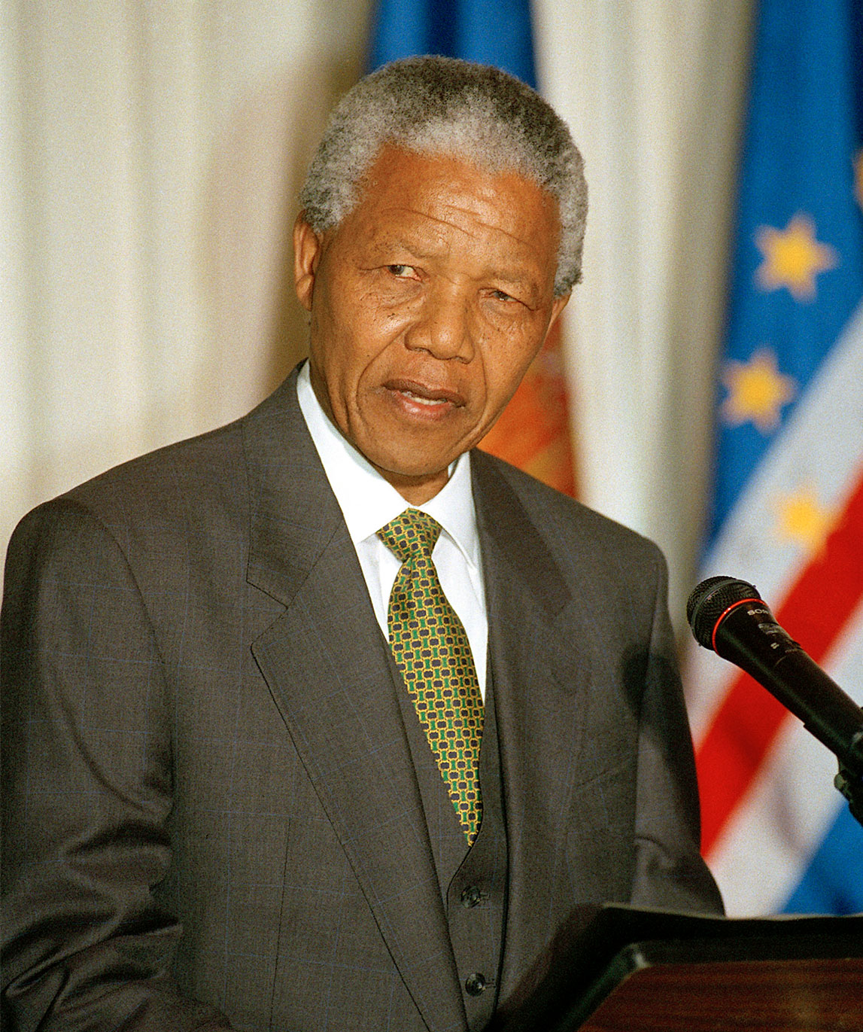
Nelson Mandela
The most famous anti-apartheid activist was Nelson Mandela. He was actively involved in the movement since the 1940s.
He was a supporter of nonviolent resistance and staged many peaceful protests that resulted in extreme government reactions.
He was arrested three times for attempting to overthrow the govt. The final arrest resulted in a guilty verdict at his trial and he was sentenced to life in prison and eventually served 27 years.

Slide 12
Apartheid Ends
South Africa becomes isolated from world due to apartheid
1989 – white South Africans elect new president F.W. de Klerk
De Klerk recognizes change needs to be made
1989 – 1990 - Klerk legalizes ANC and releases Nelson Mandela from prison

