Slide 1
Nationalism and Revolution
India, China, and Africa

Slide 2
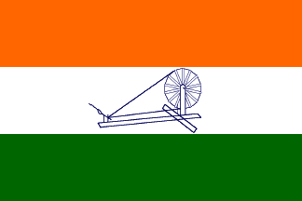
India
Spinning wheel is a symbol of Indian resistance to British Rule

Slide 3
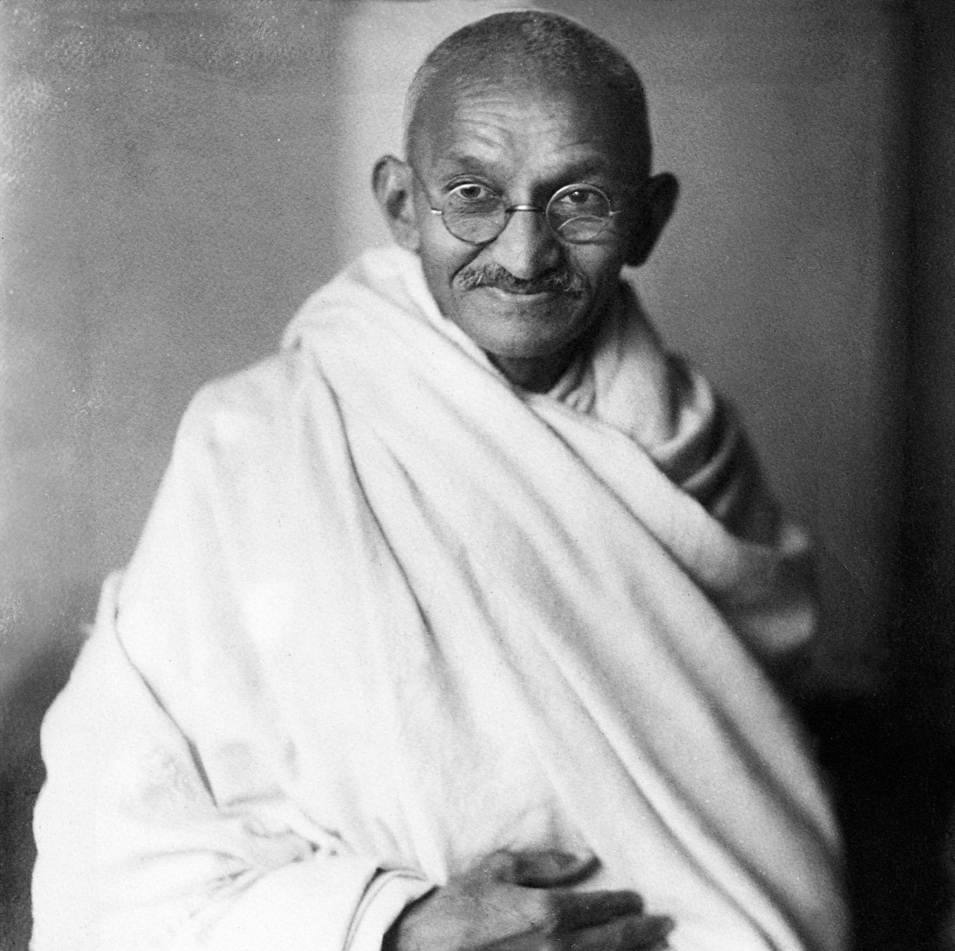
Mohandas K. Gandhi
Leader of independence movement from Britain in India
Teachings blended ideas from all major religions
Mahatma – “great soul”
Promoted civil disobedience
Deliberate and public refusal to obey an unjust law
Nonviolent

Slide 4
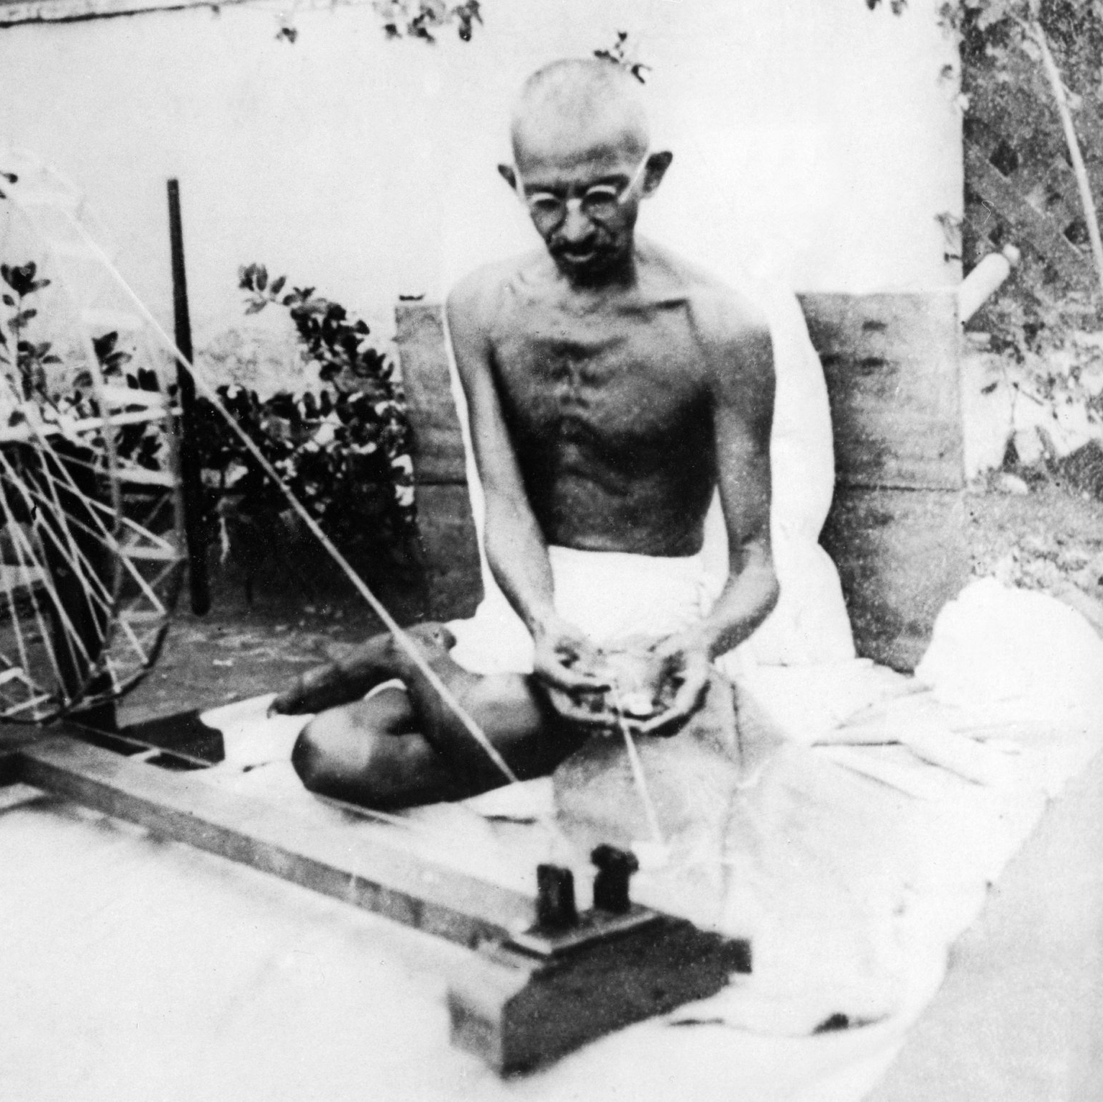
Movements Led By Gandhi
Boycotts
British cloth
Indians bough British cloth rather than India cloth, which left many farmers in poverty
Spinning wheel
Strikes and demonstrations
Refusal to work, causes disruptions in British factories and industries
Days of prayer and fasting
Led to shut down of Indian commerce

Slide 5
Partition
British experience heavy war debt after WWII, rethink having massive colonies
British left with decision after WWII – who gets power in India?
Muslims or Hindus?
Partition – dividing Indian subcontinent into two separate Hindu and Muslims nations
1947 – Hindu India and Muslim Pakistan were created
10 million people on move, trying to decide where to live
Violence between Hindus and Muslims

Slide 6
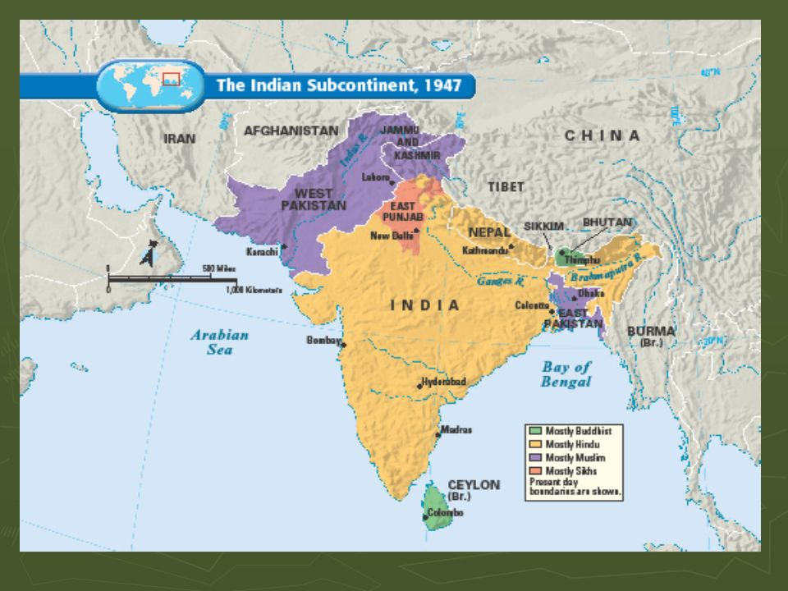

Slide 7
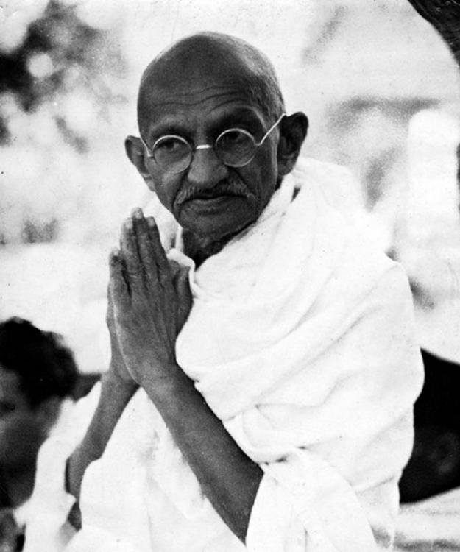
Death of Gandhi
Gandhi upset with fighting between Hindus and Muslims
Travels to Indian capital of Delhi to plead for fair treatment of Muslim refugees
Hindu extremist that thought Gandhi was too protective of Muslims shoots and kills him on January 30th, 1948

Slide 8
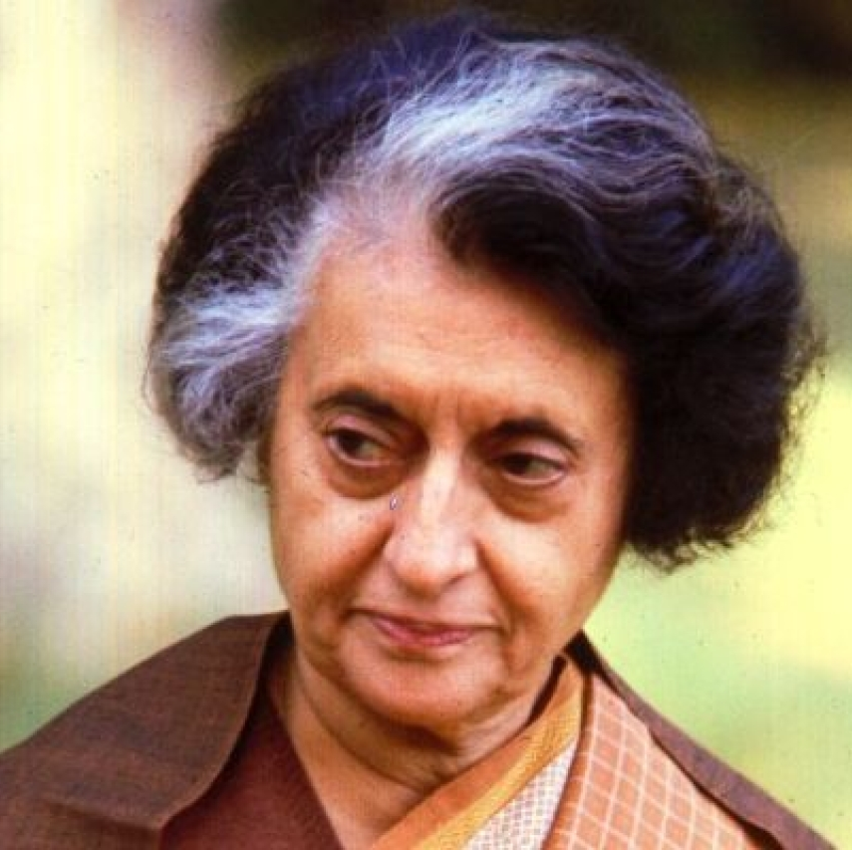
More Conflict
The Battle for Kashmir
Hindu ruler, majority Muslim population
Began fighting over land after gaining independence
Fighting still continues today
Sikhs fight for self-rule
Sikhism – religion formed in 15th century in northern India
Movement squashed by India Prime Minister Indira Gandhi

Slide 9
China
VS

Slide 10
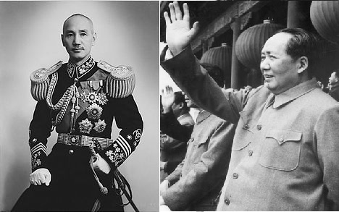
Chinese Civil War
Communists
Led by Mao Zedong (right pic)
Nationalists
Led by Jiang Jieshi (left pic)
Communists in control of China after World War II
Both sides paused fighting during World War II in order to defeat invading Japanese (common enemy bringing sides together)

Slide 11
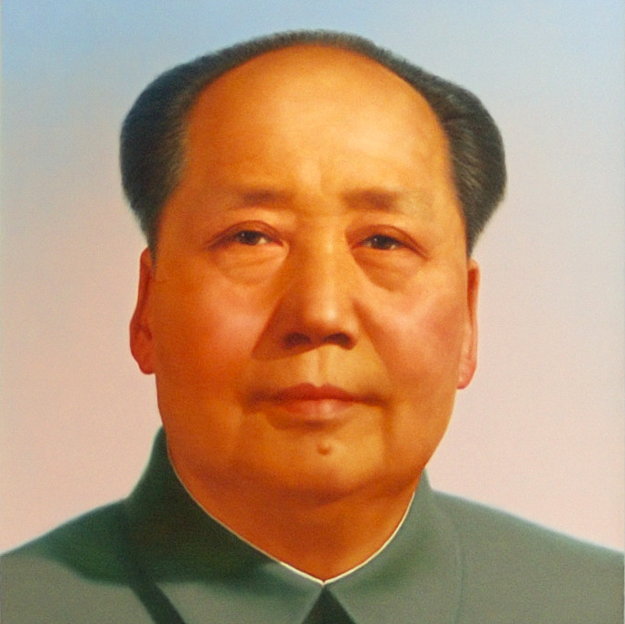
Mao Controls China
By October 1949, Mao Zedong and Communists victorious in China
Establishes Peoples Republic of China
Jiang and Nationalists flee to Taiwan
Communist victory fuels U.S. anti-Communist feelings

Slide 12
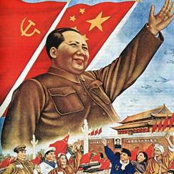
Mao’s Five Year Plan
Goal was to reform agriculture and economy
80% of people lived in rural areas, but only 10% controlled land
Agrarian Reform Law of 1950
Mao seized landlord holdings
Successfully redistributed land, but his army killed over a million land lords
Transformed industry and business as well
Coal, cement, steel, and electricity had increased dramatically

Slide 13
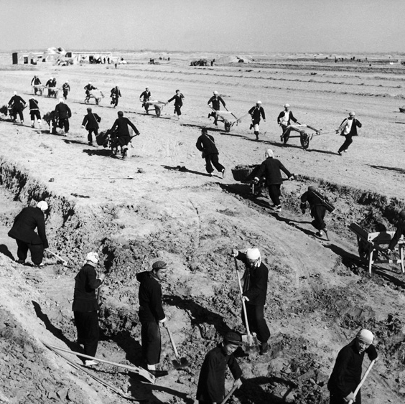
Great Leap Forward
Plan was for larger collective farms, called communes
Average commune ad 15,000 acres and 25,000 people
Strictly controlled peasant life
Millions died from starvation
Giant step backwards
Poor planning

Slide 14
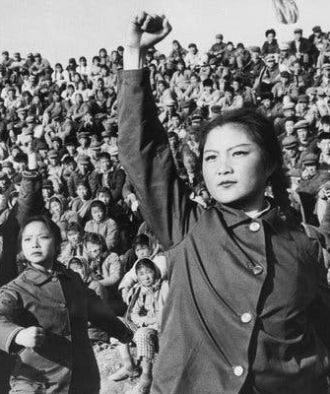
Cultural Revolution
1966
Started by Mao after the unsuccessful Great Leap Forward
Encouraged China’s young people to “learn revolution by making revolution”
Goal was to establish a society of peasants and workers where all were equal
Intellectual and artistic activity were considered dangerous – schools shut down

