Slide 1
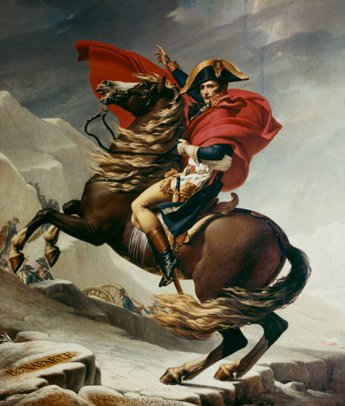
Napoleon
“He was like an expert chess player, with the human race for an opponent, which he proposed to checkmate”
-Madame Germaine de Stael

Slide 2
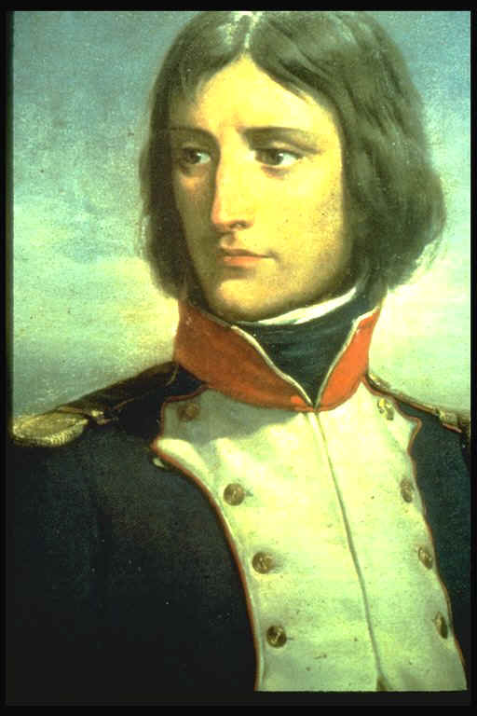
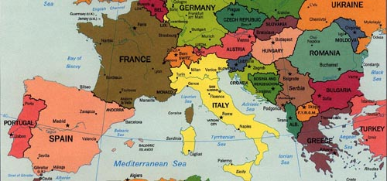
Napoleon’s beginnings
Born in Corsica in 1769
Trained at a military academy since age 9
Rose quickly in the army
Favored Jacobin ideals

Slide 3
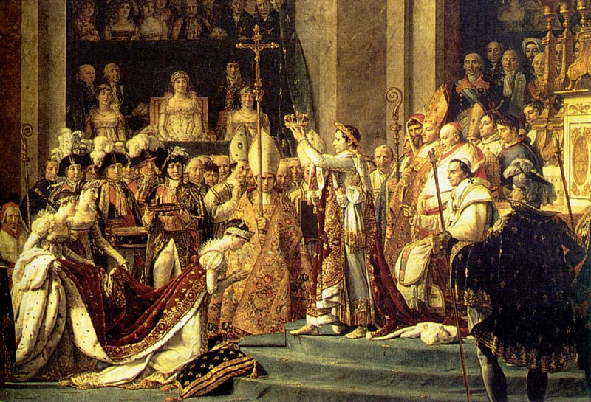
From General to Political Leader
Overthrows the Directory in 1799
Coup d’Etat
Sets up the Consulate
A three man governing board with Napoleon as First Consul
Names himself Emperor in 1804

Slide 4
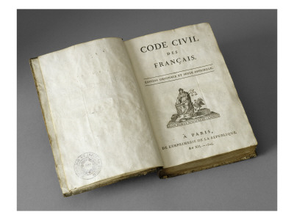
France Under Napoleon
Reforms
Church
The Concordant of 1801
Recognized Catholic church’s influence but did not allow church involvement in politics
Legislative
The Napoleonic Code
Religious tolerance, equality before the law, and merit power
Valued order and authority over individual rights

Slide 5
Empire of Napoleon
Brilliant military general
Annexed large parts of western Europe
Signed peace treaties with Russia, Austria, and Prussia
Failed battle in Egypt
Aimed at disturbing British trade routes to India
Admiral Horatio Nelson
Main enemy was Great Britain

Slide 6
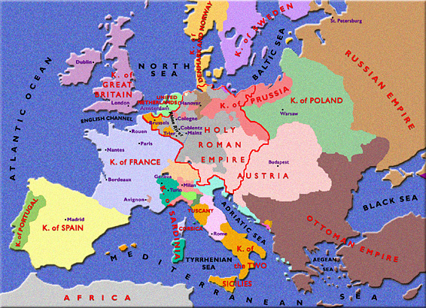
Europe in 1789, prior to French Revolution

Slide 7
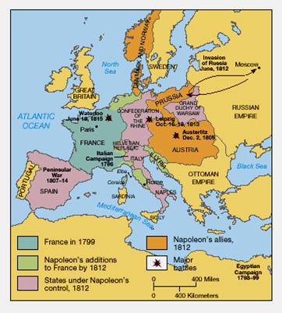
Europe in the peak of Napoleon

Slide 8
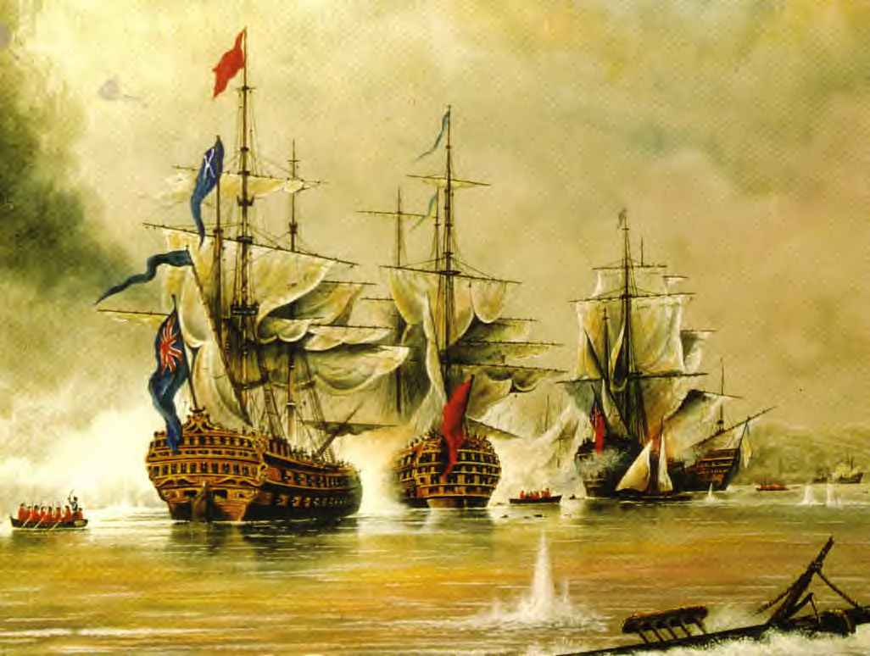
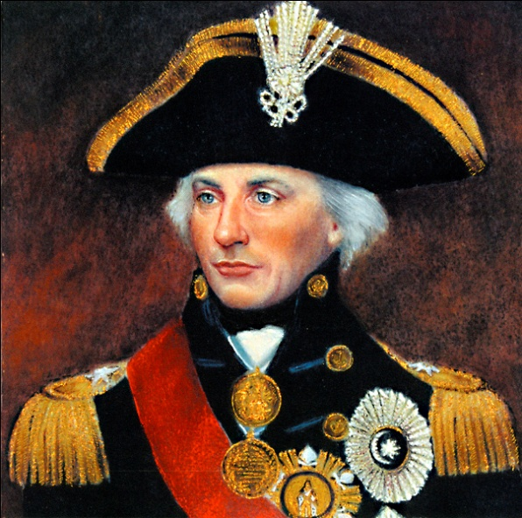
The Battle of Trafalgar
Oct. 21, 1805
Naval battle off the coast of Spain
Only major defeat for Napoleon
Against Britain
Established British naval dominance for next 100 years
Napoleon would not invade Britain

Slide 9
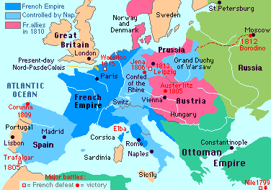
Napoleon’s Empire begins to decline
Empire was large but unstable
Napoleon had large desire for power which led to his downfall
Napoleon had three costly mistakes

Slide 10
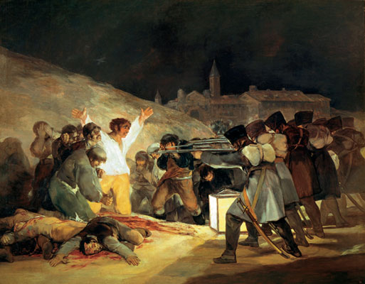
The Peninsular War
Napoleon marched through Spain to Portugal
Spanish people’s reactions:
Nationalism
Fear of Napoleon’s potential attacking of Catholic Church
Guerilla Warfare
Surprise attacks by small groups

Slide 11
The Continental System
Aimed to make Europe self-sufficient and hurt British trading economy
Set up a blockade
A forced closing of sea ports
Proved ineffective due to poor enforcement
British set up own blockade
Main cause for War of 1812 between USA and Britain

Slide 12
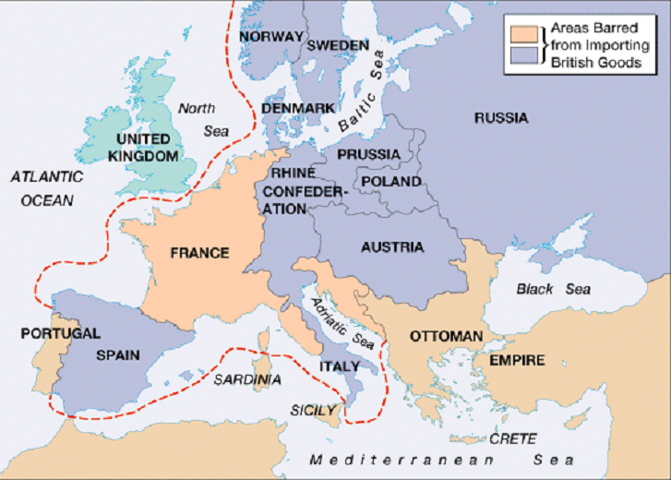
Naval Blockade

Slide 13
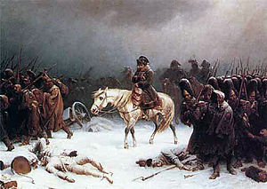
The Invasion of Russia
Breakdown of Franco-Russian alliance
Napoleon decides to invade in June 1812
Russian’s practiced scorched-earth policy
The burning of grain fields and killing of livestock as the army retreats, thus leaving no food for the incoming army
Started with 420,000 soldiers and returned to France with 10,000

Slide 14
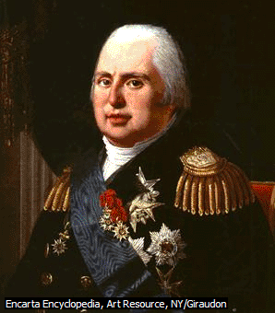
Downfall of Napoleon
Following failure of Russian invasion, Napoleon abdicates power
Napoleon exiled to Elba
Louis XVIII made king of France
Population is not loyal to the King
Fear he will reinstate the Old Regime due to Émigré influence

Slide 15
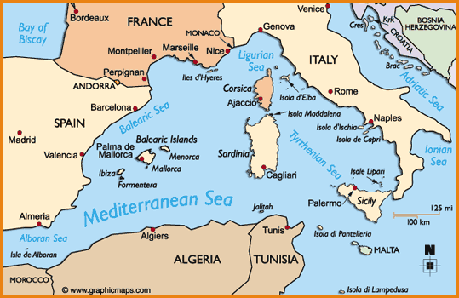

Slide 16
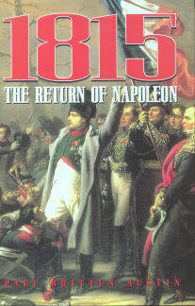
The Hundred Days
People were not loyal to King Louis XVIII
Napoleon escapes from Elba and returns to Paris
Napoleon’s last bid for power
Becomes Emperor of France again, but only for 100 days until the Battle of Waterloo

Slide 17
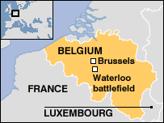
Battle of Waterloo
Fought on June 18,1815
French vs. British and Prussians
Napoleon’s final defeat
Ends Napoleon’s rule
He is exiled to St. Helena
Napoleon dies in 1821

Slide 18
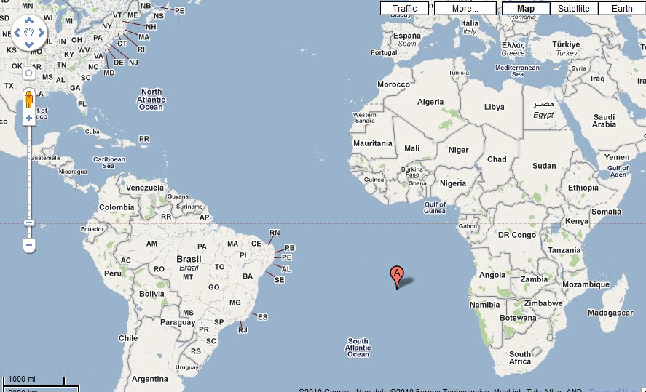

Slide 19
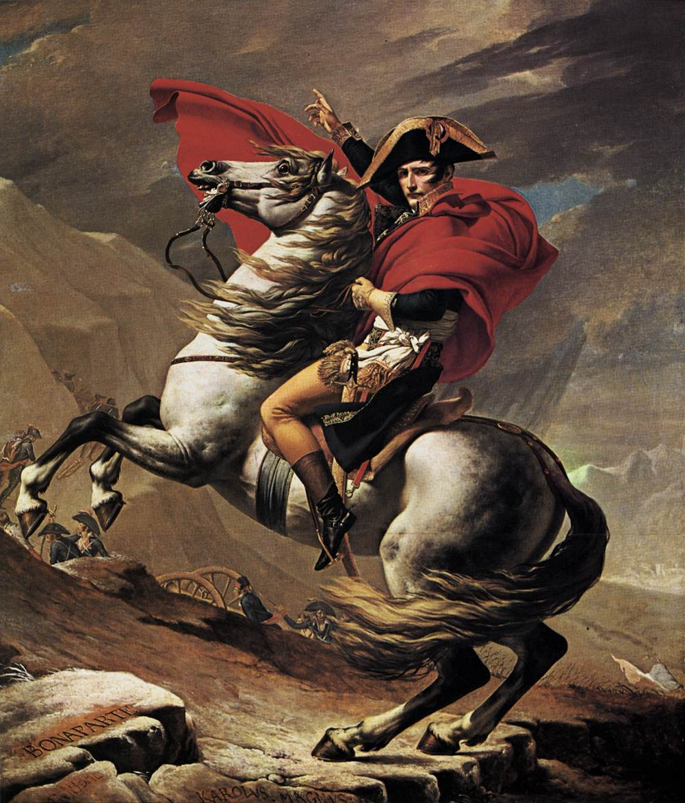
Legacy of Napoleon
Brilliant military general
Great administrator
Centralized government
However, many individual rights of Revolution were revoked
Power hungry
Millions of lives lost in his conquests
Louisiana purchase doubled U.S.A

Slide 20
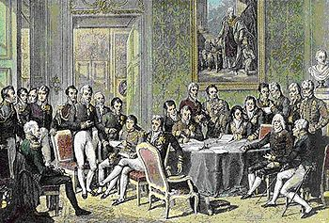
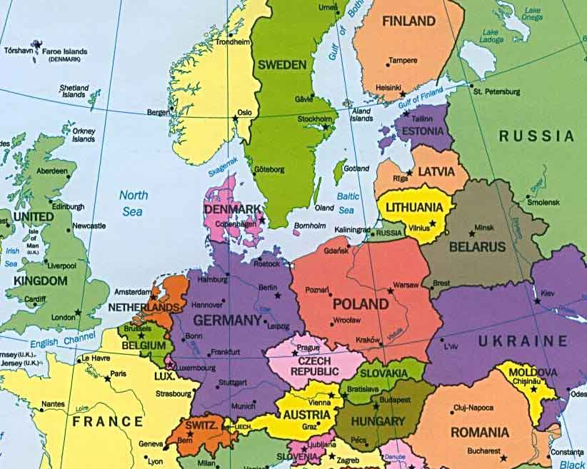
Congress of Vienna
10 month meeting of diplomats and heads of state in Vienna, Austria from Sept. 1814 to June 1815
Aimed to restore order to a war-torn Europe
balance of power and protection of monarchy system
Leaders were Clemens von Metternich, Czar Alexander I, Lord Robert Castlereagh

Slide 21
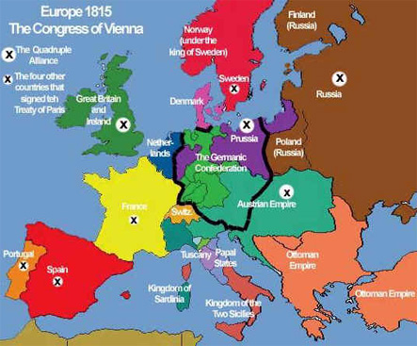
Europe following Congress of Vienna, 1815

Slide 22
Congress of Vienna
Balance of Power
Contain French expansion by putting strong countries around it (the Netherlands, Prussia, Austria)
Stability
Put “legitimate” monarchs back on the throne in Portugal, Spain, and Italy
Provided peace and stability for 100 years

Slide 23
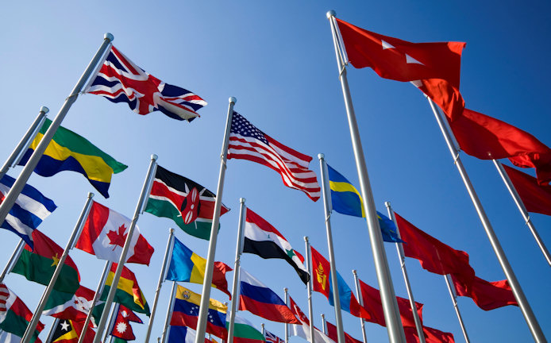
Beginnings of Nationalism
Napoleon and French Revolution would stir feelings of nationalism in Europe and Latin America
New borders from Congress of Vienna would cause internal conflicts

