Slide 1
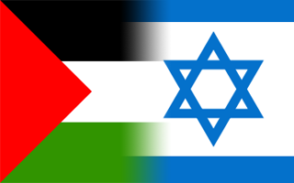
Palestine – Israel 101
At the heart of this conflict is a dispute over land and borders.
Notes:
two historically
related groups of people living in the same geographic area and who should possess it now or at
the very least how to share it.

Slide 2
SSWH20 Demonstrate an understanding of the global social, economic, and political impact of the Cold War and decolonization from 1945 to 1989.
b. Describe the formation of the state of Israel and the Arab-Israeli Conflict.

Slide 3
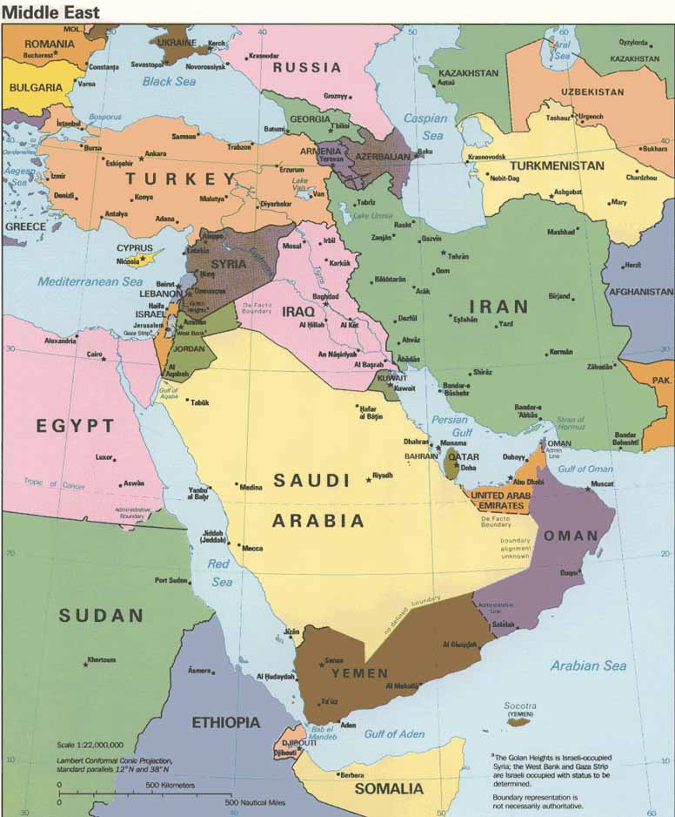

Slide 4
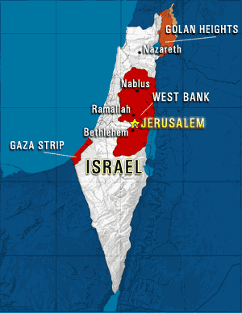

Slide 5
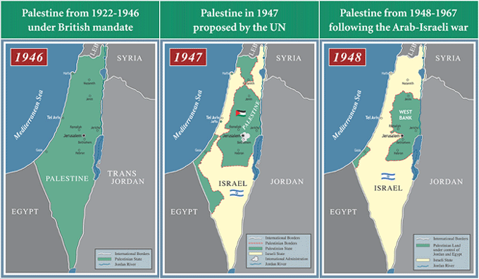
The land of Palestine was inhabited by Palestinian Arabs
400,000 Muslims – 80%
75,000 Christians – 15%
25,000 Jews – 5%
1850
For centuries these groups had lived in harmony

Slide 6

Zionism
In the late 1800s; Extremist European Jews decided to colonize Palestinian land
They wanted to create a Jewish homeland
As more and more Zionists immigrated the indigenous population became increasingly alarmed
Eventually, there was fighting between the two groups.

Slide 7
1947 – The UN gets involved
In the aftermath of WWII and the Holocaust the, UN gave 55% of Palestine to a newly created Jewish State – Israel
  Zionist Jews were 30% of the population and owned only 7% of the land

Slide 9
1948: Arab Israeli War
VS
90,000 European-trained Zionist soldiers possessing modern weaponry
30,000 ill-equipped, poorly trained Arab soldiers

Slide 10
Israel conquered 78% of Palestine
Created nearly 1 million Palestinian refugees Nakba
Over 400 towns and villages were destroyed
Every city, river, and hill received a new Hebrew name
Denied the existence of Palestine

Slide 11
Brief Historical Background

Slide 12
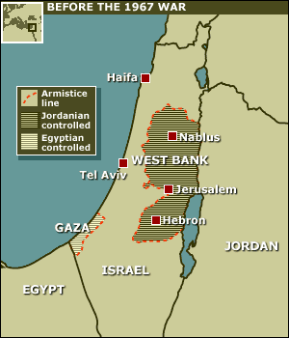
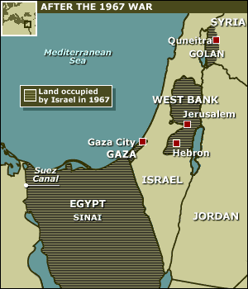
1967: Six Day War
Israel conquered more land by launching a highly successful attack
Occupied additional 22% of Palestine – The West Bank and the Gaza Strip

Slide 13
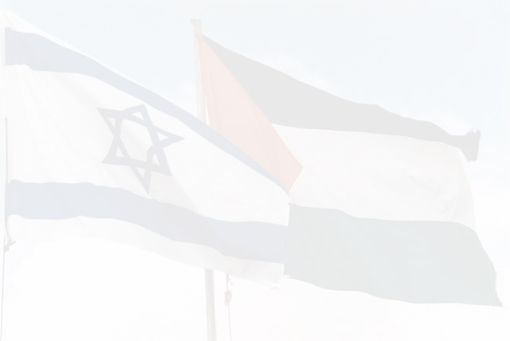
Recognizing the Two Sides
The Palestinian Side:
Fear of Dispossession / 20th Century Jewish Immigration
57-year Occupation
Spiritual connection to the Holy Land

Slide 14
Recognizing the Two Sides
The Jewish Side:
History of Jewish Persecution
Holocaust
Israel as Jewish ‘Safe Haven’
Spiritual connection to the Holy Land

Slide 15
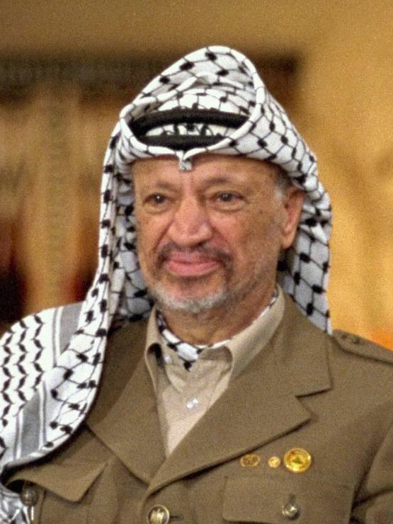
Palestine Liberation Organization (PLO)
Formed in 1964
Wanted Arab Palestinian state that included all of Israel
Became dominated by guerrilla groups that believed armed struggle was only way to go
Yasir Arafat
  Became chairman in 1969
  Led numerous terrorist attacks against Israel

Slide 16
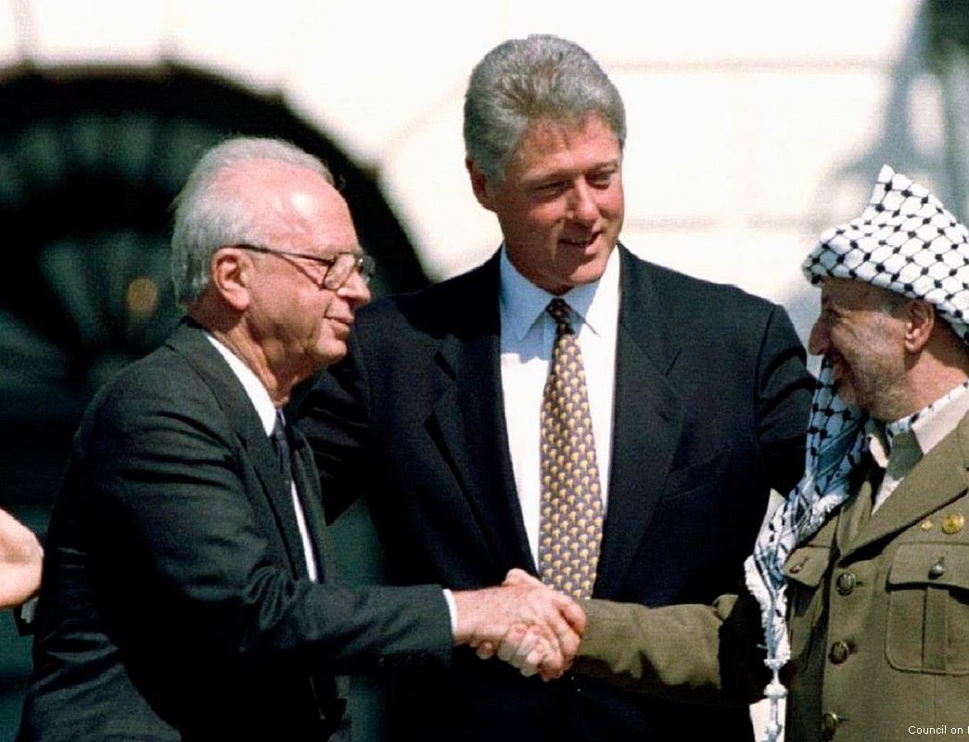
Oslo Peace Accords
1993 in Oslo, Norway
Israel agrees to Palestine self-governing Gaza Strip and West Bank
Palestinians agree to end violence and recognize Israel

Slide 17
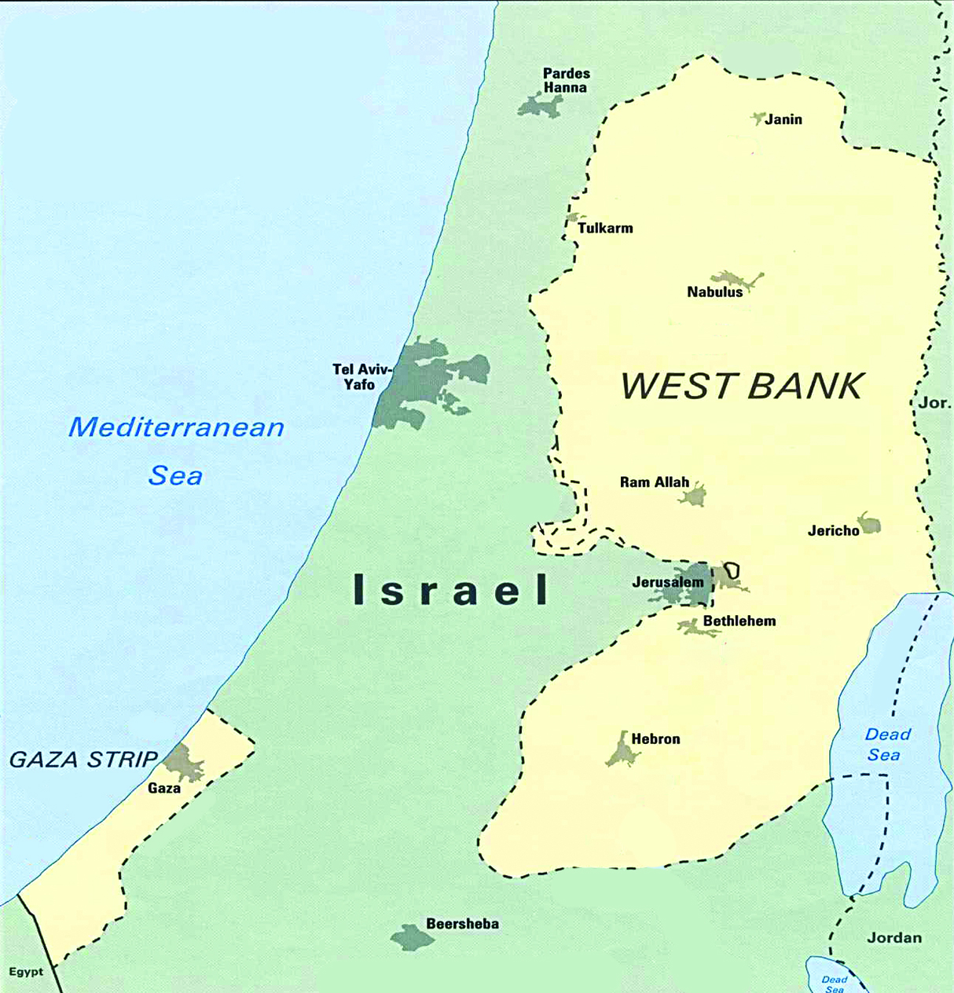
Oslo Accords Rejected…Why?
Both Jews and Arabs rejected Oslo accords
  Jews because Israel gave up land
  Arabs because they didn’t secure their own state
2003 – USA, Russia, European Union, and United Nations present a “road map for peace”
Little progress has been made, as peace and recognition are still fought over

