Slide 1

Inflation

Slide 2

What is INFLATION?
= is when the buying power of money goes down and prices go up without additional goods/services being produced.

Slide 3
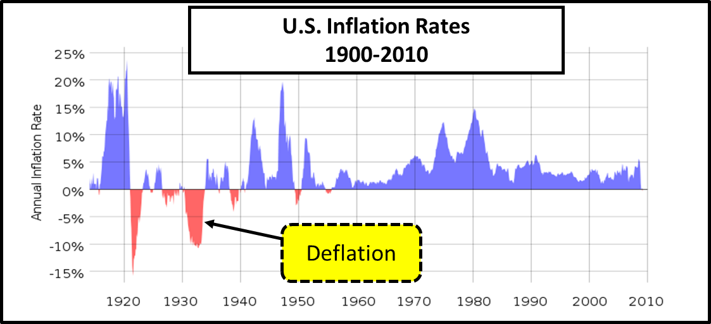
What is DEFLATION?
= is when prices fall and the value of money increases.
Dramatic periods of deflation in the U.S. are rare. The last major period of deflation was from 1930 to 1933, which was during the Great Depression.

Slide 4
How Prices Change
Inflation from 1930-2013
Year | New Home | Wages | New Car | Gallon of Gas | Loaf of Bread | Hamburger Meat
1930 | 3,845 | 1,979 | 600 | 10 cents | 9 cents | 12 cents
1940 | 3,920 | 1,725 | 850 | 11 cents | 10 cents | 20 cents
1950 | 8,450 | 3,210 | 1,510 | 18 cents | 12 cents | 30 cents
1960 | 12,700 | 5,315 | 2,600 | 25 cents | 22 cents | 45 cents
1970 | 23,450 | 9,400 | 3,450 | 36 cents | 25 cents | 70 cents
1980 | 68,700 | 19,500 | 7,200 | 1.19 | 50 cents | 99 cents
1990 | 123,000 | 28,960 | 16,950 | 1.34 | 70 cents | 89 cents
2008 | 238,000 | 40,523 | 27,958 | 2.051 | 2.79 | 3.99
2013 | 289,000 | 44,321 | 31,352 | 3.80 | 1.98 | 4.68

Slide 5
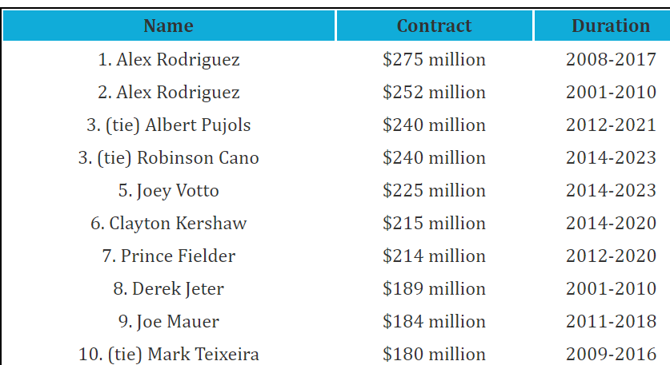
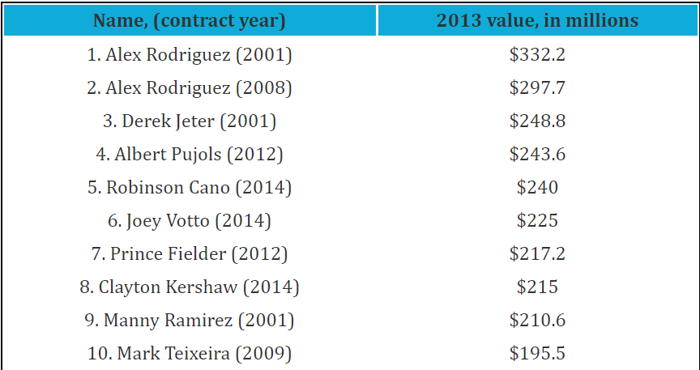
Anticipated v. Unanticipated
Baseball Salaries
Not adjusted for inflation
Adjusted for inflation

Slide 6
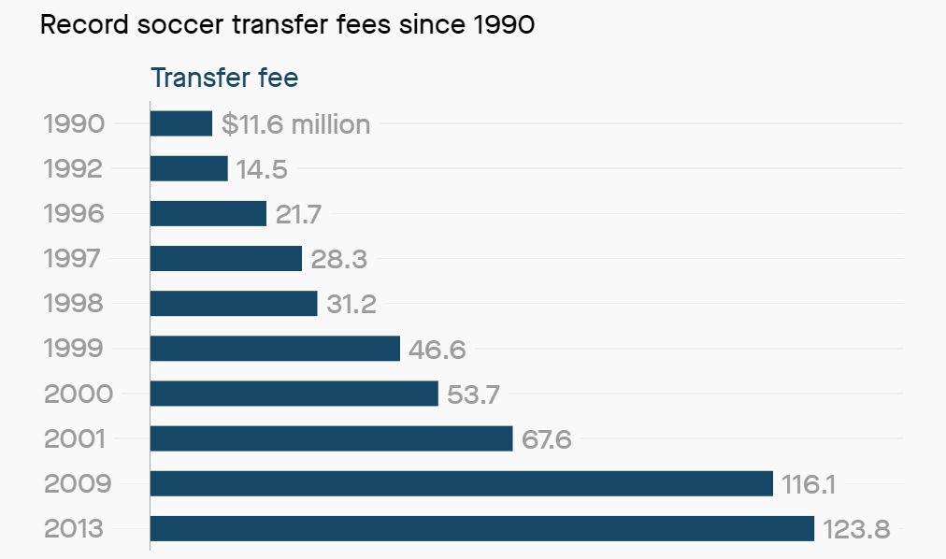
Anticipated v. Unanticipated
Soccer Transfers

Slide 7
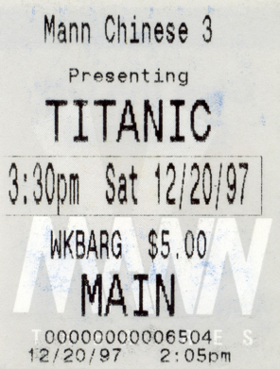

Anticipated v. Unanticipated
Creeping
1-3% a year and healthy
(Anticipated)

Slide 8
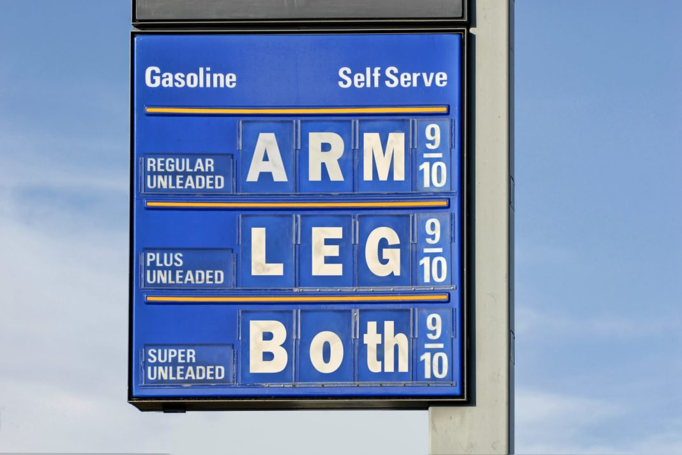
Anticipated v. Unanticipated
Chronic
Changes month to month
Ex. Recent gas prices
11/16/10 $3.07
5/09/11 $4.29
39% increase.
10/9/12 4.75
11/28/12 3.83
24% decrease.

Slide 9
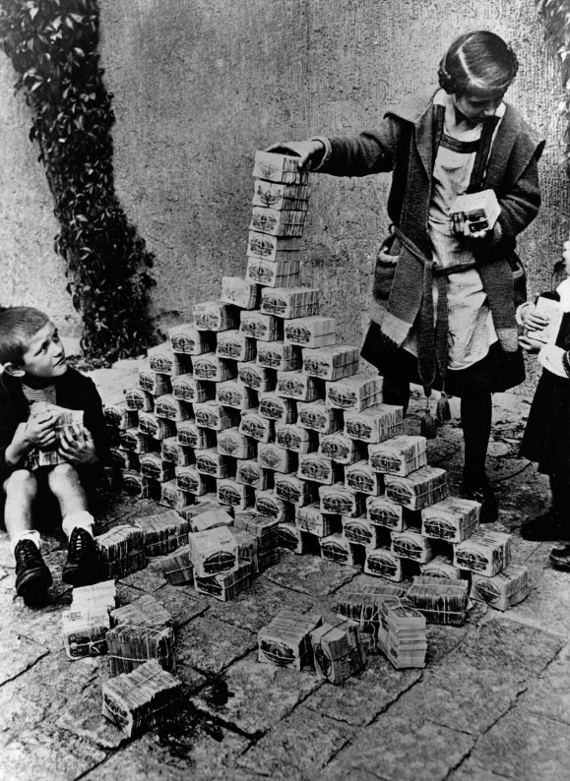
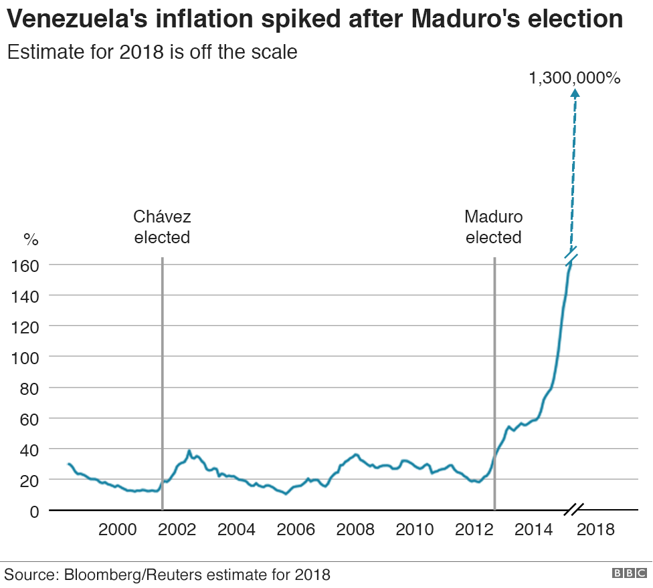
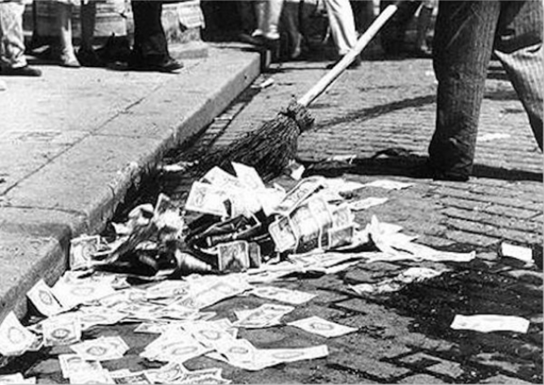
Anticipated v. Unanticipated
Hyper
100-500% in 1 month
(Can crush banks and savings accounts)
Ex. Natural disasters can cause hyper inflation

Slide 10
Hyperinflation
Country | Month with highest inflation rate | Highest monthly inflation rate | Equivalent daily inflation rate | Time required for prices to double
Hungary | July 1946 | 1.30 x 10¹⁶% | 195% | 15.6 hours
Zimbabwe | Mid-November 2008 | 79,600,000,000% | 98% | 24.7 hours
Yugoslavia | January 1994 | 313,000,000% | 64.6% | 1.4 days
Germany | October 1923 | 29,500% | 20.9% | 3.7 days
Greece | November 1944 | 11,300% | 17.1% | 4.5 days
China | May 1949 | 4,210% | 13.4% | 5.6 days
Notes:
http://www.cato.org/Zimbabwe
Venezuela- current almost 1 million percent . Prices doubling every few weeks 20 Million bolivars for fast food meal
For one dozen eggs in Venezuela; You can buy 101 dozen eggs in the U.S. for the same price
Minimum wage equal to around $1.61USD

Slide 11
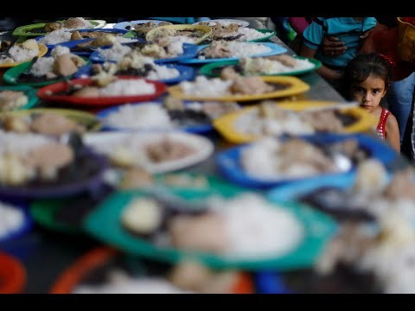
Venezuela Today

Slide 12


Anticipated v. Unanticipated
Anticipated v. Unanticipated
Anticipated: Healthy, plan accordingly.
vs.
Unanticipated: Unpredictable, hurtful.

Slide 13
What are some effects of inflation?
1) When inflation occurs, we all lose buying power.
2) The loss of buying power, especially hurts those on fixed incomes.
A fixed income is income that doesn’t change. People that are retired or on disability are on fixed incomes.
Fixed interest rate is when the interest rate of a loan does not change over the life of the loan.

Slide 14
Other effects of inflation
3) Increases the cost of borrowing.
4) Savers are negatively impacted with inflation.
5) Lenders are hurt when they lend money at fixed rates
Cost of living adjustments- Some payments/ jobs have a cost of living adjustment which means if the average cost of living (rent, food, transportation, etc.) increases, then so do the payments.
I.e.- Social Security

Slide 15
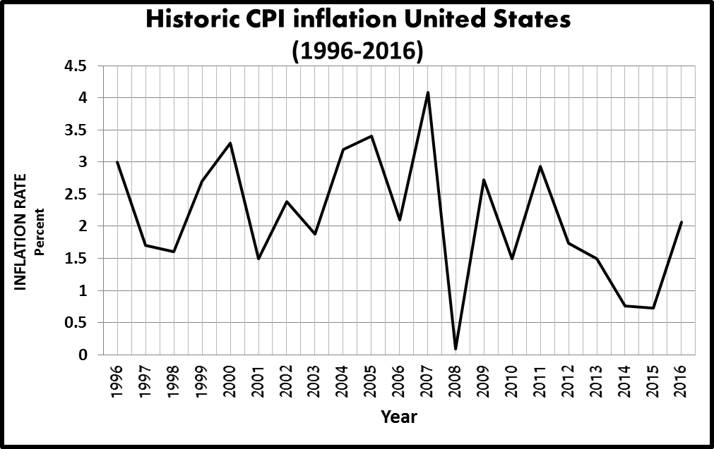

How is inflation measured?
The Bureau of Labor Statistics measures inflation by using what is called the Consumer Price Index (CPI).

Slide 16
How does the Consumer Price Index (CPI) measure inflation?
CPI measures the price change of a selected group of consumer goods and services overtime.
Thousands of goods and services are selected and placed in what is called a “market basket.”
Each month the “market basket” is checked to see if the overall price of the basket has increased or decreased.

Slide 17
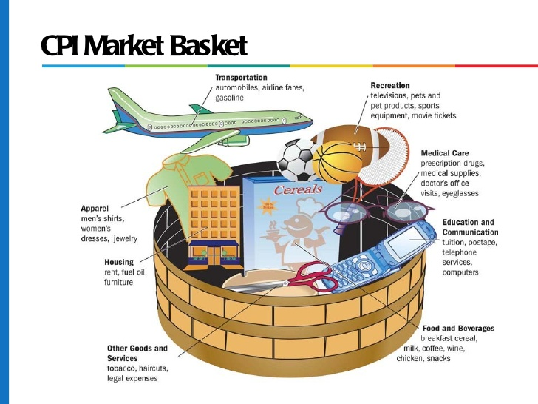
Anticipated v. Unanticipated
Consumer Price Index
Consumer Price Index: A “Market Basket” of goods for a typical urban middle-class household.
Goods
Bread
Appliances
Jewelry
Postage
Cosmetics
Services
Hospital Visit
Bus Fair
Dental Visit
Legal Services
Rent

Slide 18
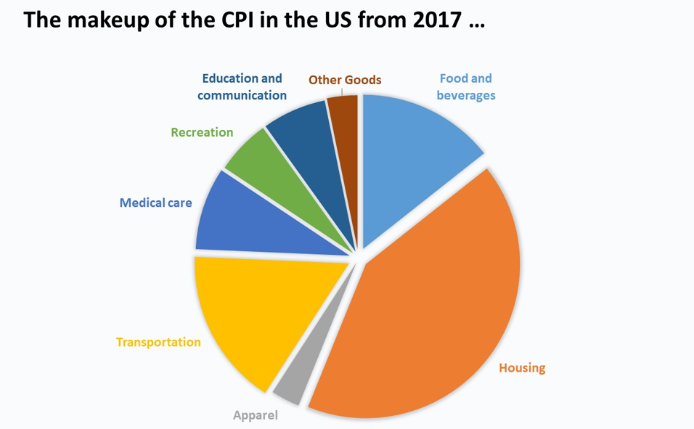
Anticipated v. Unanticipated
Consumer Price Index

Slide 19
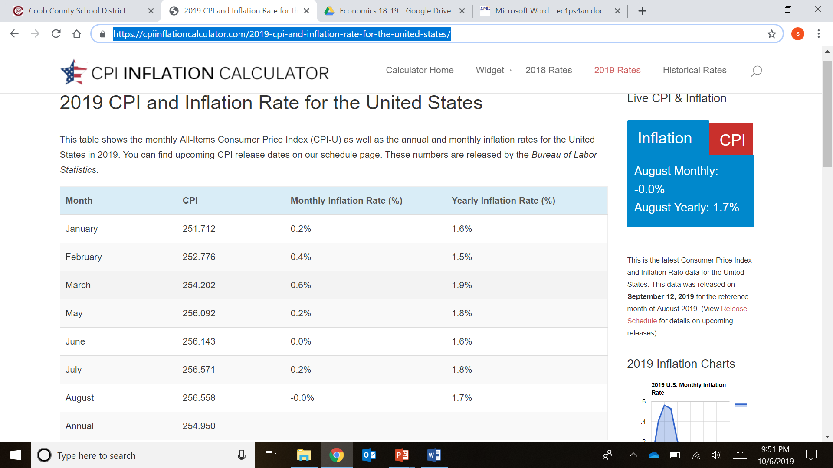
Anticipated v. Unanticipated
CPI 2019

Slide 20
CPI and Inflation
Consumer Price Index
CPI is calculated by looking at a base year’s prices and comparing to current year’s prices
  CPI = cost of market basket in year looking for x100 = CPI for year look for
  cost of market basket from base year
  CPI = 1000 = 1.04 x 100 = 104 (CPI)
  960
  To figure out inflation between the two years-
  100(base always 100) To 104 (CPI) = 4% increase = 4% Inflation

Slide 21
CPI and Inflation
Consumer Price Index
Market Basket1960= 710
Market Basket 2000= 1145
CPI in 2000=
Inflation Rate=
Market Basket 2010= $1455
Market Basket 2015= $1600
CPI in 2015=
Inflation Rate=

Slide 22
Hyperinflation Examples
Germany (1923) 29,500 % inflation rate ; prices doubling every 3.7 days
Zimbabwe (2008)- 79 billion % Loaf of bread cost 35 million
Hungary 1946 – 13.6 quadrillion prices doubled every 15 hours
Venezuela- current almost 1 million percent . Prices doubling every few weeks 20 Million bolivars for fast food meal
For one dozen eggs in Venezuela; You can buy 101 dozen eggs in the U.S. for the same price
Minimum wage equal to around $1.61USD

