Slide 1
SSWH 15 Presentation
Describe the impact of industrialization and urbanization.

Slide 2
SSWH 15 A
Analyze the process and impact of industrialization in Great Britain, Germany, and Japan.

Slide 3
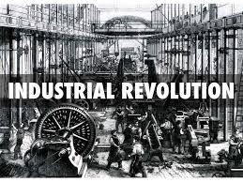
In the Beginning
After the political revolutions of the 1700’s and early 1800’s, another type of revolution began
The Industrial Revolution - the shift, during the 18th century, from making goods by hand to making them by machine.

Slide 4
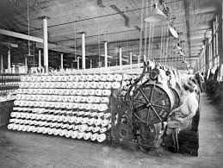
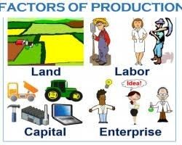
At the roots of the Industrial Revolution
Industrialization – the process of developing machine production of goods
Factors of production – the resources needed to produce goods and services that the Industrial Revolution required
Water & coal to fuel machines
Iron ore to construct machines
Rivers for cheap transportation
Harbors to encourage international trade

Slide 5
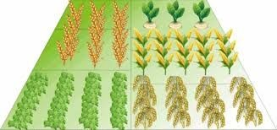
At the roots of the Industrial Revolution
Crop Rotation – the process where a farmer changes the crop they grow in a field to keep the land healthy
Animal and human power eventually replaced by steam powered machines
Railroads became the most important method of transportation during the Industrial Revolution
Why?
Railroads can move heavy materials quickly and cheaply

Slide 6
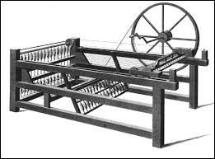
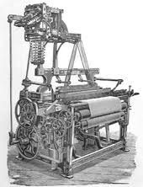
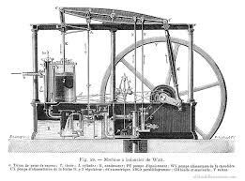
Inventions of the Industrial Revolution
Spinning jenny (James Hargreaves)
Spun thread faster
Water powered loom (Edmund Cartwright)
Weave fabric faster to keep up with the spinning.
Steam engine (James Watt)
Made machines run faster
Increased the demand for coal

Slide 7
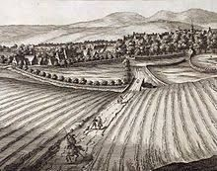
Where does it all start?
Begins in Britain when the wealthy buy up farm land and improve farming techniques
New larger farms, called enclosures were created
farmers discovered better ways to farm

Slide 8
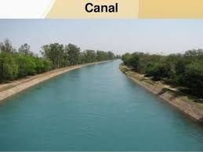
Why does it start in Britain?
Had a large population of workers (former farmers that were removed from their lands)
Had a vast source of raw material (Coal, iron)
Had a good transportation system (canals, ports, and roads)

Slide 9
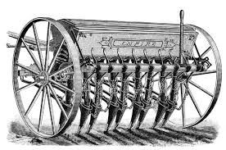
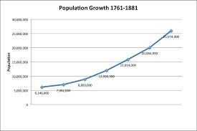
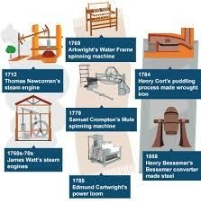
So how did the process go?
Agricultural improvements led to surplus food.
Surplus food led to population growth.
Population growth led to
labor pool
market to sell goods
Inventions begin making production easier, faster, and more efficient
Extra capital is reinvested and business keeps growing.

Slide 10
Impact of the Industrial Revolution on Britain
Growth of cities
More population (increased food, decreased death rate, disease & wars)
2 new classes of people:
Industrial middle class (factory owners)
Industrial working class (factory workers)
Large number of women and children working in factories
Created Jobs
Raised the standard of living
Nations became wealthy
Movement to machine-made items created a demand for unskilled labor

Slide 11
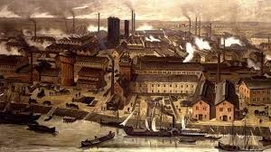
So how did the Industrial Revolution work in Germany?
Industrial Revolution began about a century later in Germany than it did in England
delayed in part because Germany was divided into smaller states
Germany did not exist as a unified political unit until 1871 after the Franco-Prussian War

Slide 12
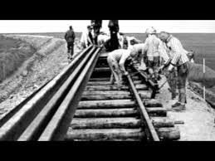
So how did the Industrial Revolution work in Germany?
Construction of railways, the need for steel, and an increase of population helped start industrialization
Germany focused on nationalistic identity, which created a push for economic & industrial growth.
Heavy industry, boomed.
Iron became the major thrust of industrial growth

Slide 13
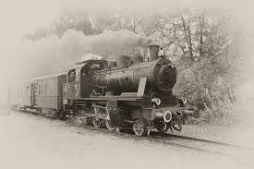
So how did the Industrial Revolution work in Germany?
By 1900 Germany had surpassed Britain in the manufacture of steel.
major accomplishment for Germany: the electrical and chemical industry.
electrification of Germany, including an extensive trolley system and over-land
power-transmission stations

Slide 14
Impact of the Industrial Revolution on Germany
Quick Urbanization (growth of cities)
Became overcrowded and polluted
Heavy Migration (movement from the country to the city)
Deep Sense of Nationalism (extreme pride in country)

Slide 15
So how did the Industrial Revolution work in Japan?
Under the Meiji Restoration the Industrial Revolution began
military reforms to modernize Japan's army and established the foundation for industrialization
Internal infrastructure was created
Lack of capital dictated direct government involvement in the stages of industrialization

Slide 16
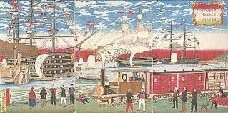
So how did the Industrial Revolution work in Japan?
Japan established the Ministry of Industry in 1870 to oversee economic development.
Built model factories to provide experience with new technology.
Education was extended as a means of developing a workforce.
Private enterprise soon joined government initiatives

Slide 17
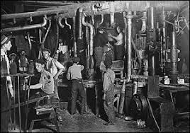
So how did the Industrial Revolution work in Japan?
Japan tried to limited foreign involvement, but
depended on importation of equipment and raw materials from the West
depended on selling manufactured goods abroad.

Slide 18
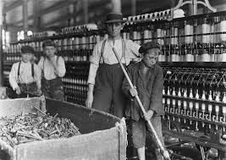
Impact of the Industrial Revolution on Japan
rapid population growth strained Japanese resources
Created an education system that stressed science and loyalty to the emperor
Western culture arrived in Japan along with models of constitutional structure and industrialization

Slide 19
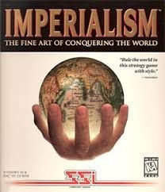
Impact of the Industrial Revolution on Japan
Movement toward imperialism emerged.
Searching for raw materials,
Trying to prevent Western encroachment
Movement toward nationalism to keep from losing distinctive Japanese identity.

Slide 20
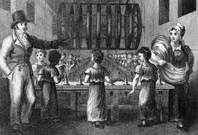
Overall Impact of the Industrial Revolution
Widened the gap between rich and poor globally
Led to exploitation of colonies for resources
Europe became the strongest economy in the world
Increased competition between countries

Slide 21
SSWH 15 B
Examine the political and economic ideas of Adam Smith and Karl Marx.

Slide 22
Forms of Economic Systems
Capitalism
economic system in which the factors of production are privately owned and money is invested in business ventures to make a profit
Laissez-Faire – letting industry and business set working conditions without interference
Government should not interfere in business
Lower taxes and tariffs
Will help promote wealth

Slide 23
Forms of Economic Systems
Socialism
Society (government) owns & controls means of production
Developed as an idea to get rid of competition to promote equality
Government should plan the economy to improve the lives of everyone
Public ownership would help workers
Socialism holds an optimistic view of human nature

Slide 24
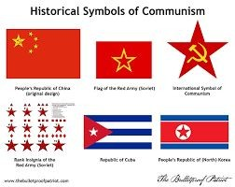
Forms of Economic Systems
Communism
the means of production – all land, factories, railroads, & businesses would be owned by the people
Proletariat would eventually own the means of production
No more private ownership
Classless society
Each person gives according to their abilities and receives based on their needs

Slide 25
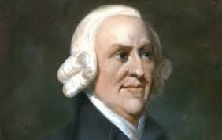
Adam Smith
A Scottish philosopher and economist (1700s)
Father of Modern Economics
a leader in the Scottish Enlightenment
Believed in laissez-faire economics and the free market
Defends the idea of a free economy

Slide 26
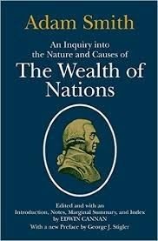
Adam Smith
Wrote the “Wealth of Nations”
how markets determine prices
Three laws of Economics
Law of self-interest – people work for their own good
Law of Competition – competition forces people to make a better product
Law of supply and demand – good are produced at the lowest possible price to meet demand.

Slide 27
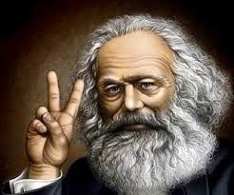
Karl Marx
German philosopher
Introduced the idea of communism
Society is divided into warring classes
Upper Class - Haves
Middle Class/Bourgeoisie – Haves
Owned the means of production
Lower Class/Proletariats – Have Nots

Slide 28
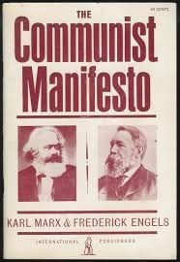
Karl Marx
Wrote The Communist Manifesto
Capitalism would destroy itself due to the workers being angry over the wealth of a few
private property should not exist
factors of production should be placed in the control of the public
Workers would seize the factories and share the wealth
all workers in the world would eventually unite in a revolution against the bourgeoisie

Slide 29
SSWH 15 C
Examine the social impact of urbanization, include: women and children.

Slide 30
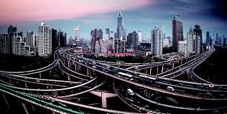
Urbanization
In the late 1700’s more and more people moved to cities
This is called Urbanization
Cities are built near water
Factories are also built near water
People move to cities for jobs in factories

Slide 31
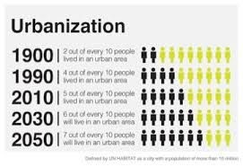
Urbanization - Cities
Urbanization – city building and the movement of people to cities
Occurs because factories are built near cities
People move there for jobs
England sees a boom in cities
London is most important industrial city

Slide 32
Living & Working Conditions
Due to the speed that cities grew, services were not always available
No sewers, trash collection, cramped housing
An increase in the spread of infectious diseases
Life expectancy in London for a factory worker was 17 / 38 for rural farmers
Factories were dark and dangerous
People worked 14 hours a day, 6 days a week
Conditions were poor, many workers injured or killed

Slide 33
Urbanization’s Impact on Society
Women began working in ● factories
Began to be included in education laws
Women’s colleges open
Economic equality led women to demand political equality
Elizabeth Cady Stanton & Susan B Anthony
Woman’s right to vote
Women fought for the right to vote (1919 – US)
Free Public education for all children
lower wages than men
Long and hard work days
Workers rights were nonexistent
Women made up a significant portion of the workforce
This inequality would lead to several women led reform movements

