Slide 1
Indus River Valley
Archaeological Excavation

Slide 2
Aim: What can archaeology tell us about the Indus River Valley (IRV) civilizations?
Do Now: If you were an archaeologist excavating in the IRV, what three kinds of artifacts/structures would be helpful to find? Explain what they might tell you about the IRV.

Slide 3
Review: How many of the “8 characteristics of a civilization” can you recall?
Cities/settled population
Government
Complex religion
Job specialization
Class structure/social classes
Writing system
Art/architecture
Public works/infrastructure

Slide 4
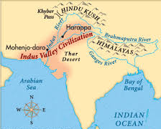
Indus River Valley Civilizations
Two major cities: Mohenjo Daro and Harappa – people called “Dravidians”
Present-day Pakistan
Why are the cities located where they are??
Emerged around 2500 BC
… and then mysteriously went into decline 1000 years later when a people called the “Aryans” moved in!

Slide 5
What we DON’T know about the IRV
We can’t yet understand their writing!
No info on:
Names of leaders
Tax records
Literature
Accounts of victories

Slide 6
Today’s task: What DO we know about the IRV from archaeology??
Working in groups, use each image from the Mohenjo Daro/Harappa site excavations to fill out your chart
Rotate around the room with your group to see each image
Examine the image and try to
Figure out what it is
Describe it
What types of conclusions can you make about this society?
Based on this artifact/image, does Mohenjo Daro/Harappa classify as a civilization? Why or why not?

Slide 7
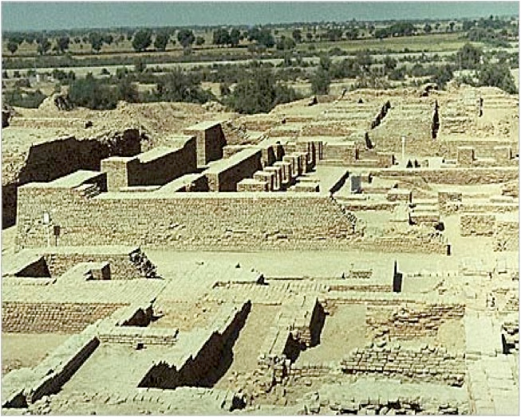
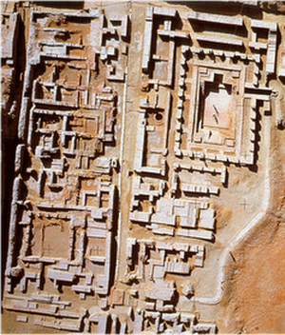
Well-organized cities
Grid layout
Intersections: north/south/east/west

Slide 8
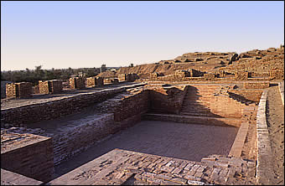
The Great Bath

Slide 9
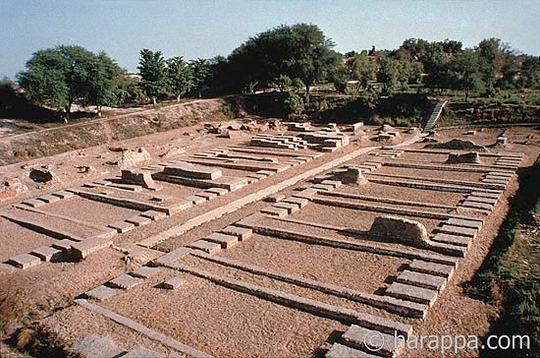
The “Granary”

Slide 10
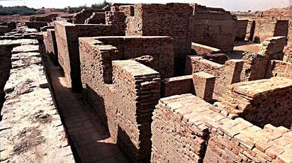
Houses

Slide 11
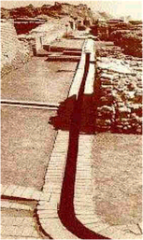
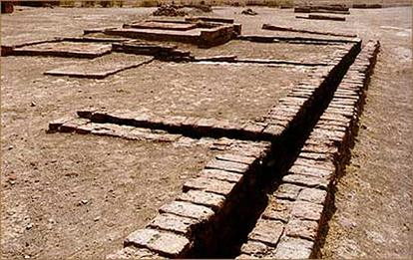
Drains/Sewers

Slide 12
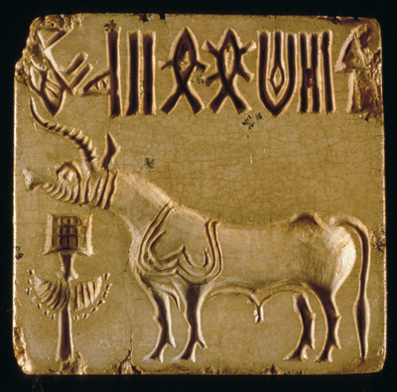
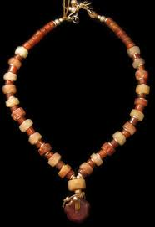
Stamps/Jewelry

Slide 13
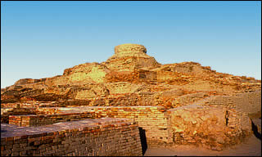
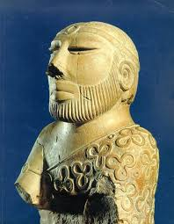
Religious Life??
The Citadel

Slide 14
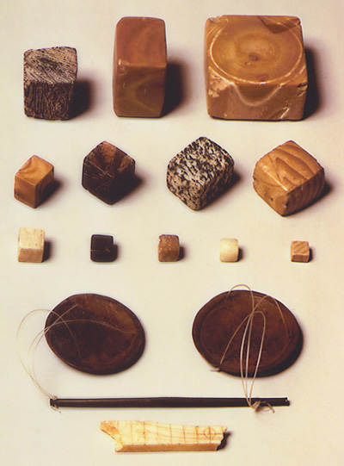
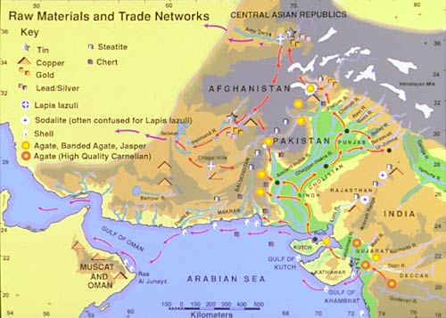
Trade networks
(with Mesopotamia)
Standardized weights and scale

Slide 15
Summary Activity
Read “Did Democracy Begin in the Indus Valley?” and answer the following question:
How do both perspectives support the idea that IRV cities did contain aspects of a civilization? What archaeological evidence do they cite?

