Slide 1
Imperialism in Asia
Muslim Lands and India

Slide 2
Ottoman Empire Loses Power
Suleyman dies 1566 – begins line of weak sultans
Geopolitics – taking land strategically for positioning or products
Attractive land area – Mediterranean and Atlantic access
Russians wanted control and a warm port on Black Sea
Allied with Ottoman enemies and waged war

Slide 3
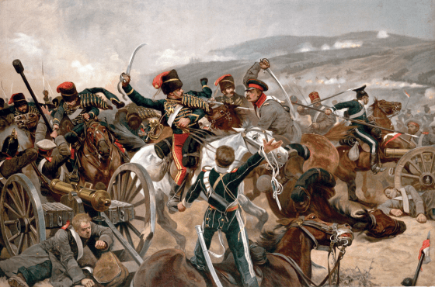
Crimean War
Russia vs. Ottomans
France and Britain aided Ottomans. Why?
Ottomans win, but demonstrate military weakness
Russians aided Balkans in revolt against Ottomans
Continued to lose land

Slide 4
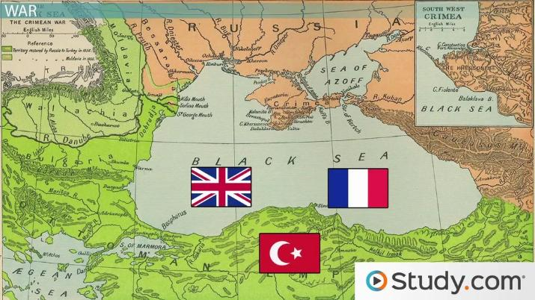

Slide 5
Egypt Update
After watching Ottoman decline, Egypt recognizes that they need to adjust to modern world
Begin military and economic reforms
Building of Suez Canal
Paid for by French private investment groups
Egypt couldn’t pay even the interest on $450 million debt
British overseeing the financial control of canal
By 1882, British occupied Egypt

Slide 6
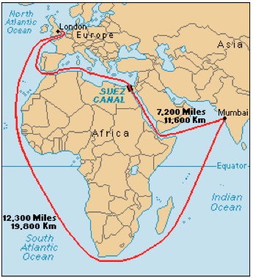
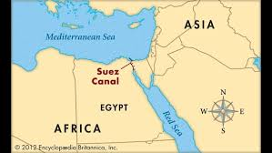

Slide 7
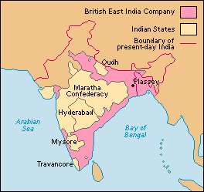
Beginnings of British Imperialism in India
Britain had economic interest in the area in 1600’s
British East India Company
Mughal Empire ruled most of India
By early 1700’s empire was breaking up
Small states ruled by a maharajah
From 1757 to 1858 East India Company controlled India

Slide 8
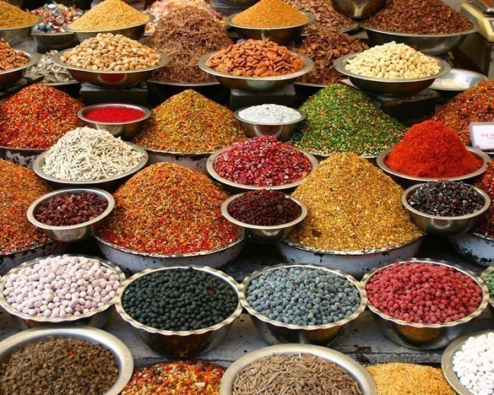
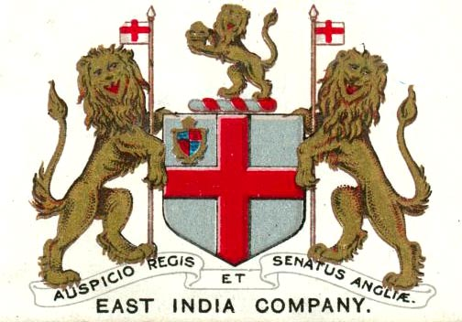
British East India Company
Company specializing in trading Indian goods like spices
Became powerful due to advancement of European naval fleets
Surpassed Spain and Portugal after the destruction of Spanish Armada in 1588
Ruled with little British government regulation

Slide 9
India becomes Britain’s “Jewel in the Crown”
Seen as most valuable colony
Huge amount of resources and large population
British controlled economy
Raw materials had to go to Britain
Citizens had to buy British goods
Did not allow competition with British goods
Newly developed railroads connected ports with interior cities

Slide 10
Effects on India
Negative:
Destruction of Indian industries
Loss of self-sufficiency
Loss of traditional Indian culture
Positive:
Vast railroad network connected Indian regions and cities
Improved infrastructure modernized nation
Increased education

Slide 11
Beginnings of mutiny
British had racist attitudes towards Indians
Indians resented British attempts to convert them to Christianity
Indian feelings of Nationalism
Indian desire for independent economy

Slide 13
The Sepoy Mutiny
Sepoy: Indian soldiers serving under British command
Refused beef/pork fat cartridges (cultural reasons)
Sepoys jailed, causes other sepoys to rebel
Rebellion spreads across northern India
Divisions within sepoys
Hindus vs. Muslims
East India Company takes control again after a year of fighting

Slide 14
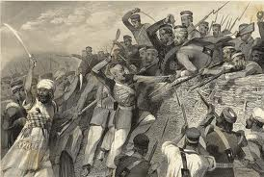
Results of Sepoy Mutiny
British take direct control
The Raj
Fueled racial attitudes of British
Increased distrust between Indians and British
Nationalism and desire for self-rule

