Slide 1
Haiti and Latin America Revolutions
Student – Created Notes

Slide 2
Each student will be assigned one of the following. Find 1 – 2 important facts for each
Setting the Stage
Colonial Society Divided
Peninsulares
Creoles
Mulattos
Revolutions in the Americas
The Divisions in Spanish Colonial Society, 1789
Revolution in Haiti
Toussaint Louverture
Haiti’s Independence
Creoles Lead Independence
12. Simón Bolívar
13. José de San Martín
14. Bolívar’s Route to Victory
15. San Martín Leads Southern Liberation Forces
16. Mexico Ends Spanish Rule
17. A Cry for Freedom
18. Miguel Hidalgo
19. José María Morelos
20. Mexico’s Independence
21. Brazil’s Royal Liberator

Slide 3
Setting the Stage
Ideas of liberty, equality, and democratic rule from European countries
American and French Rev – major impact
Resented European domination

Slide 4
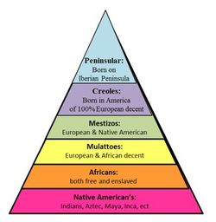
Colonial Society Divided
Social structure
Peninsulares
Creoles
Mestizos – mixed European and Native American ancestry
Mulattos
Indians at the bottom

Slide 5
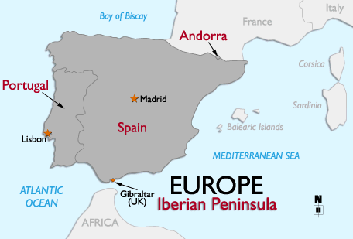
Peninsulares
People born in Spain
Tiny percent of population
Ranked top of Spanish-American society

Slide 6
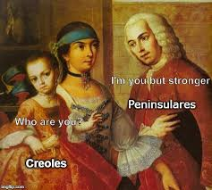
Creoles
Spaniards born in Latin America
Could not hold high level political office
Could be military officers
Controlled land, wealth, and power along with peninsulares

Slide 7
Mulattos
Mixed European and African ancestry
Enslaved Africans – lower in social structure

Slide 8
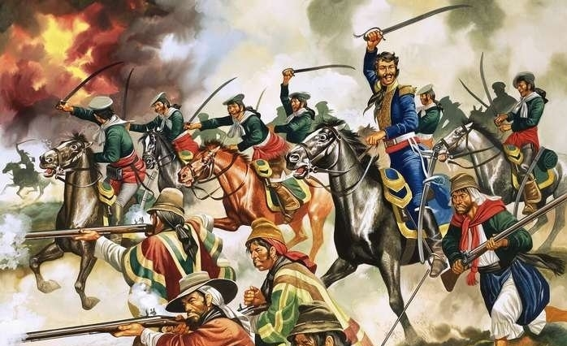
Revolutions in the Americas
Success of other revolutions encouraged freedom in Latin America

Slide 10
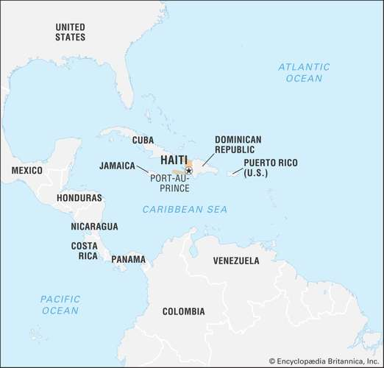
Revolution in Haiti
Saint Domingue – first colony in LA to gain independence
Now called Haiti
500,000 enslaved Africans – brutally tortured

Slide 11
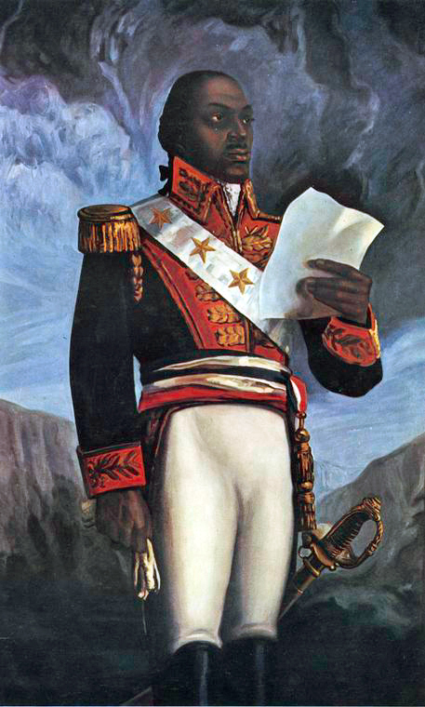
Toussaint Louverture
Ex-slave who rose to power after freedom
Freed slaves in Haiti
Total control of Haiti by 1801
Demanded independence from France
Sent to prison in French Alps – died in 1803

Slide 12
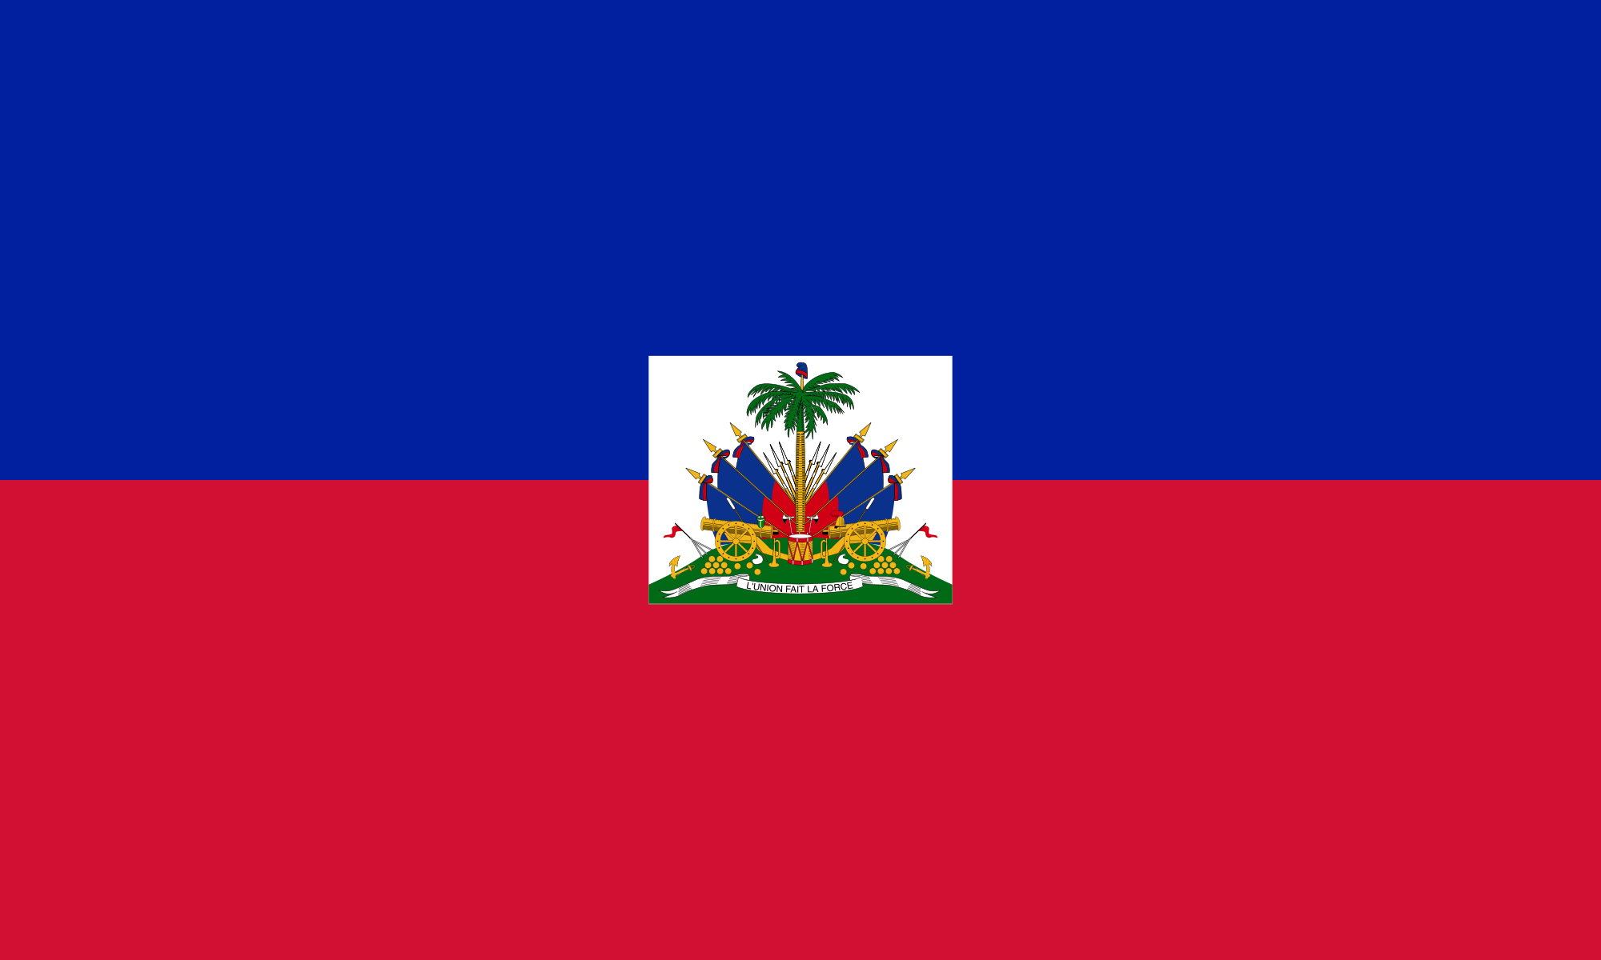
Haiti’s Independence
Jean Jacques Dessalines – Toussaint’s lieutenant
Jan 1st, 1804 – Haiti claims independence
First African colony to be free from European control
Were St. Domingue – now Haiti

Slide 13
Creoles Lead Independence
Most educated in LA
Brought ideas of Enlightenment
Led by 2 generals
Simon Bolivar - Venezuela
Jose de San Martin – Argentina

Slide 14
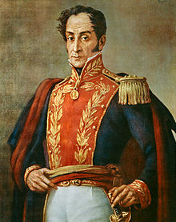
Simón Bolívar
“George Washington of South America”
Wealthy creole
Won Venezuela’s independence in 1821

Slide 15
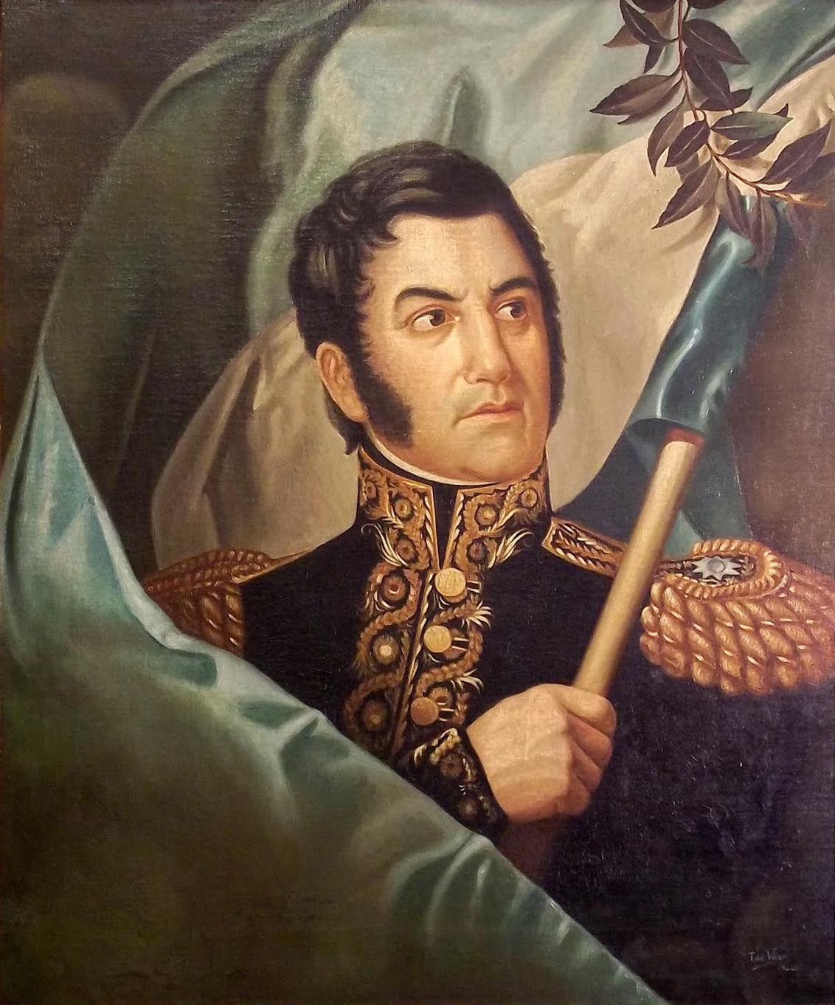
José de San Martín
Military officer
Fought against Napoleon
Liberator of Argentina, Chile, and Peru

Slide 16
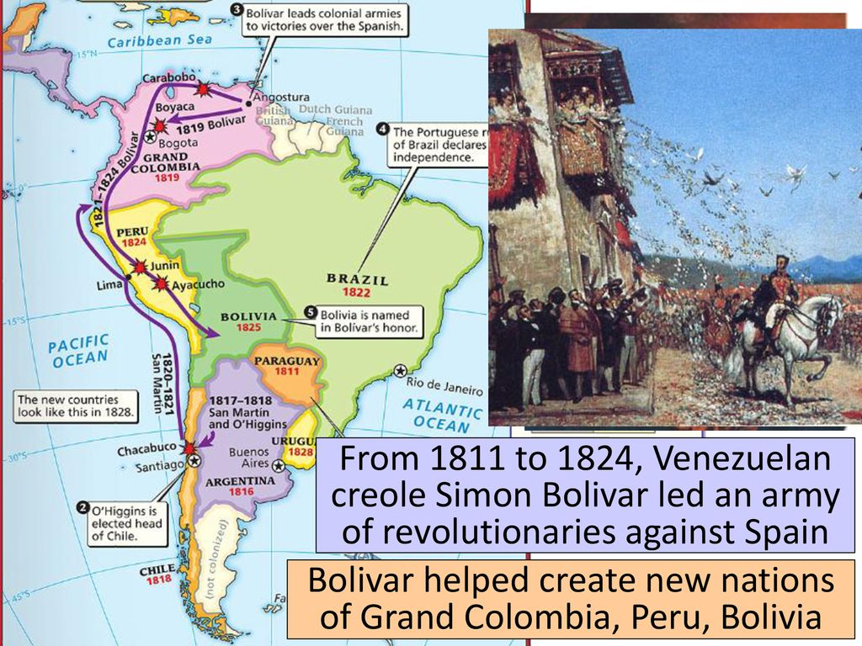
Bolívar’s Route to Victory
1811 – declared independence from Spain
Bolivar exiled twice
Surprised Spanish army – traveled thru Andes Mtns
1821 – won Venezuela’s independence
Domination station

Slide 17
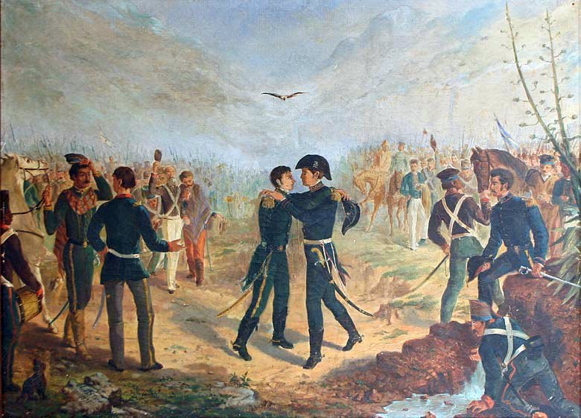
San Martín Leads Southern Liberation Forces
1817 – freed Chile from Spanish control
San Martin and Bolivar met while liberating South America
San Martin leaves his army for Bolivar to command

Slide 18
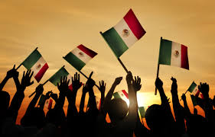
Mexico Ends Spanish Rule
Ethnical and racial groups mixed freely

Slide 19
A Cry for Freedom
Peasants rebelled against Spanish
Miguel Hidalgo
Rang church bells, declared independence from Spain on Sept 16, 1810
Lost, regrouped, and fought again

Slide 20
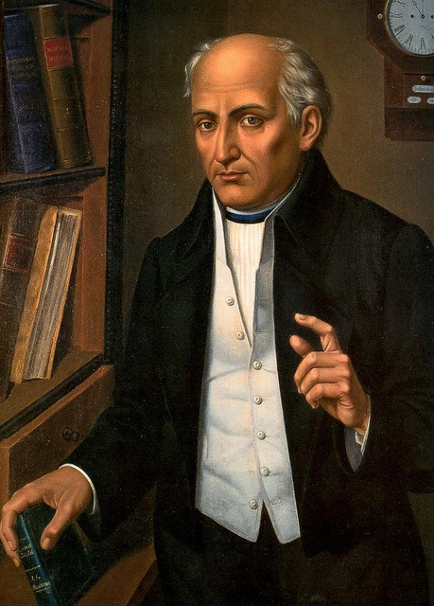
Miguel Hidalgo
Priest, believed in Enlightenment
Began march on Mexico City
Caught Spanish by surprise, but was unsuccessful at first

Slide 21
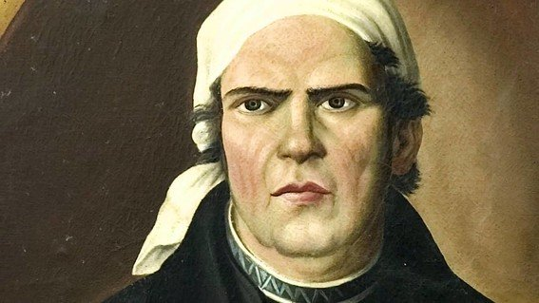
José María Morelos
Led after Hidalgo
4 years
Defeated by a creole officer
Augustin de Iturbide

Slide 22
Mexico’s Independence
Declared independence in 1821
Accepted in 1823
Central America also gains independence as a part of Mexico

Slide 23
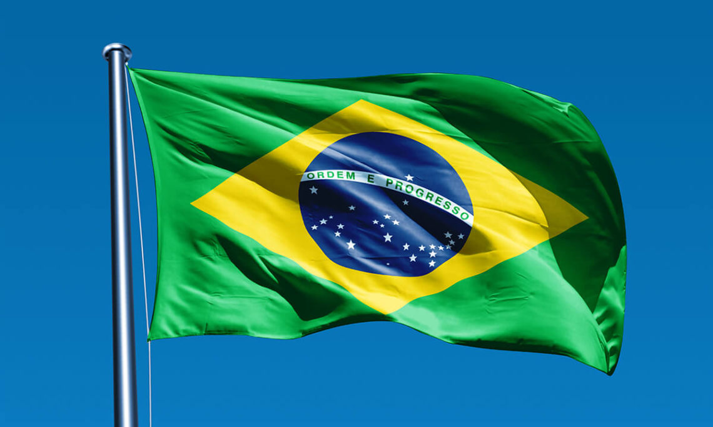
Brazil’s Royal Liberator
Freed from Portugal
King John pushed out of Portugal by Napoleon
Rules Portuguese empire from Brazil for 14 years
Creoles demand Johns son, Dom Pedro, become independent ruler
September 2nd, 1822 declared independent
Peaceful revolution – no bloodshed

