Slide 1
Textbook Access
http://www.clever.com
click on “login”
select “Student”
search for Pope High School and select the one that labeled “Pope High School Cobb County School District, GA”
click on “Log in with Active Directory”
enter their student ID and the password they use to access the Learning Commons computers
Click on Economics textbook

Slide 3
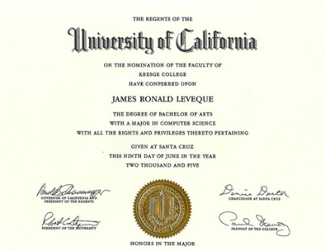
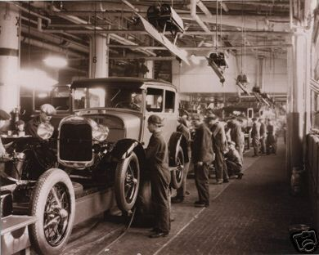
Specialization/ division of labor
Specialization- boosts the overall productivity of a business or country
Division of Labor – type of specialization

Slide 4
Both parties gain as a result of voluntary, non-fraudulent exchange

Slide 5
How should Parking spots at pope be assigned?
Lottery
Authority
First-come-first served
Personal Characteristics
Contest
Price
Majority Rule
Contests
Force
Sharing

Slide 6
Public Goods and services
Governments in the United States usually produce public goods and services only when there is a reason that the private market is unable to provide the good or service
“Shared consumption”- One persons use doesn’t not diminish the use for another
“Non-exclusion”- difficult or impossible to keep a person unwilling to pay for a good from using it
i.e.- U.S. provides military protection for everyone living in the US regardless of paying taxes
“Free-rider” problem- enjoys the benefit without paying ofr it.

Slide 7
Is it a public good/ service? (provided by the govt and paid for by taxes)
Car Wash
Streets and Roads
Police/Fire Protection
Chocolate Milkshakes
Trash Collection
School Desks
Haircuts
Teachers

Slide 8
Market failures
occur when the private market is unable to produce goods and services in a way that the marginal benefit to society from the production of the good is equal to or greater than the marginal cost to society for producing the good. Market failures include externalities and market power

Slide 9
Video Questions
1. Emissions that result from the production of paper are a good example of a negative externality because
There are fines for air pollution
Air pollution is no longer an issue in our economy
Paper-producing firms are generally unaware of environmental regulations
Paper-producing firms will not include the cost of pollution in their production costs

Slide 10
#2
When positive externalities are present in a market:
Demand will be too high
Overproduction will occur
Underproduction will occur
Producers will be affected but not consumers

Slide 11
#3
When the cost of a transaction spills over to third party, the effect is called a:
Positive externality
Positional externality
Negative externality
Internal externality

Slide 12
Government can internalize a negative externality by
Taxing the activity that generates the externality
Subsidizing the activity that generates the externality
Outlawing the activity that generates the externality
Fully funding the activity with the taxpayer money

Slide 13
Which of the following statements best illustrates a positive externality ?
A well-maintained yard increases the home’s market value
A well-maintained yard increase the property tax
A well-maintained yard makes other homeowners
A well-maintained yard increases the value of adjacent properties in the neighborhood

Slide 14
When negative externalities are present in a market
Demand will be too high
Overproduction will occur
Underproduction will occur
Producers will be affected, but not consumers

Slide 15
Externalities
They occur when a third party other than the consumer or producer of a good is hurt or benefits from the production or consumption of that good.
Negative – ( pollution )
Positive- Education ( working conditions, standards, less crime)

Slide 16
Government attempts to fix market failures
Government can tax the company that has created the pollution to help close the gap
Government subsidies (education, clean production) to help close the gap

