Slide 1
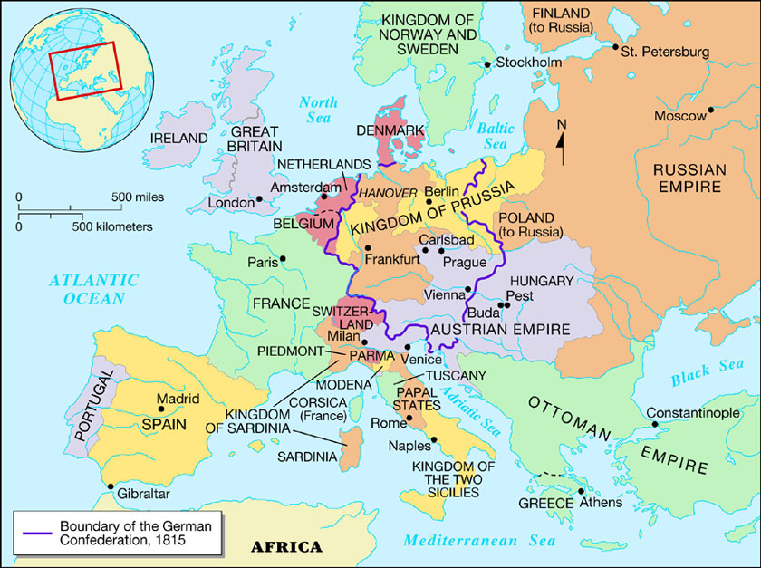
European Empires
Comprised of large empires and kingdoms
Multiple ethnic, lingual, and religious groups
Ex: Austria-Hungary, Russia, Ottoman
Congress of Vienna, 1815
Aimed for peace in Europe
Reinstated monarchies

Slide 2
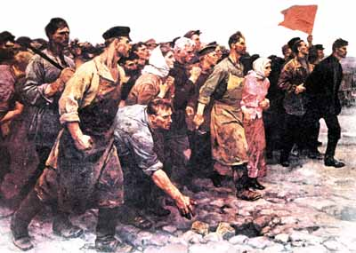
Impact of Nationalism
Minorities embraced nationalism
Nationalism could divide or unite countries
Areas where people of similar background would often unify
Areas where people of different background would often divide

Slide 3
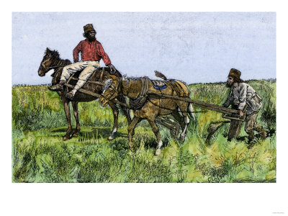
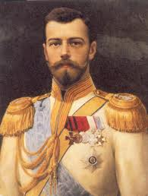
Nationalism as a dividing force
Russia:
Economically backward
Autocratic rule
Unequal society (serfs)
Multiple ethnicities over a large empire (part European, part Asian)
Russification: the forcing of Russian culture on all minority groups in the Russian empire
Russian language, orthodox religion, traditions, style of government
Notes:
Efforts to modernize had been unsuccessful. The monarchy would often resist reforms due to the fear of losing autocratic rule. Huge population, but majority were serfs. Serfs would not be freed until the late 1800’s. Landowners had no incentive to improve agriculture or develop industry. This would leave Russian empire backward and behind other industrializing nations. HUGE empire that encompassed a variety of ethnic groups across Europe and Asia.

Slide 4
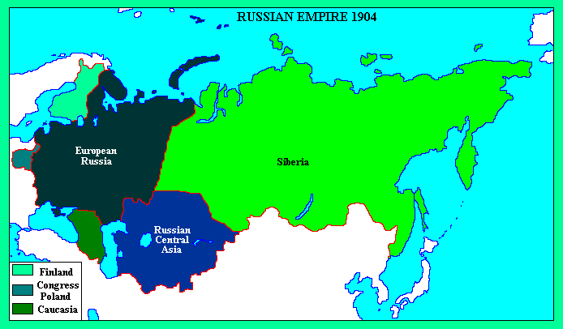

Slide 5
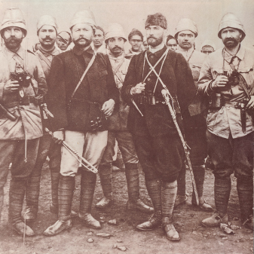
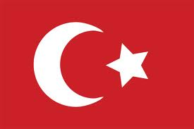
Nationalism as a Dividing Force
Ottoman Empire
In decline
Lack of modernization
European nations take advantage of territory
Russia on the Black Sea
France in North Africa
Great Britain tries to suppress Ottoman expansion
Ethnic minorities rebel
Greeks, Serbians, Romanians, Bulgarians

Slide 6
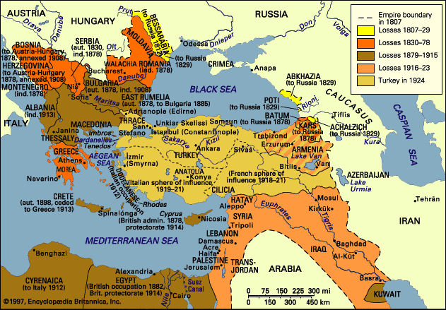

Slide 7
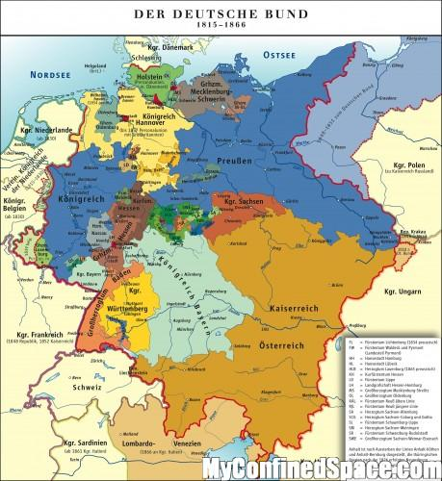
Nationalism as a Unifying Force
Germany:
Began as German Confederation after Congress of Vienna
Under Austrian rule
Multiple nation-states
Politically divided
Common German language
Prussia the strongest

Slide 8
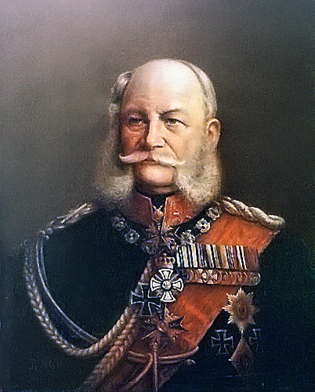
Wilhelm I
Kaiser (King) of Prussia from 1861-1888
Prussia was most powerful German state
Wished to strengthen army
Militarism
Tension with liberal parliament
Selects Otto Von Bismarck as prime minister

Slide 9
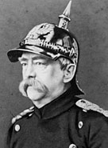
Movement Towards Full Unification
Otto Von Bismarck
Prussian, Junker (conservative)
Goal was to build strong and unified Germany
No desire for representative government
“Germany does not look to Prussia’s liberalism, but to her power…The great questions of the day are not to be decided by speeches and majority resolutions, but by blood and iron”
Notes:
Notice Otto Von Bismarck is wearing a German military helmet in this portrait. What does that say about him and his political views?

Slide 10
Otto Von Bismarck
Master of Realpolitik
Realistic politics based on tough-minded evaluation of the needs of the state
Desire to build up military
Three war victories would increase Prussian territory and power
Difficult to unify northern and southern Germany
Protestant North and Catholic South

Slide 11
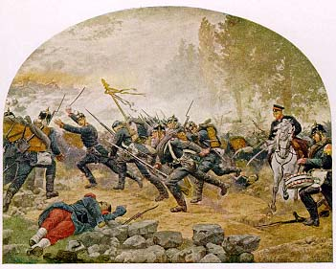
Franco-Prussian War
Way to unify southern Germany with Northern Germany
Gained territory of Alsace-Lorraine
Creates animosity and distrust between French and Germans

Slide 12
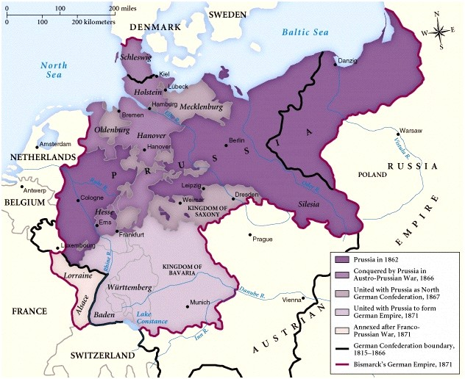

Slide 13
German rises as European Powerhouse
Large coal deposits and growing population encouraged industrialization
Government promoted economic development
Second strongest navy after Great Britain
Advanced chemical and electrical industries
Highly educated and disciplined workforce

Slide 14
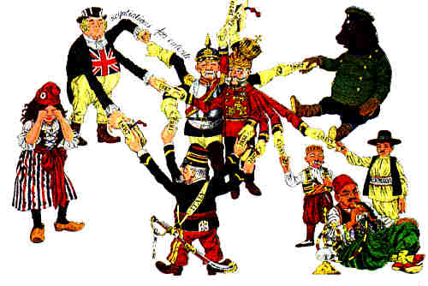
German Foreign Policy
Build up alliances with Austria and Russia
Keep France weak
Increase military power

Slide 15
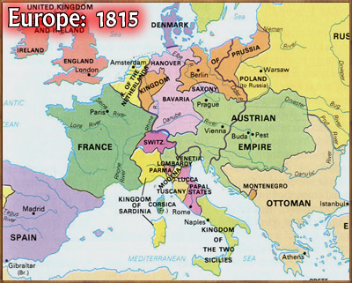
Italy before Unification
Peninsula plagued by frequent warfare
Citizens historically identified with local leaders
Napoleon sparked ideas of nationalism and unification
Congress of Vienna left multiple Italian nation-states under foreign rule
Encouraged nationalism

Slide 16
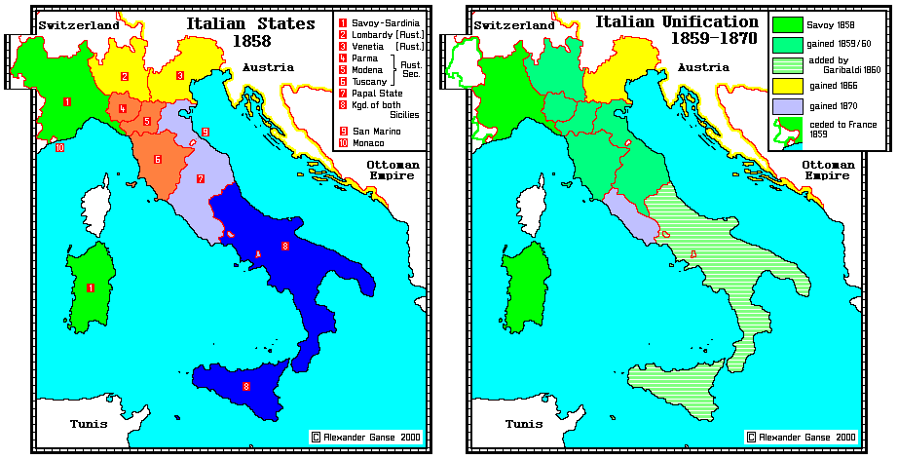

Slide 17
Movement Towards Italian Unification
Nationalists argued for unification due to:
Social Reasons:
Geography, common language, shared traditions
Economic Reasons:
End trade barriers between nation-states, stimulate industry, encourage railroad building

Slide 18
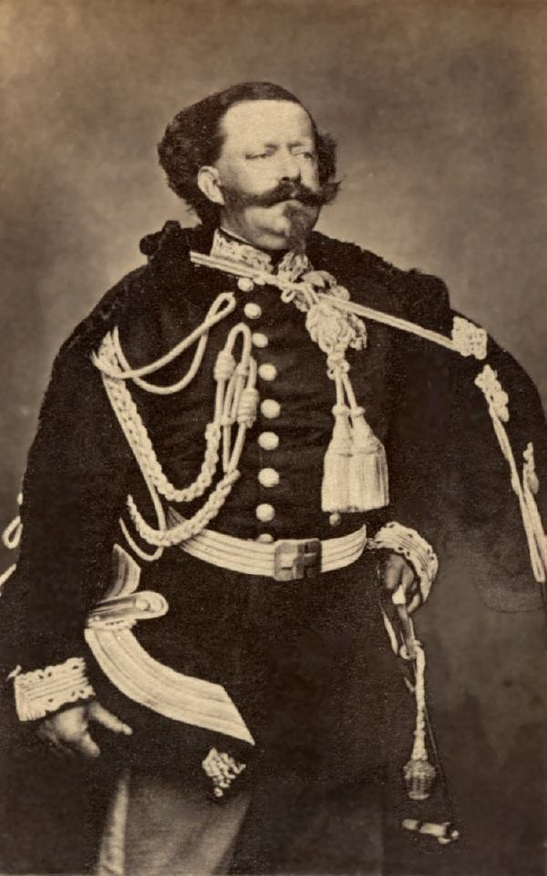
Sardinia-Piedmont takes Control of Northern Unification
Consisted of Sardinia, Piedmont, Savoy, and Nice (North-Western Italy)
Ruled by constitutional monarch Victor Emanuel II
Father of Italian Unification

Slide 19
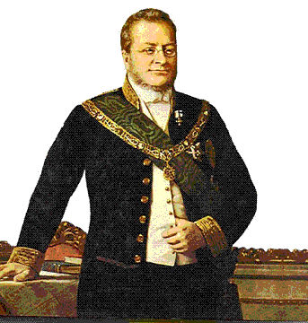
Camillo Di Cavour
Appointed prime minister by Victor Emmanuel II
Aimed to improve economy (free trade)
expel Austria from Italy
add Lombardy and Venetia to Piedmont-Sardinia

Slide 20
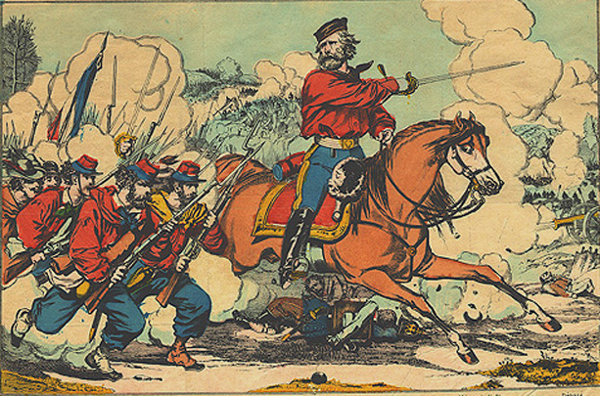
Southern Italian Unification
Giuseppe Garibaldi led his volunteer army through southern Italy
Known as the “Red Shirts”
Accepted assistance from Cavour in the North

Slide 21
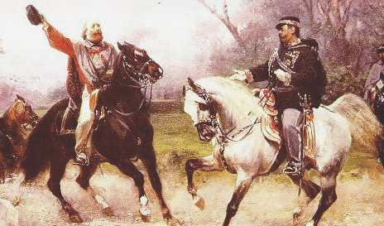
Troubles in Newly Unified Italy
Cavour and Garibaldi unite northern and southern Italy
Garibaldi gives control of southern Italy to Victor Emmanuel II
Economic disparity between north and south
Dissatisfaction with the government
Slow economic progression/modernization

Slide 22
