Slide 1
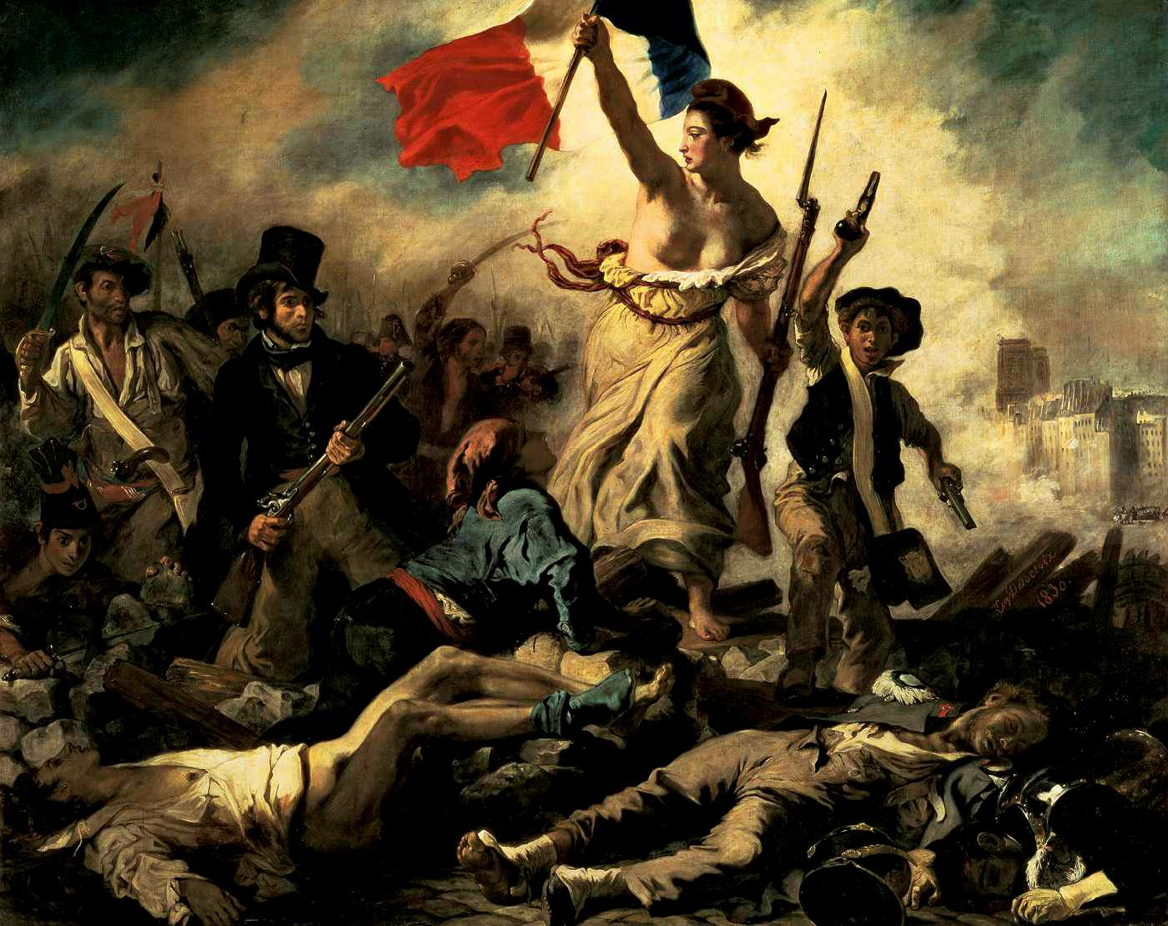
France at the Dawn of Revolution
Ms. Halty
1//2012

Slide 2
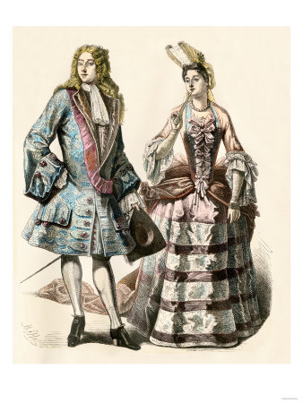
18th Century France
The Old Regime
Social class system from the Middle Ages
Consisted of three classes:
First Estate
Second Estate
Third Estate
Enlightenment Ideals
American Revolution

Slide 3
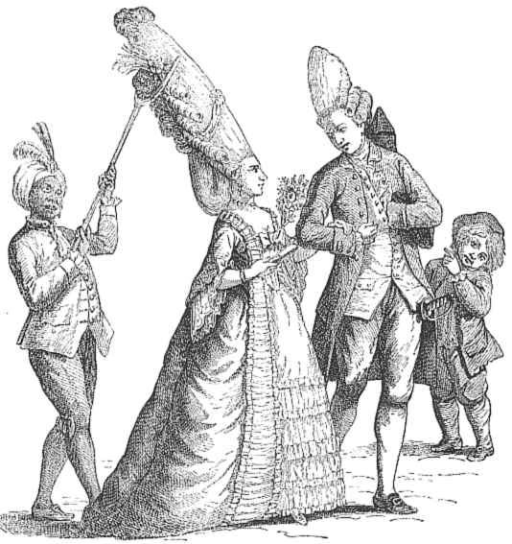
The “Privileged” Estates
The First Estate
Consisted of the clergy
.5% of the population
Paid no taxes
The Second Estate
The noble class (2% of pop.)
Paid almost no taxes, yet
owned 20% of land
Notes:
Add notes from outline

Slide 4
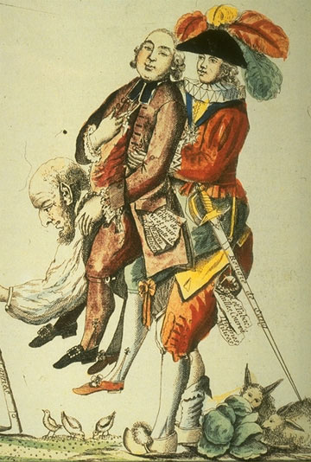

Slide 5
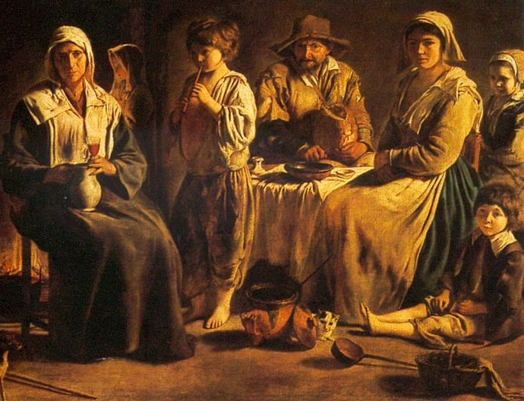
The Third Estate
Consisted of three major groups: bourgeoisie, factory workers, and peasants
Strong believers in Enlightenment
97% of population
50% of income went to taxes

Slide 6
En Route to Revolution
Third Estate inspired by Enlightenment
Crop shortages lead to high food prices (esp. bread) and poor economy
King Louis XVI weak leader
Poor advice/spending from Marie Antoinette
France’s debt rises dramatically
King Louis XVI calls for Estates General

Slide 7
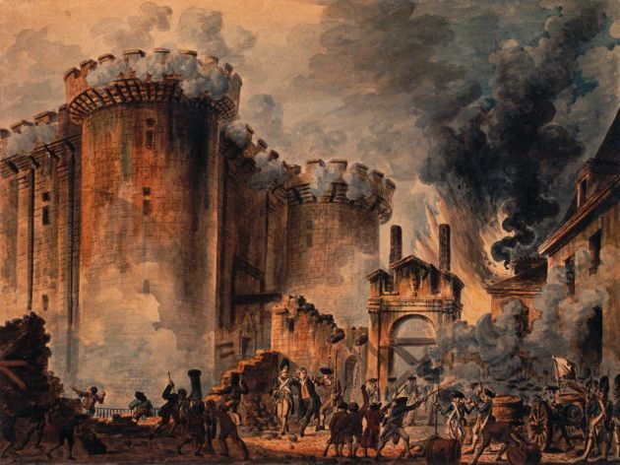
First Acts of Revolution
Third Estate forms National Assembly
Tennis Court Oath
Storming the Bastille
July 14,1789

Slide 8
The Declaration of the Rights of Man and of the Citizen
Inspired by the U.S. Declaration of Independence
Thomas Jefferson assisted
Approved on August 26, 1789 by National Assembly
Rejected by king on October 4th

Slide 9
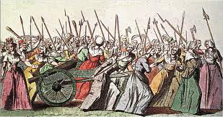
The Great Fear
Followed the storming of the Bastille
Widespread panic and fear
National Guard led by Marquis de Lafayette guards Paris
March on Versailles – October 5th 1789

