Slide 1
Feudalism and the Middle Ages

Slide 2
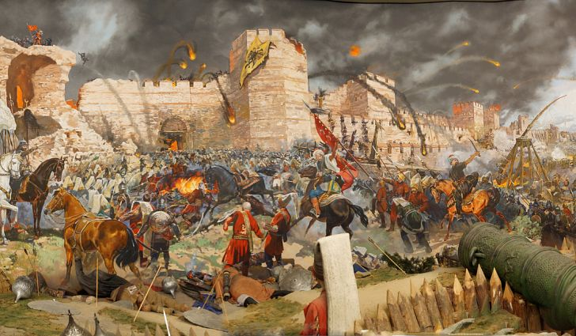
Students will be able to…..
Describe the relationships between social groups in The Middle Ages
Develop an argument on feudalism from an assigned perspective after a class simulation

Slide 3
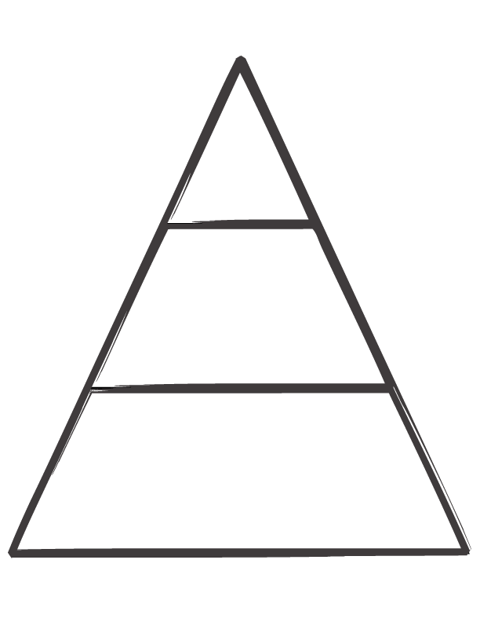
What do you think of when you see this?

Slide 4
Before we begin…..
let’s answer these questions together:
What social relationships exist between people today? (Think jobs/work)
How do different roles affect how hard we work?

Slide 5
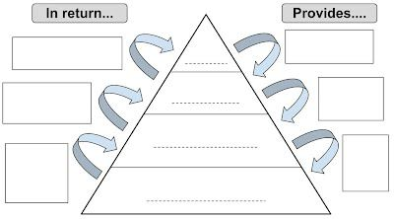

Slide 6
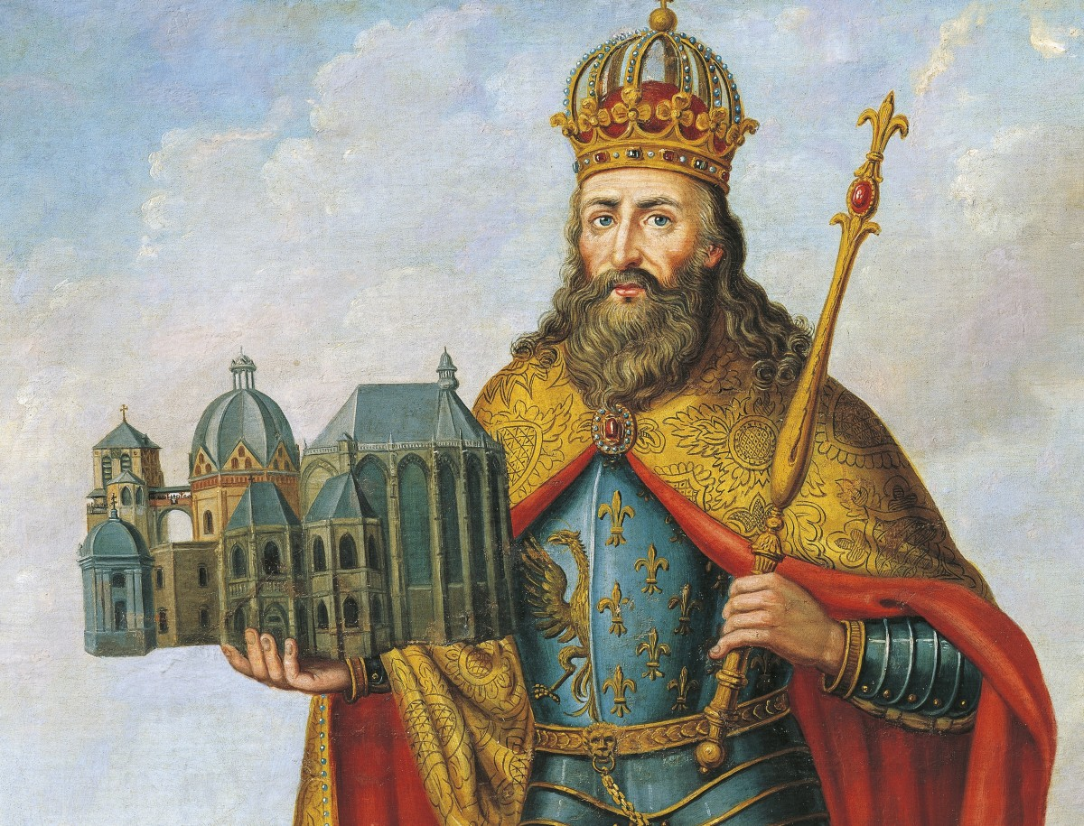
Kings/Queens
What do they have?
Land
Wealth
What do they need?
Political support
Military service
Additional wealth
Power
Charlemagne – king that laid the foundation for feudalism in Europe

Slide 7
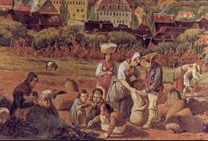
Peasants
What do they have?
Labor capability
Strength in numbers
What do they need?
Land
Housing
Protection
Resources

Slide 8
LAND,Loyalty
Political Support, Military Service, Money
King/Queen
Food/Crops,
Services When Demanded
LAND
PEASANTS (Serfs)

Slide 9
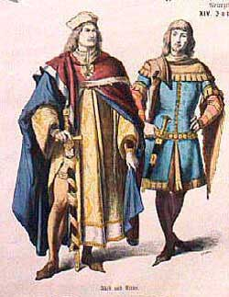
Lords (Nobles)
What do they have?
Land
What do they need?
Military protection
Wealth/Resources
Wealth/Resources

Slide 10
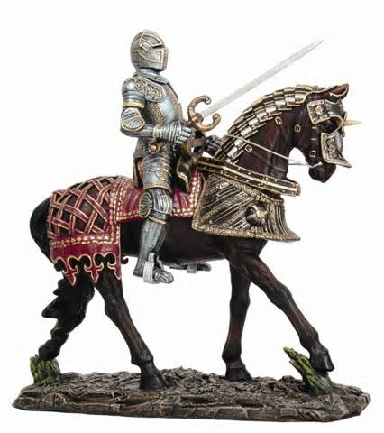
Knights
What do they have?
What do they need?
Protection power
Military service
Land
Resources

Slide 11
LAND,
Loyalty
Political Support, Military Service, Money
King/Queen
LAND, Loyalty
Protection, Military Service
LORDS
KNIGHTS
Food/Crops,
Services When Demanded
LAND
PEASANTS (Serfs)

Slide 12
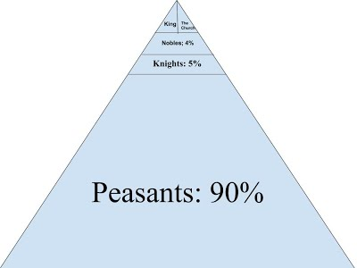

Slide 13
Feudalism Simulation!
To understand this further, you will now go through a simulation that demonstrates the system of feudalism!
Instructions:
Each student will be assigned a role from the Middle Ages:
King/Queen – sit in “throne” at front of classroom
Lords – stand on opposite sides of the King/Queen
Knights – stand next to the Lord
Peasants – everyone else! Stay in your seats for now.

Slide 14
Feudalism Simulation!
We will run through one trial run with one peasant from each manor:
Peasants – One at a time, give 6 of your Starbursts to your Knight
Knights – For each payment you receive, give 5 Starbursts to your lord
Lords – For each payment you receive, give 3 Starbursts to the King/Queen
King/Queen – Do nothing!

Slide 15
ADD THEM UP!

Slide 16
Closing Question
Do you think feudalism in The Middle Ages was fair?
Answer the question on the back of your Feudalism Triangle.
When finished, turn in to black tray at the front of the room.

