Slide 1

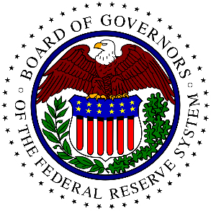
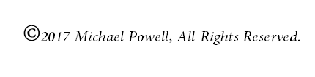

The Federal Reserve Bank

Slide 2
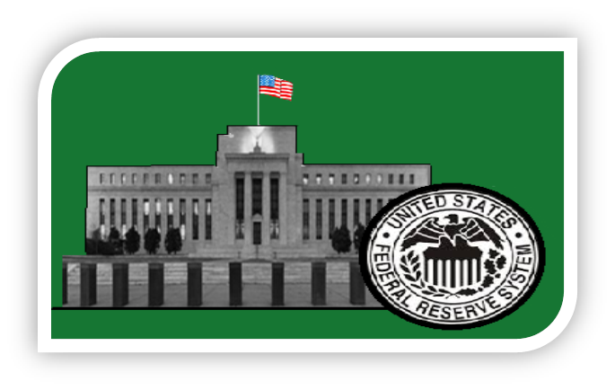
What is the Federal Reserve System?
Our nation’s central bank that manages the nations money.
Referred to as THE FEDERAL RESERVE or the FED.

Slide 3
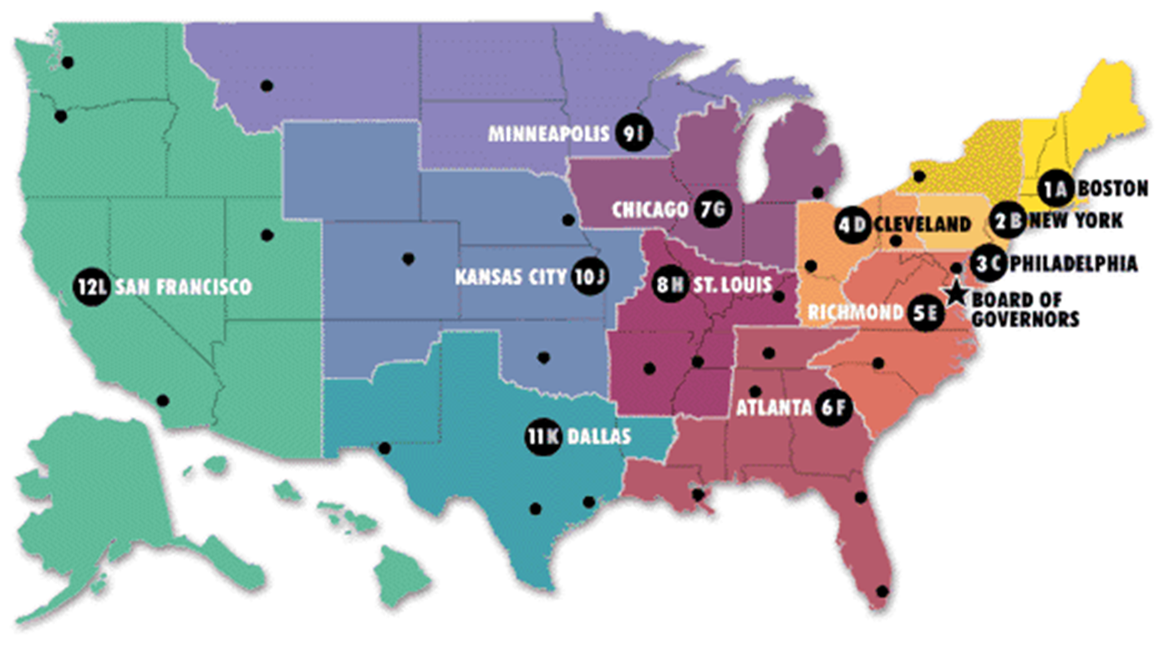
Who runs the Federal Reserve?
The head person is called the Fed Chairman or Fed Chief.
Made up of a network of 12 regional Federal Reserve banks.
Each bank is led by a Board of Governors.

Slide 4
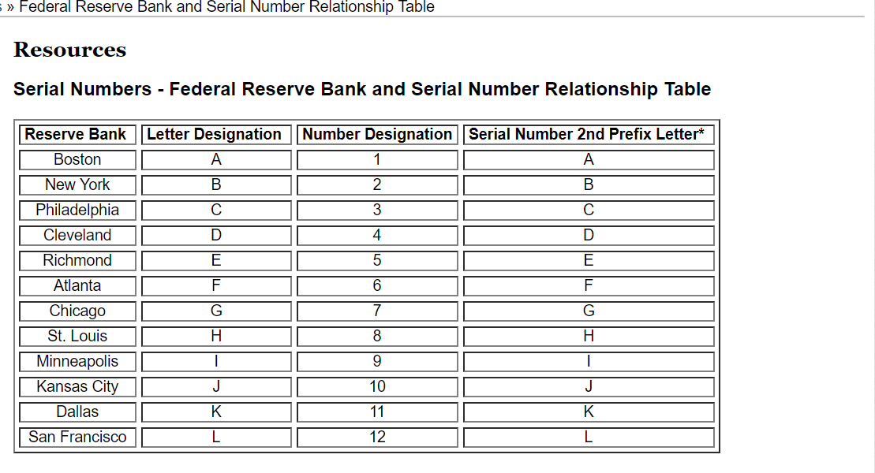

Slide 5

Why was the Fed created?
A. Was created because our nation had experienced several banking crisis.
a. People panicked and rushed to withdraw money out of the banks, leading to the collapse on many banks and to an economic recession.
B. After a very severe bank panic of 1907 and a major economic recession. Congress passed the Federal Reserve Act of 1913 in an effort to stabilize and strength the U.S. banking system.
C. Other major economic crisis such as the Great Depression of 1930s, led to an expansion of the Fed’s role, and the Fed become more involved in trying to managing the U.S. economy.

Slide 6
What does the Fed do?
HAS THREE MAIN FUNCTIONS:
    Promotes stability of the financial System
    Provides financial (money) and payments services for banks and the government
    Is responsible for promoting a HEALTHY economy using monetary tools.
1)
2)
3)

Slide 7

How does the Fed make sure our nation’s banking system is sound and safe?
1) Function of the Fed
Establishes rules and procedures for all banks.
By performing onsite examinations of banks and measuring their soundness.

Slide 8
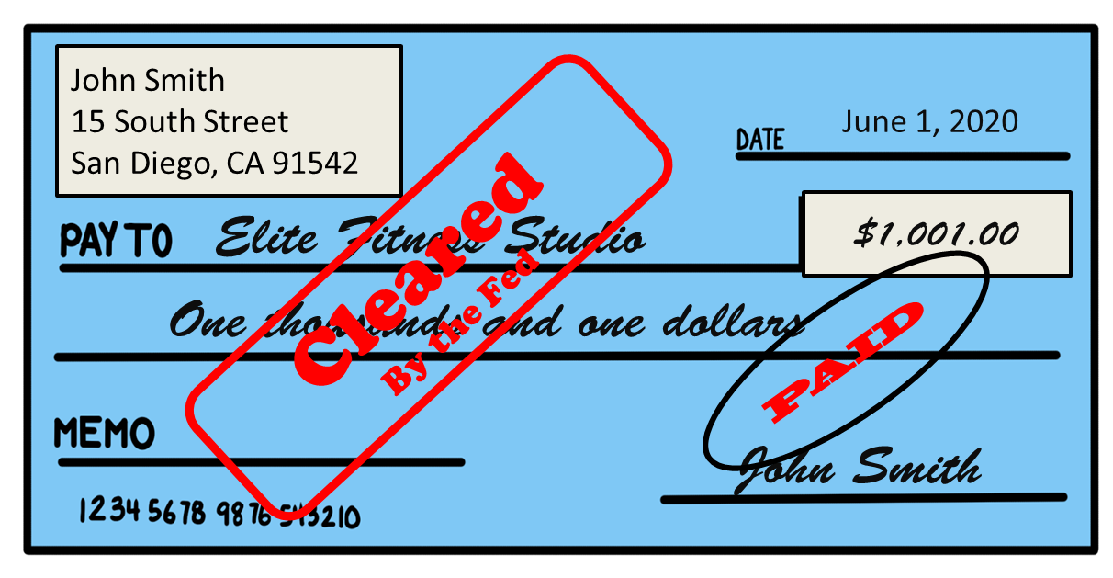
    What services does the Fed provide to banks and the government?
2) Function of the Fed
A. Fed is a bank for the banks,.
a. Often called the “Banker’s Bank.”
b. Doesn’t provide services for individuals .
B. Provides cash and lends money to banks.
C. Processes millions of payments and electronic money transfers.
D. Provides check clearing service= the processing of checks by handling the withdraw and the deposit for each check.

Slide 9
How does the Fed try to promote a healthy economy using monetary tools?
3) Function of the Fed
By trying to influence the supply of money in circulation (THE MONEY SUPPLY)

Slide 10
What is the MONEY SUPPLY?
= is the total amount of money that is in circulation in our economy at a give time.
A. The Fed tends to evaluate the money in the economy that is liquid, meaning it can easily be used. It looks at
    a. M1, which is money that is in actual physical use; it is being used to buy and sell goods and services every day.
    b. M2, which includes all of monies in M1 but also includes money in savings accounts worth less $100,000.

Slide 11
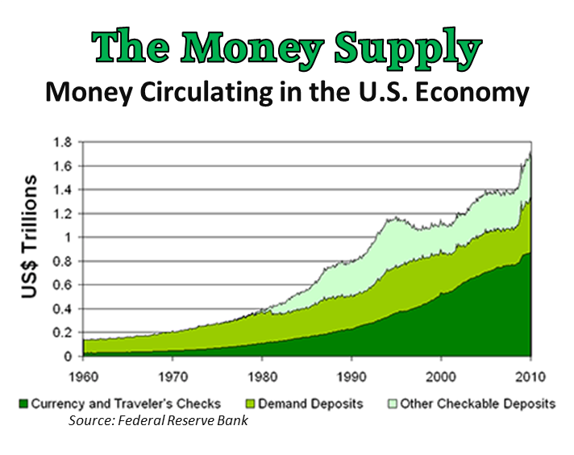

Slide 12

How does the money supply affect the economy?
a. An increase in the money supply, means there is more money available in the economy, which promotes growth.
- There is more money for businesses and people to spend.
b. A decrease in the money supply, means less money in the economy, which slows growth.
Increasing the money supply is like giving more water to a garden in an effort to encourage it to grow faster.

Slide 13

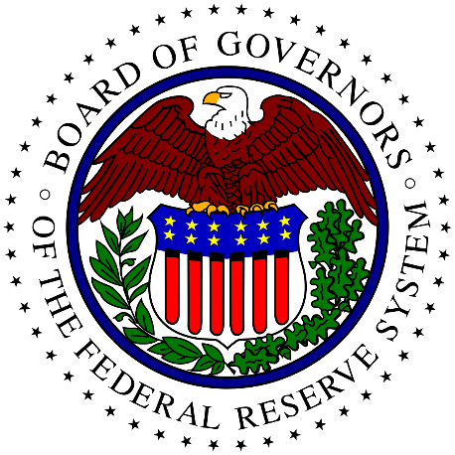
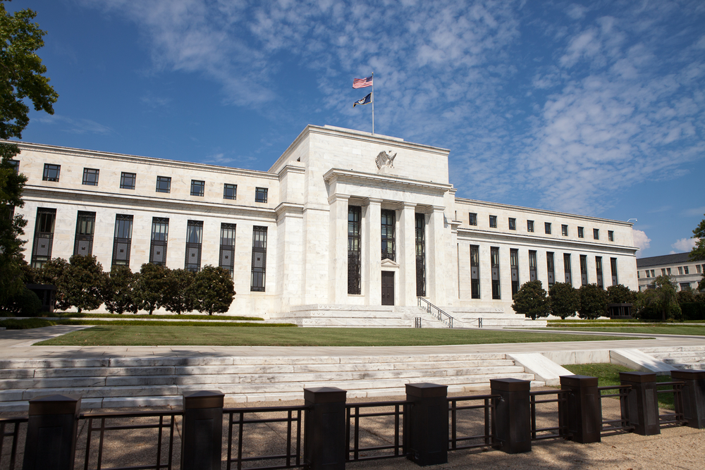
What are the tools used by the Fed to manage the money supply and the economy called?
MONETARY POLICY.

Slide 14
What are the Fed’s monetary tools that can be used to influence the money supply?
THREE KEY MONETARY TOOLS:
    Buying and selling government securities (bonds).
    Adjusting the reserve requirements
    Changing the discount rate

Slide 15
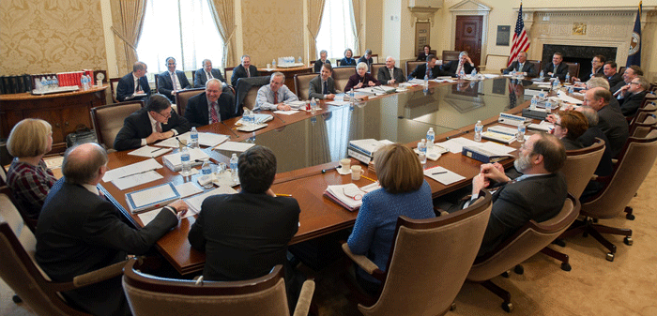
Who decides when and which MONETARY TOOL to use?
The Federal Open Market Committee (FOMC), which is made up Federal Reserve members decides.

Slide 16
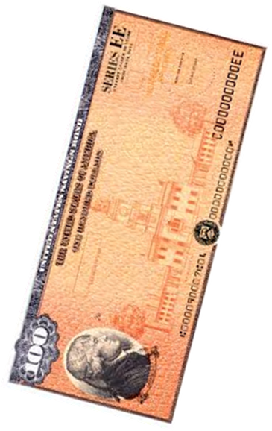
What is the buying and selling of government securities (treasury bills) ?
Monetary Tool #1
Are bonds (IOU) that are issued by the government.
The government promises to repay the buyer of the bond as well as pay them interest.

Slide 17
How does the buying and selling of government bonds influence the money supply?
Monetary Tool #1
When the government buys bonds it injecting money into the economy (increasing supply= growth).
When the government sell bonds it taking money out of the economy (decreasing supply= slows growth)
Interesting Fact: The Fed can buy its own bonds, which it does.

Slide 18
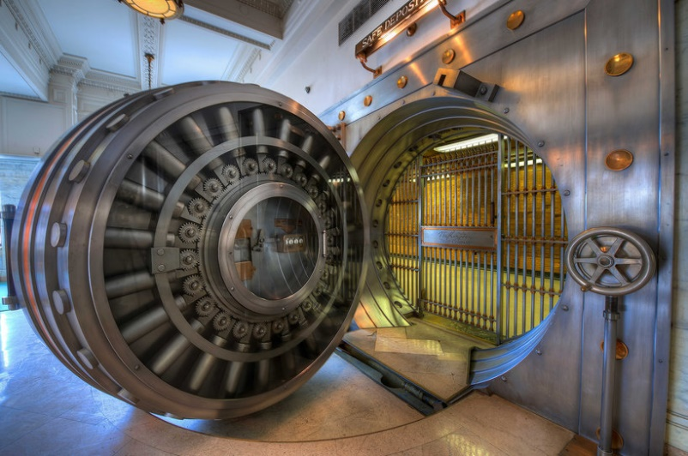
What is the Fed’s RESERVE REQUIREMENT?
Monetary Tool #2
Is how much money each bank is required to keep on hand.
The Fed has the ability to require banks to hold a certain amount of money, meaning banks can’t use the money for anything.

Slide 19
How does the reserve requirement influence the money supply?
Monetary Tool #2
TO DECREASE SUPPLY
The Fed increases the reserve requirement for banks, which takes money out of the circulation.
TO INCREASE SUPPLY
The Fed lowers the reserve requirement for banks, which means banks will place more money into circulation.

Slide 20
What is the DISCOUNT RATE?
Monetary Tool #3
is the interest rate that the Fed charges banks to borrow money from them.

Slide 21
How does raising or lowering the DISCOUNT RATE influence the money supply?
Monetary Tool #3
The discount rate influences how much it cost people to borrow money from the banks.
The interest rate banks charge their best customers is the prime rate, which is linked to the discount rate.
LOWER RATES =
INCREASES THE MONEY SUPPLY
Lower rates make money cheaper because it cost less to borrow it.
HIGHER RATES =
DECREASES THE MONEY SUPPLY
Higher rates make money more expensive because it cost more to borrow it.

