Slide 1
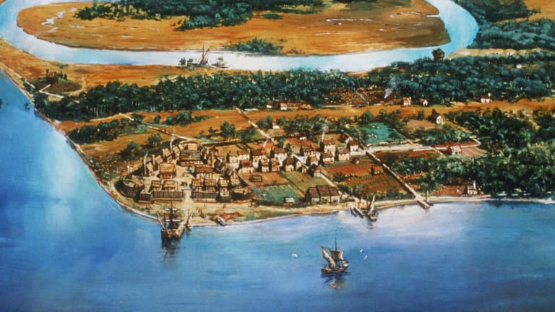
Claims in North America
Treaty of Tordesillas was ignored by other European countries
Samuel de Champlain
French explorer
Founded Quebec - “New France”
English arrive
Establish Jamestown in present day Virginia
First official settlement in North America

Slide 2
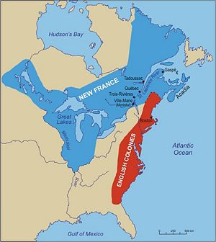

Slide 3
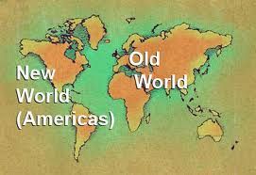
Colombian Exchange
Exchange of goods from the Old World to the New World and vice versa
Trade of plants, animals, people, and disease

Slide 4
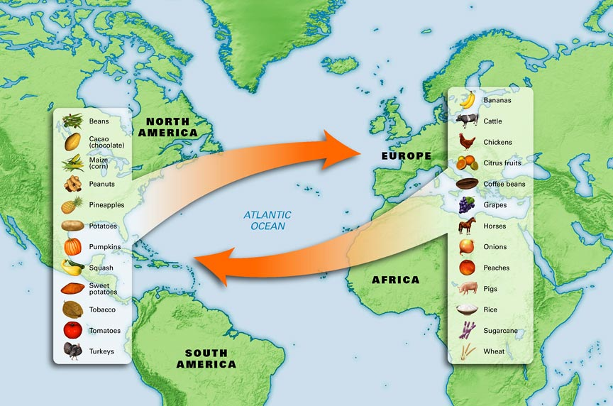
Columbian Exchange Simulation

Slide 5
Impact of Columbian Exchange
Altered the biodiversity of the world
Brought disease that wiped out Native populations
Increased population of the Americas and the world as a whole
Increased agriculture in the New World
Encouraged Triangular Trade and the Atlantic Slave Trade

Slide 6
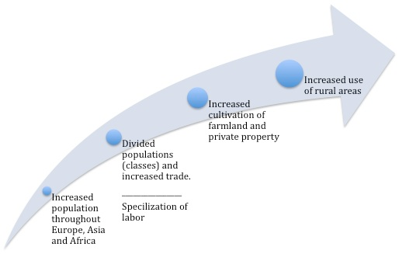
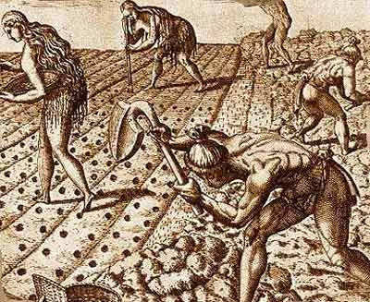
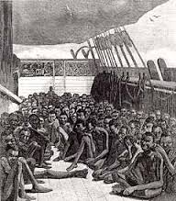
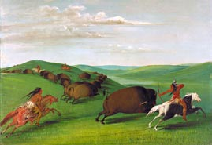

Slide 7
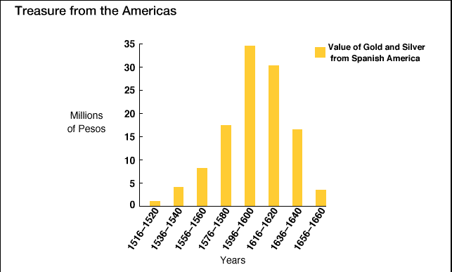

Slide 8
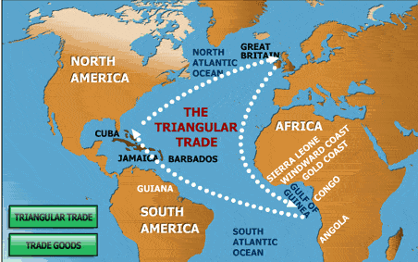
Triangular Trade
Trade between Europe, Africa, and the Americas
Based on mercantilism
Encouraged the Colombian Exchange

Slide 9
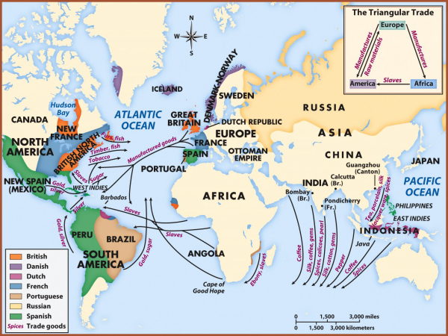

Slide 10
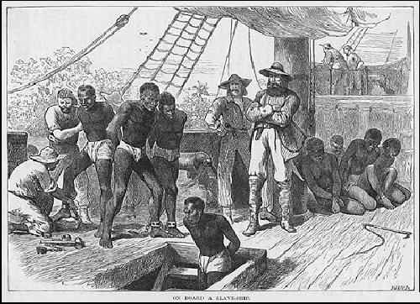
The Main Idea
To meet their growing labor needs, Europeans enslaved millions of Africans in forced labor in the Americas.

Slide 11
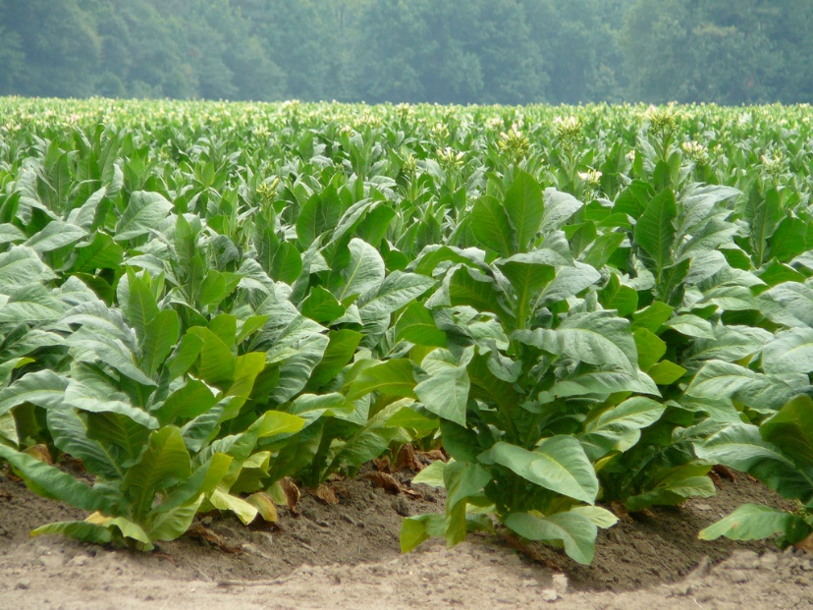
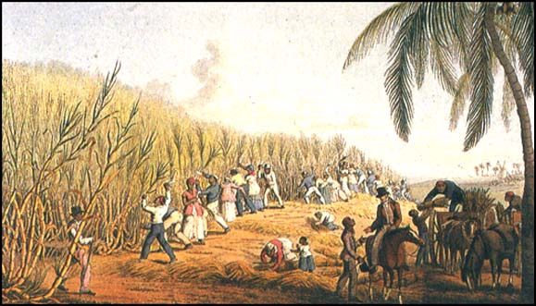
Setting the Stage
Sugar plantations and tobacco farms needed lots of workers
Most of the Native Americans that were used for labor had died
Needed new labor force: turned to Africa

Slide 12
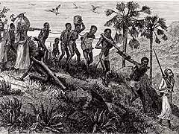
The Evolution of African Slavery
Slavery in Africa had existed for ages, tied to religious beliefs
New agricultural techniques created a need for more labor
Africans would trade fellow Africans for European goods
Guns, swords, spices, and other goods

Slide 13
The Desire for Africans in the Americas
Advantages of Africans vs. Native Americans:
They had been exposed to European diseases
They had experience in farming
They had little knowledge of the land and there were no familiar tribes (couldn’t run away)

Slide 14
Atlantic Slave Trade
This trade for slaves became the Atlantic Slave Trade
Between 1500 and 1880, 10-12 million slaves were shipped to the Americas
48% to Caribbean
41% to Brazil
5% to North America
Majority of slaves worked on sugar plantations

Slide 15
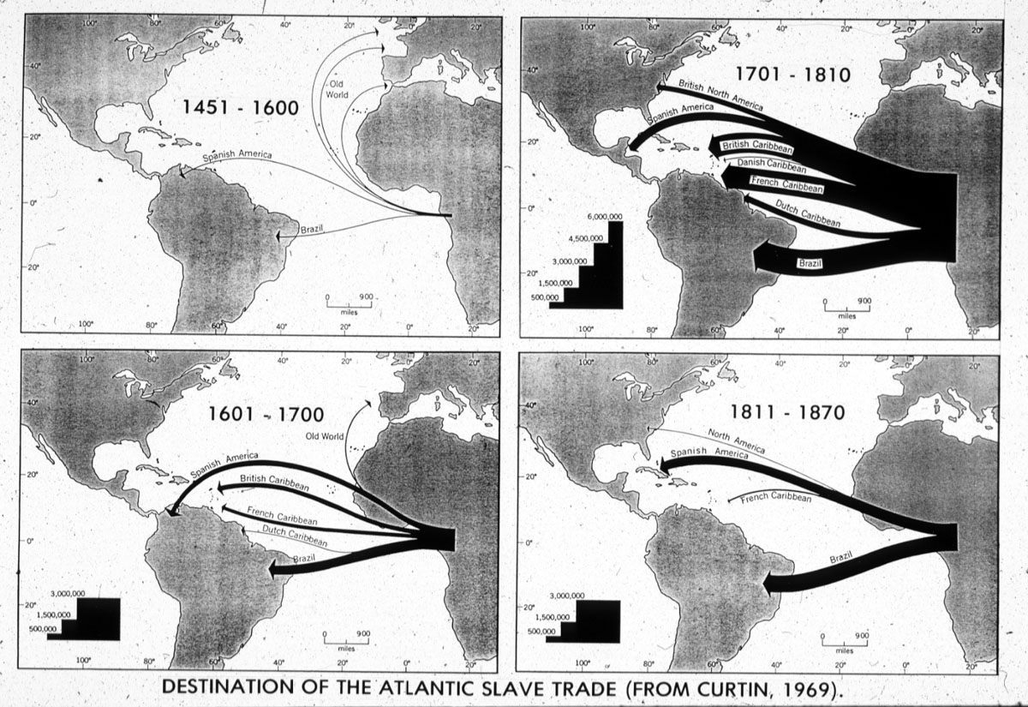

Slide 16
Raw materials from the Americas to Europe
Manufactured goods from Europe to Africa
Slaves from Africa to the Americas

Slide 17
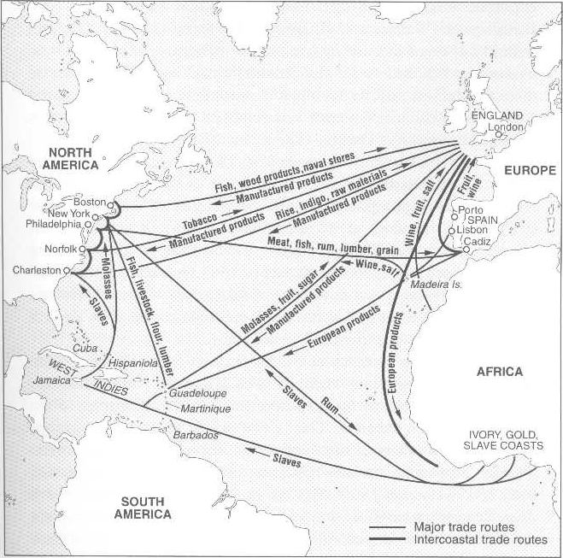

Slide 18
Consequences of the Atlantic Slave Trade
In Africa, numerous cultures lost generations of their strongest members, both men and women.
The slave trade introduced guns to the African continent
African slaves contributed greatly to the cultural and economic development of the Americas.
Africans brought their culture to the Americas

