Slide 1
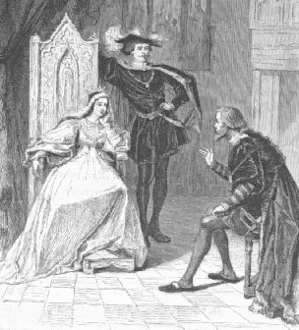
Spain
King Ferdinand and Queen Isabella
Inspired by/envious of Portugal
Aims to establish colonies and spread Christianity
Had just expelled the Moors and Jews in Spain through the Spanish Inquisition in 1492

Slide 2
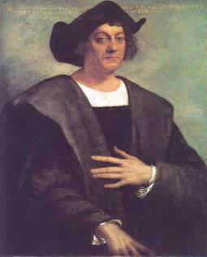
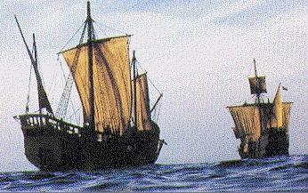
Christopher Columbus
Convinced Ferdinand and Isabella to pay for trip to find a western trade route to Asia
“Discovers” the Americas in 1492
Opens up exploration westward

Slide 3
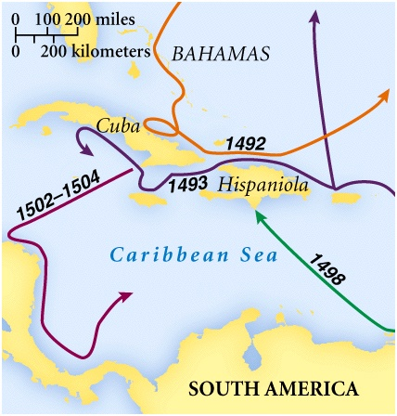
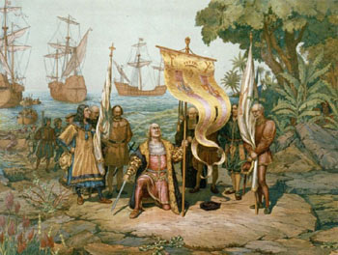

Slide 4
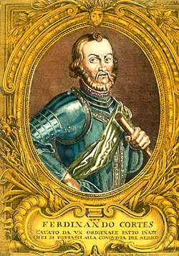
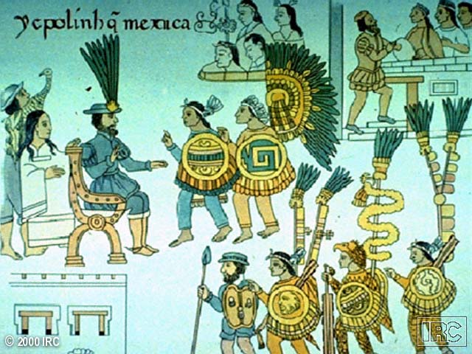
Hernando Cortez
Glory and Gold
Conquered the Aztecs in 1520

Slide 5
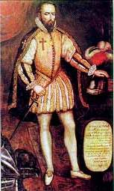
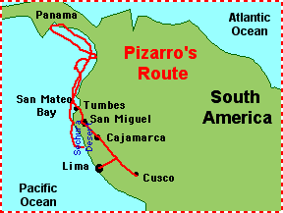
Francisco Pizzarro
Conquered the Incan Empire in 1535
Glory and Gold

Slide 6
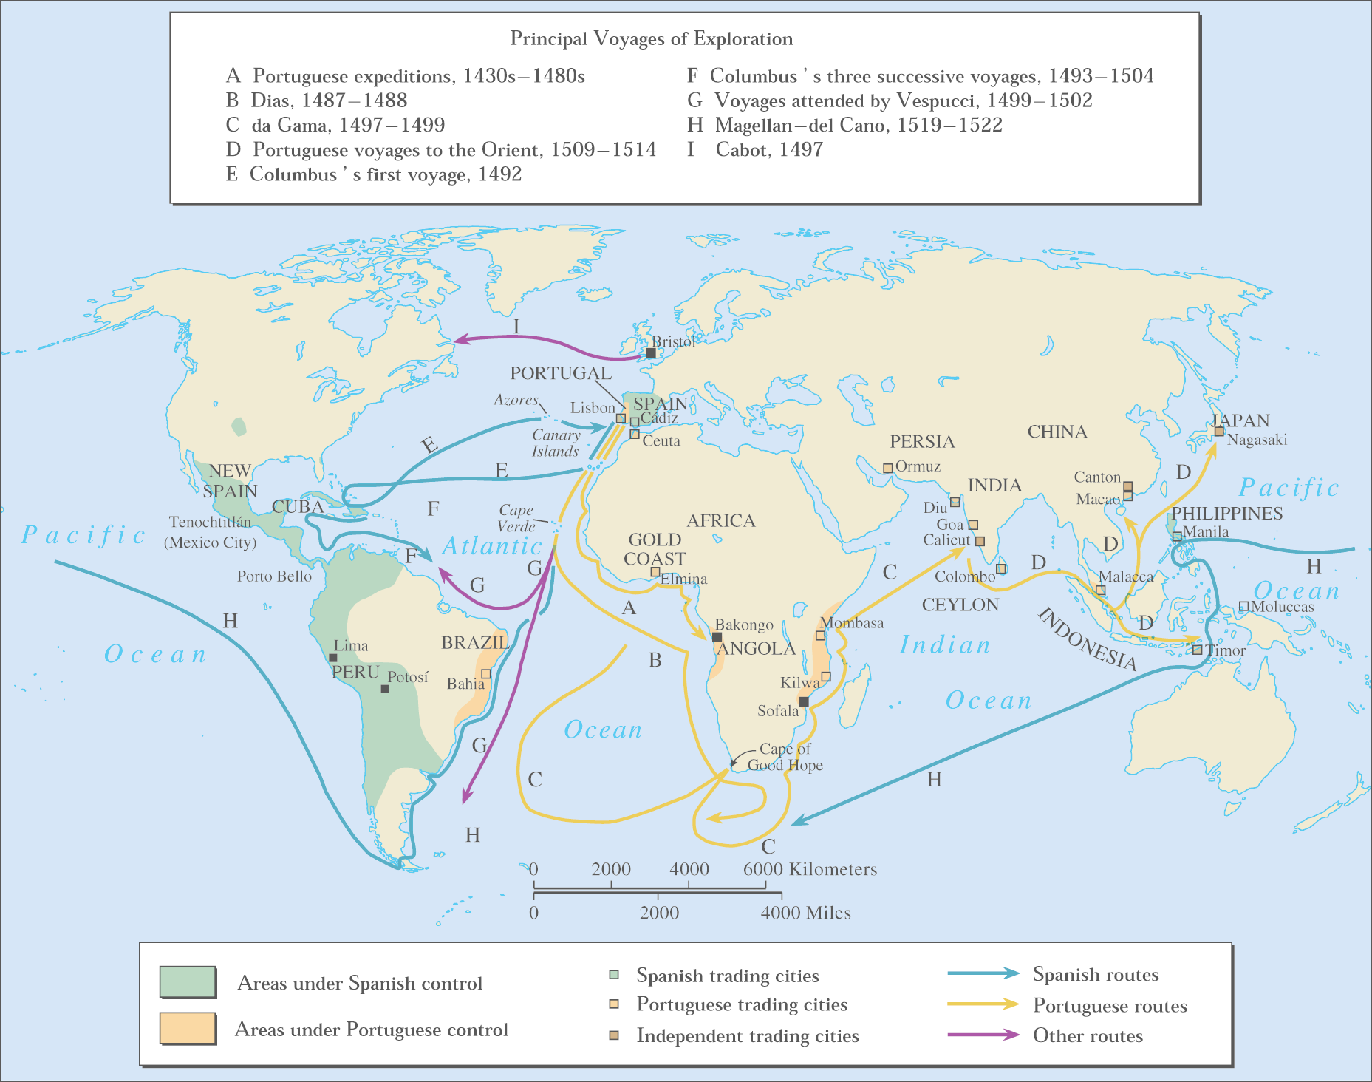
Map of voyages

Slide 7
