Slide 1
SSWH10 Analyze the causes and effects of exploration and expansion into the Americas, Africa, and Asia.
a. Explain the roles of explorers and conquistadors.
b. Analyze the global, economic, and cultural impact of the Columbian Exchange.
c. Explain the role of improved technology in exploration.
d. Examine the effects of the Transatlantic Slave Trade on Africa and on the colonies in the Americas

Slide 2
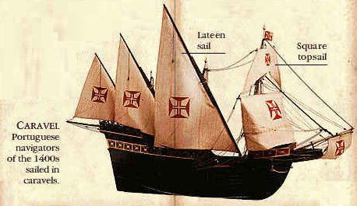
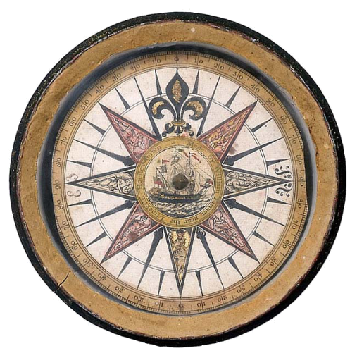
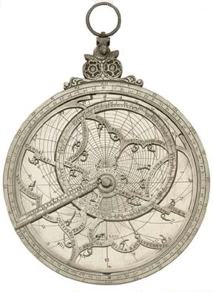
Background Information
Late 1400's to early 1600's
Renaissance
Spread of ideas, inventions, and curiosity
New inventions made for longer and safer journeys overseas

Slide 3
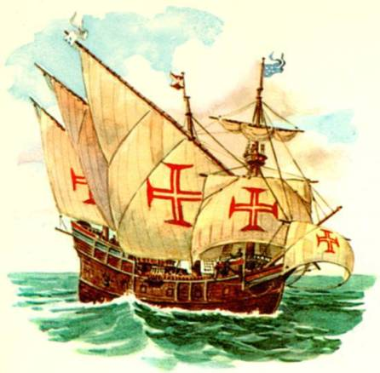
New Inventions
Caravel
Triangular Sails
could sail against the wind easier
Shallow keel allowed for travel up rivers
Easier to steer and could handle stronger winds and currents

Slide 4
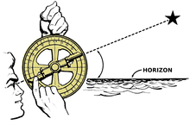
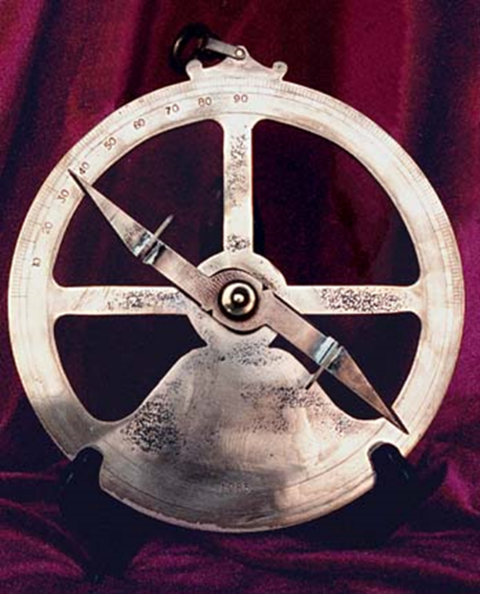
New Inventions
Astrolabe
Measured location of sun and North Star
Ability to determine latitude and longitude
Used for navigation

Slide 5
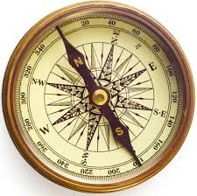
New Inventions
Magnetic Compass
Used in navigation
Became more accurate

Slide 6
Reasons for the Age of Exploration
Three main reasons:
God: sought to convert more people to Christianity
Christian and Muslim hostility
Glory: explorers sought fame for themselves and their country
Nationalism
Gold: looking for sources of wealth
Spices (nutmeg, cinnamon, pepper, ginger)
Mercantilism
WANTED A MORE DIRECT TRADE ROUTE TO ASIA

Slide 7
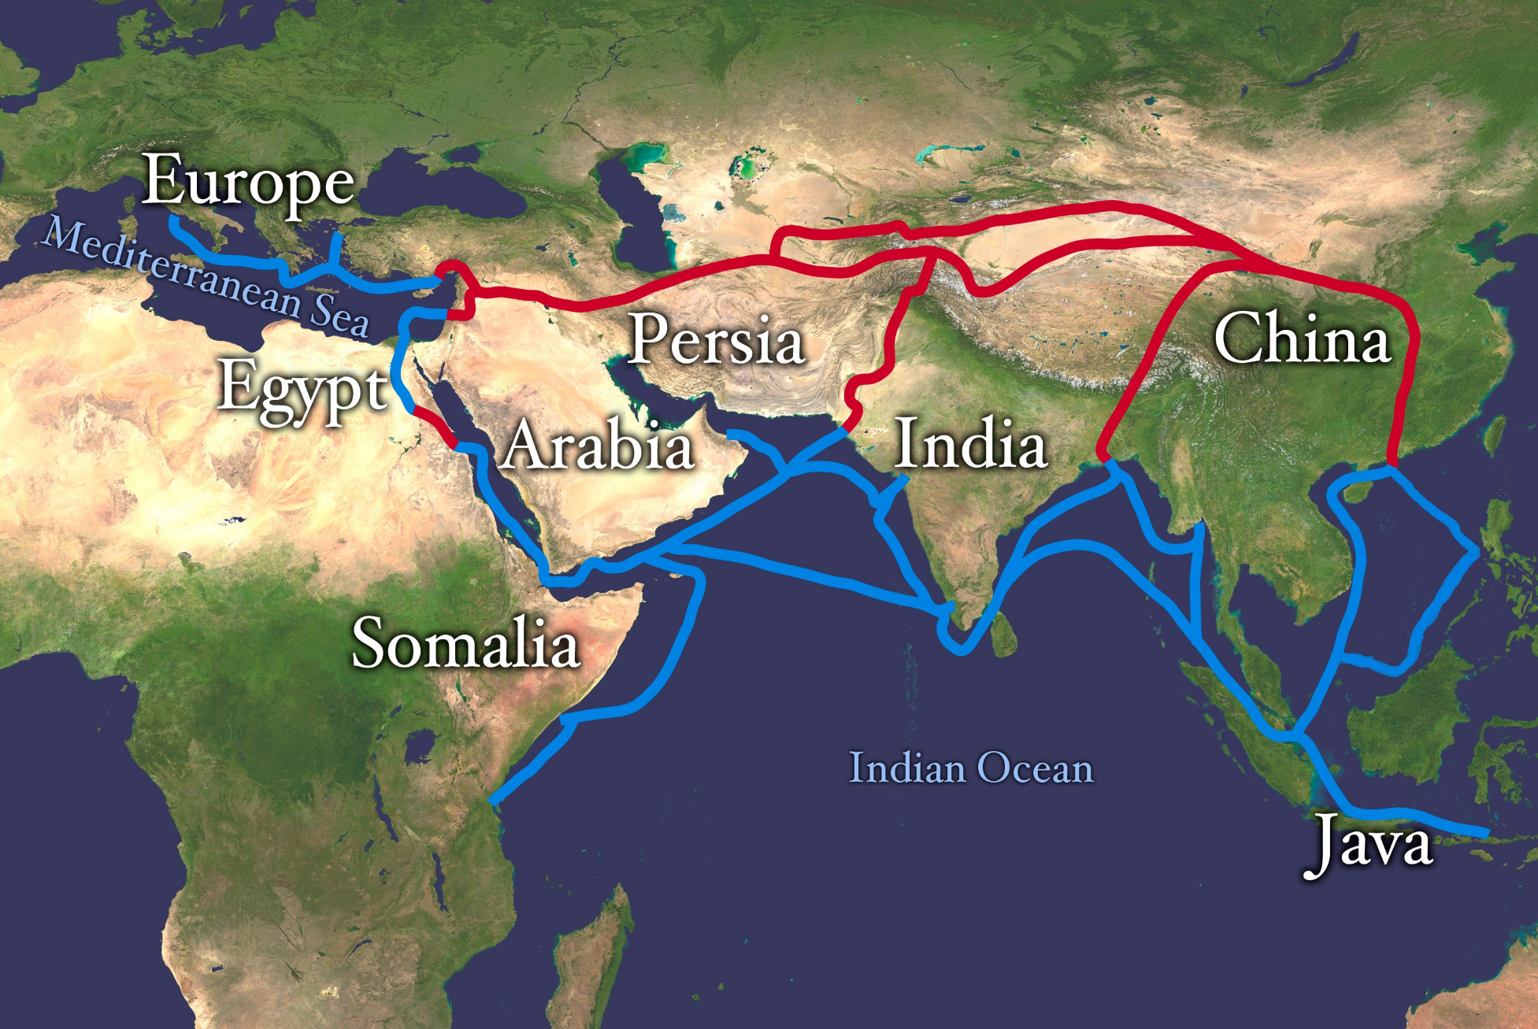
MAP OF TRADE ROUTES

Slide 8
Where did they go?
Goal = Asia
Originally around Africa to Indian Ocean
Later sailed West into the unknown
End up in the Americas

Slide 9
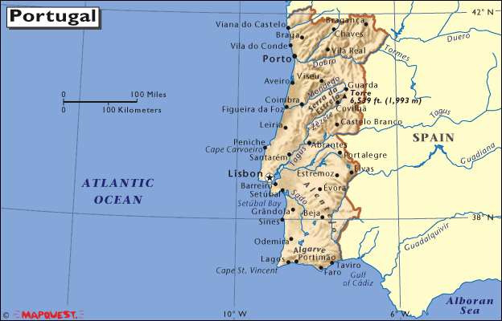
Portugal
Dominated trade in West Africa and then the Indian Ocean
Monarchy supported exploration
Prince Henry the Navigator
Had schools of navigation
Motivations for exploration:
Trade
Gold, slaves, spices, new products

Slide 10
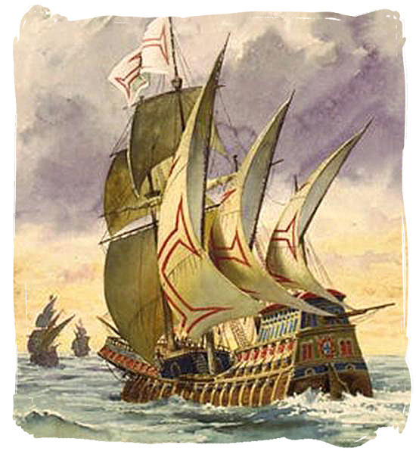
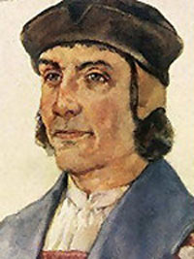
Bartolomeo Dias
Rounds the Cape of Good Hope (Southern tip of Africa) in1488
Opens up trade in the Indian Ocean

Slide 11
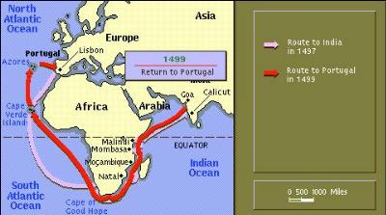
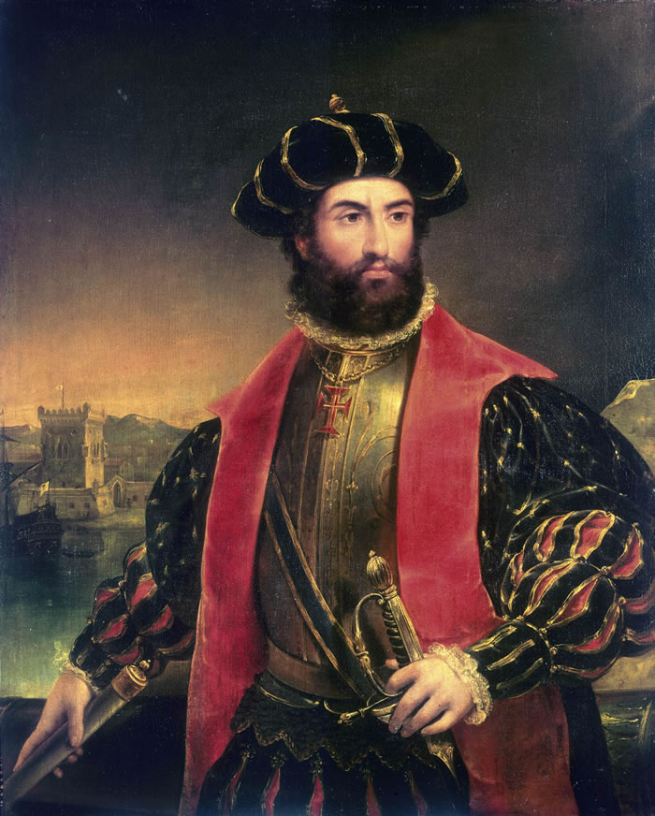
Vasco de Gama
Reaches India in 1498
First direct route by sea that doesn't go through Ottoman Territory
Brings back riches

Slide 12
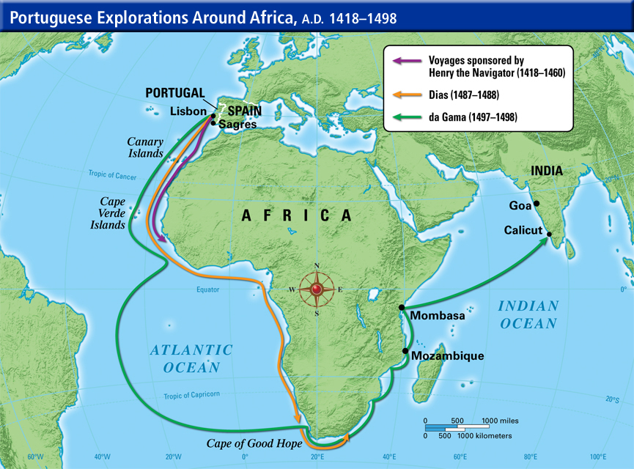

Slide 13
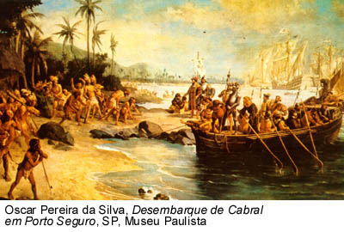
Pedro Alvarez Cabral
Claims Brazil for Portugal
Amerigo Vespucci
Identifies South America as a new continent (not part of Asia)
Ferdinand Magellan
Circumnavigates the globe

