Slide 1
End of World War II
Allied Victory

Slide 2
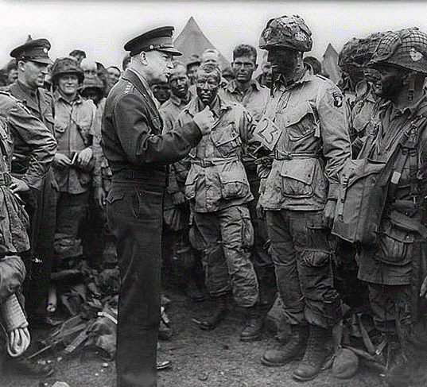
Where we left off…
In Europe:
Allies take Sicily – move into Italy
Allies take Rome
Nazis defeated at Stalingrad
In the Pacific:
Japan weakened
Battle of Midway
Allied victory at Guadalcanal

Slide 3
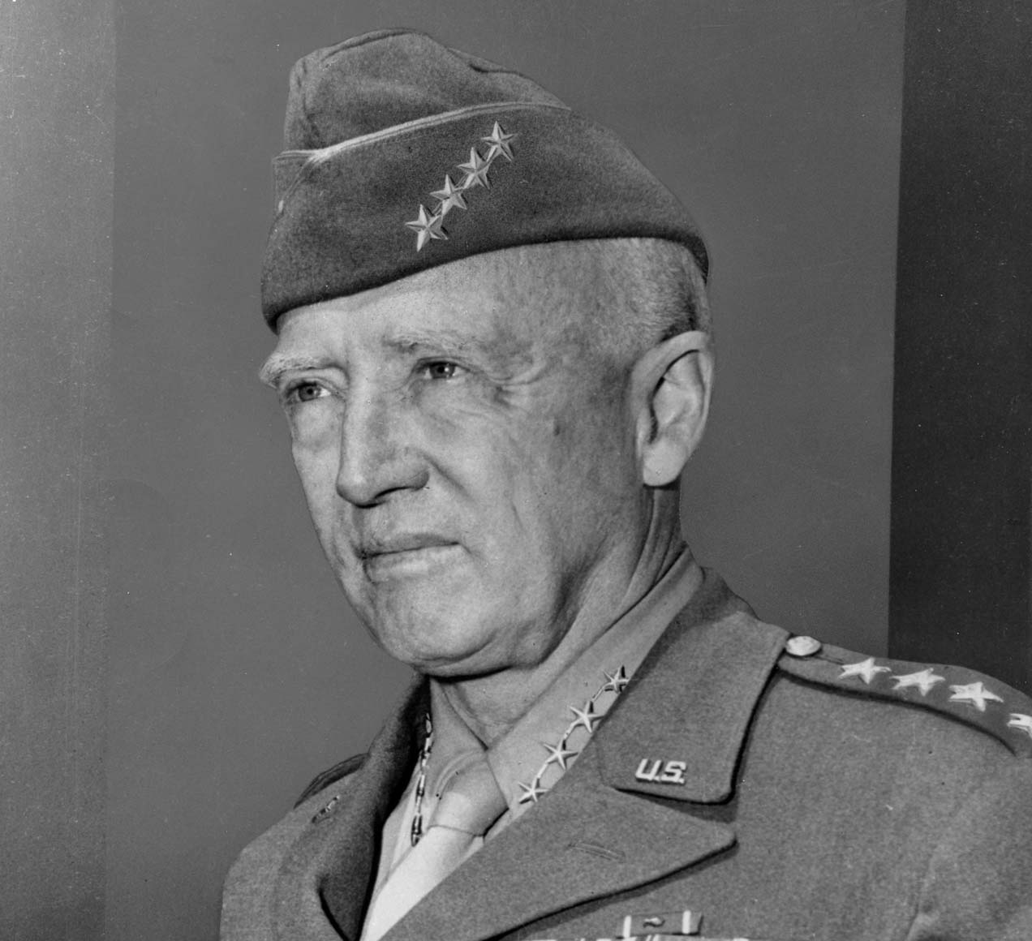
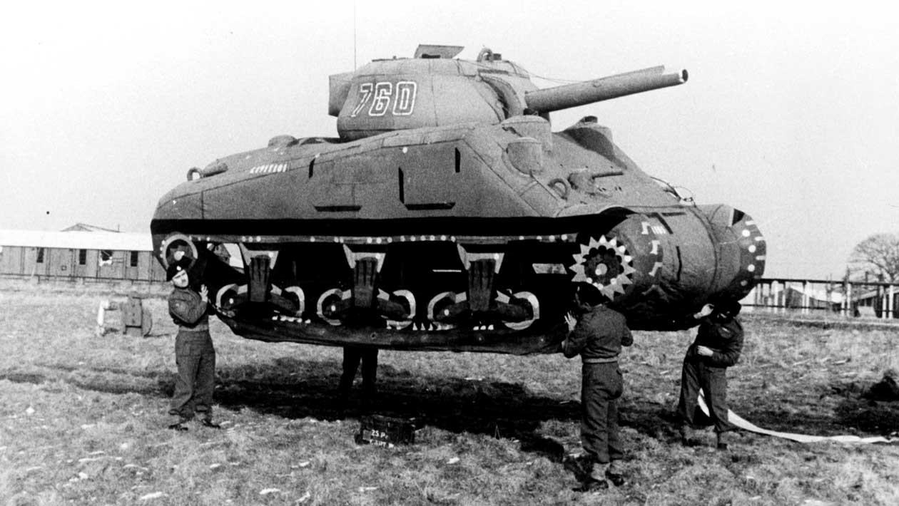
Plans to Invade France
Allies next move is to invade German-occupied France
1943 – Allies secretly build invasion force
Create Ghost army using film props and balloons to give impression attack was coming from somewhere else
Commanded by General George Patton
May 1944 – Allied attack was prepped and ready

Slide 4
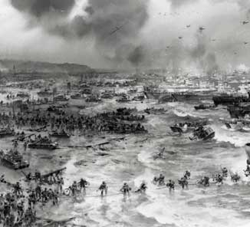
D-Day Invasion
Code named Operation Overlord
Commanded by General Dwight D Eisenhower
June 6, 1944 – Allied soldiers from USA, Britain, France, and Canada storm the beaches in Normandy, France
Largest land and sea attack in history
Germans surprised by attack – expected at another location
Additional reinforcements arrive
Allies take heavy casualties, but successfully move into France

Slide 5
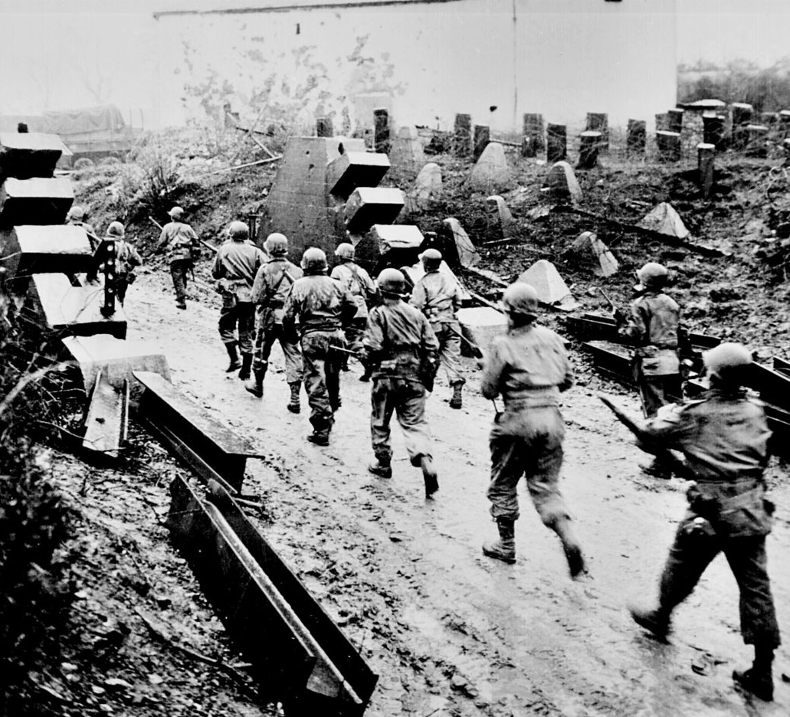
Allied Occupation of France
July 25th, 1944 – Allies successfully break through German defenses
US Third Army, led by General Patton
August 1944 – Allies march into Paris
By September, the Allies had liberated France, Belgium, and Luxembourg

Slide 6
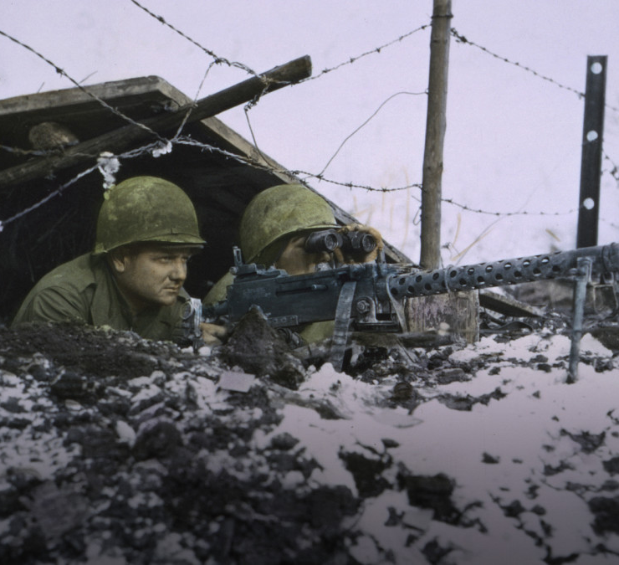
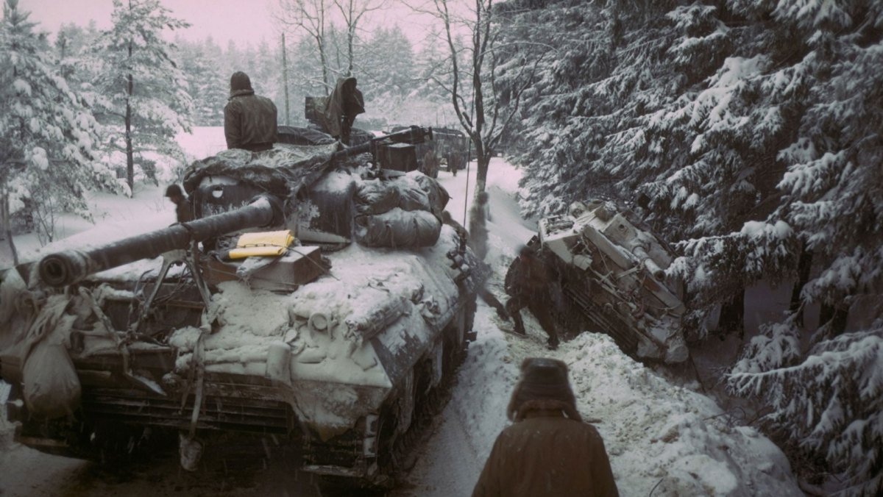
The Battle of the Bulge
While Allied forces were attacking from the west, Stalin and Soviets were attacking from the East
Take Poland and Romania
December 16, 1944 – Germans break through Allied defenses, beginning of the Battle of the Bulge
Largest battle ever fought by US Army, largest of WWII
Weakened German army is forced to retreat

Slide 7
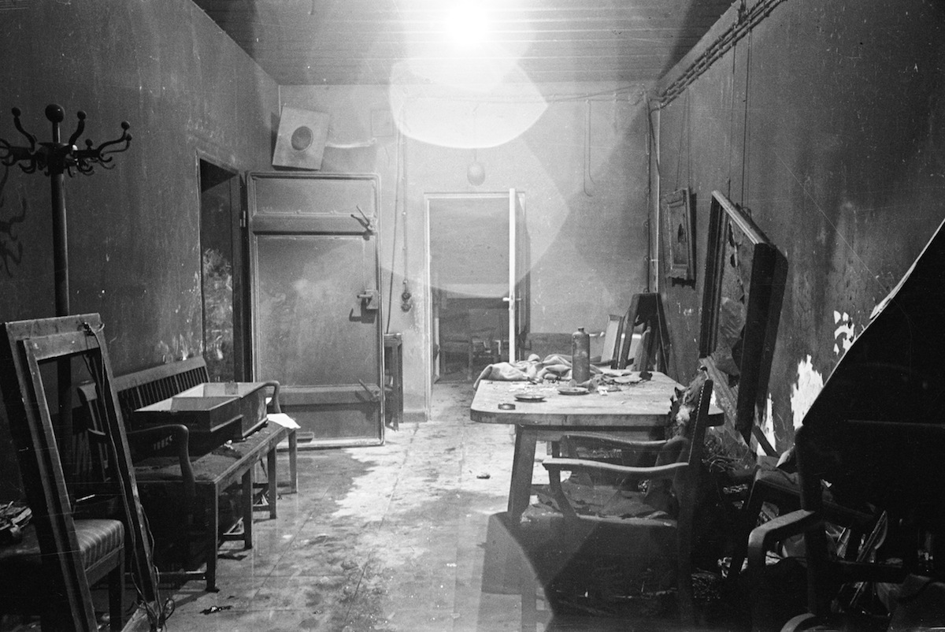
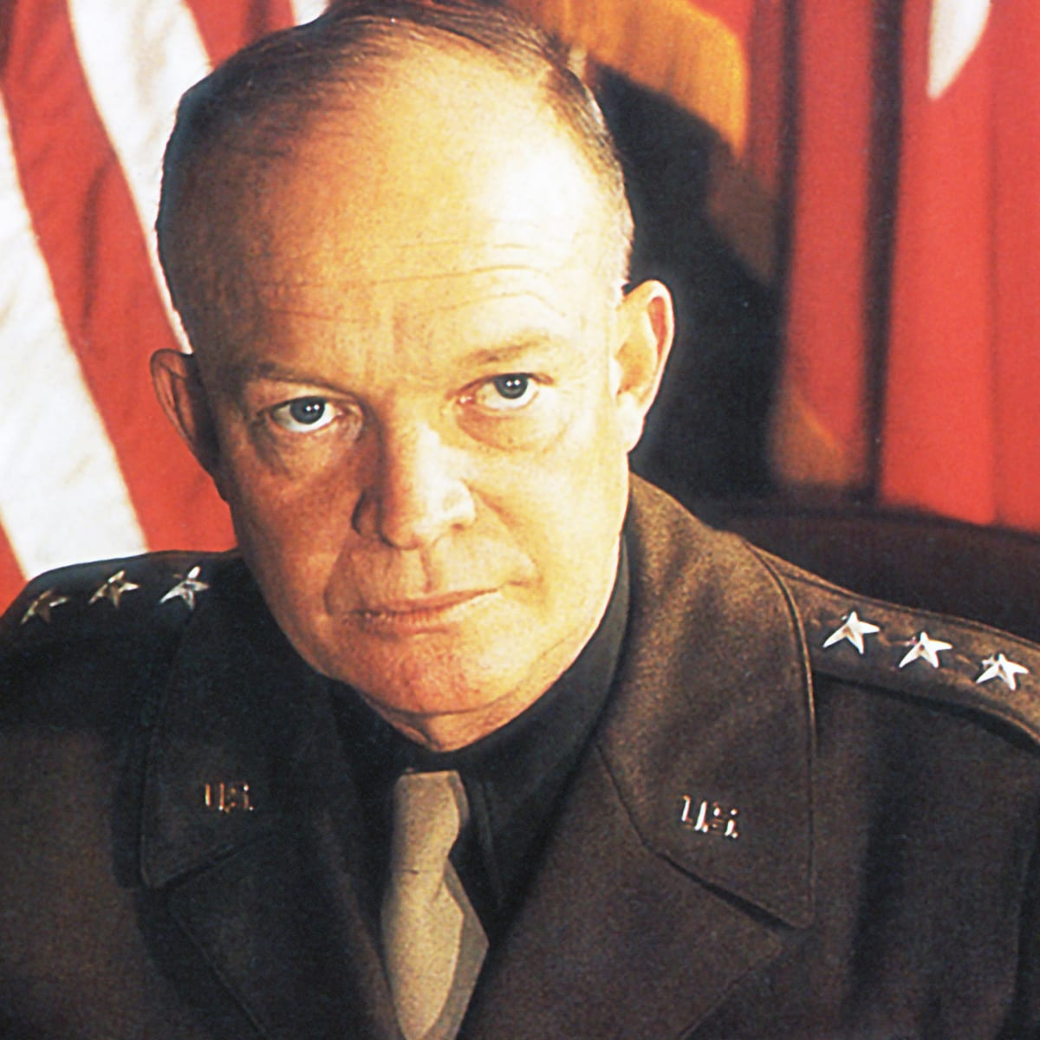
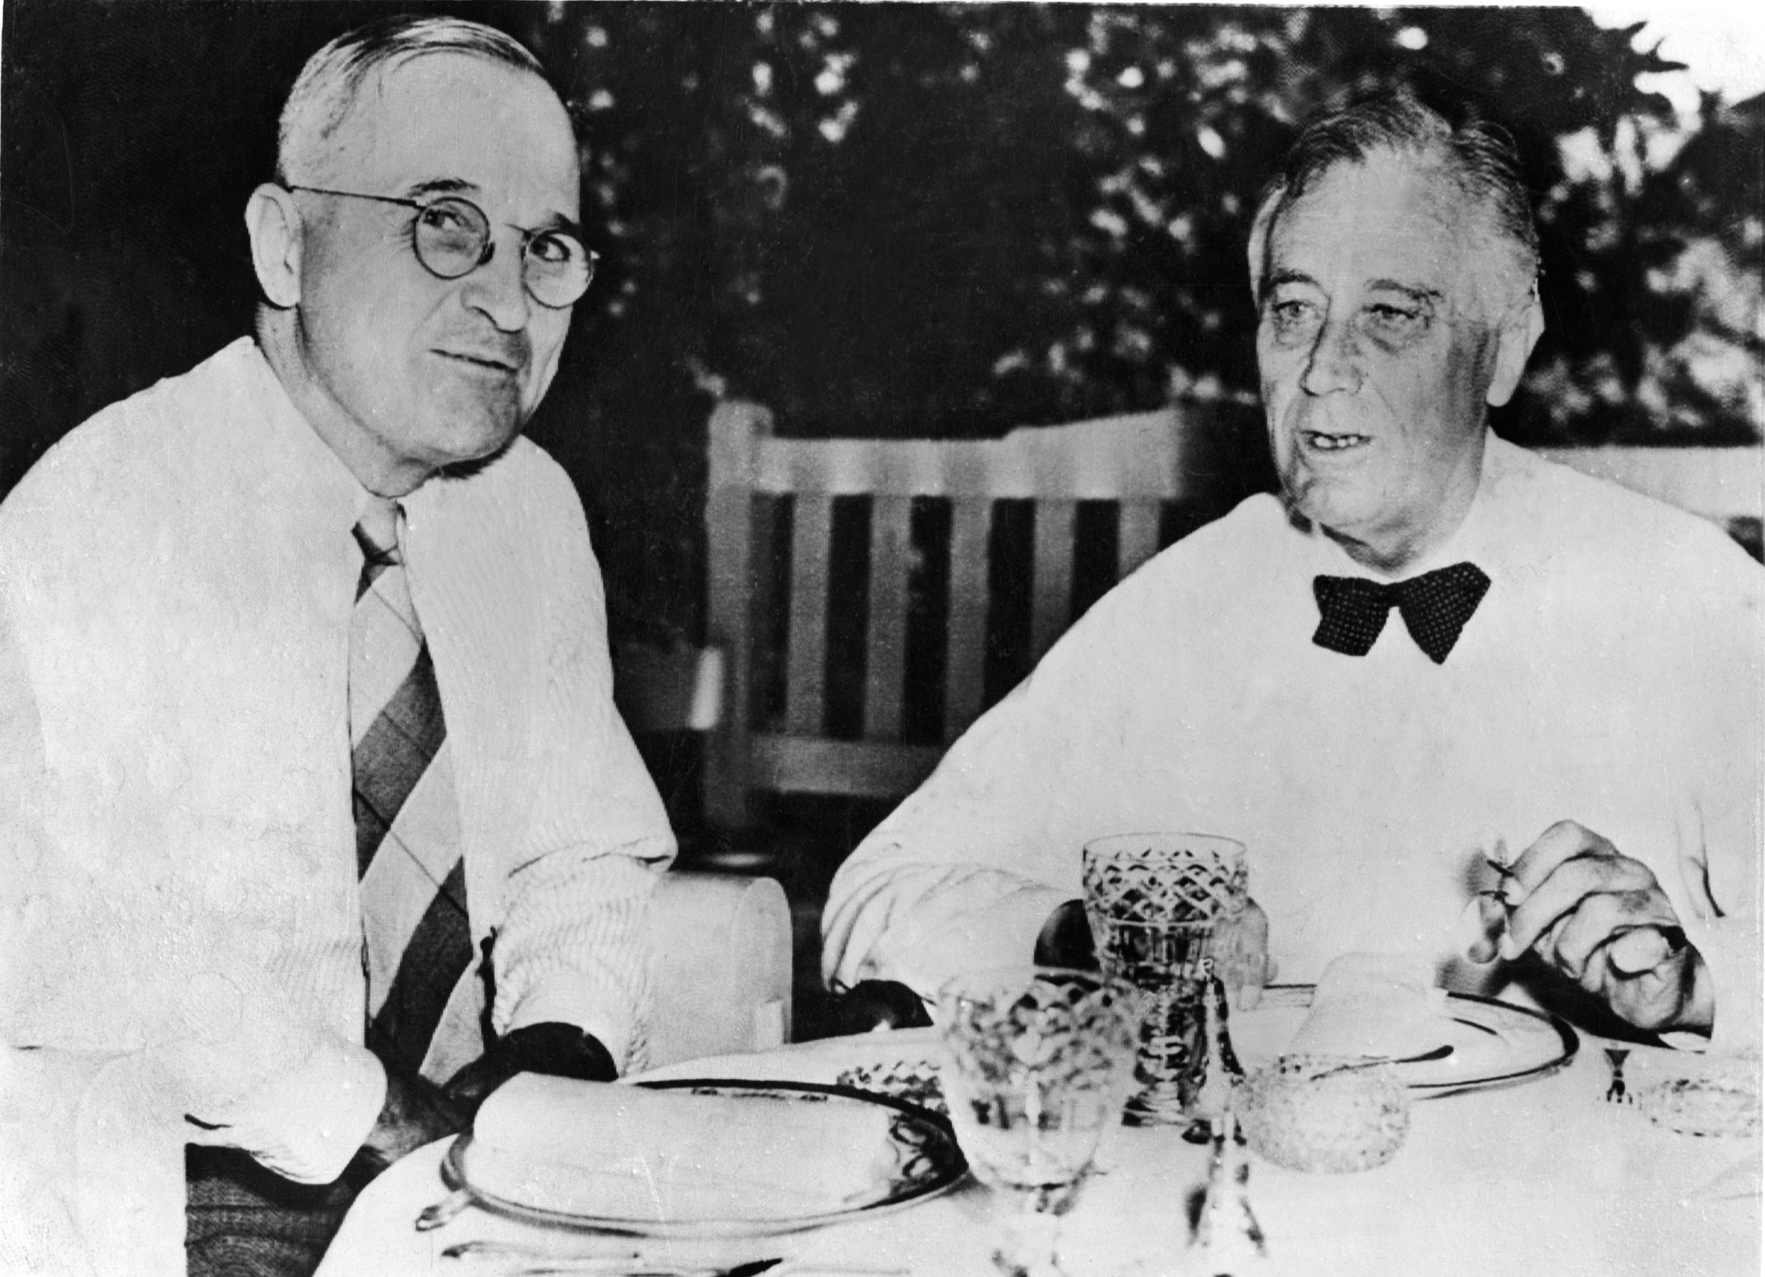
German Surrender
Spring of 1945 – Allied forces surround German capital of Berlin
Soviets unleashing heavy artillery on Berlin
Hitler takes shelter in underground bunker
Commits suicide – bodies burned
May 7th, 1945 – General Eisenhower accepts unconditional German surrender
President Harry Truman accepts surrender
President Roosevelt suffered a stroke on April 12th and died

Slide 8
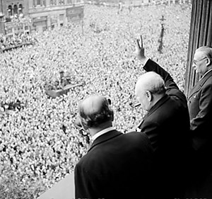
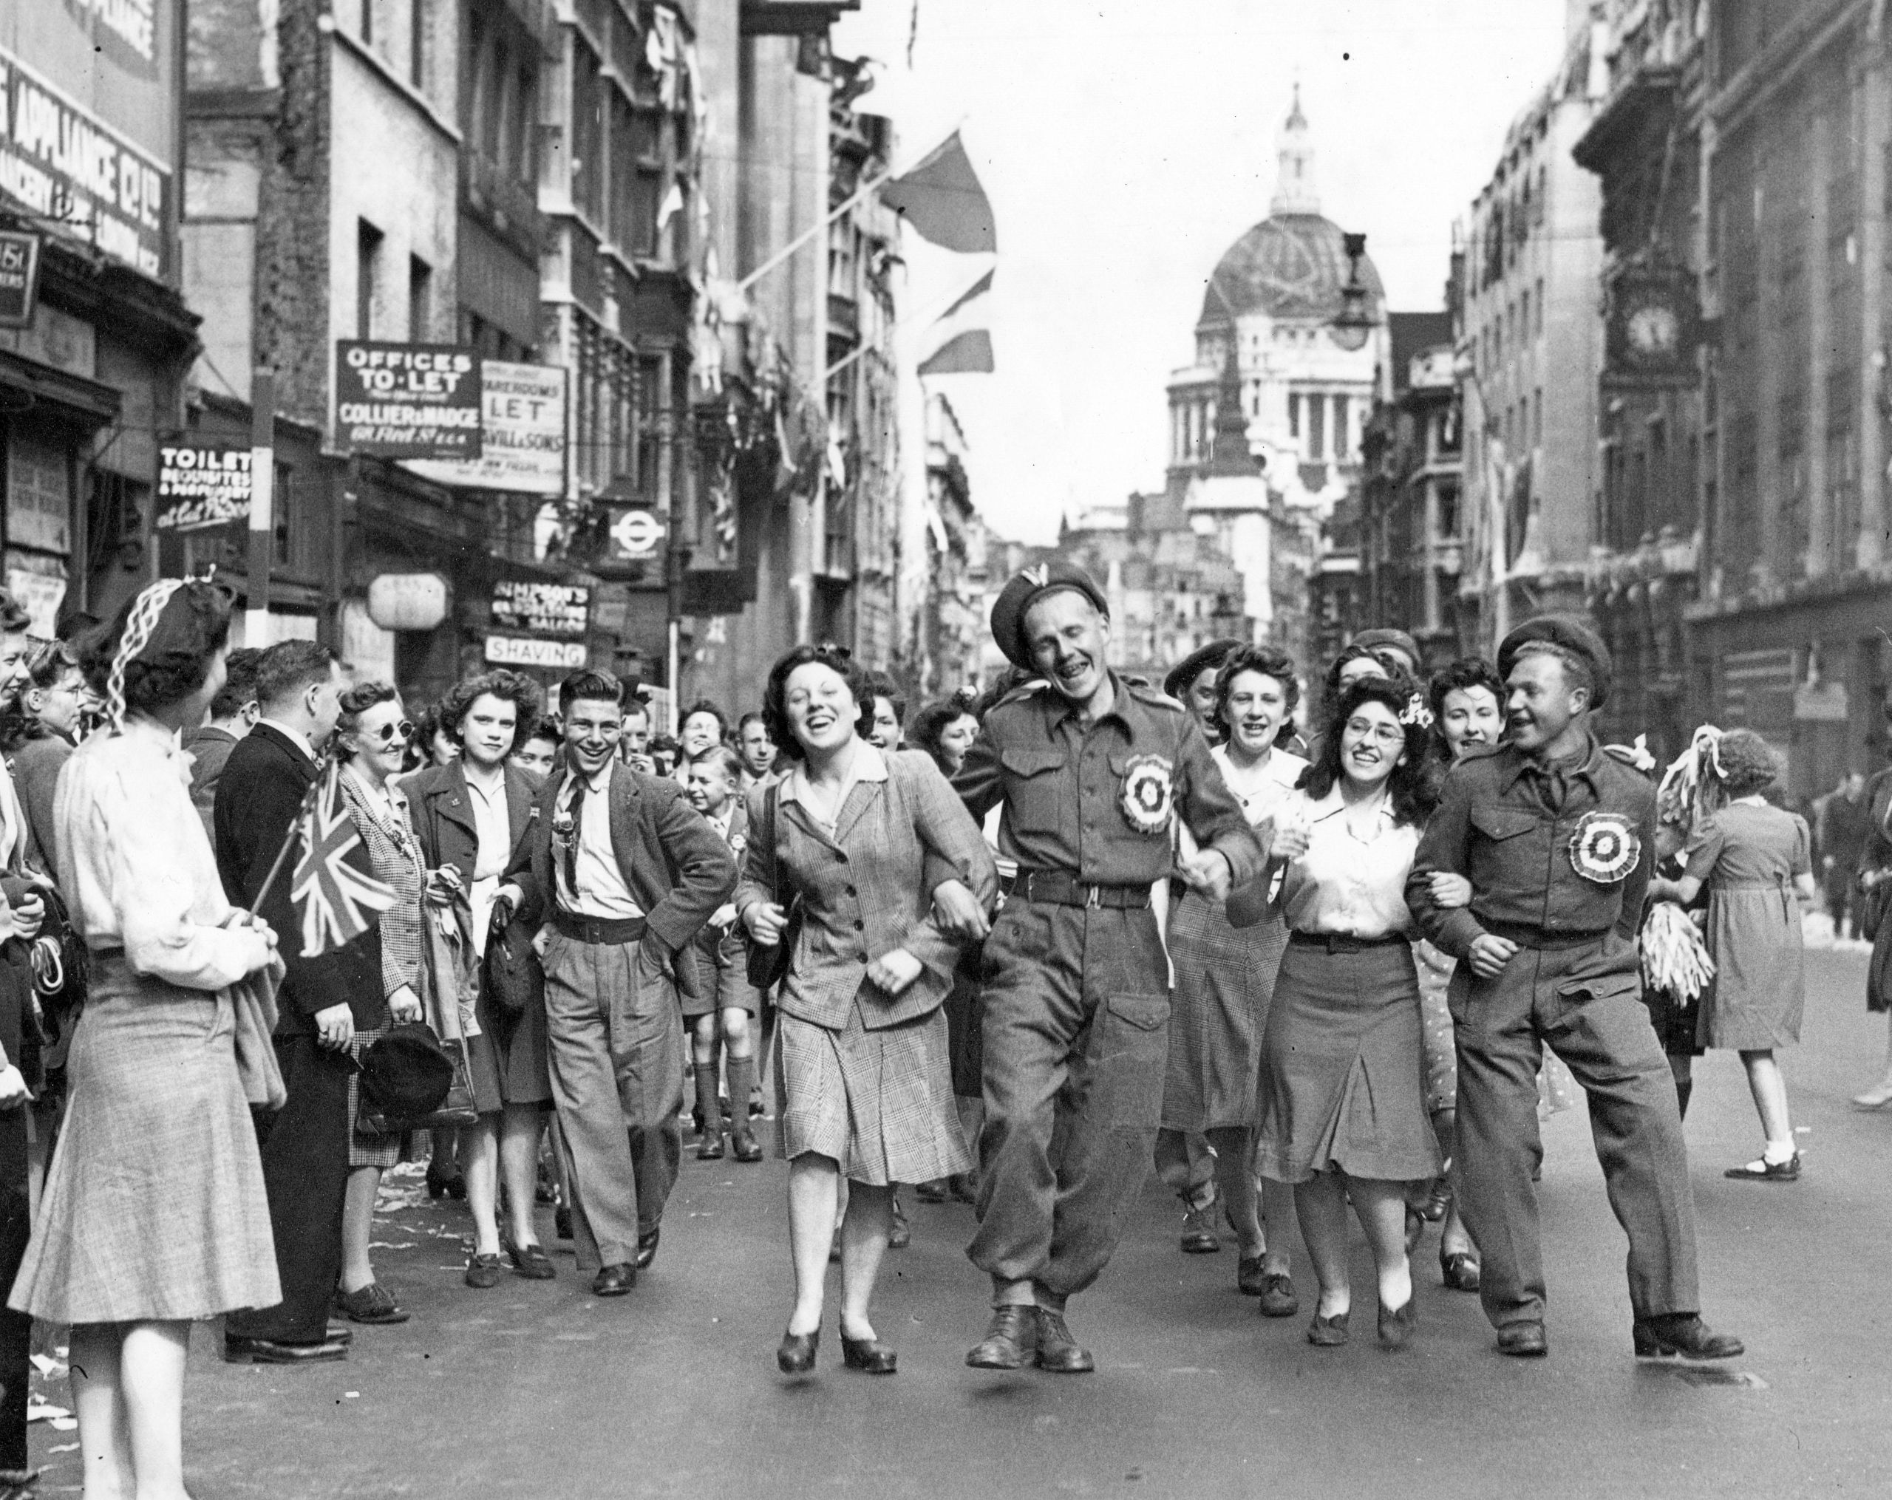
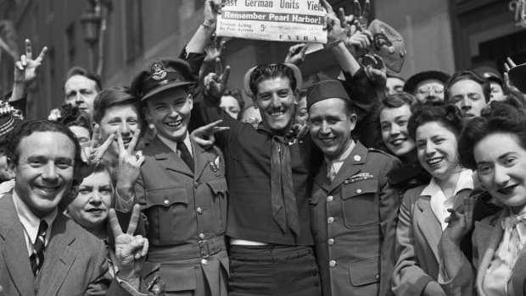
VE Day
Victory in Europe Day
May 8th, 1945
Surrender officially signed May 9th

Slide 9
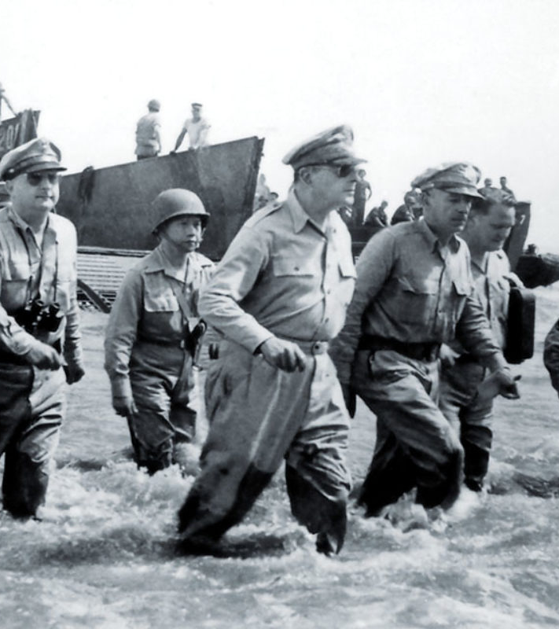
Pacific Theatre
While fighting was over in Europe, Allies were still fighting Japanese in Pacific
Douglas MacArthur makes return to Philippines to help move in on Japan
Japanese take risk at Battle of Leyte Gulf – major loss
Elimination of navy
Kamikazes and army remain
Japanese suicide pilots

Slide 10
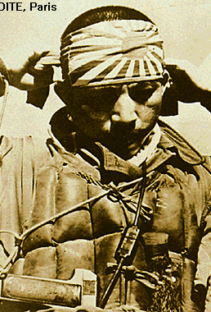
Kamikaze Pilot

Slide 11
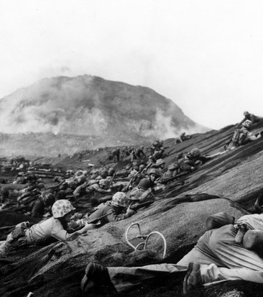
Iwo Jima and Okinawa
Iwo Jima – Allied victory
March 1945
Battle for 14 square mile island located 760 miles from Tokyo
25,000 Japanese protected the small rocky island and it took over 110,000 Americans to defeat them. Only 216 Japanese surrendered--the rest died.
More US medals of honor were given for this battle than any other single battle of the war.
Okinawa – Allied victory
Island 350 miles from southern Japan
One of the bloodiest battles of war
Japanese lose over 100,000, Americans 12,000

Slide 12
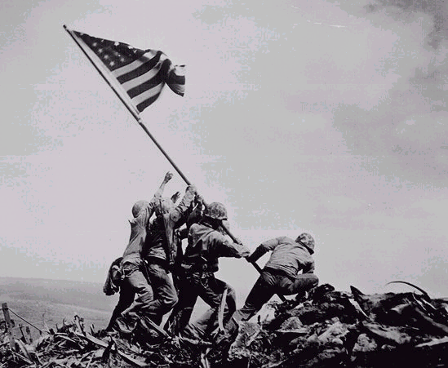
Marines Raising US Flag at Iwo Jima

Slide 13
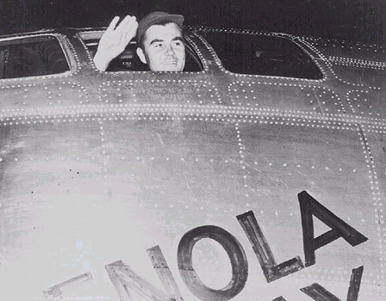
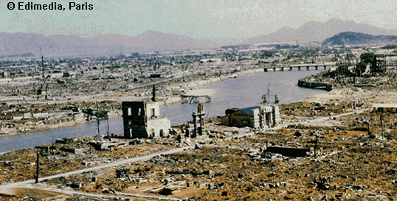
The Bombing of Hiroshima
Invasion of Japan would risk half a million lives
President Truman warned Japanese of destruction if they did not surrender
Truman uses new weapon technology – atomic bombs
August 6, 1945: On President Truman’s orders, the Enola Gay dropped an atomic bomb on the city of Hiroshima.
It destroyed about 90% of the city and killed between 70k – 80k people

Slide 14
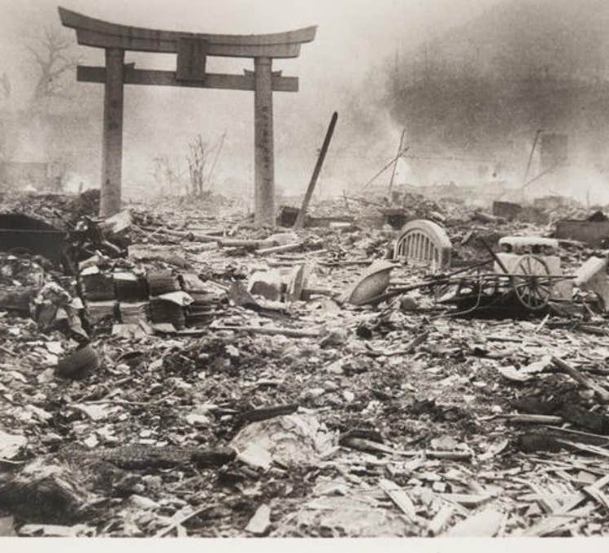
The Bombing of Nagasaki
Japan did not surrender after Hiroshima bombing
August 9th, 1945 – second atomic bomb dropped on Nagasaki
More than 70k people killed instantly

Slide 15
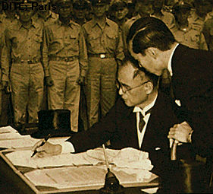
VJ Day
Japanese agree to an unconditional surrender on August 14, 1945
Victory in Japan Day - September 2nd, 1945
Japanese surrender to Douglas MacArthur on USS Missouri in Tokyo bay, officially ending World War II

