Slide 1
East Asia
Two Different Stories: China and Japan

Slide 2
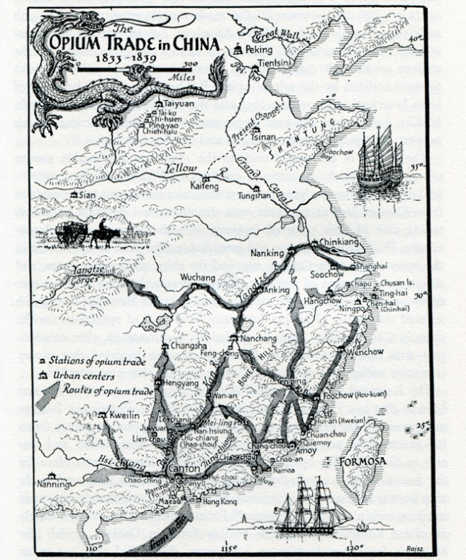
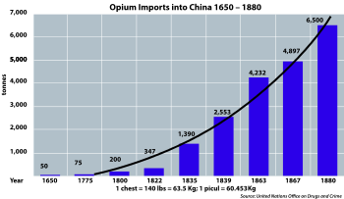
Trade in China
Opium Trade
British: sought a more favorable balance of trade with China
Need a product to introduce into China to reverse balance of trade=choose opium
Opium addictive=creates ongoing demand
$$$ to England
Disruptive to Chinese society

Slide 3
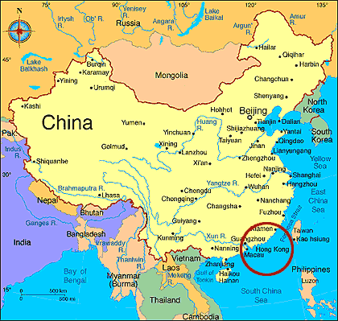
Opium War
Chinese try to ban opium
British send gunboats to Canton to force trade to continue
Opium War (1840-42)
British easily defeat Chinese navy and army
Signify WEAKNESS of China
Treaty of Nanjing
Force opening of 5 Chinese ports to Western trade
British-receive control of the city of Hong Kong
2 billion dollars to the British in payment

Slide 4
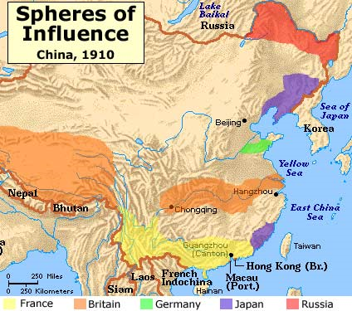
China overrun by foreign influence
Christian Missionaries pour into China
1890s United States issue Open Door Policy
NOBODY gets to colonize China
“market” stays open for everyone to trade
Demands by European powers and America create “spheres of influence” for trade
Each gets an area to control

Slide 5
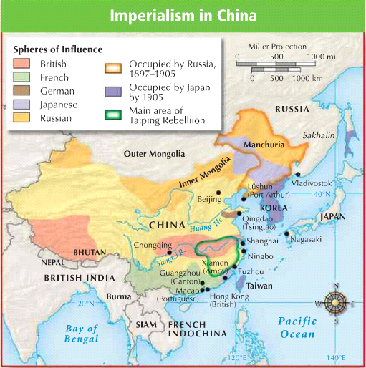
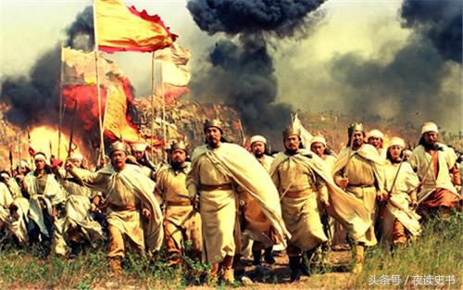
Taiping Rebellion
Internal belief among Chinese that Qing Dynasty lost mandate (Mandate of Heaven or right to rule)
1850s-1860s Taiping Rebellion
Uprising to overthrow the Qing
Put down by European/Qing forces
Qing too weak to put it down on their own
20 million die in the process

Slide 6
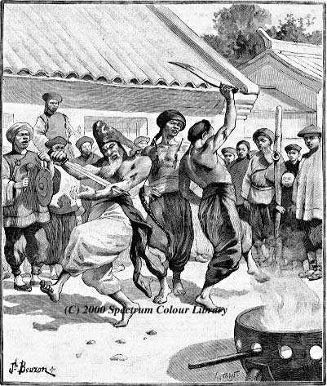
Chinese Rebellion
1900 Boxer Rebellion:
Led by group known as Society of Harmonious Fists or “Boxers”
Believed were immune to foreign bullets
Attacked Europeans, Americans, and Chinese Christians
Wanted to end foreign influence in China
Put down by foreign forces
Ironic
Humiliation for China at the hands of foreigners!!
Unable to end internal conflict, Qing comes to and end after 268 years
-1912 China becomes a republic

Slide 7
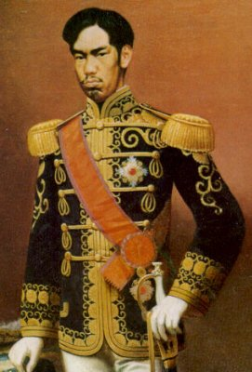
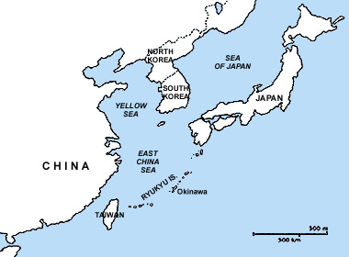
Japan’s Experience- Very Different!
Had been closed to trade with the west
Forced to open to Western contact in 1850s
Admiral Perry (U.S. Navy) sailed into port and demanded trade with Japan
Japan ROWED out to meet US gunships
Gave 1 year or face US gunships
Realize their weaknesses and saw need to modernize and industrialize
Result: Treaty of Kanagawa
Open ports to US trade
Meiji Restoration
Emperor Mutsuhito rise in power
Power return to emperor
Forced Westernization and industrialization to avoid being overpowered like China
Economic development and infrastructure
Military, education, industries

Slide 8
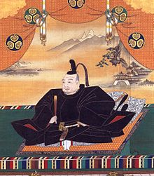
JAPAN – Different Outcome Tokugawa Shogunate
In the early 1600’s, Japan shut itself off from the world (isolationism)
System of feudalism (strict class distinctions and land ownership)
Samurai warriors kept Japan protected and fairly peaceful for two centuries.
Only occasional contact/trade with Korea and China
Ethnocentric

Slide 9
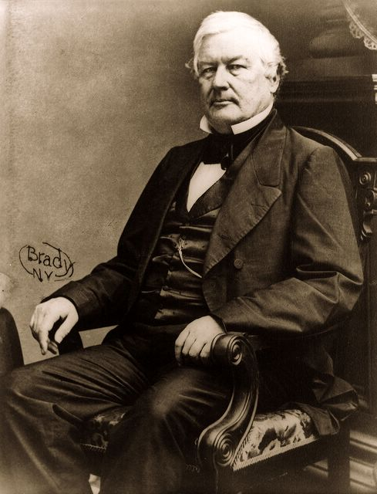
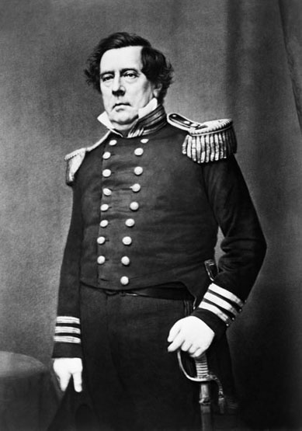
Tokugawa Shogunate
American Commodore Matthew Perry sent to Japan in 1853
This letter urged Japan to open up its ports to western trade or be destroyed in one years time.

Slide 10
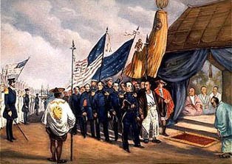
Tokugawa Shogunate
The Japanese reply came in the form of the Treaty of Kanagawa (1854)
Japan agreed to open 2 ports for the U.S. to take on supplies.
Soon other European nations were trading with Japan

Slide 11
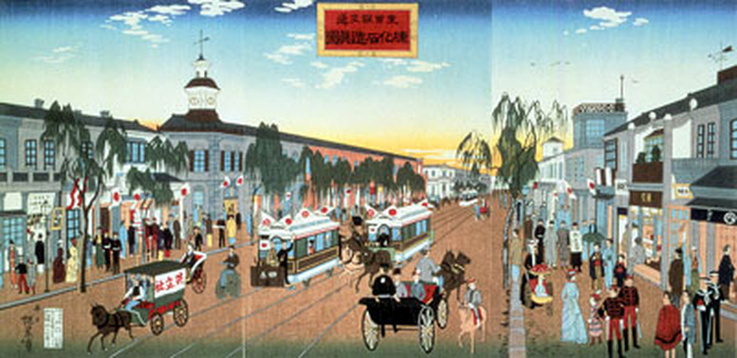
Meiji Reform and Modernization
Tokugawa Shogunate steps down in 1867
young Emperor Mutsuhito brought a new sense of national pride to Japan. (Nationalism)
Mutsuhito felt that the best way to counter Western influence in Japan was to quickly modernize, industrialize, and militarize.
This began the Meiji Era (1867-1913)
(Meiji = “enlightened rule” )

Slide 12
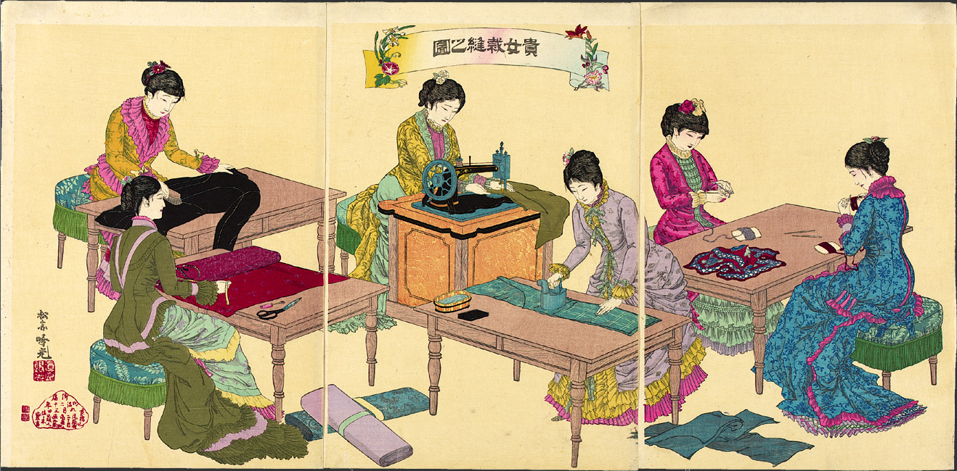
Meiji Restoration
Japan modeled their navy after Great Britain, their government and army after Germany, and their educational system after the United States.
In 30 years, Japan goes from a weak isolated nation to a powerful, industrial nation

Slide 13
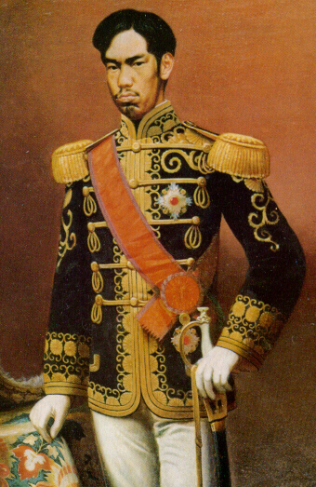
Quick Acrostic/Mnemonic Device
M = Meiji
E = Ends
I = Isolation
J = Japan
I = Industrializes

Slide 14
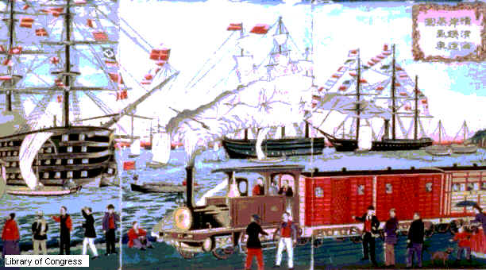
From Nationalism to Imperialism
Feeling proud of their new strength, Japan's feelings of nationalism grew.
Japan looked to compete with Europe and build their own imperial empire.

Slide 15
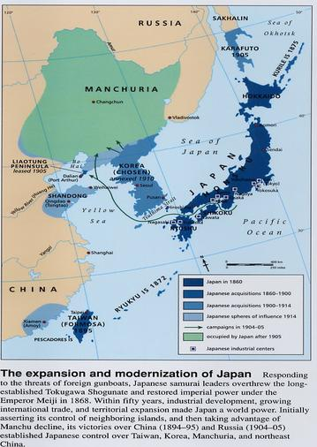
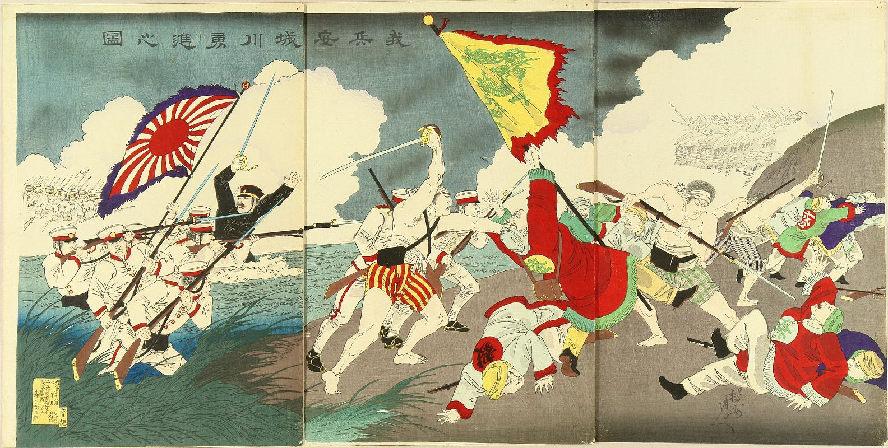
Meiji Restoration
Sino-Japanese War (1894-1895)
Fought between Japan and China for trading rights in Korea
Japan drove China out of Korea
Destroyed the Chinese navy
Gained a foothold in Manchuria (Northeast China)

Slide 16
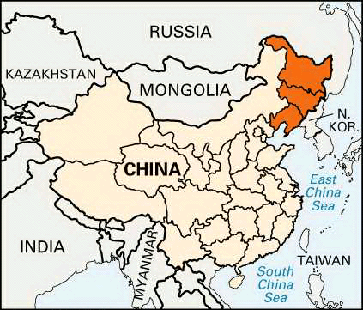
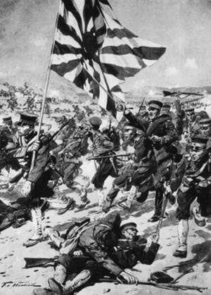
Meiji Restoration
Russo-Japanese War (1904)
War fought between Japan and Russia for control over Manchuria
Region is rich in resources in North Eastern China (borders Korea).
Ends in an embarrassing defeat for the much larger Russians

Slide 17
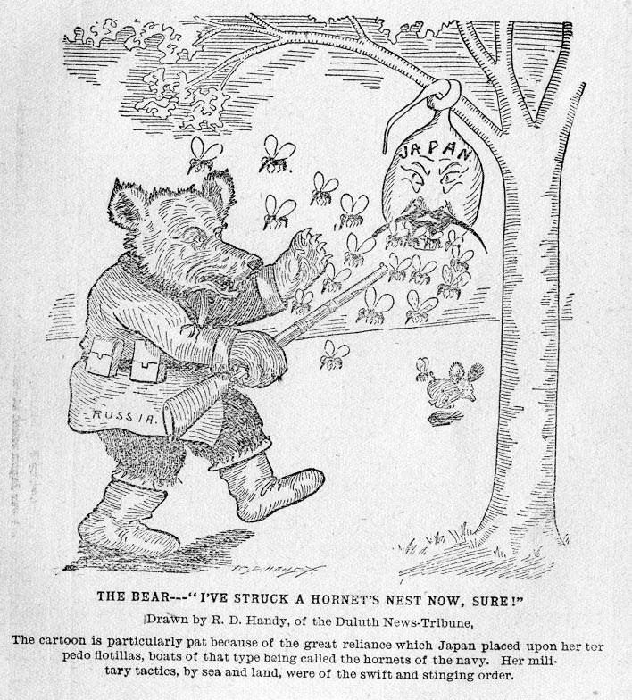
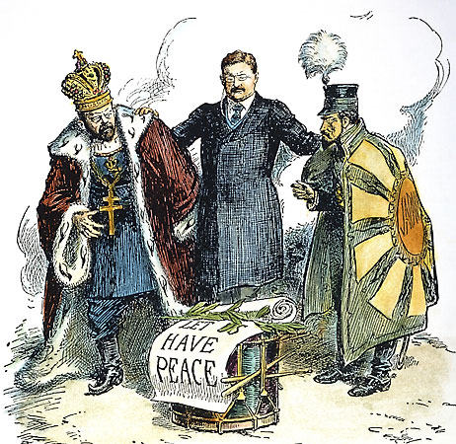
Russo-Japanese War Cartoons

Slide 18
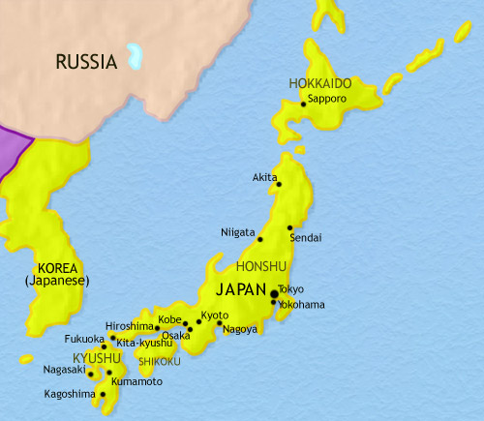
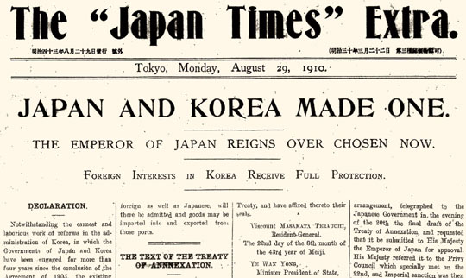
Meiji Restoration
After defeating Russia, Japan attacked Korea with a vengeance.
In 1905 Korea became a Japanese protectorate
By 1910, Japan took over, or annexed all of Korea.
Japan then set out on a brutal campaign to destroy Korean culture, and take over their businesses and industries.

