Slide 1
The Early Middle Ages

Slide 2
Europe in the 6th century

Slide 3
Impact of Fall of Rome
Disruption of trade led to decline of cities
People Needed protection
Decline of learning
People moved to the country
Gave up freedoms for protection
Decline of a common language
Results…

Slide 4
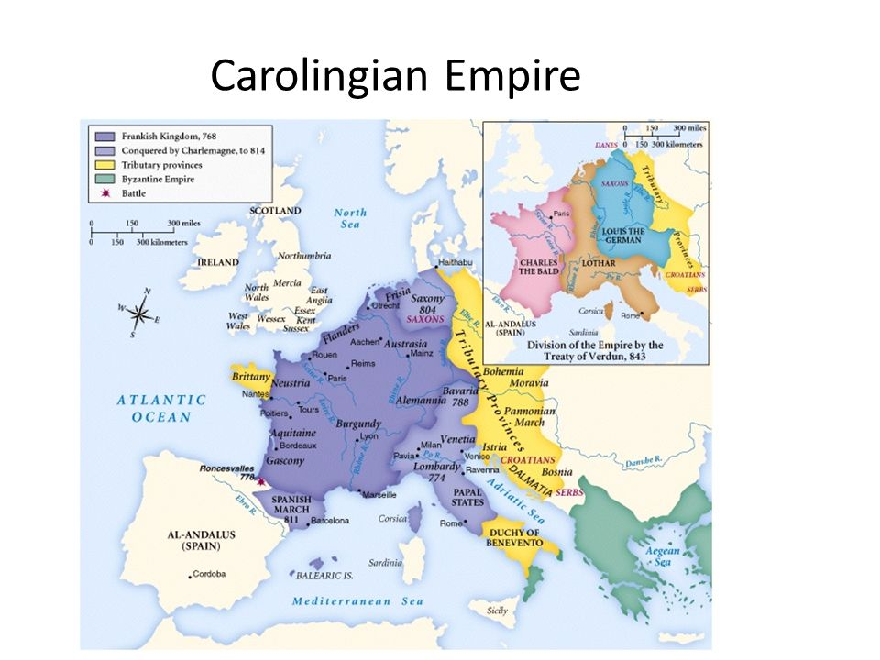
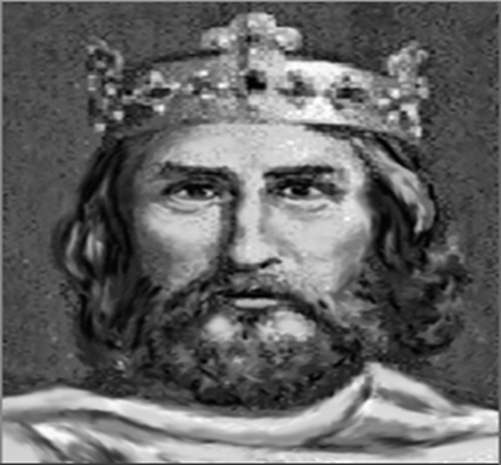
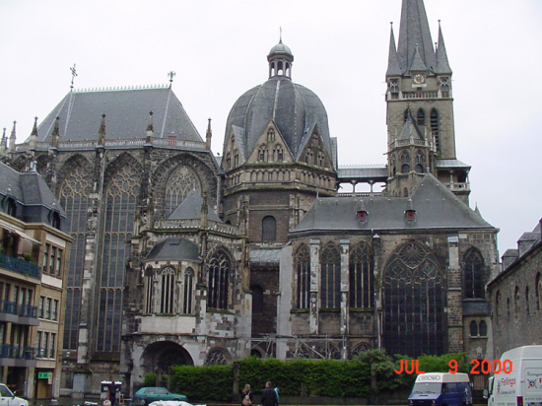
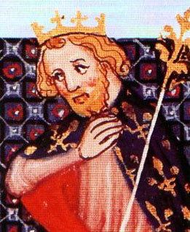
Carolingians
Carolingians
Charles Martel – reunited the Franks
Pippin III
Charles (Charlemagne)
Aachen-Roman Emperor’s
Residence
Notes:
Martel-ruled and reunited the entire Frankish empire. He fought off many invasions by Muslim invaders. Charlemagne’s gpa.
Pippin-was the first ruler of the Carolingians and Charlemagne’s dad. He was the first Frankish King anointed by the Pope.

Slide 5
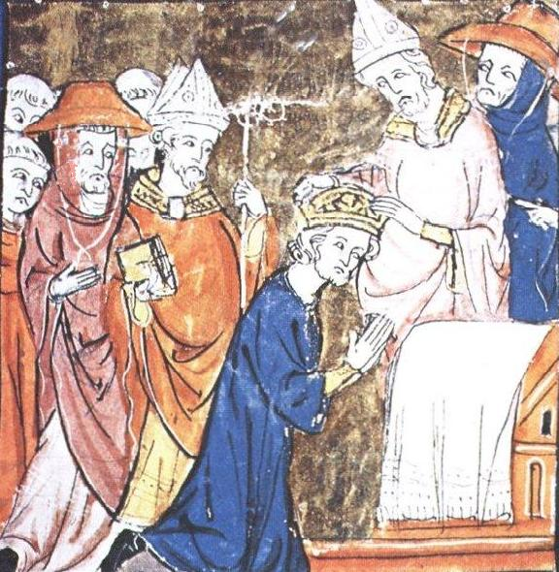
Charlemagne
Military Power- keep soldiers ready to fight all the time
Papal Alliance with Leo III
Defender of Pope
Crowned Holy Roman Emperor by the Pope (link the two)

Slide 6
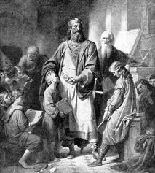
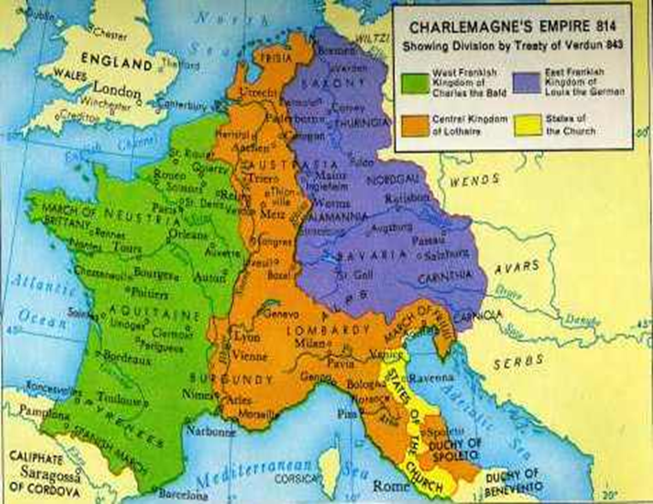
Society under Charlemagne (742-814)
Warfare
Education- schools through monasteries
Christendom- unified in Christianity
Empire Divided after death

Slide 7
The Roots of Feudalism
Carolingian Agriculture
Land=wealth and power
aristocrats held states or “manors.”
Manor Life
Peasants worked lord’s land and their own
Peasants owed dues and services to their lords
System of scattered manors =weakened defenses/vulnerable

Slide 8
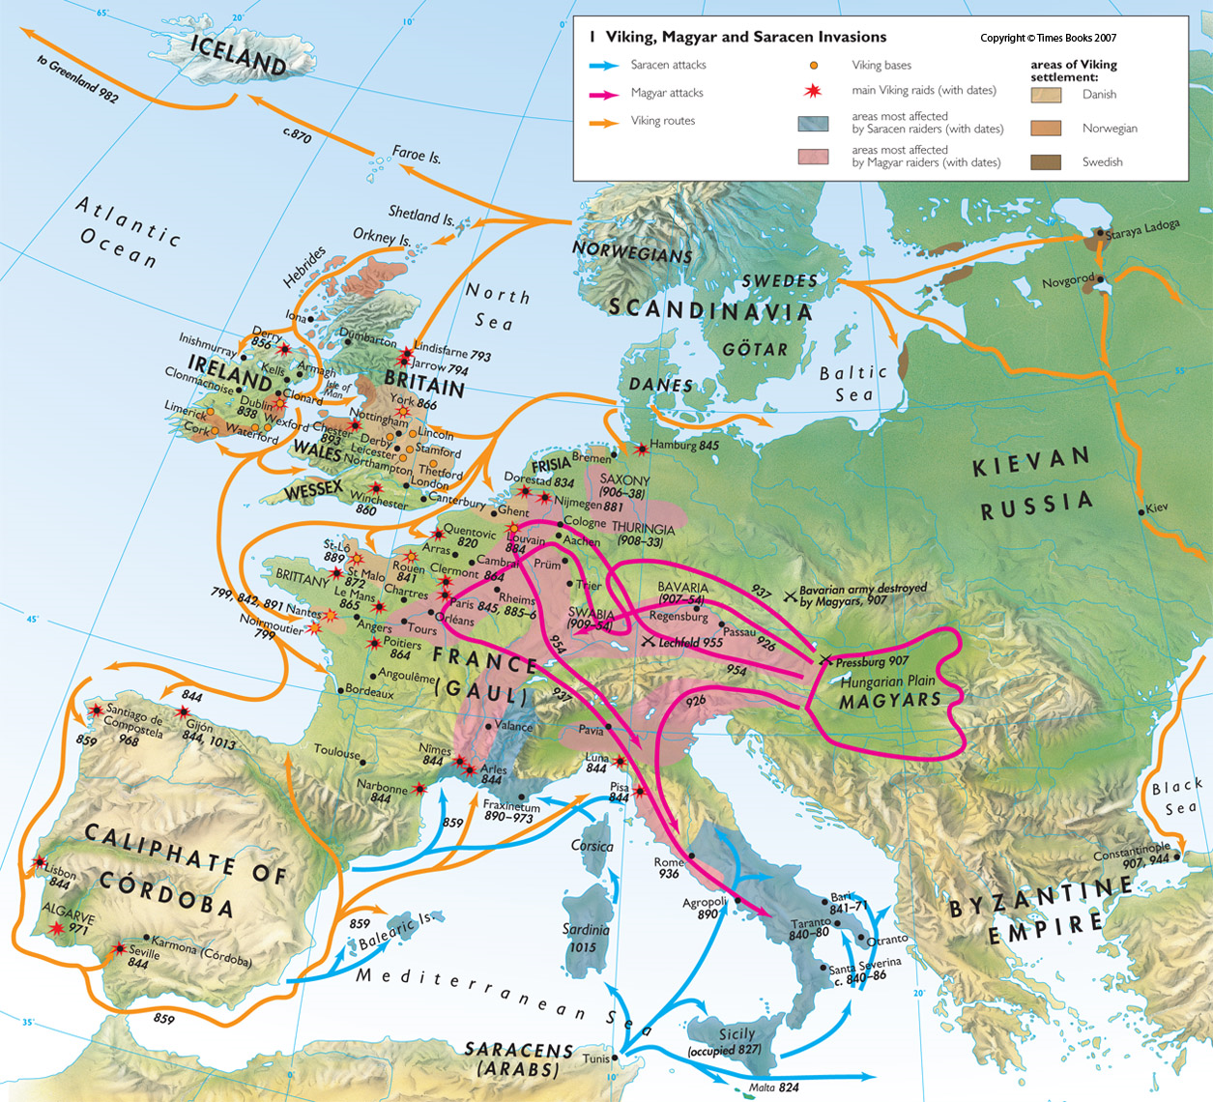
MORE INVASIONS!!

Slide 9
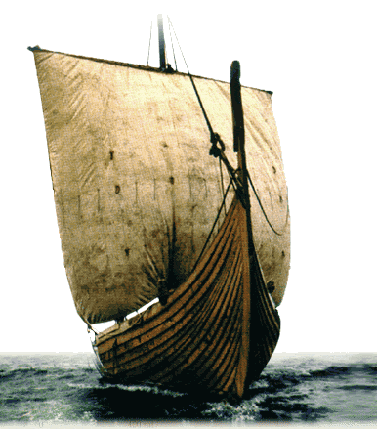
Invaders into Europe
Muslims
Spain and Med Sea
Magyars
East
Viking raids
No warning
Heavily armed
Sell victims into slavery
Destroyed Monasteries
Result?? Chaos.
Collapse of Central Government-Need for local protection=FEUDALISM

