Slide 1
Demand: Desire, ability, and willingness to buy a product
The law of demand says that as the price of a good rises the quantity of the good consumers are willing and able to buy will decrease
Inversely related
Low price= High quantity
High price= Low quantity
Quantity Demanded- The amount of a good that buyers are willing and able to purchase at a given price. (SPECIFIC NUMBER)

Slide 2
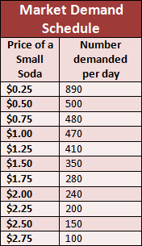
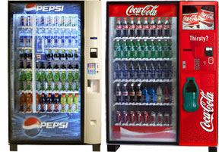
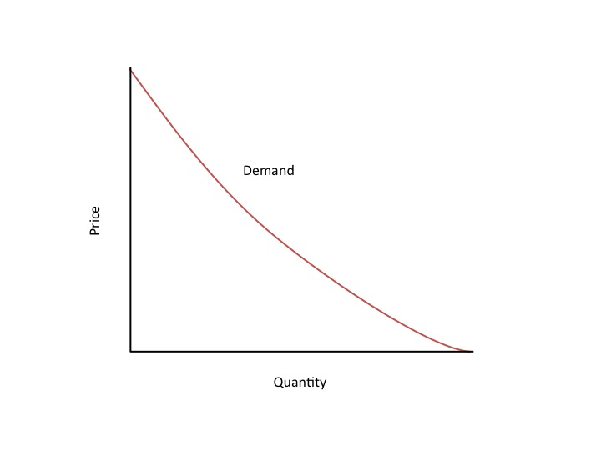
Demand Schedule & Curve
Demand schedule shows the relationship between the price of the good and the quantity demanded.
Demand curve is a graph of the relationship between the price of a good and the quantity demanded

Slide 3
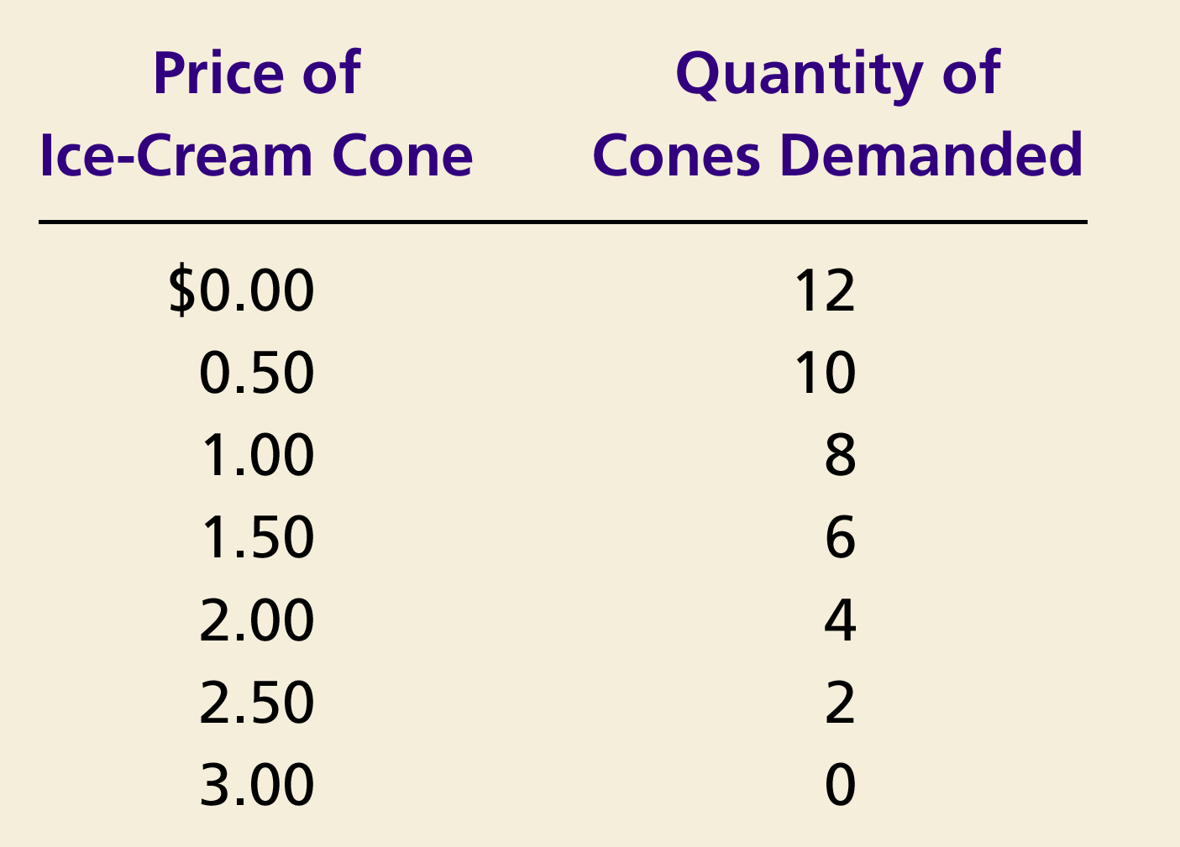
Demand Curve for Ice Cream Cones
Price of
Ice-Cream Cone
$3.00
2.50
1. A decrease
2.00
in price
...
1.50
The demand curve slopes downwards from left to right (a negative slope), indicating the Law of Demand.
1.00
0.50
0
1
2
3
4
5
6
7
8
9
10
11
12
Quantity of
Ice-Cream Cones
2.
...
increases quantity
of cones demanded.

Slide 5
Shifts and Changes in Demand
Changes in Quantity Demanded (Qd)
If there is a change in PRICE for the product, then there is a change in the QUANTITY DEMANDED (Qd)
This causes movement ALONG the demand curve.

Slide 6
Determinants of Demand
Change in Demand
Income of consumers
Number of consumers
Substitute price change
Expectations
Complement price change
Tastes or preferences
This results in a shift in the demand curve, either to the left or right.
Causes a change that alters the quantity demanded at every price.

Slide 7
Shifts in the Demand Curve
An increase is always to the right and a decrease is always to the left.
Price of
Ice-Cream
Cone
Increase
in demand
Decrease
in demand
Demand
curve,
D
2
Demand
curve,
D
1
Demand curve,
D
3
0
Quantity of
Ice-Cream Cones

Slide 8
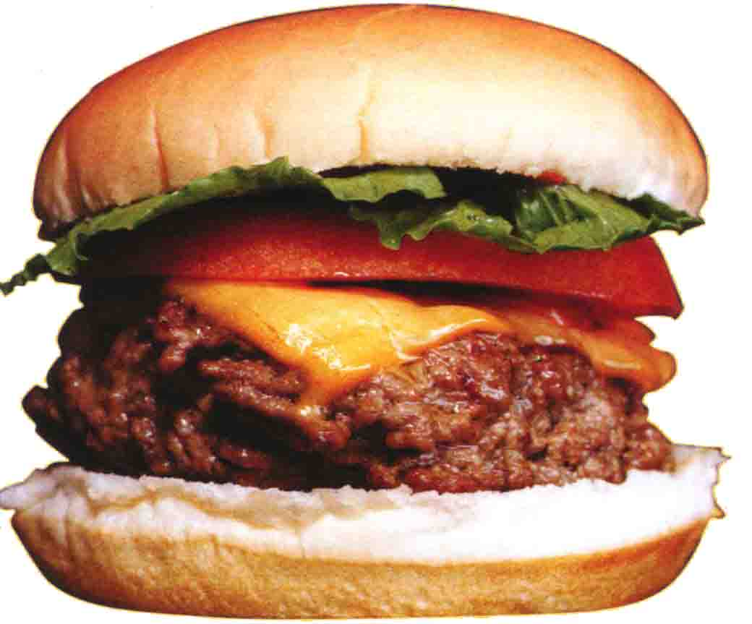
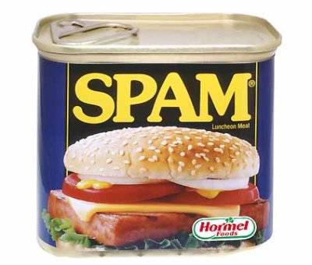
Shifts and Changes in Demand cont.
A closer look at changes in income
Normal Good
A good that consumers
demand more when their
incomes increase
Inferior Good
A good that consumers
demand less when their
incomes increase

Slide 9
Consumer Income Normal Good
Price of Hamburgers
$3.00
An increase in income...
2.50
Increase
in demand
2.00
1.50
1.00
0.50
D₂
D₁
Quantity of Hamburgers
0
1
2
3
4
5
6
7
8
9
10
11
12

Slide 10
Consumer Income Inferior Good
Price of Spam
$3.00
2.50
An increase in income...
2.00
Decrease
in demand
1.50
1.00
0.50
D₁
Quantity of Spam
0
1
2
3
4
5
6
7
8
9
10
11
12

