Slide 1
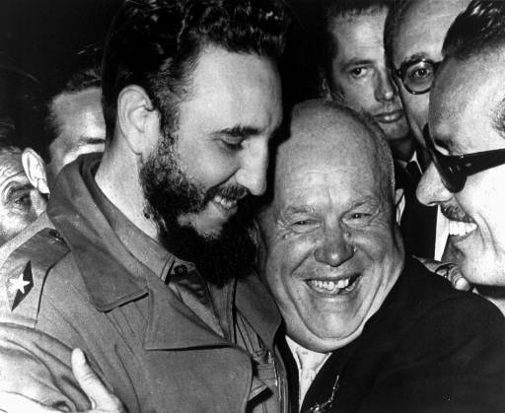
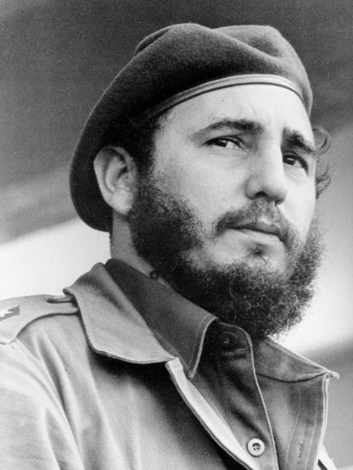
1959 - Castro takes power
January 1, 1959 leftist forces under Fidel Castro overthrow Fulgencio Batista in Cuba
Castro signs trade agreements with the Soviets
The next year, Castro seizes U.S. assets on the island.

Slide 2
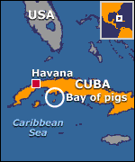
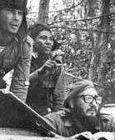
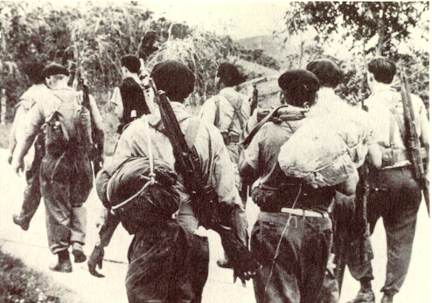
Bay of Pigs Debacle (1961)
U.S.-organized invasion force of 1,400 Cuban exiles is launched from Guatemala in ships and planes.
Mission is defeated by Castro's government forces on Cuba's south coast at the Bay of Pigs in 3-days (April 20).

Slide 3
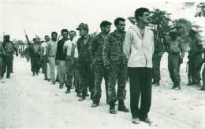
Bay of Pigs (1961)
Kennedy takes full responsibility for the disaster.
Captured Cubans

Slide 4
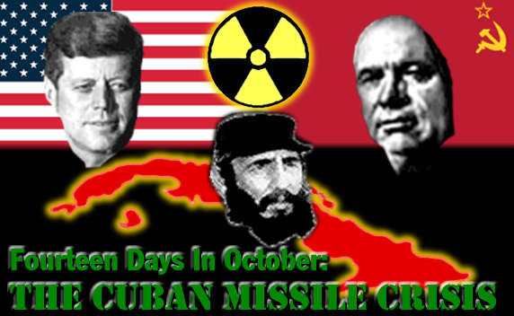
Cuban Missile Crisis (1962)
* 1962- After Bay of Pigs invasion, the Soviets secretly installed nuclear missiles in Cuba.

Slide 5
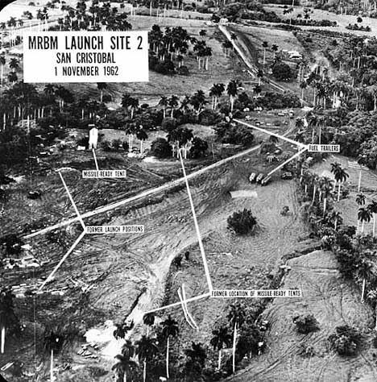
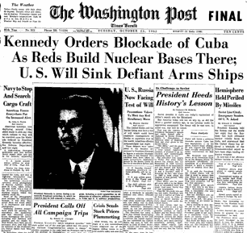
Cuban Missile Crisis (1962)
After U-2 flights Kennedy ordered a naval blockade of Cuba (Oct. 22) until the Soviet Union removed its missiles.

Slide 6
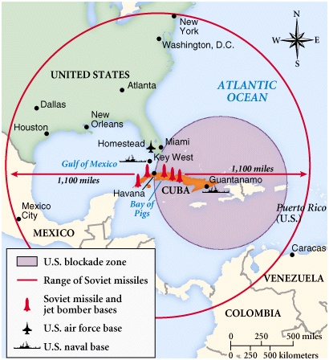
Cuban Missile Crisis (1962)
October 28, the Soviets agreed to remove the missiles & the USA agrees to remove their Jupiter missiles in Turkey & not to invade Cuba, thus defusing one of the most dangerous confrontations of the Cold War

Slide 7
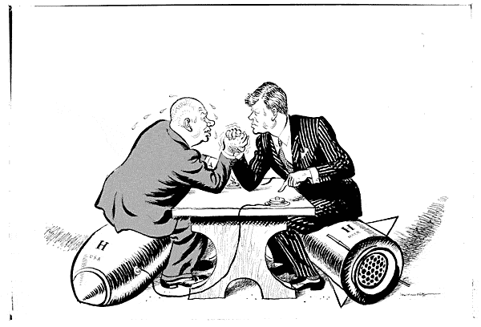
Cuban Missile Crisis (1962)
One of the most significant events of the Cold War.
Because we came so close to nuclear war, both nations decide to establish a better relationship.
Because of his handling of the crisis & economic problems at home, Khrushchev is removed from power. (Oct., 1964)
We went eyeball-to-eyeball with the Russians, and the other man blinked!

Slide 8
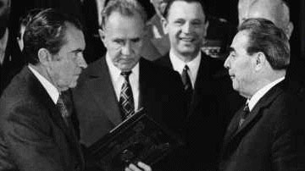
SALT (1969)
On November 17, the 1st phase of Strategic Arms Limitation Talks began in Helsinki, Finland.
The finished agreement, signed in Moscow on May 26, 1972, placed limits on both submarine-launched and intercontinental nuclear missiles.

Slide 9
Nixon visits China (1972)
Nixon becomes the first U.S. president to visit China, meeting with Mao Zedong on February 21.
The two countries issue a communiqué recognizing their "essential differences" while making it clear that "normalization of relations" was in all nations' best interests.
The rapprochement changes the balance of power with the Soviets.

Slide 10
Afghanistan (1979)
December 25, 100,000 Soviet troops invaded Afghanistan.
U.S.-backed Muslim guerrilla fighters waged a costly war against the Soviets for nearly a decade before Soviet troops withdraw in 1988.
Afghanistan—the Soviet “Vietnam”

Slide 11
Star Wars (1983)
March 23, Reagan outlined his Strategic Defense Initiative, or "Star Wars," a space-based defensive shield that would use lasers & other advanced technology to destroy attacking missiles far above the Earth's surface.
Soviets accuse the U.S of violating the 1972 Antiballistic Missile Treaty.
Soviets forced to spend heavily to match the program causing near economic collapse.

Slide 12
Gorbachev comes to power (1985)
On March 11, Mikhail Gorbachev came to power in the Soviet Union.
Gorbachev ushered in an era of reform.
perestroika
Economic reform- restructuring
glasnost
means openness, allowed greater free expression and criticism of Soviet policies

Slide 13
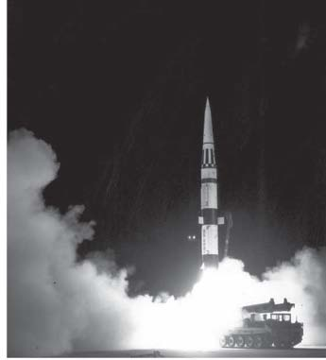
1987 - INF
On December 8, 1987, Reagan and Gorbachev signed the Intermediate Range Nuclear Forces Treaty
It mandated the removal of more than 2,600 medium-range nuclear missiles from Europe, & eliminated the entire class of Soviet SS-20 and U.S. Cruise and Pershing II missiles.

Slide 14
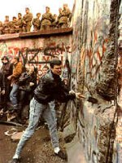
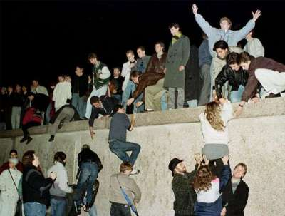
Berlin Wall falls (1989)
In 1988, the Soviets were defeated in Afghanistan. They were in no shape economically or militarily to stop German unification
Gorbachev renounced the Brezhnev Doctrine, which pledged to use Soviet force to protect its interests in Eastern Europe.
On September 10, Hungary opened its border with Austria, allowing E. Germans to flee to the West.
After massive public demonstrations in E. Germany and in E. Europe, the Berlin Wall fell on November 9.

Slide 15
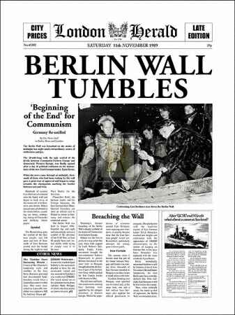
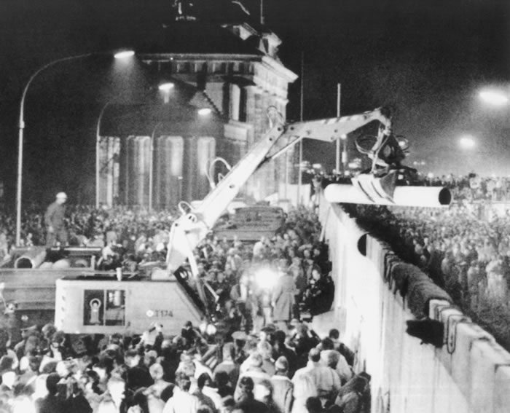
The Berlin Wall Falls (1989)
Ronald Reagan said, “Mr. Gorbachev, tear down this wall!!”

Slide 16
German Unification(1990)
At a September 12 meeting in Moscow, the United States, Soviet Union, Great Britain, France and the two Germanys agreed to end Allied occupation rights in Germany.
On October 3, East & West Germany united as the Federal Republic of Germany.
1991 marked the collapse of the USSR and the End of the Cold War.

