Slide 1
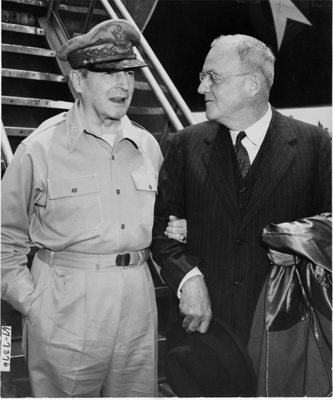
Massive Retaliation
On January 12, 1955 U.S. Secretary of State John Foster Dulles first announces the doctrine of Massive Retaliation.
It threatens full-scale nuclear attack on the Soviet Union in response to communist aggression anywhere in the world.
John Foster Dulles and MacArthur in Korea, 1950

Slide 2
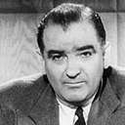
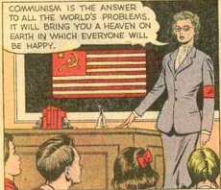
Red Scare
The Red Scare was a fear of the spread of communism in the U.S.
Congress set up committees to investigate suspected communists. (Labor leaders, writers, & entertainers)
The Senate Committee was headed by Joseph McCarthy of Wisconsin, who felt that there was a huge Communist movement in the State Department & around the country.
He called numerous witnesses to defend themselves but was never able to prove a single case.
The climate in the country was one of accusation (not based on any evidence).

Slide 3
1956 - Khrushchev's 'secret speech'
Soviet leader Nikita Khrushchev denounces the policies of Stalin.
He rejects the Leninist idea of the inevitability of war & calls for a doctrine of "peaceful coexistence" between capitalist & communist systems.

Slide 4
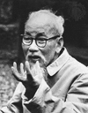
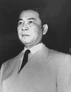
Background of the Vietnam War
* Under Japanese control during !
* With U.S. aid, France attempted recolonization after WWII.
* Democratic Elections set up to reunify Vietnam
* Ho Chi Minh controls the North
* Ngo Dinh Diem controls the South
* Diem backs out of the elections setting up a military conflict
between the North and the South

Slide 5
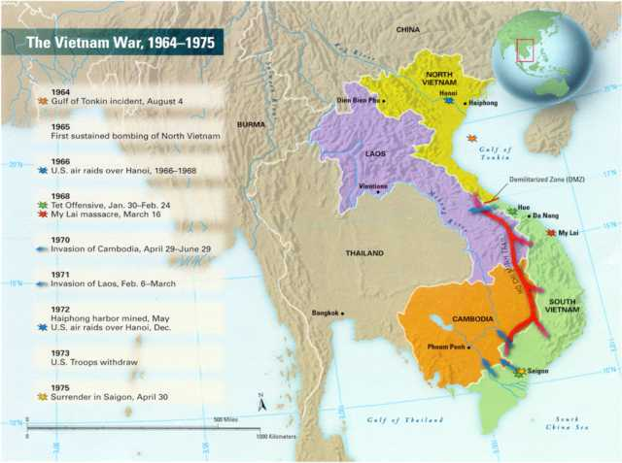
Vietnam War
China supports the North
Vietcong and the Ho Chi Minh Trail

Slide 6
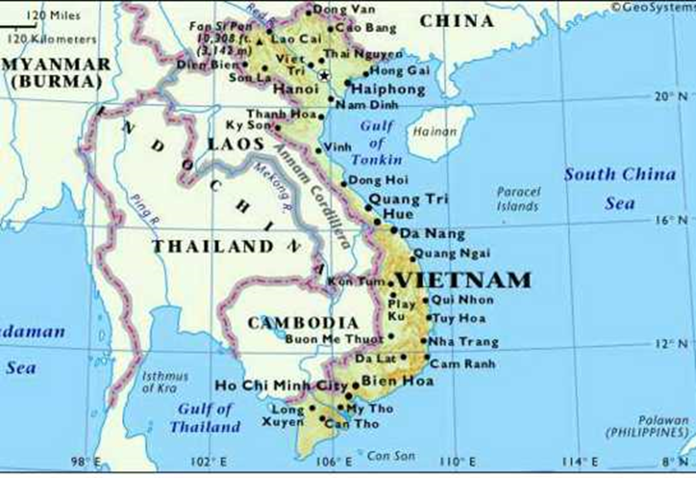
Vietnam War
1973 – Cease fire, American Troops withdraw
1975 – North Vietnam defeats South Vietnam and unites country under communist rule.
Formerly Saigon

Slide 7
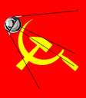
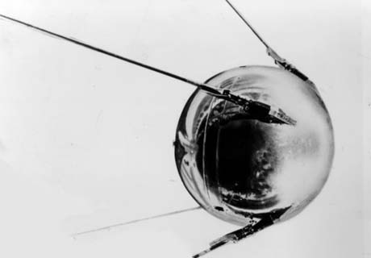
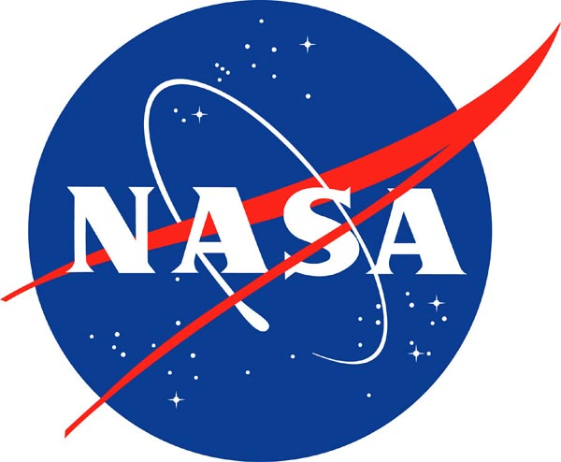
Sputnik I (1957)
On October 4, the USSR launches Sputnik, the first man-made satellite to orbit the Earth.
In 1958, the U.S. creates the National Aeronautics and Space Administration, and the space race is in full gear.

Slide 8
Sputnik
The Russians have beaten America in space—they have the technological edge!
Sputnik begins the Space Race.
Spy satellites, satellite laser weapons and defenses
Soviets were also the 1st to send a man to space and built the MIR Space Station
USA was the 1st to put a man on the moon.

Slide 9
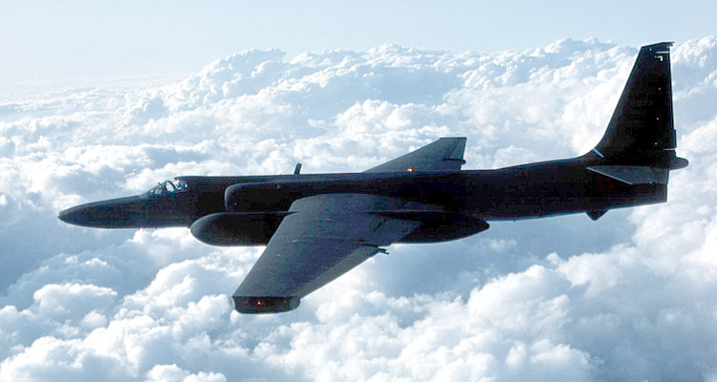
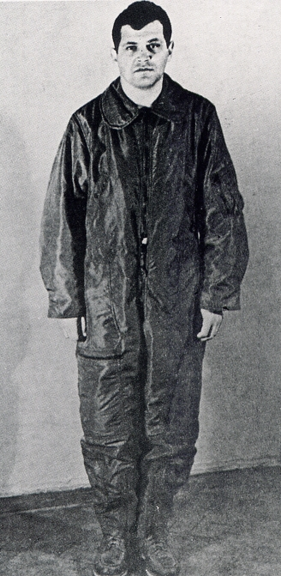
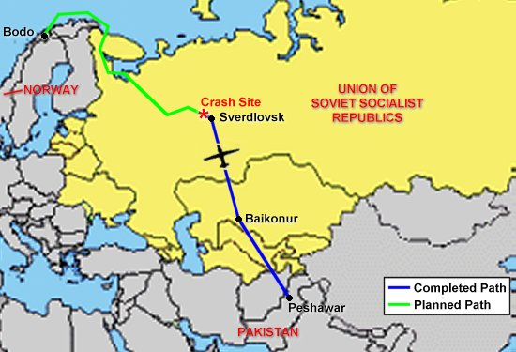
U-2 Spy Incident (1960)
On May 1, 1960, Francis Gary Powers & his U-2 spy plane were shot down 1200 miles inside of the USSR. The U-2 flew at 75,000 ft. and was supposedly untouchable.

Slide 10
U-2 Spy Incident (1960)
Pres. Eisenhower denied that it was a spy mission until the Soviets informed the USA that they had captured the pilot & recovered the wreckage of the plane.
Suffering major embarrassment, Eisenhower was forced to admit the truth behind the mission & the U-2 program.
Eisenhower agreed to stop these flights for the remainder of his presidency but did not apologize for this incident. The Paris Summit collapsed when Khrushchev stormed out of negotiations.

Slide 11
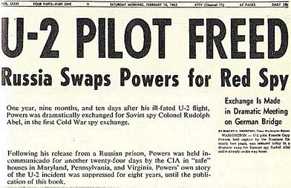
U-2 Spy Incident (1960)
Powers was sentenced to 10-years in prison, following an infamous show-trial.
Powers serves 2 yrs. until the USA traded Soviet spy Rudolf Abel for him. (Berlin’s Glienicke Bridge)

Slide 12
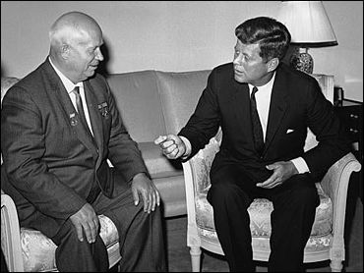
Paris, 1961
Khrushchev & JFK meet to discuss Berlin and nuclear proliferation. Khrushchev thinks that JFK is young, inexperienced, and can be rolled.

Slide 13
The Berlin Wall & the Division of Germany
Soviets want the Fr., GB and USA to pull out of W. Berlin.
When they do not, the Soviets shock the world by constructing the Berlin Wall (Aug. 15, 1961)

Slide 14
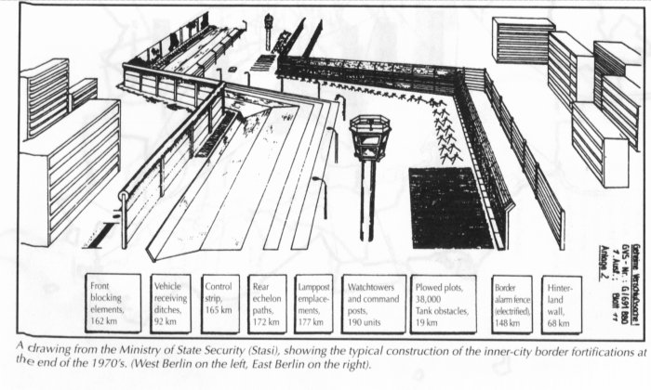
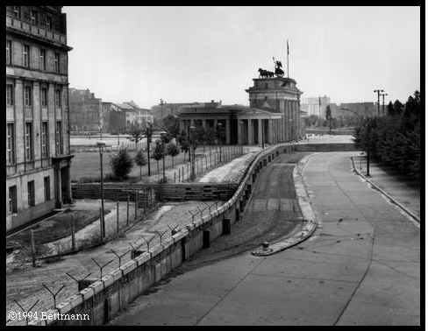
1961 - Berlin Wall
Prevents E. Germans from fleeing to W. Berlin.

Slide 15
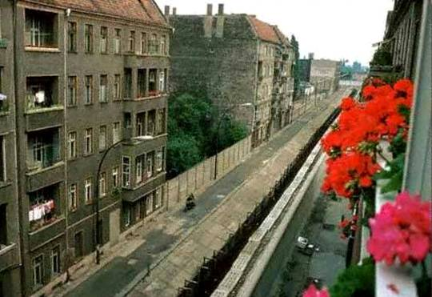
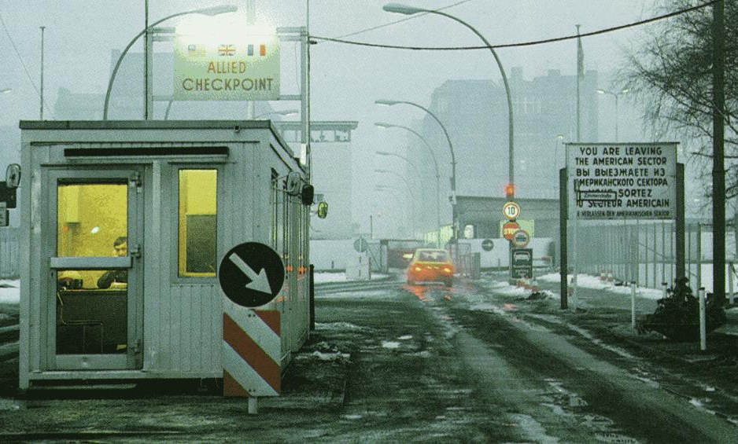
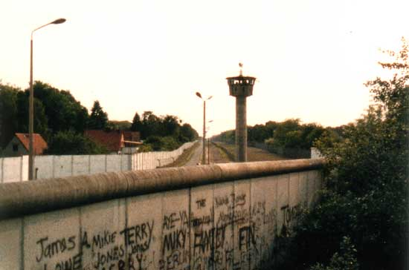
The Berlin Wall Goes Up (1961)
Berlin Wall became major symbol of the Cold War
Checkpoint Charlie

Slide 16
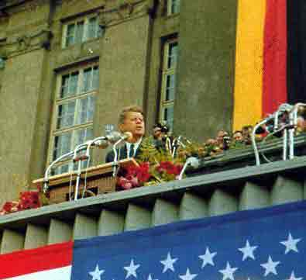
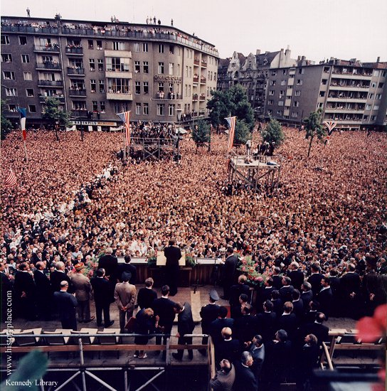
JFK in Berlin (1963)
President Kennedy tells Berliners that the West is with them!

