Slide 1
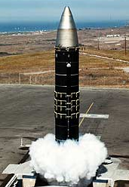
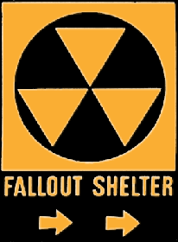
The Arms Race:
The USSR exploded its first A-bomb in 1949.
Now there were two nuclear superpowers!

Slide 2
NATO and the Warsaw Pact
NATO is a military alliance (1949).
In response, the Soviet Union & its E. European allies sign a military alliance WARSAW PACT (1955).
Soviets use the PACT to not only defend Eastern Europe but to also strengthen its hold on them.

Slide 3
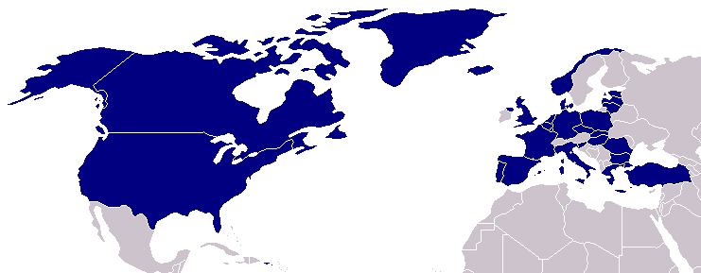
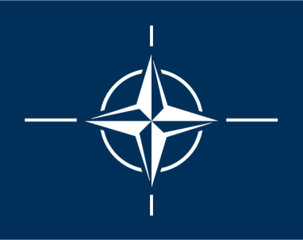
North Atlantic Treaty Organization (1949)
United States
Belgium
Britain
Canada
Denmark
France
Iceland
Italy
Luxemburg
Netherlands
Norway
Portugal
1952: Greece & Turkey
1955: West Germany
1983: Spain

Slide 4
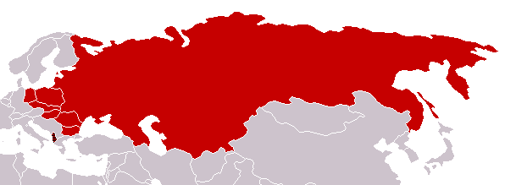
Warsaw Pact (1955)
U. S. S. R.
Albania
Bulgaria
Czechoslovakia
East Germany
Hungary
Poland
Rumania

Slide 5
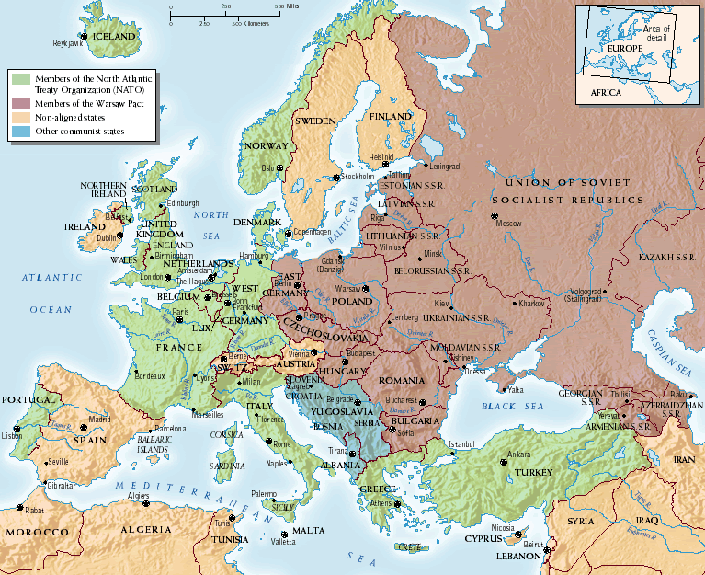
The Bipolarization of Europe

Slide 6
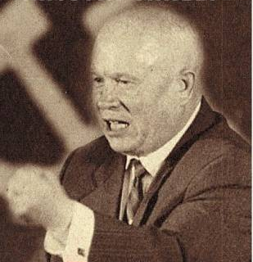
Premier Nikita Khrushchev
About the capitalist states, it doesn't depend on you whether we (Soviet Union) exist. If you don't like us, don't accept our invitations, and don't invite us to come to see you. Whether you like it our not, history is on our side. We will bury you. -- 1956

Slide 7
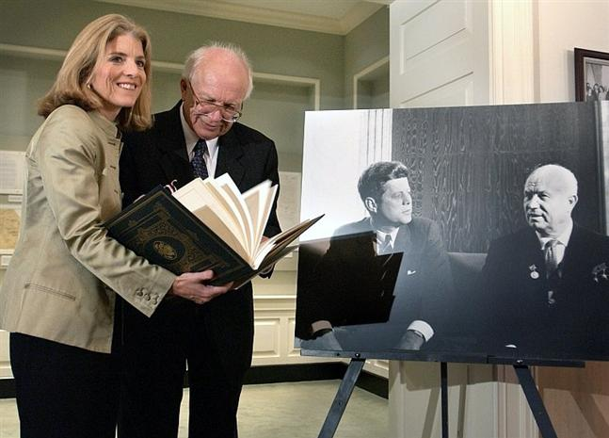
An Historic Irony: Sergei Khrushchev, American Citizen
Who buried who?

Slide 8
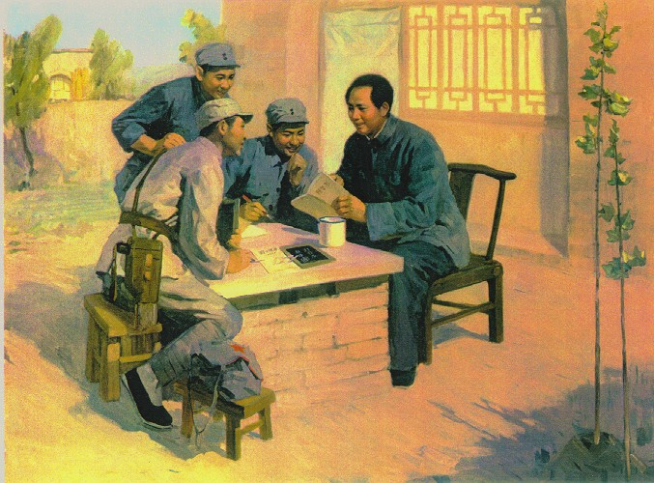
Mao’s Revolution: 1949
A 2nd Communist Power!

Slide 9
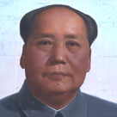
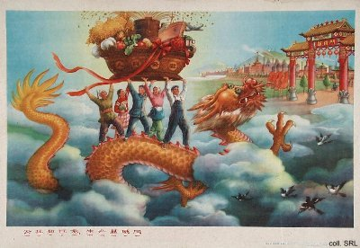
The Communist Revolution in China
After WWII, the Nationalists (Chiang Kai-shek) & the Communists (Mao Zedong) fought a civil war.
1949- The Communists won & established the People’s Republic of China. The Nationalists fled to Taiwan.
The Communists won over the peasants with a promise of land & an end to oppression. Many Chinese were also tired of Western influence & the corruption of Chiang Kai-shek’s govt.

Slide 10
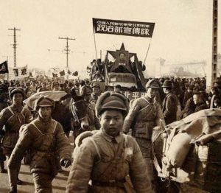
1949 – Fall of China
Oct 1, Mao proclaims People’s Republic of China
Two months later, Mao travels to Moscow,
negotiates the Sino-Soviet Treaty of Friendship, Alliance and Mutual Assistance.
Zedong establishes a totalitarian govt. & tries to move China from a mostly agricultural nation into an industrial one.
The Great Leap Forward-
20 million may have died as a result of starvation.
Mao Zedong was possibly one of the most brutal dictators of our time, killing an estimated 35 million people

Slide 11
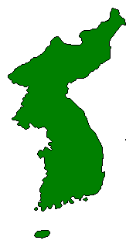
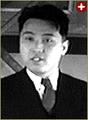
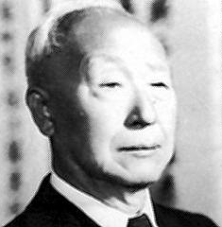
The Korean War: (1950-1953)
Kim Il-Sung
Syngman Rhee

Slide 12
The Korean War
The Korea was ruled by Japan 1910-’45
Allies agreed to occupy Korea until govt. elections could be held. IN 1945, the Soviets occupied the northern part of Korea & the USA occupied the southern part. (38th parallel)
The USSR & USA could not agree on how to hold elections so by 1948 two separate govt.s claimed to be the ruler of Korea.
N. Korea kept ties with the USSR & China while S. Korea kept ties with the USA.
The USSR withdrew their troops in 1948 and the USA did the same in 1949.

Slide 13
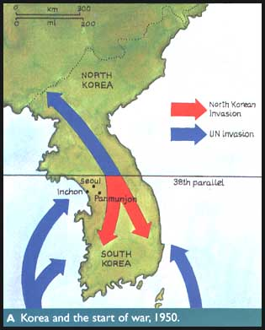
June 25, 1950- N. Korea attacked S. Korea in hopes of unifying under their communist govt.
On June 27, Truman orders U.S. forces to assist the South Koreans
The U.N. voted to condemn the action & organized an army to oppose it. The USSR could not veto the action because they were absent. (Protested the UN’s refusal to recognize China’s communist govt.)

Slide 14
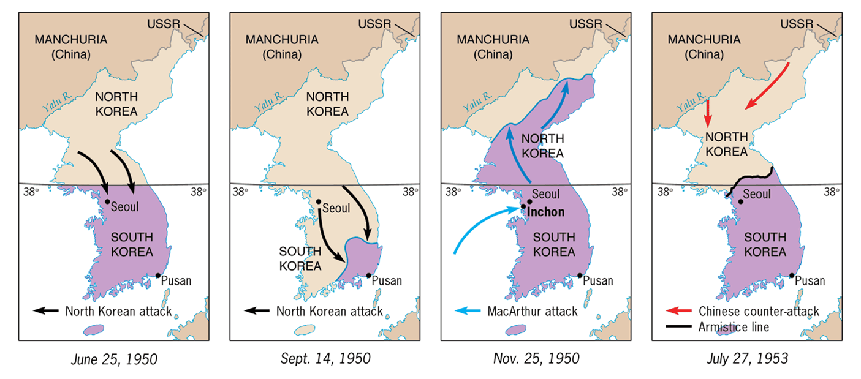
The Shifting Map of Korea (1950-1953)
Within 6 mo., the UN had pushed N. Korea out of S. Korea and back to the Chinese border.
The Chinese came to the North’s aid & pushed the UN troops back to the 38th parallel where a stalemate developed.

Slide 15
The Korean War
Cease fire eventually brings war to close by 1953
Talks lasted for 2 years.
The 38th parallel was again the line that divided the two Koreas.
North Korea and South Korea today????

