Slide 1
The Cold War: 1945-1991

Slide 2
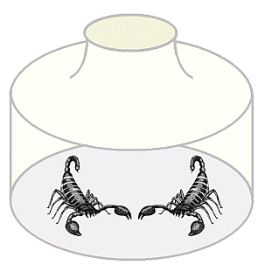
What do you think will happen?

Slide 3
What was the Cold War?
USA and USSR had extremely different economic and political beliefs
These two superpowers were the political and military leaders of the world who had considerable influence.
Both wanted world domination and would do anything short of nuclear “hot” war.
Both would use the threat of force, propaganda & military or economic influence in regions.

Slide 4
The Ideological Struggle
Soviet & Eastern Bloc Nations (“Iron Curtain”)
U.S. & the Western Democracies
GOAL → “Containment” of Communism & the eventual collapse of the Communist world.
GOAL → spread world-wide Communism
METHODOLOGIES:
Espionage (KGB vs. CIA)
Arms Race (nuclear escalation)
Ideological Competition for the minds and hearts of Third World peoples
Bi-Polarization of Europe (NATO vs. Warsaw Pact)
War of Proxy

Slide 5
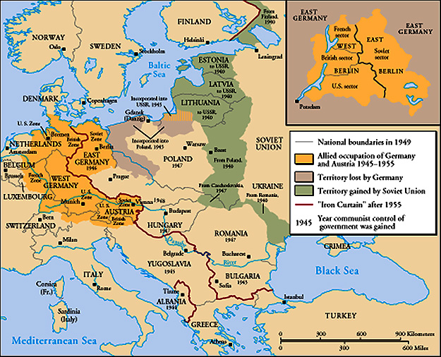
The “Iron Curtain”
From Stettin in the Balkans, to Trieste in the Adriatic, an iron curtain has descended across the Continent. Behind that line lies the ancient capitals of Central and Eastern Europe. -- Sir Winston Churchill, 1946

Slide 6
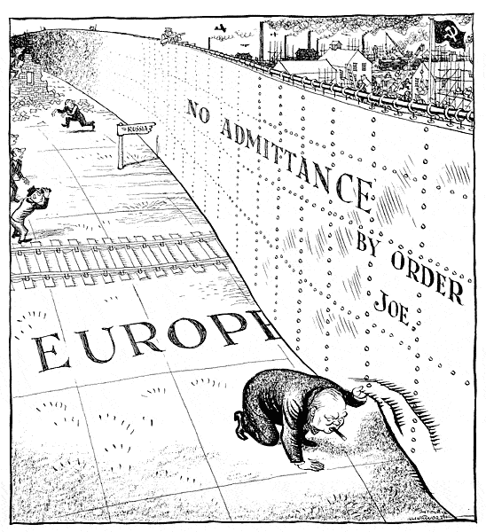

Slide 7
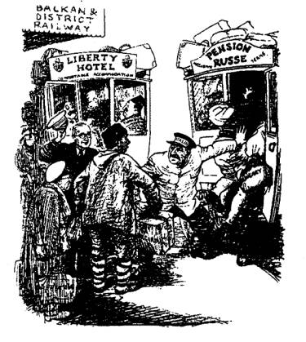
Truman Doctrine (1947)
The U. S. should support free peoples throughout the world who were resisting takeovers by armed minorities or outside pressures…We must assist free peoples to work out their own destinies in their own way.
The U.S. gave Greece & Turkey $400 million in aid.
American military would be available to any nation threatened by communism.

Slide 8
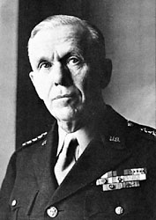
Marshall Plan (1948)
“European Recovery Program.”
WWII severely weakened European economies.
USA feared an economic collapse would lead to the spread of communism. U.S. depended on these allies for support.
Secretary of State, George Marshall
“The U. S. should provide aid to all European nations that
need it. This move is not against any country or doctrine,
But against hunger, poverty, desperation, and chaos.
Proposes an economic aid program that will give $13 billion over 4 yrs.”
Western nations except $$$, stabilize their economies & grow closer to the USA and away from Communism.

Slide 9
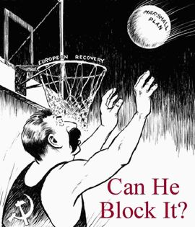
Marshall Plan (1948)
Offer extended to E. Europe & USSR, but was rejected.
Eastern nations unite under Soviet aid.

Slide 10
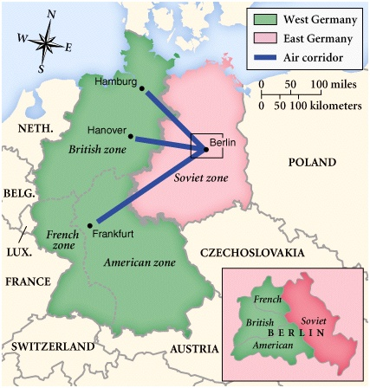
Post-War Germany

Slide 11
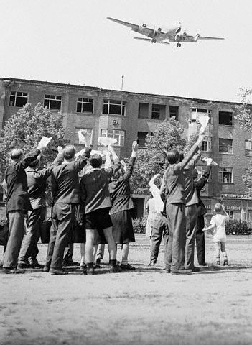
Berlin Blockade & Airlift (1948-49)
Soviets stripped their zone of all of its resources. Fr., GB, and USA give economic aid to their zones eventually uniting them into West Berlin.
Stalin wants these nations to pull out of W. Berlin which they do not.
The Berlin Blockade (1948-49)-
The Berlin Airlift-
In response, the Soviets established East Germany

Slide 12
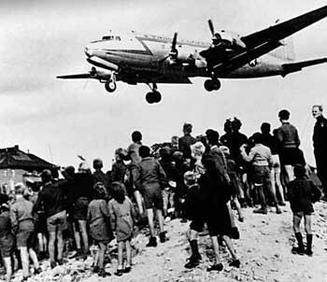
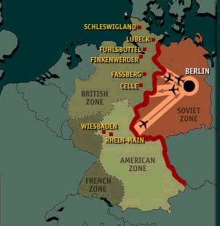
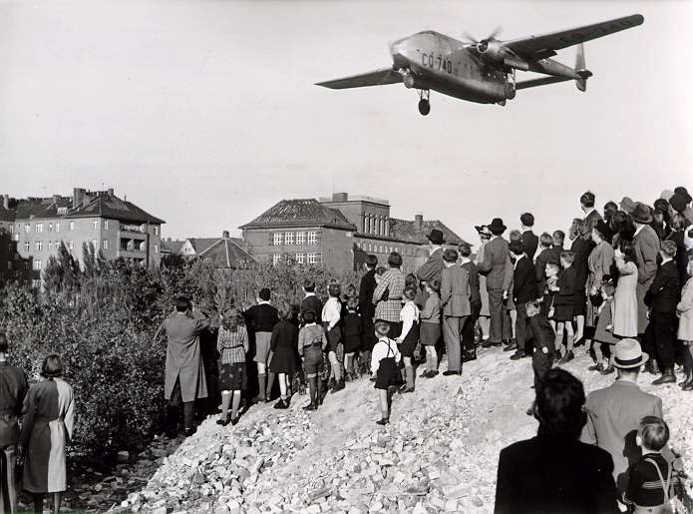
Berlin Airlift
Blockade began on June 24, ’48
June 1948 - May 1949, U.S. & British planes airlift 1.5 million tons of supplies to the residents of West Berlin.
After 200,000 flights, the USSR lifts the blockade.

