Slide 1
China and Japan: Isolation

Slide 2
11th c. Japan
Lawless and dangerous
For safety land owners trade land for protection
Sounds like???
Feudalism
Lord uses warriors=samurai
Bushido-reckless courage, reverence for gods, honor

Slide 3
Shogun
Emperor gave powerful clan leader new title-SHOGUN
“supreme general of emperor’s army”

Slide 4
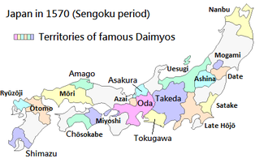
Warring States Period
16th c. new Feudal Era
Daimyo (one of the great lords who were vassals of the shogun) warlords build castles and build armies of samurai on horseback
Add guns
Rival daimyo fight for power

Slide 5
Tokugawa Shogunate
Tokugawa Ieyasu (1603)
Unify Japan
Named Shogun
Move power base to Edo (Tokyo)
Restore order until1867
Control daimyo
Ex: Residency requirement in Edo

Slide 6
Impact of Tokugawa on Japan
Order and stability
Food up=Population increase
Shift from rural to urban
Edo exceed one million people
Europe arrives during Warring States Period
Trade=Missionaries plus GUNS
Ban Christianity and Exclusion Policy (1639)
Disruptive influence
1637 uprising of 30,000 rebels many of which were Christian converts
1639 close borders and only Dutch and Chinese trade through one port

Slide 7
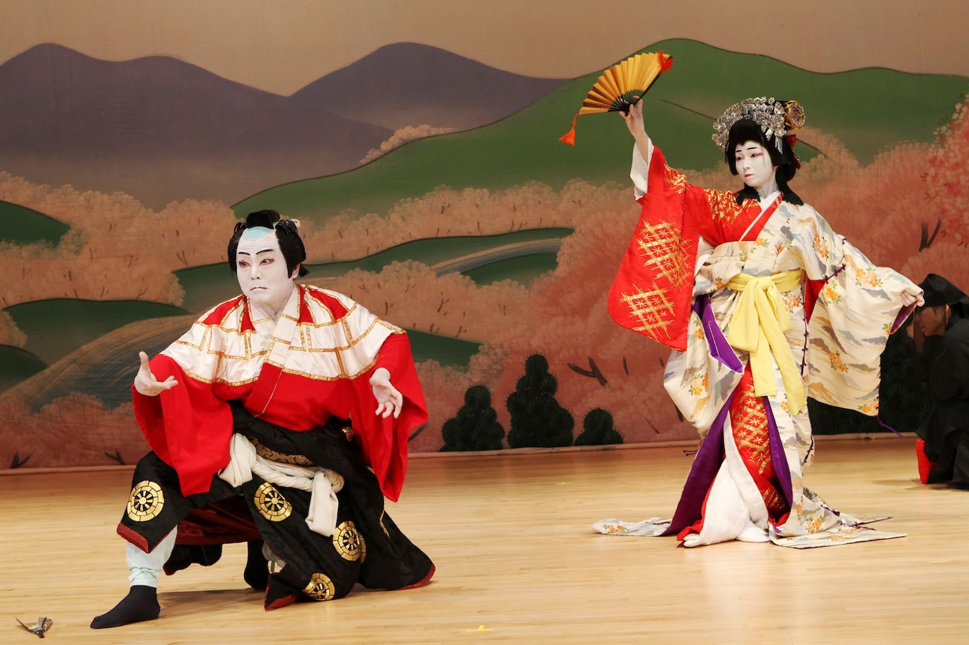
Culture Under Tokugawa Shogunate
Kabuki theatre
Haikus
5-7-5 syllable format
Presents images rather than ideas

Slide 8
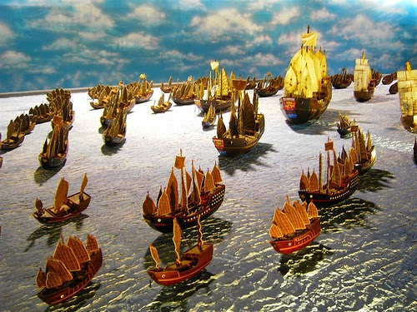
Checking in on China: Ming
Restore Confucian moral standards
Restore merit based civil service exams
Yonglo (son of Hongwu) sent out Treasure fleet until 1433, led by Zheng He
Limit Chinese trade to certain ports (still profitable due to DEMAND)

Slide 9
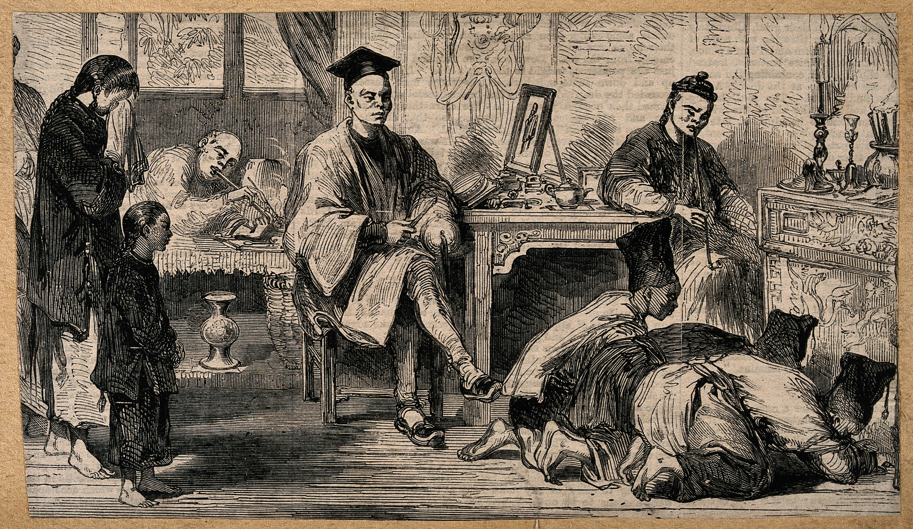
Checking in on China: Qing
Manchus invade and seize China (1644)
Establish Qing Dynasty and rule for 260 years
Restore prosperity, order and respect
To Chinese their country “Middle Kingdom”
Center of universe and all must follow rules
“kowtow”
Dutch willing and maintain steady flow of porcelain, silk and TEA
British refuse and are expelled

