Slide 1
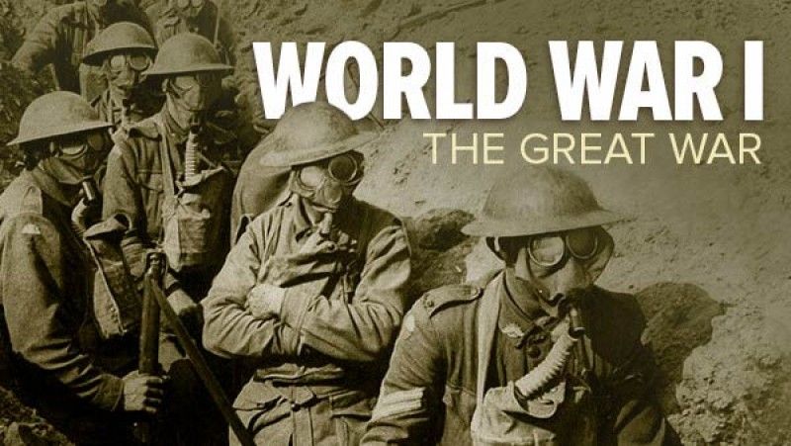
WORLD WAR I

Slide 2
Causes of WWI
M.A.I.N
Militarism
Alliances
Imperialism
Nationalism

Slide 3
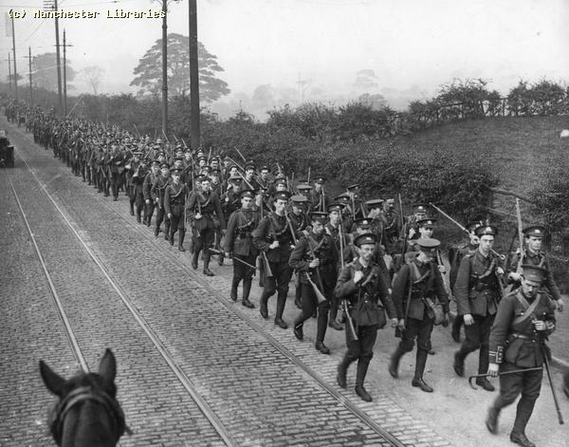
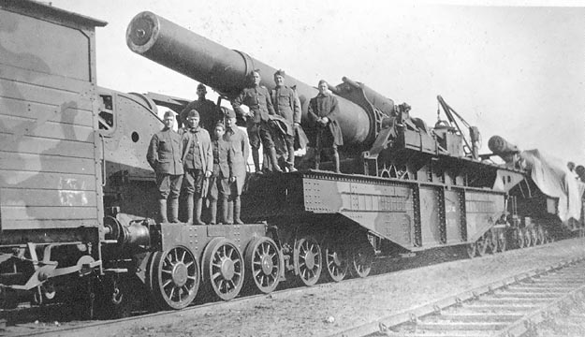
M.A.I.N
Militarism: the policy of glorifying military power
Large military = power = national pride
Built up large standing armies for protection and intimidation
Competition between nations
Ready to fight at moments notice
Notes:
Railway Howitzer was generally naval surplus that had been salvaged and mounted on a railroad car.

Slide 4
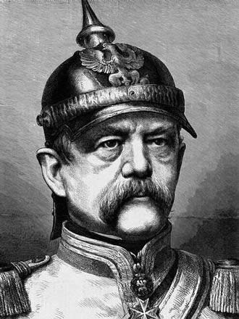
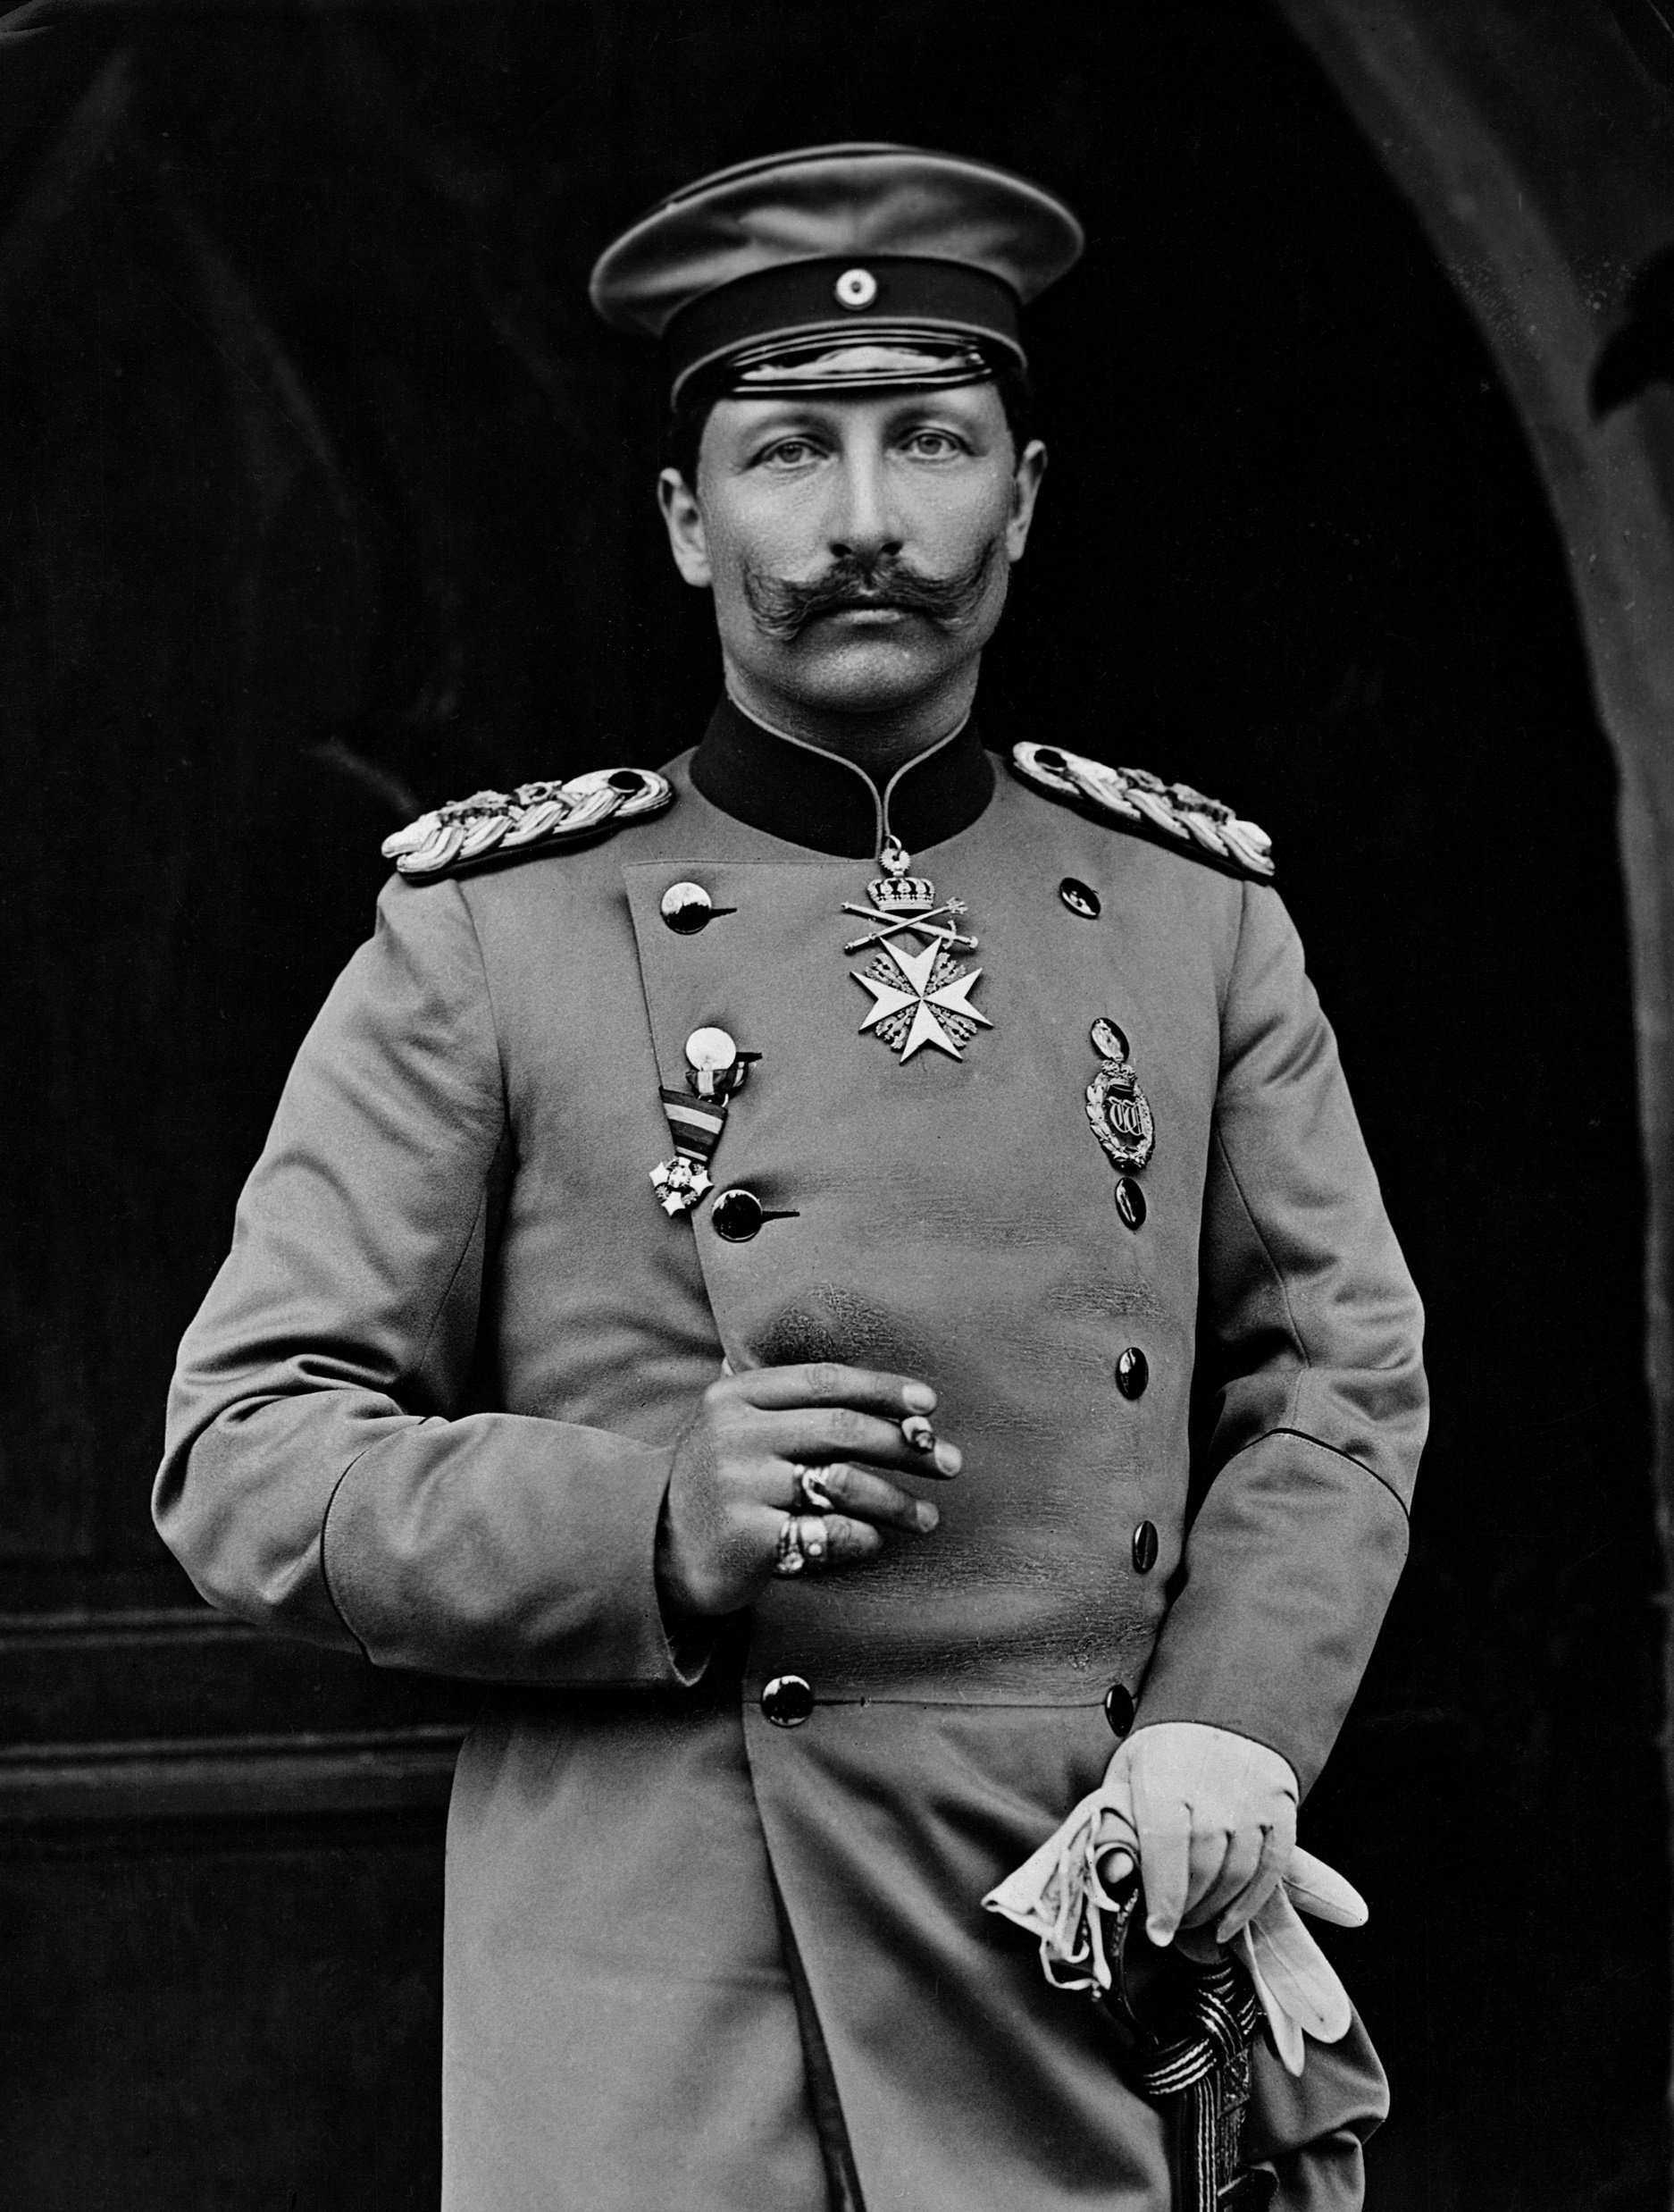
German Militarism
Otto Von Bismarck:
“Blood and Iron” Chancellor
Built up Germany navy and army
Aimed to increase German power
Kaiser Wilhelm II
Forced Bismarck resignation
Wanted to demonstrate German might to rest of the world
Began shipbuilding program – alarmed Britain

Slide 5
M.A.I.N
Alliances: an agreement between countries that states they will assist one another in a time of conflict
If one country declared war, their ally had to declare war
Result of mistrust and rivalry between nations

Slide 6
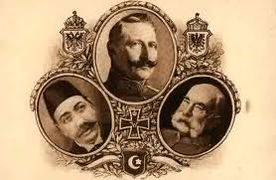
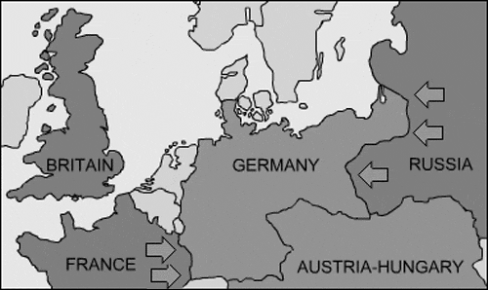
Triple Alliance
Germany allied with Austria-Hungary and Ottoman Empire
Called the Triple Alliance
Main goal was to isolate France
Tried to form alliance with Russia
Didn’t work due to A-H control of Slavic regions

Slide 7
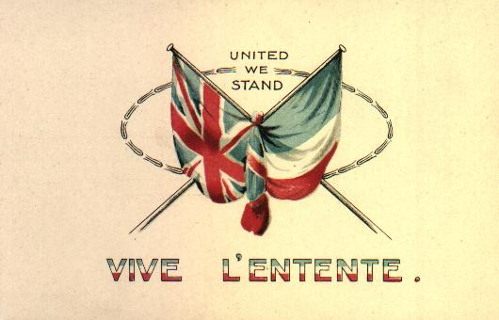
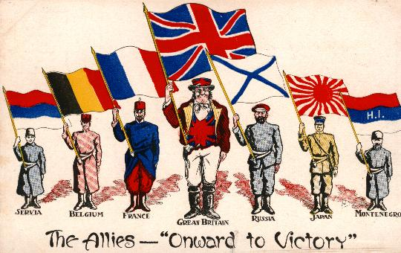
Triple Entente
French seek revenge for Franco-Prussian War
British threatened by German navy
Russians rivals Austria-Hungary
Competition over Balkans
Form the Triple Entente
Not formal alliance like Triple Alliance
Notes:
Identify each country by flag. Comment on Japan.

Slide 8
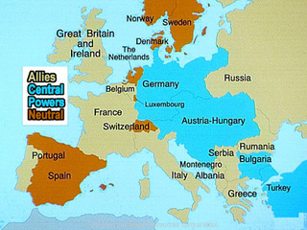
Allies= Triple Entente Central Powers= Triple Alliance

Slide 9
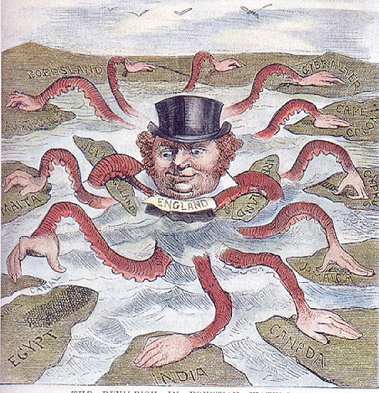
M.A.I.N
Imperialism
Spurred competition
Encouraged militarism
Increased tensions

Slide 10
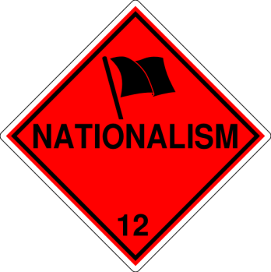
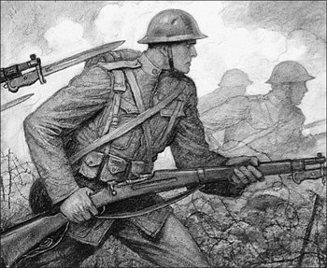
M.A.I.N
Nationalism
Unified nations
Caused intense competition between nations
Led to independence movements and conflict
Notes:
What does this poster translate? How does it illustrate nationalism?

Slide 11
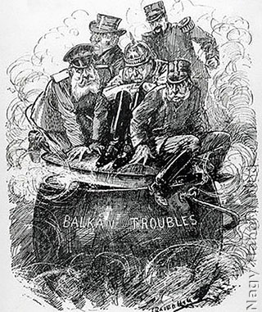
The Powder Keg: The Balkans
Area of intense conflict and nationalism
Controlled by Austria-Hungary and Ottoman Empire
Russians allied with Serbians and other Slavic groups
Spark ignites on June 28, 1914

Slide 12
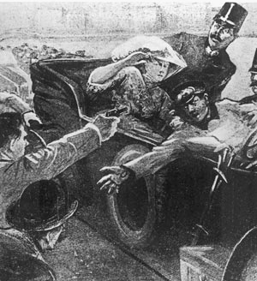
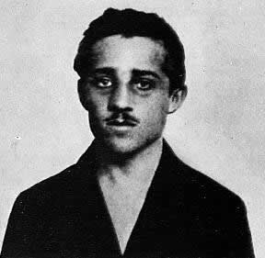
Serbian nationalist Gavrilo Princip shoots and kills both Franz Ferdinand and his wife Sophie
This is the spark that ignites the “powder keg”

Slide 13
Archduke and his wife are killed by Serbian nationalists
June 28, 1914
Russia declares war on Austria due to alliance with Serbia
Austria declares war on Serbia
France declares war on Germany and Austria due to alliance with Russia
Germany declares war on Russia due to alliance with Austria
Germany declares war on France

Slide 14
Great Britain declares war on Germany due to alliance with France
Countries in British Commonwealth join the war effort (Canada, New Zealand, Australia, South Africa, and India
Germany invades Belgium and moves to attack France (Western Front)
Germans and Austrians fight off advancing Russians on the Eastern Front

Slide 15
