Slide 1
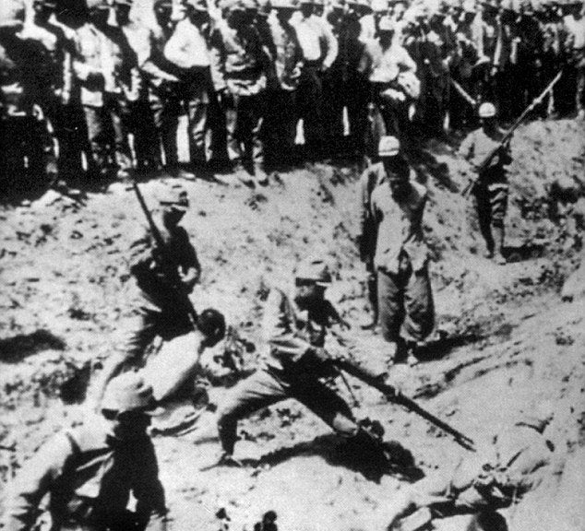
Japan invades China
July 1937 – Japan invades China
China’s army bigger, but Japan’s much more advanced
Japanese take over major cities (Beijing, Nanjing (capital))
Killed tens of thousands of captured soldiers and civilians
Known as the “Rape of Nanjing”

Slide 2
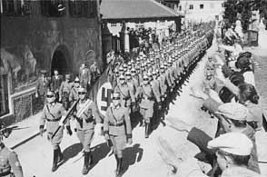
Germany Annexes Austria
Hitler announces his plans to absorb Austria and Czechoslovakia into the Third Reich
German Empire
Treaty of Versailles prohibited Anschluss
A union between Austria and Germany
Hitler knew he would have support from ethnic Germans
March 1938 – Hitler annexes Austria
France and Britain ignore pledge to protect Austria

Slide 3
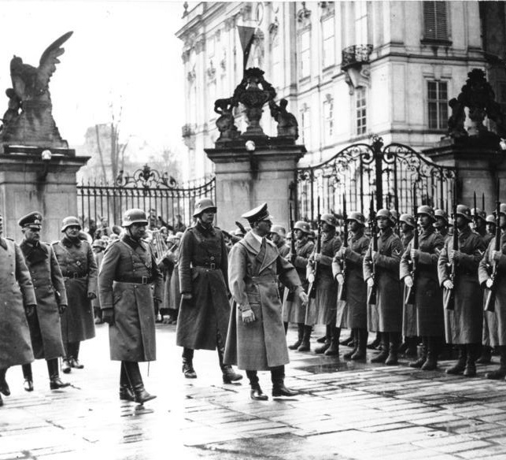
Hitler Turns to Czechoslovakia
Hitler wanted Sudetenland
Heavily fortified area that separates Czechoslovakia from Germany
Continue to add native Germans to empire
Anschluss raised pro-Nazi feelings among Sudeten Germans
Hitler demanded – Czech said no; asked France for help

Slide 4
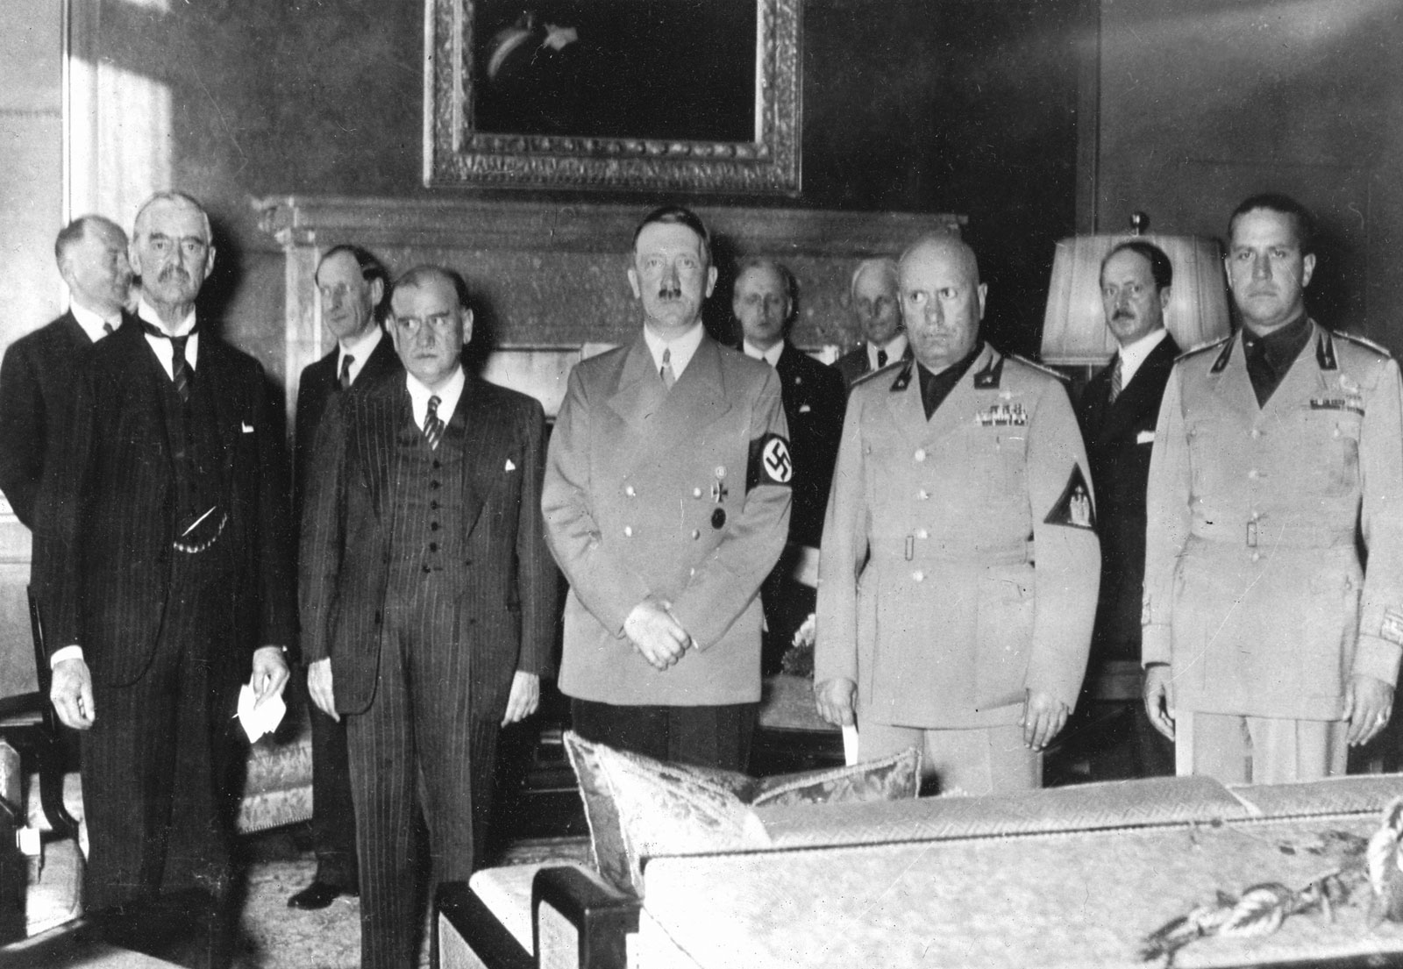
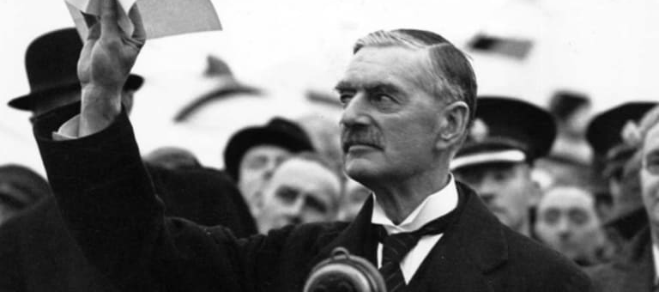
Munich Conference
September 29, 1938
Proposed by Mussolini – included Germany, France, Britain, and Italy
Results:
Neville Chamberlain (GB Prime Minister) believed he could preserve peace by giving into Hitler
Britain and France allow Hitler to take Sudetenland
Hitler has to respect Czechoslovakia’s new borders

Slide 5
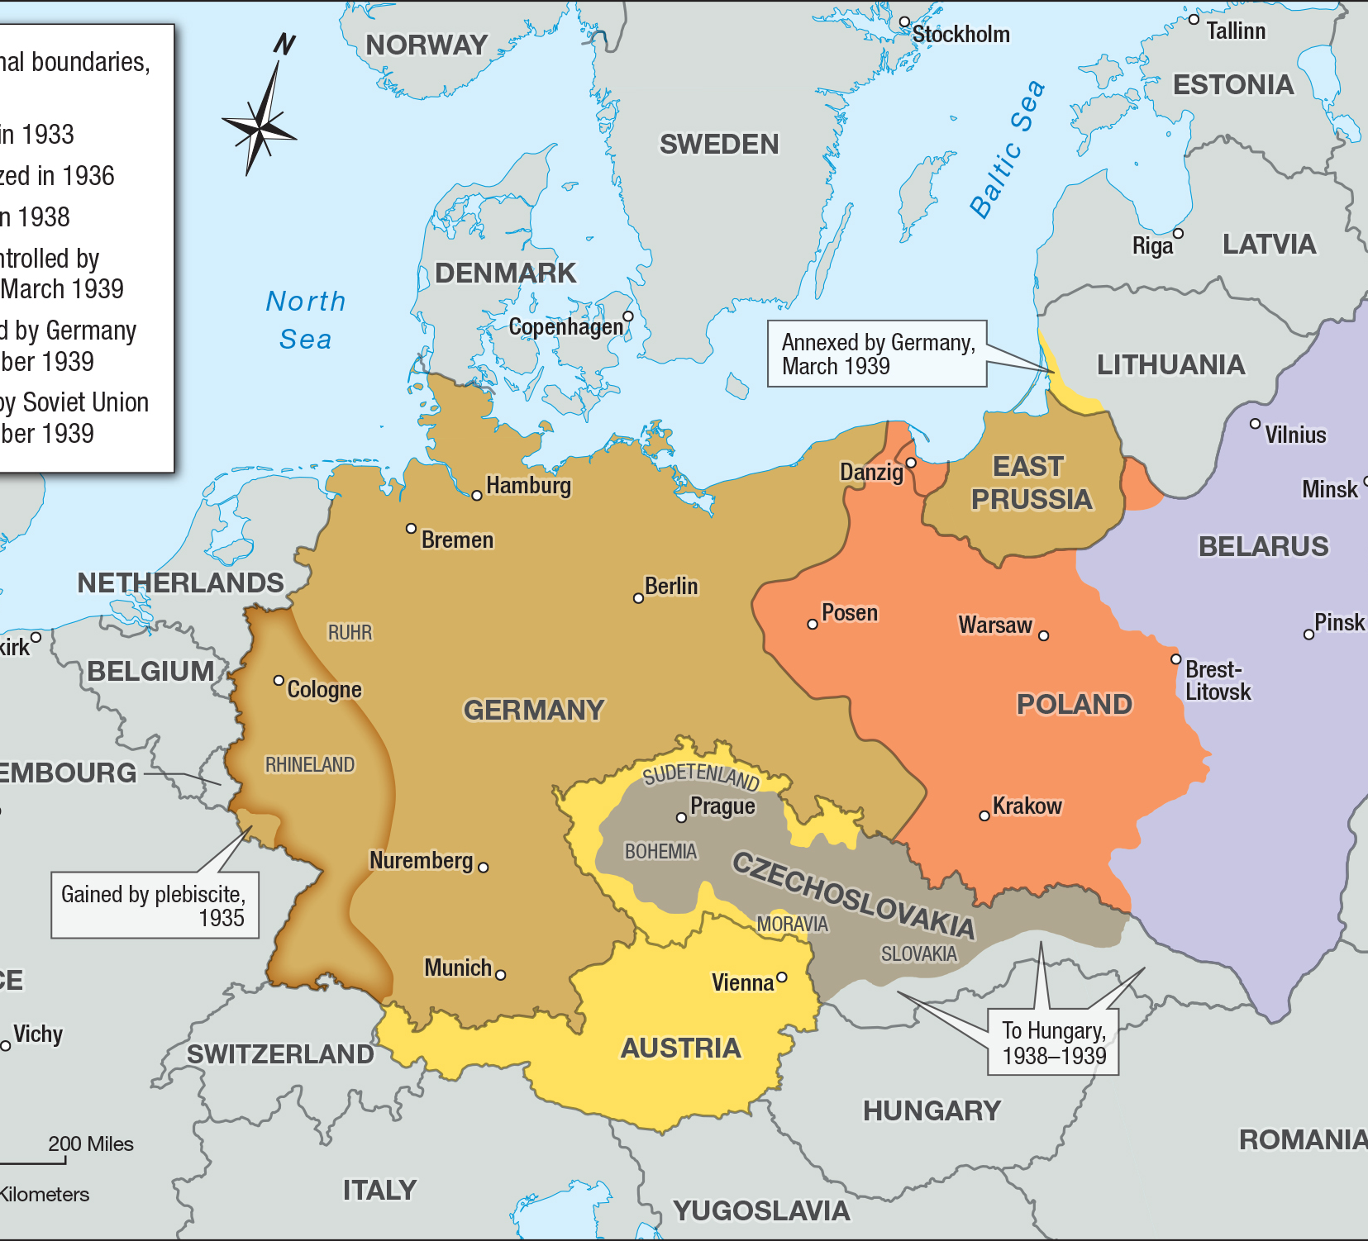
Hitler Invades Czechoslovakia
March 1939
Less than 6 months after Munich Conference, Hitler ignores and takes over Czechoslovakia

Slide 6
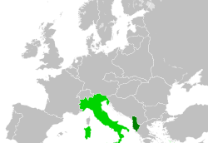
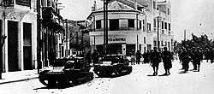
Mussolini Seizes Albania
April 1939
Italy invades Albania and makes it a protectorate

Slide 7
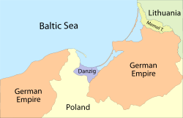
Hitler Wants Poland
Hitler demanded the former German port of Danzig
Poland refused – looked to France and Britain for help
Hitler was convinced appeasement would not result in war
France and Britain turn to Russia to help

Slide 8
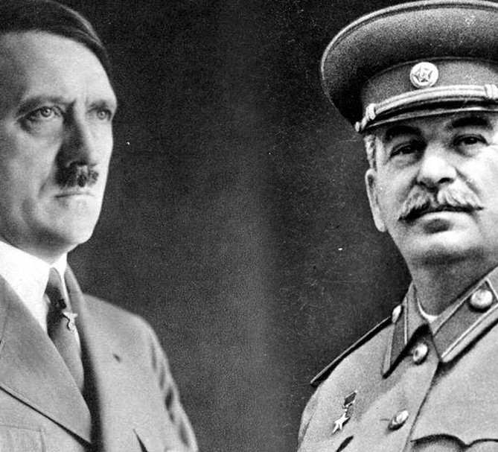
Nazi and Soviet Nonaggression Pact
Stalin and the Soviet Union played both sides – listened to Britain and France, along with Hitler and Germany
Stalin and Hitler reach an agreement
August 23rd, 1939 – leaders sign a nonaggression pact
Stalin was bitter from not being included in Munich Conference
Hitler also promised him territory
Agreed to divide Poland between the two of them

