Slide 1
World War II
Axis Power Conflict

Slide 2
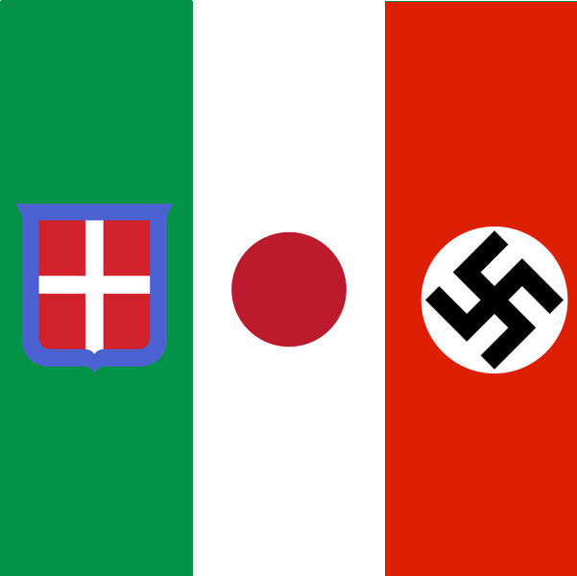
Where We Left Off
Italy
Mussolini – overthrows government in 1922
Fascism
Germany
Hitler – named chancellor in 1933
Fascism
Widespread economic problems
Japan
Hideki Tojo
Imperialist military regime

Slide 4
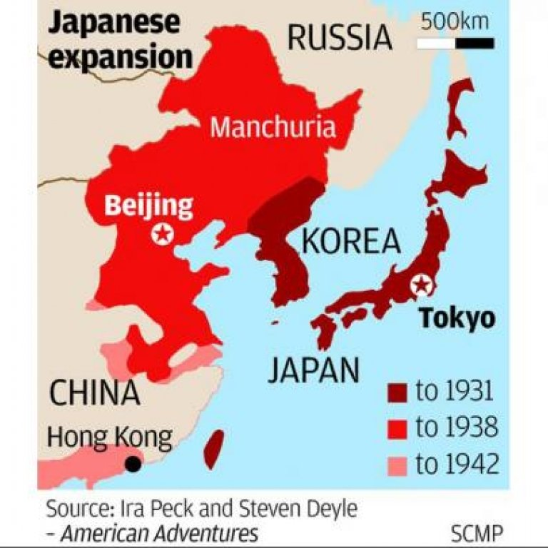
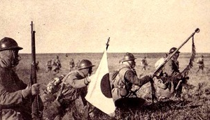
Japan Invades Manchuria
1928 – Japan signs Kellogg –Briand pact w/ China renouncing war
September 1931 – invaded Manchuria
Japan invades Chinese are rich in iron and coal
Set up fake government to give impression of independence

Slide 5
Why was this a problem?
Went against League of Nations
All major democracies w/o United States
Including Japan, Germany, Italy
League upset, Japan doesn’t care
Japan withdraws from League of Nations in 1933
First in a series of regional conflicts that led to WWII

Slide 6
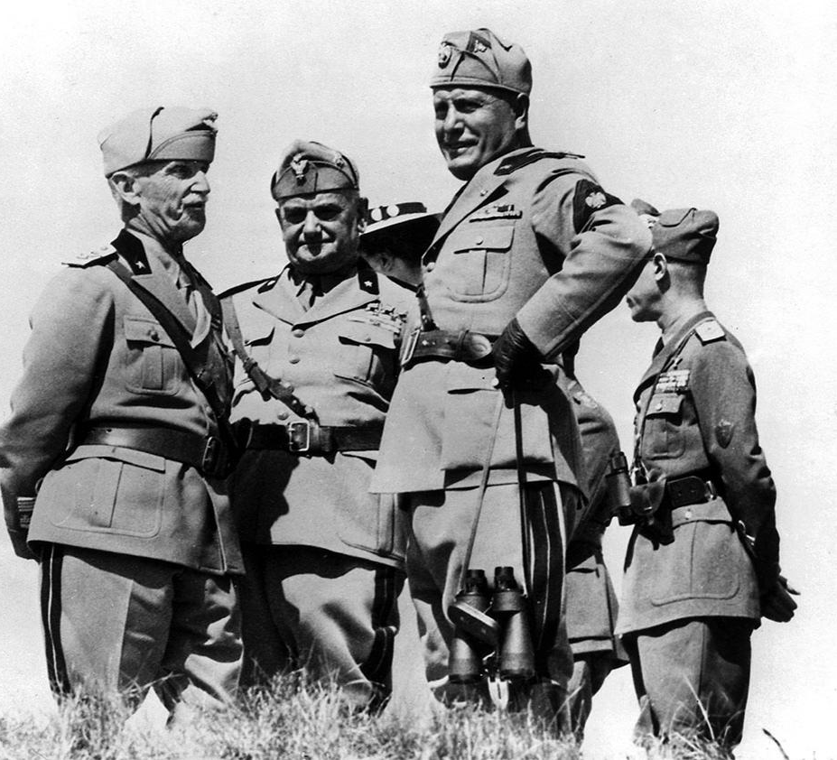
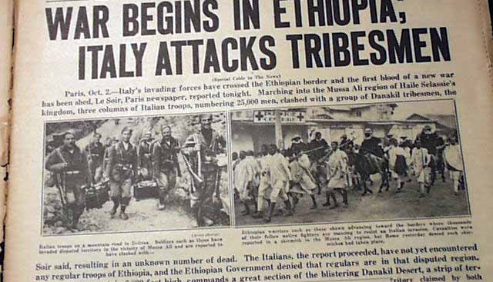
Mussolini Invades Ethiopia
Europe saw League fail to stop the Japanese – encouraged aggression
Mussolini dreamed of Italian empire in Africa
Remember failed Italian invasion of Ethiopia?
October 1935 - Mussolini avenges defeat by invading
Planes, tanks, guns, poison gas > spears, swords
What does League of Nations do? Nothing
Britain lets supplies flow thru British controlled Suez canal
Hope was to do nothing in an effort to keep peace

Slide 7
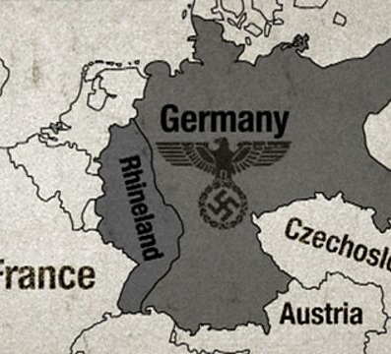
Hitler Takes Rhineland Back
March 1935 – Hitler says he will not limit army per Treaty of Versailles
What is the Rhineland?
Buffer land between Germany and France around Rhine River
Major industrial area
March 7th, 1936 – German troops invaded Rhineland
French did nothing
Britain and France practiced appeasement – giving in to an aggressor to keep peace
Gave Hitler confidence to expand, showed French and British weakness

Slide 8
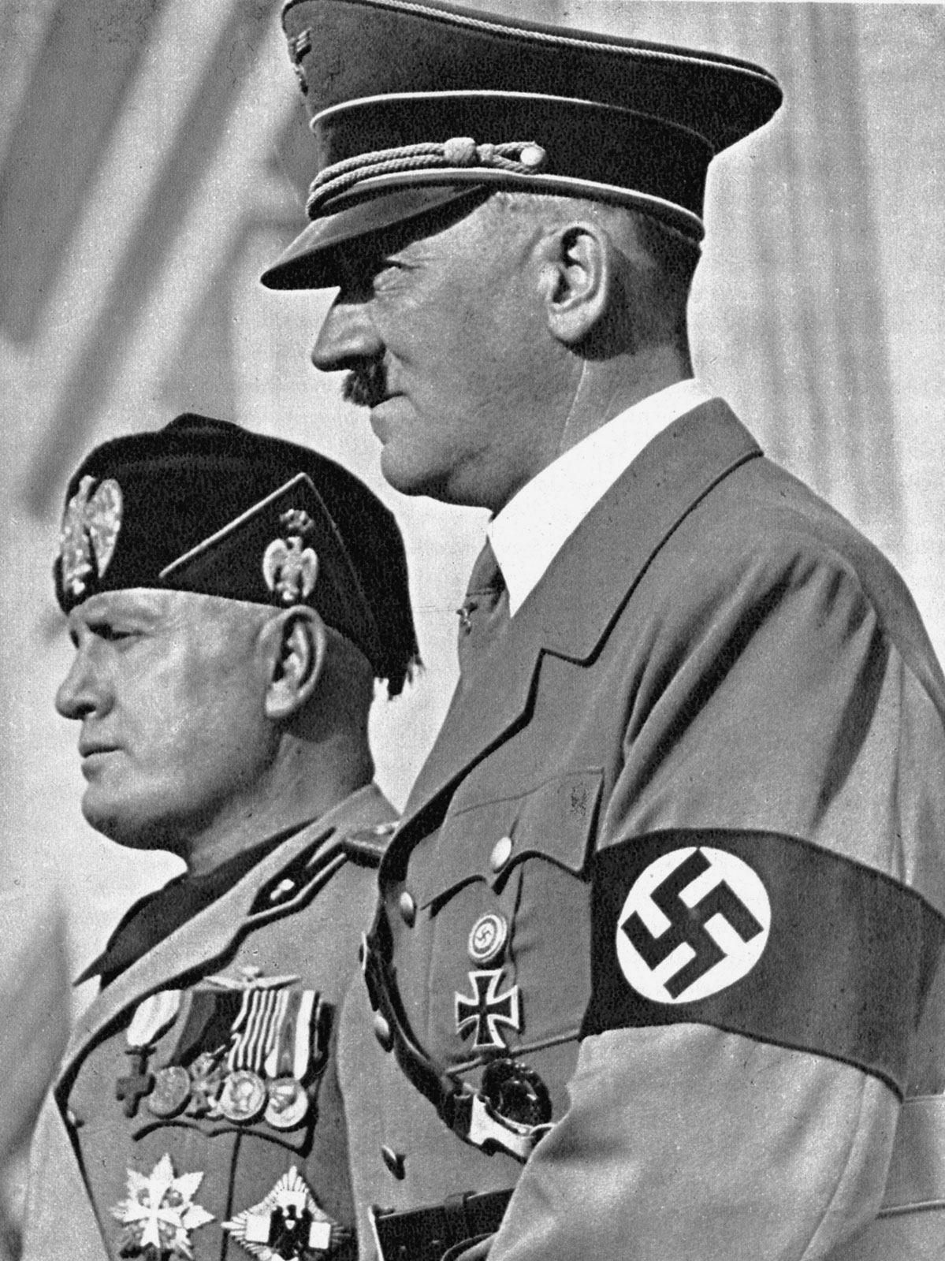
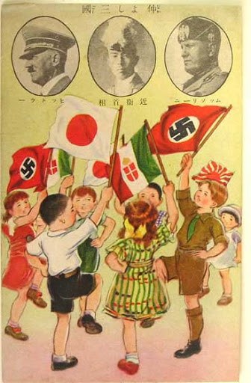
Formation of Axis Powers
October 1936 – Germany and Italy form alliance (Rome-Berlin Axis)
November 1936 – Japan added
Official formation of Axis Powers

Slide 9
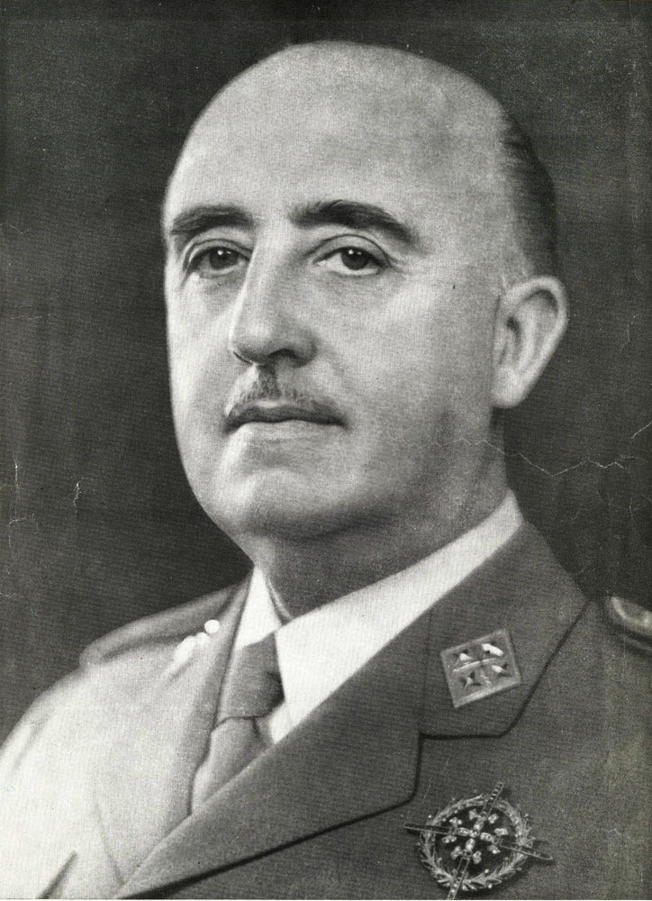
Spanish Civil War
Spain traditionally a monarchy
Republic in 1931
Francisco Franco
Army general favored a fascist-style government
Led revolt that lead to three year civil war (1936 – 1939)
Why does it matter?
Hitler and Mussolini sent troops, tanks, and planes to help Franco win
Western democracies remained neutral
Franco wins – sets up totalitarian regime in Spain

