Slide 1
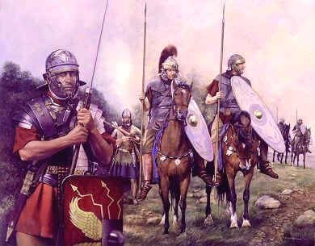
PROBLEMS IN THE ROMAN REPUBLIC
Rome’s expanding territory brought wealth, but also brought issues:
People flocked to the big cities from farms, which created food supply shortages
Struggles for power led to a series of civil wars between Romans

Slide 2
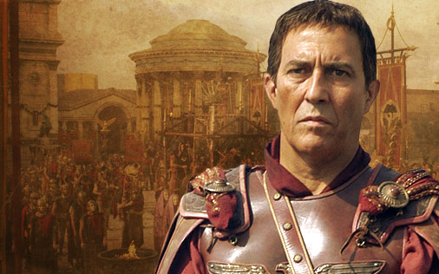
JULIUS CAESAR
From the turmoil within the Roman Republic, a new political leader emerged: a general named Julius Caesar

Slide 3
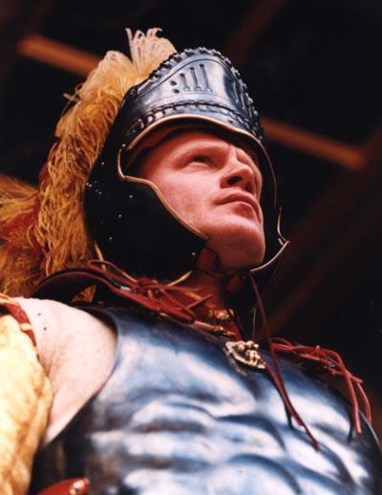
Julius Caesar partnered with two other Roman politicians to take control of Rome (they formed a triumvirate)
Julius was extremely popular with the Roman people, due to his great military victories

Slide 4
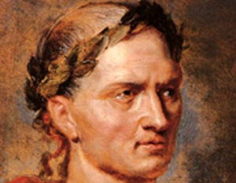
Julius Caesar gathered more power to himself, while looking to solve the Roman Republic’s problems by initiating reforms
Caesar named himself dictator-for-life in 46 BCE, which weakened the Senators’ power a great deal

Slide 6
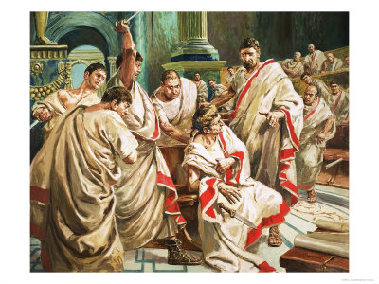
Fearing that he was becoming too powerful, members of the Roman Senate conspired to assassinate Caesar

Slide 7
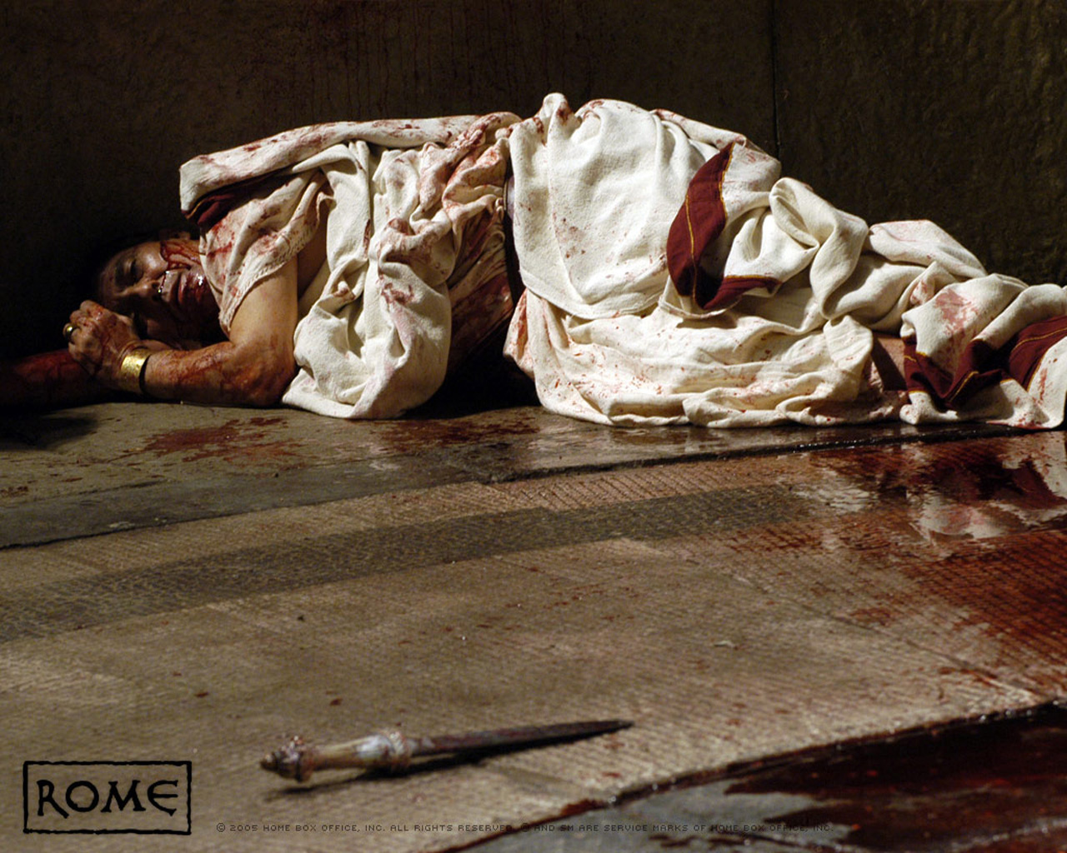
Caesar was cornered and stabbed to death in the Roman Senate building, which began the end of the Roman Republic

Slide 9
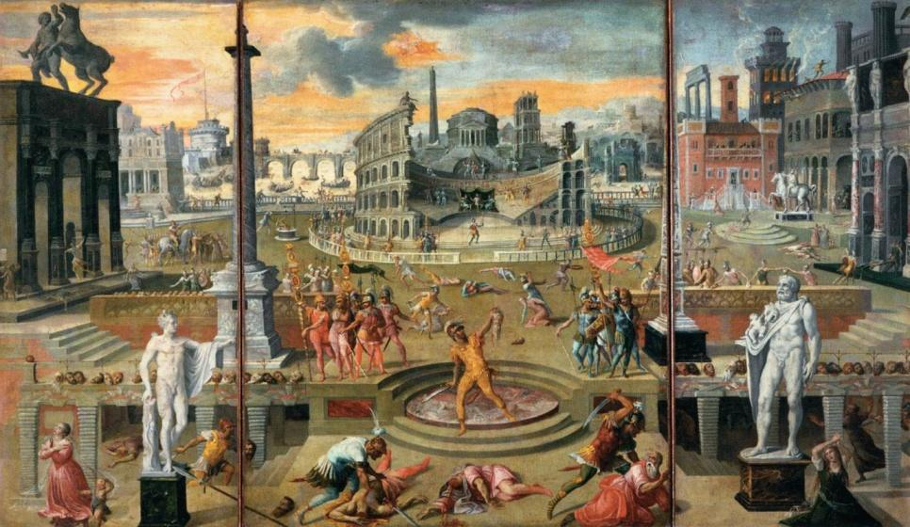
The assassination led to another civil war led by Caesar’s adopted son Octavian and his best general, Marc Antony

Slide 10
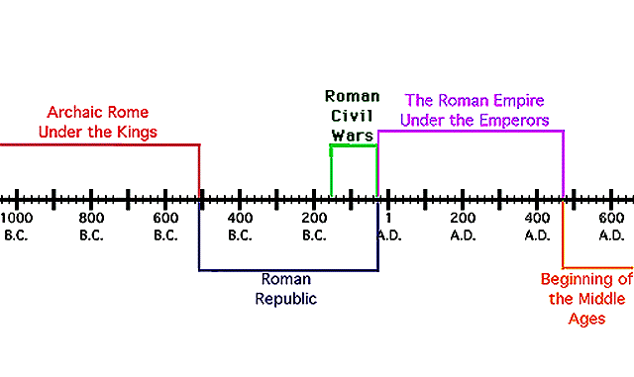
FROM ROMAN REPUBLIC TO ROMAN EMPIRE
Julius Caesar’s death changed Rome; the people no longer trusted the Senate to rule the Roman Republic

Slide 11
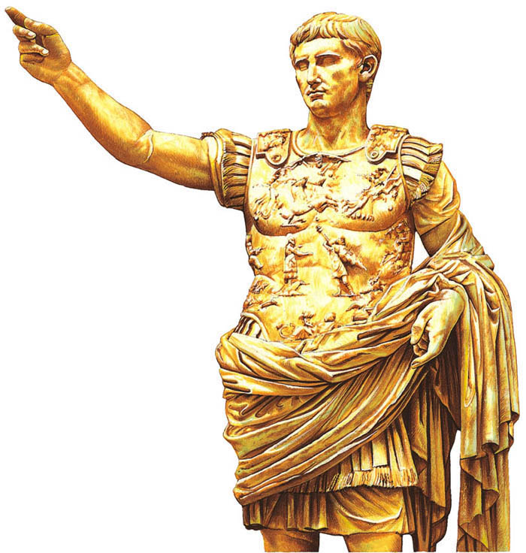
FROM ROMAN REPUBLIC TO ROMAN EMPIRE
Octavian exacted revenge on the Senators who assassinated Julius
Octavian soon became undisputed ruler of Rome, renaming himself Augustus Caesar
“Augustus” means “exalted one”; Julius Caesar’s last name became the title for “emperor”

Slide 12
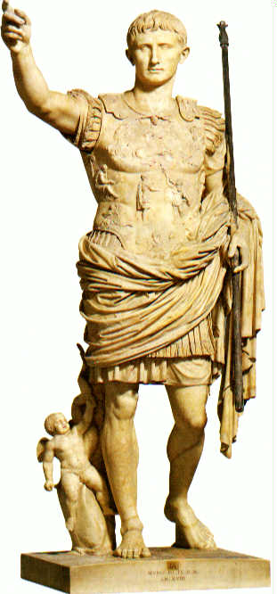
FROM ROMAN REPUBLIC TO ROMAN EMPIRE
Augustus did away with the Senators’ power, eventually ending the representative government of Rome and becoming Rome’s first emperor
The Senate still met, but the emperor had all of the real power

Slide 14
THE PAX ROMANA
Augustus’ 41 year reign marked the beginning of a 207-year era of peace, wealth, and expansion called “Pax Romana” (the “Roman Peace”) from 27 BCE to 180 CE
The Empire was over 3 million square miles in size and contained about 80 million people
Pax Romana

Slide 15
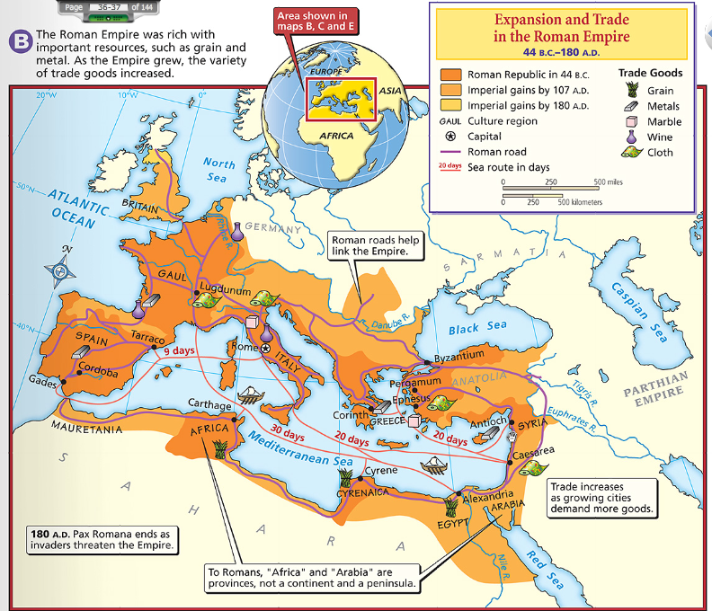
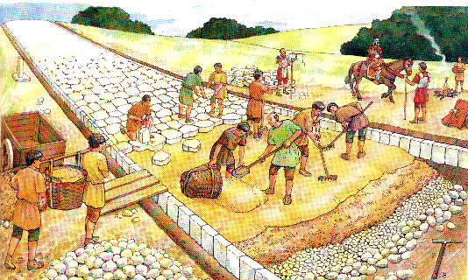
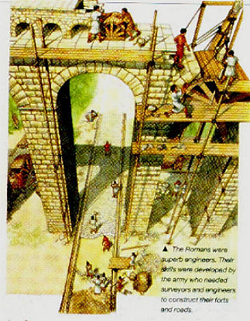
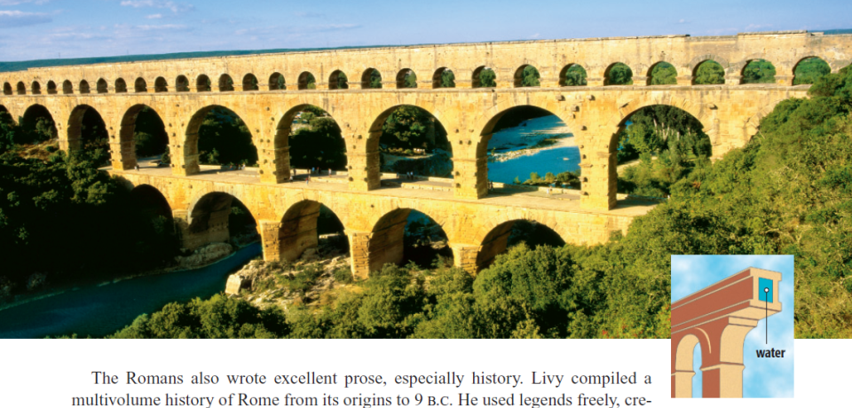
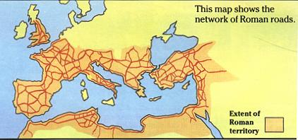
Pax Romana became the “golden age” of Rome as emperors like Augustus built well-paved roads and a modern infrastructure; they had a merit-based bureaucracy to rule the empire
Notes:
During the Pax Romana, emperors continued to expand

Slide 16
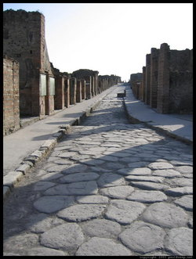
Solid paved roads were built to assist trade and communication around the empire. Many still exist today.

Slide 17
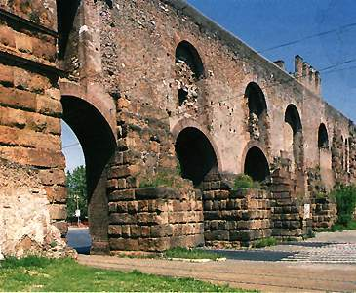
Roman aqueducts were incredible works of engineering and architecture.
The aqueducts could carry up to 300 million gallons of water to the city of Rome every day.

Slide 18
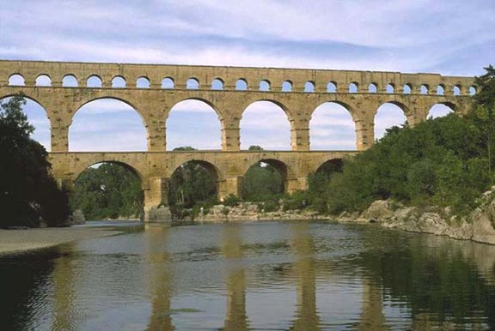

Slide 19
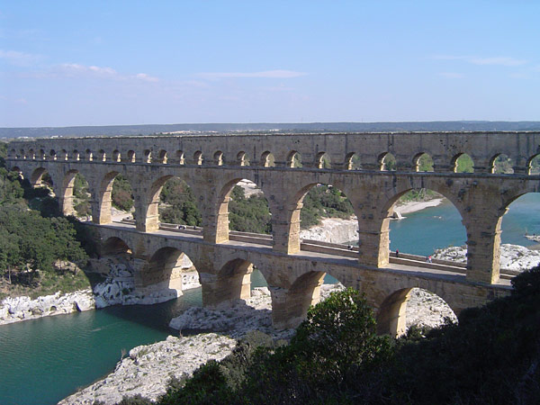

Slide 20
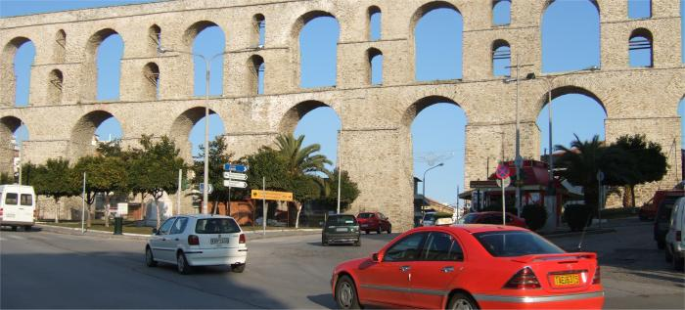

Slide 21
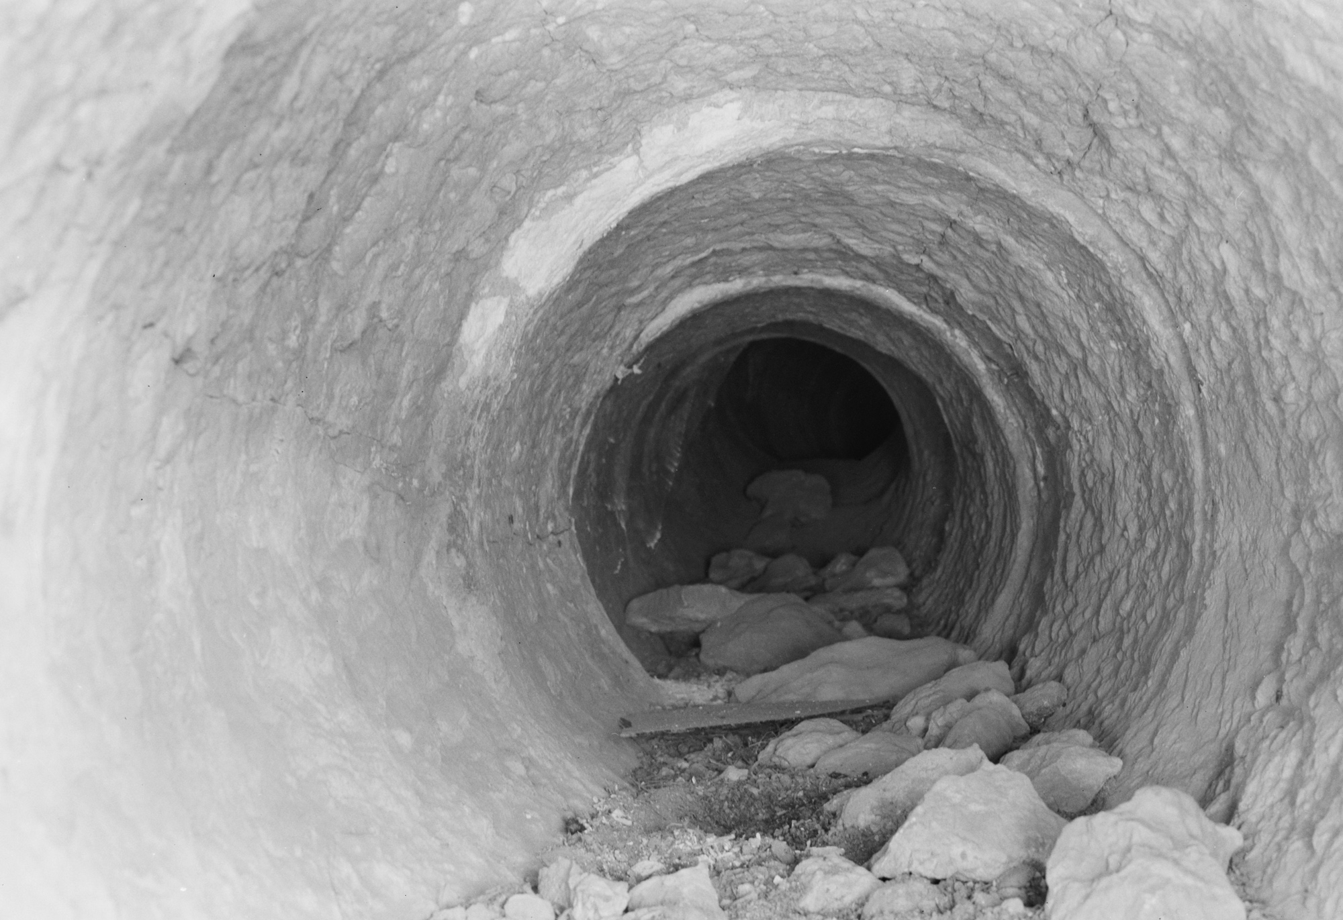

Slide 22
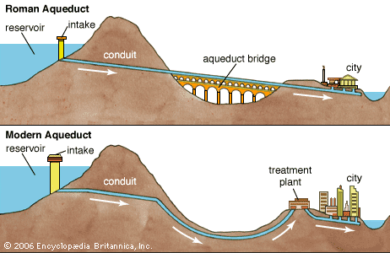

Slide 23
Roman architecture borrowed Greek elements, but made them more grand and heavy.
Roman architects designed arches and domes that could carry great weights.

Slide 24
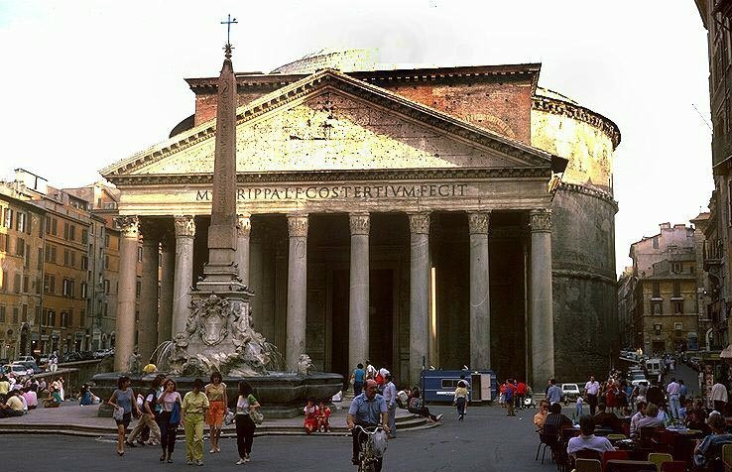

Slide 25
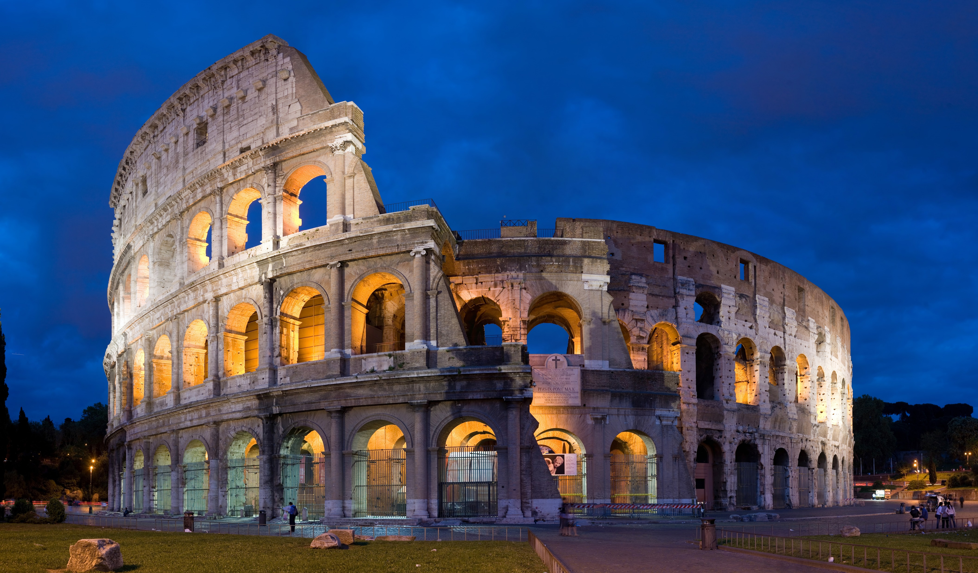
The Colosseum

Slide 26
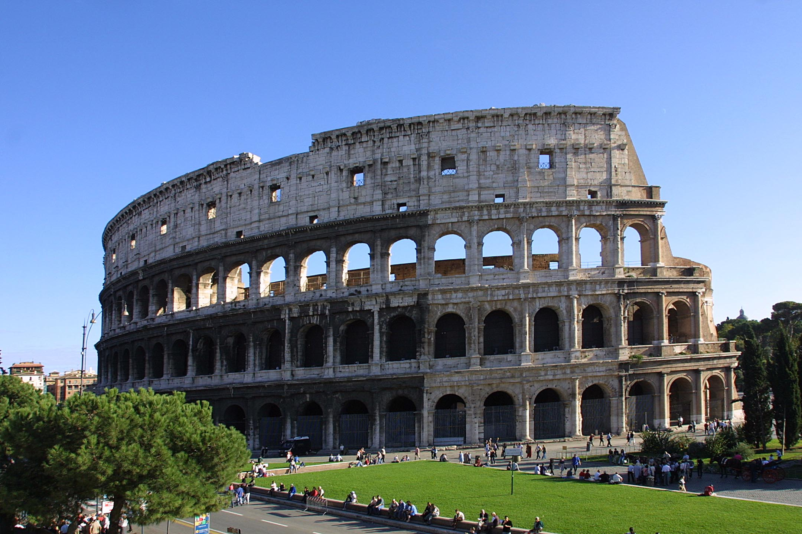

Slide 27
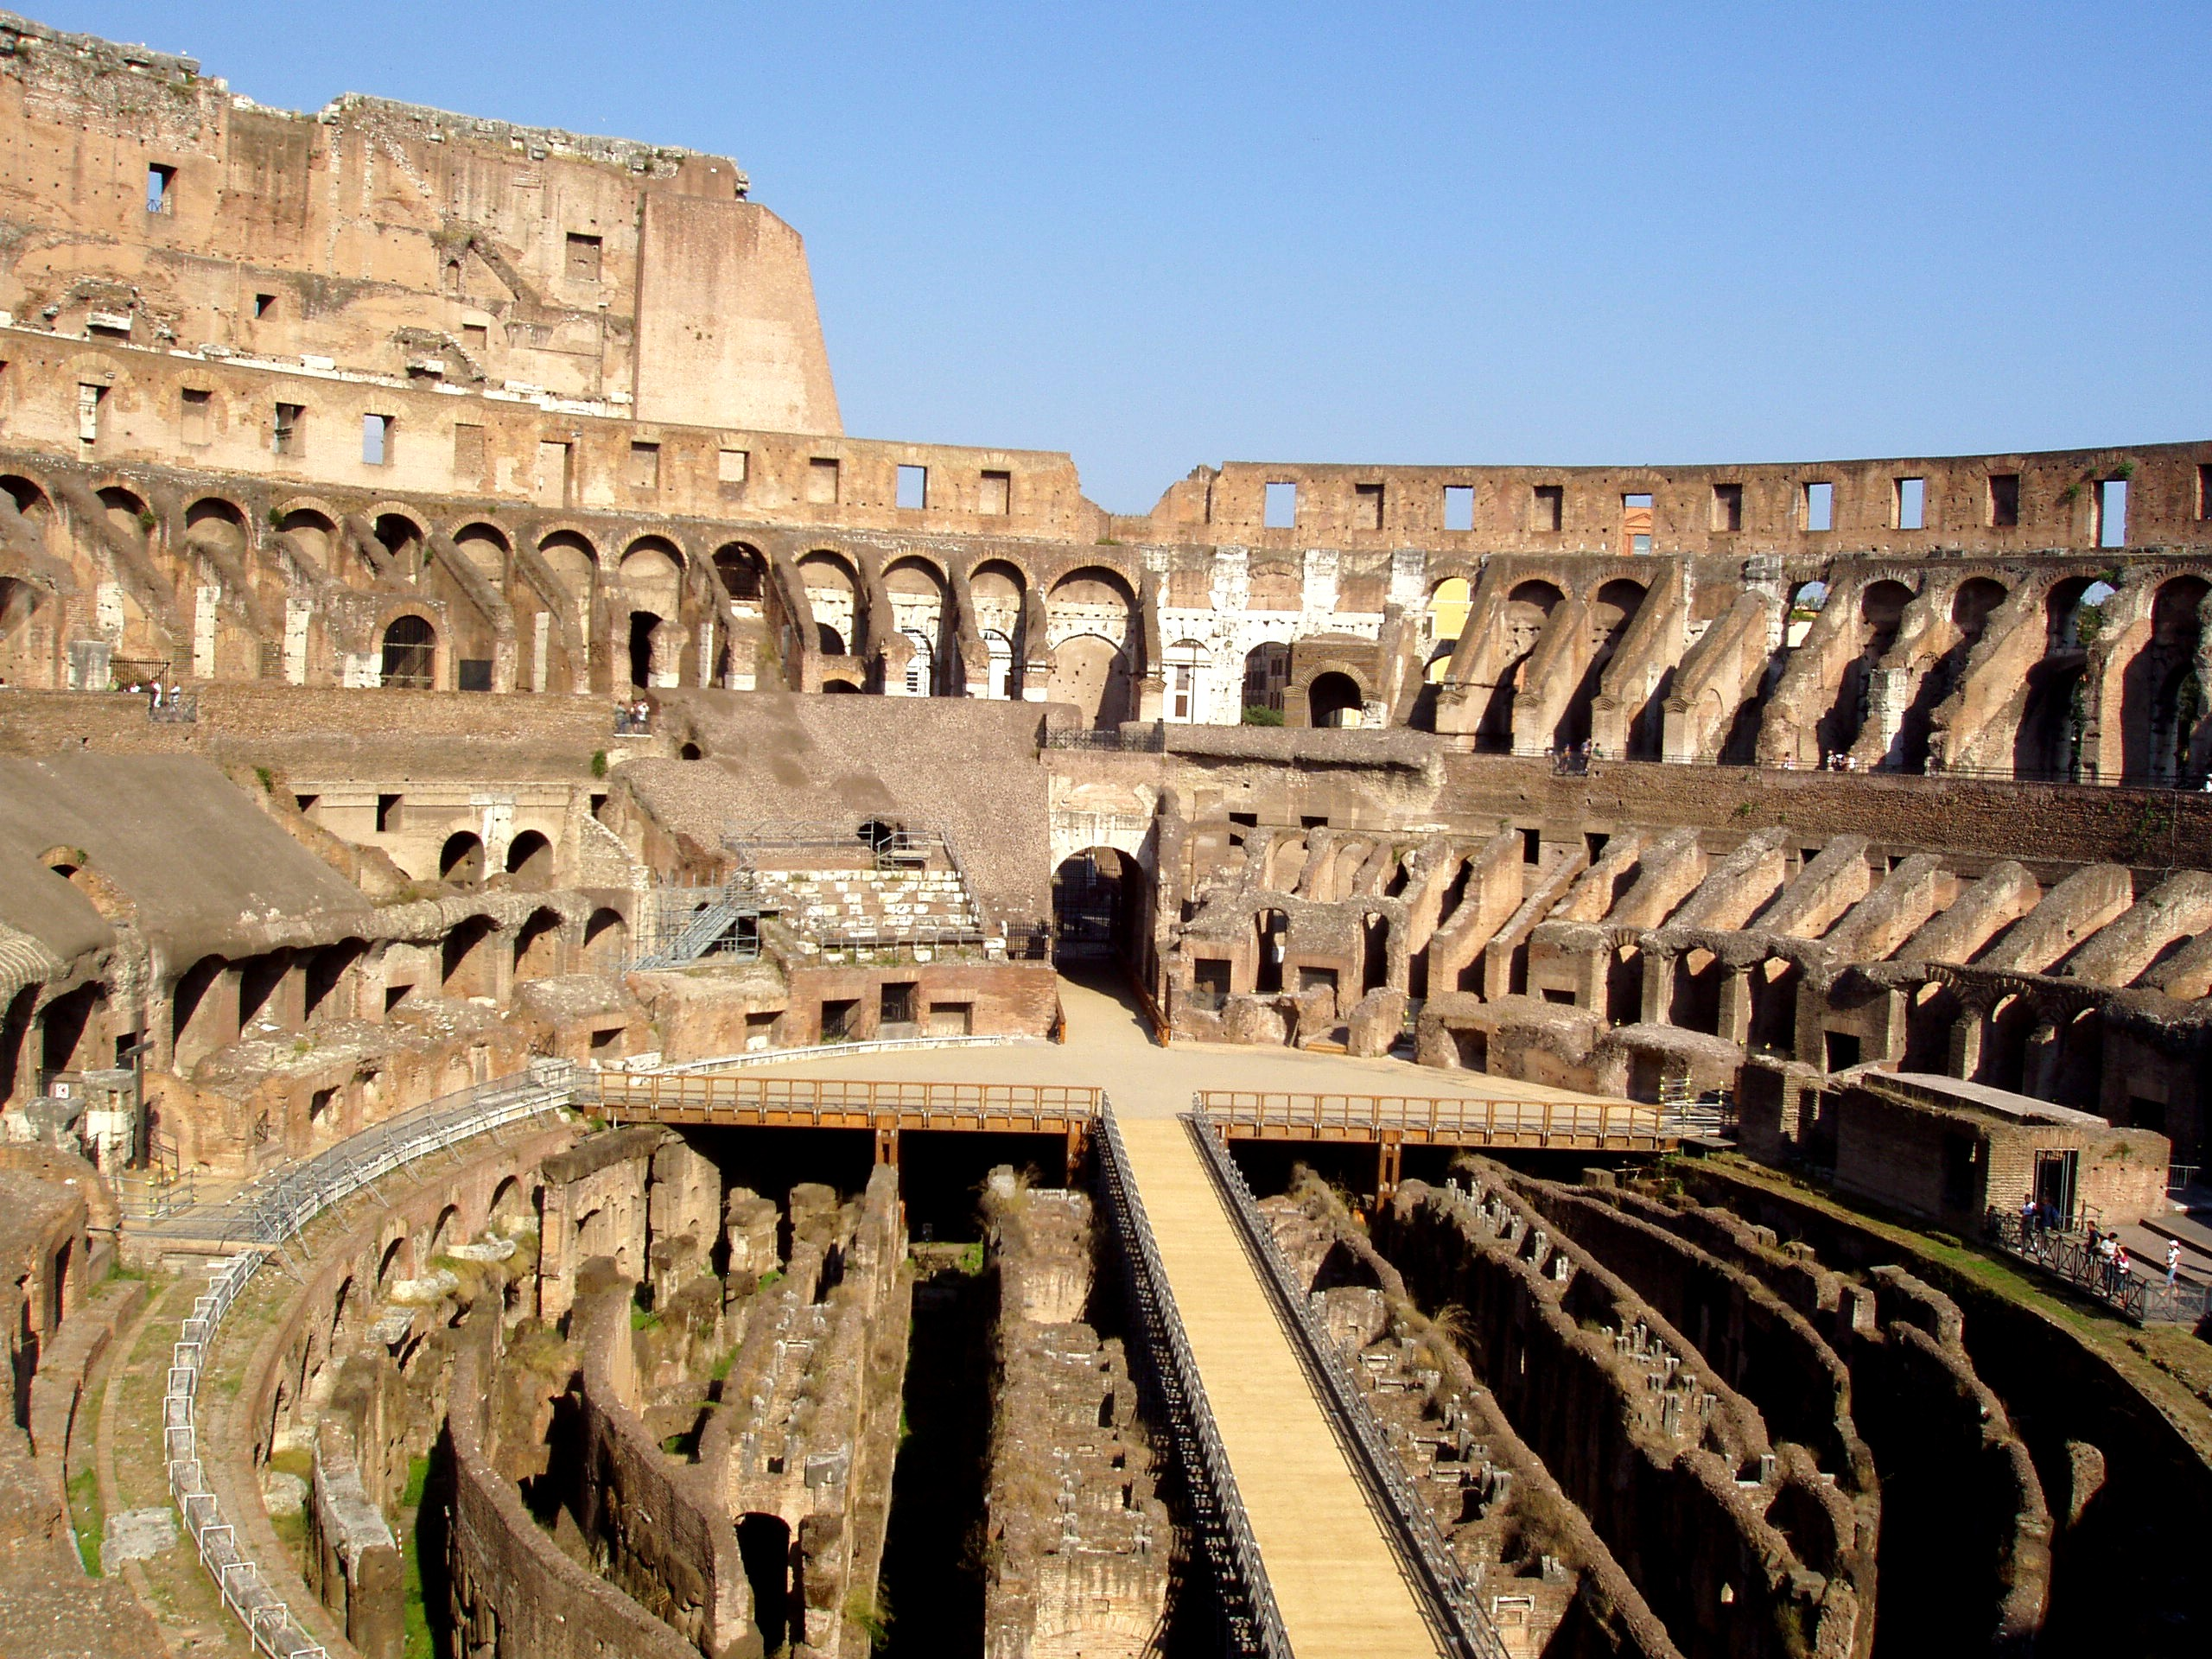

Slide 28
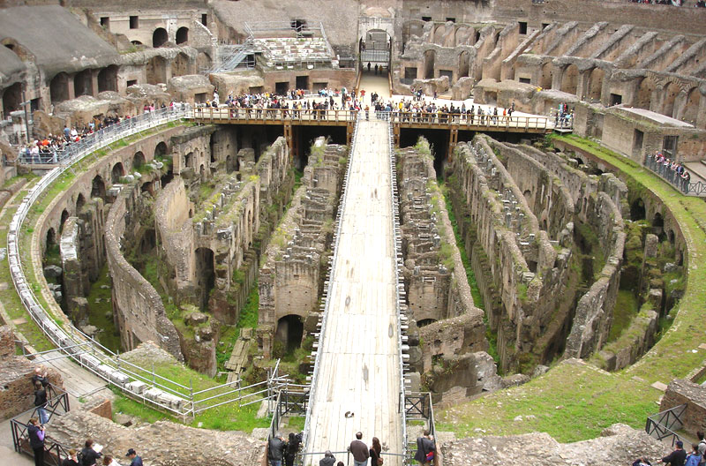

Slide 29
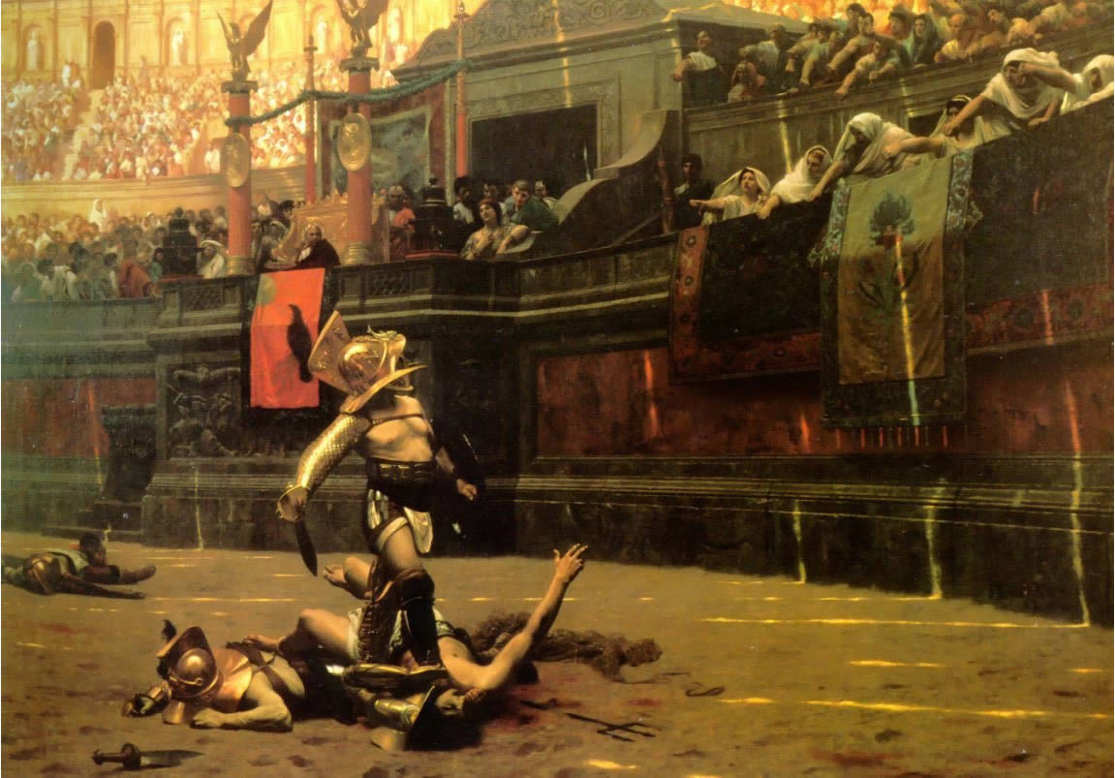

Slide 30
Gladiators

Slide 31
Cultural Contributions
Roman poets, historians and philosophers like Virgil and Tacitus wrote works in Latin that survive to this day.
Latin is the root of several modern languages.
Roman numerals can also be seen in many places today.

Slide 32
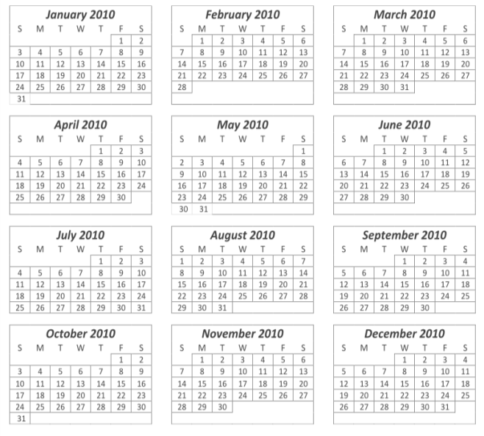
The Roman Calendar
This new calendar (called the “Julian Calendar” after Julius Caesar) had 365 days and one extra day every fourth year
July was named after Julius because it included his birthday

Slide 33
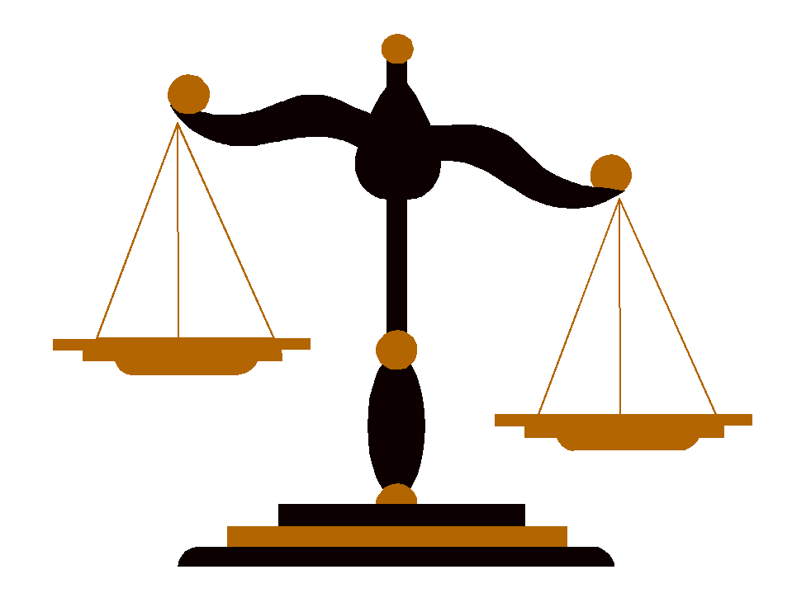
Legal Contributions
The most valued contribution of the Romans to the world was the Twelve Tables of written laws.
The Roman legal system provided security for the empire, equality under the law, the right to a defense and to be considered innocent until proven guilty.
The Roman legal system inspired legal principles still practiced around the world today.

Slide 34
Decline and Fall
Rome wasn’t built in a day and it took a long time to decline. Eventually the emperor Diocletian divided the empire into eastern and western empires.
While the western empire fell into chaos and was invaded, the eastern empire survived as a center of trade and culture and became the Byzantine Empire.

Slide 35
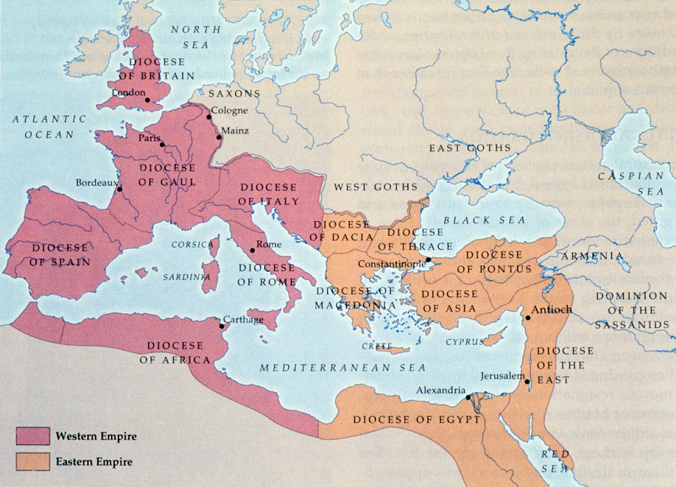

Slide 36
Decline and Fall
Invasions of
Visigoths and
Germanic tribes
Governmental
Corruption,
People stop
Supporting the
government
Causes of the
Fall of Rome
Heavy taxes,
Shrinking middle
Class,
Not enough
farmers
Population decline
From war and
Famine,
People got lazy

