Slide 1
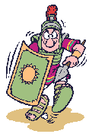
Ancient Rome

Slide 2
Film: Ancient Rome’s Accomplishments
https://www.youtube.com/watch?v=GXoEpNjgKzg

Slide 3
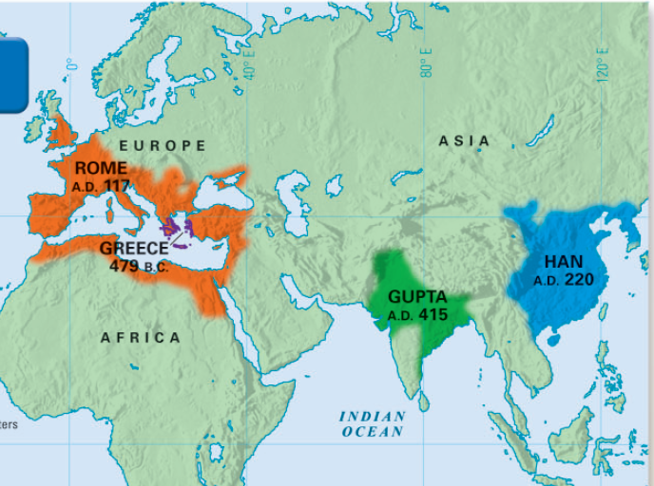
In addition to Greece, another significant classical civilization was ancient Rome

Slide 4
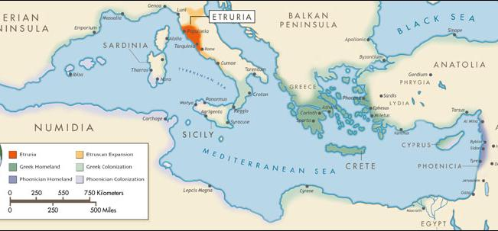
Impact of Geography on Rome Identify one GEOGRAPHIC FEATURE and propose how it might impact the culture of Rome

Slide 5
Geography
Rome is located on the peninsula of Italy. The Mediterranean Sea provides transportation and food.
Italy provides fertile plains and river valleys for food and easy communication.

Slide 6
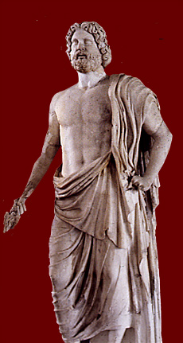
Roman Religious Ideals
Romans were polytheistic, believing in many gods and spirits.
Knowledge of the Greek Gods filtered into Roman culture. This is known as cultural diffusion.
The Greek God Zeus became the almighty Roman God Jupiter.
The Greek Goddess Hera became the Roman Goddess Juno.

Slide 7
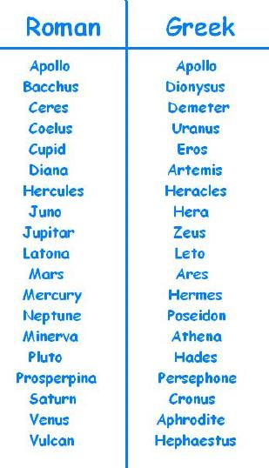
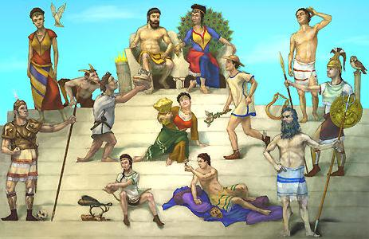
The Culture of Ancient Rome

Slide 8
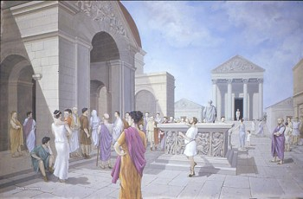
The Culture of Ancient Rome
Like Greek agoras, Roman cities had a forum for markets and public gatherings

Slide 9
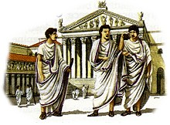
Ancient Roman Society
Roman society was divided into three major groups
At the top were the nobles (called patricians); they controlled most of the land and held key military and government positions
Notes:
5%

Slide 10
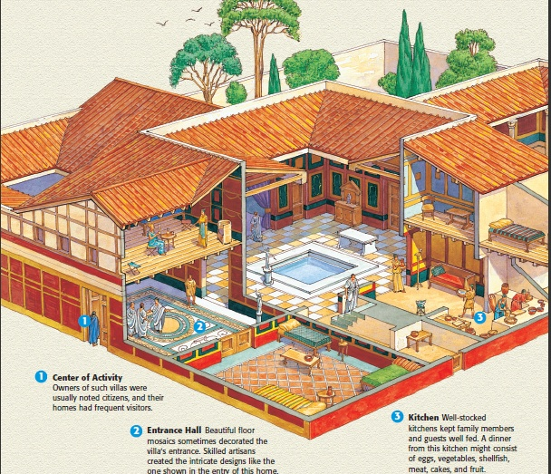
The Life of the Patricians

Slide 11
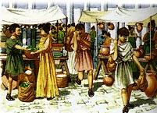
Ancient Roman Society
Most Roman people were commoners (called plebeians); they were farmers, shopkeepers, or peasants

Slide 12
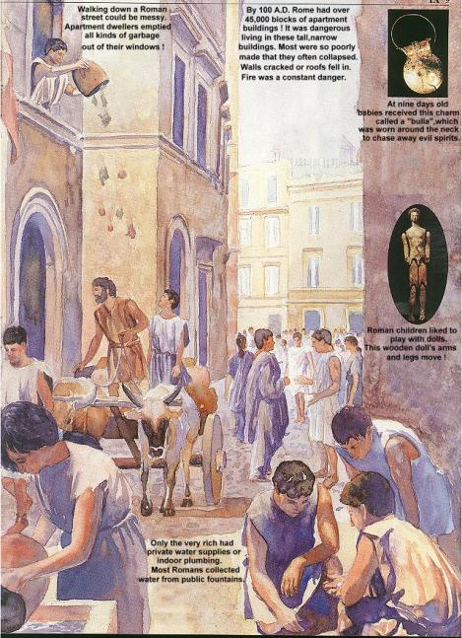
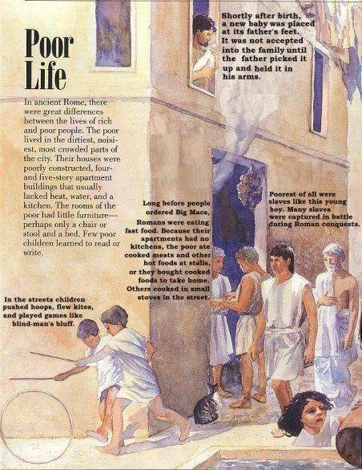
The Life of the Plebeians

Slide 13
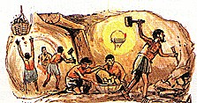
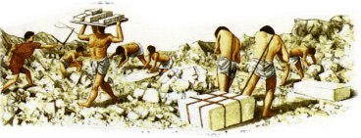
Ancient Roman Society
At the bottom of society were slaves and residents of the Roman Republic who were not Roman

Slide 14
Romans Valued Family Ties
Roman families were headed by the eldest male. The Romans emphasized discipline, strength, and loyalty.
Women had many rights and duties in Roman society. She did not, however have the key right, the right to vote.
Officially, the Roman women were expected to remain in the background.

Slide 15
The Roman Republic
Use pages 193 – 196 to examine the Early Republic in Rome
Each row will research:
Consuls
Senate
Tribunes
Dictator
Role of Citizens
How do this compare to the United States government?

Slide 16
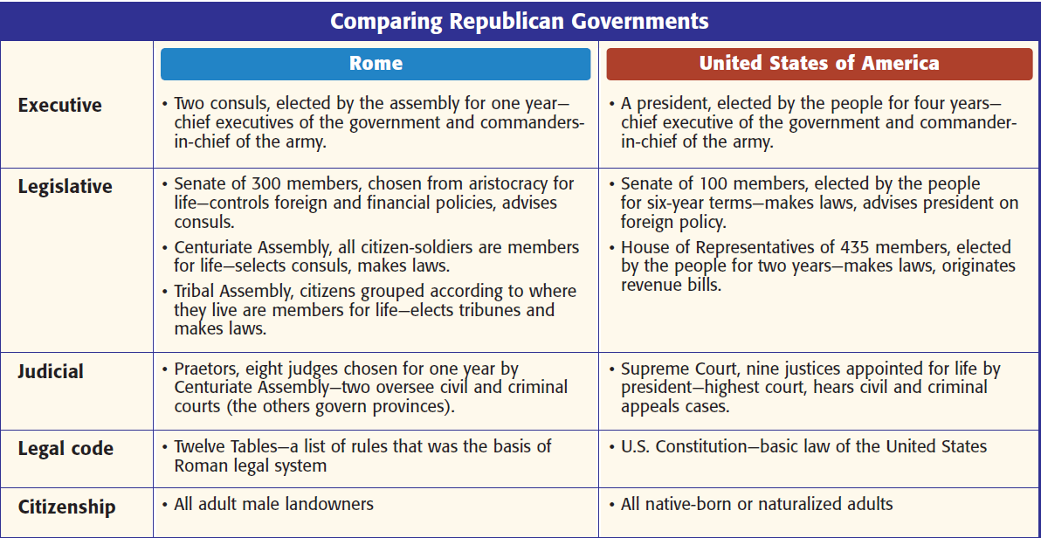

Slide 17
The Roman Republic
Rome was founded about 509 BCE. Romans founded a new type of government called a republic. In a republic, people chose officials to represent them.

Slide 18
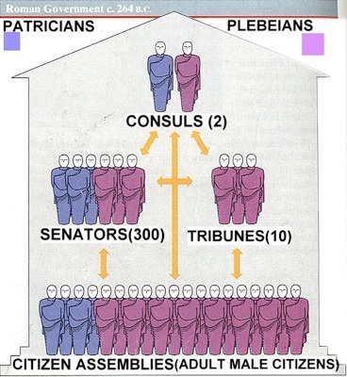
Structure of Roman Republic
Executive Branch:
Consuls (2)
Chief Executive
Commander-in-Chief
Elected by Senators
Elected for 1 year
Patrician
Aristocrats
Dictator
Time of emergency
6 months

Slide 19
Structure of Roman Republic Cont...
Legislative Branch:
Senate
300 (Patrician, later plebeians)
Elected for life
Handle money and advise Consuls
POWER
Tribunes
Own plebeian assembly
Power to veto Senate’s laws
Citizens Assemblies
Majority Plebian

Slide 20
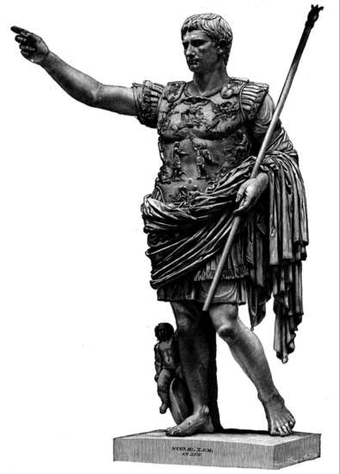
Structure of Roman Republic Cont…
Judicial Branch:
Praetors
judges

Slide 21
Rome Built a Mighty Army
Both patricians and plebeians lead double lives as farmers and soldiers because of the constant threat of war.
All male citizens were required to serve in the army, and no one could hold public office until he served 10 years as a soldier.
Largest army in the Mediterranean at the time

Slide 22
Rome Built a Mighty Army
Massive military units were called legions. Which consisted of:
Infantry: 4,000-6,000 Heavily armed foot soldiers.
Cavalry: Smaller groups on horseback that assisted the infantry.
Each legion was divided into 60 smaller groups called a century.

Slide 24
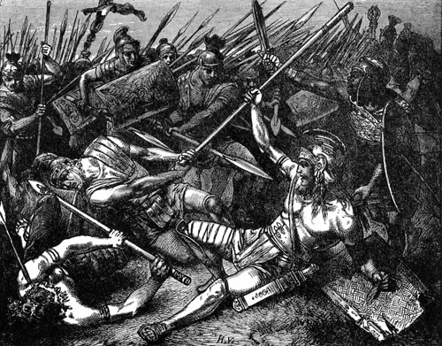
THE PUNIC WARS
The Romans went to war with a neighboring kingdom, Carthage (based in northern Africa)

Slide 25
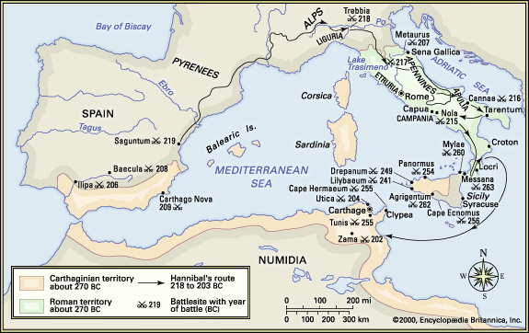

Slide 26
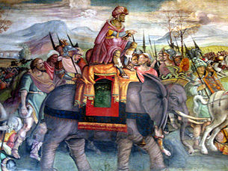
THE PUNIC WARS
The Carthaginians engaged the Romans in three long wars over the course of about a hundred years

Slide 27
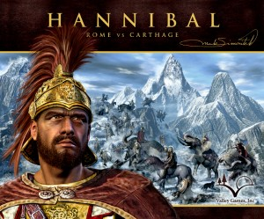
THE PUNIC WARS
Led by the great general Hannibal, the Carthaginians nearly defeated the Romans in the second war; they invaded the Italian peninsula and almost captured Rome
Notes:
Instead of a head on attack, Hannibal marched his enormous army (which included 50,000 men, 9,000 cavalry and 60 war elephants) through Spain and France, over the Alps and into Italy.

Slide 28
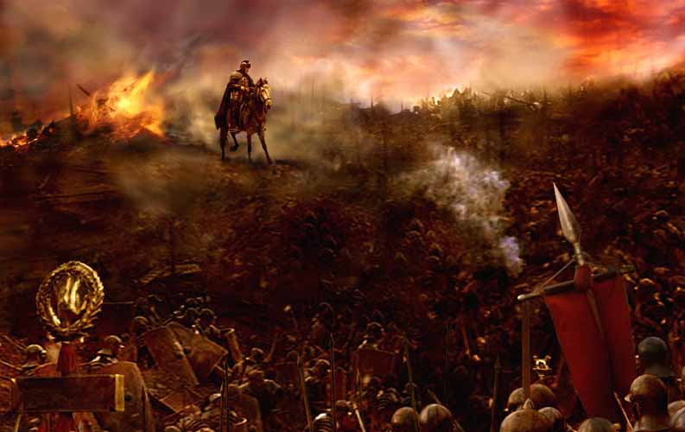
THE PUNIC WARS
The Romans held the Carthaginians off, then completely destroyed Carthage in their third war

Slide 29
THE PUNIC WARS
With Carthage’s defeat, the Romans were then the most dominant power in the Mediterranean, carving out an enormous empire

Slide 30
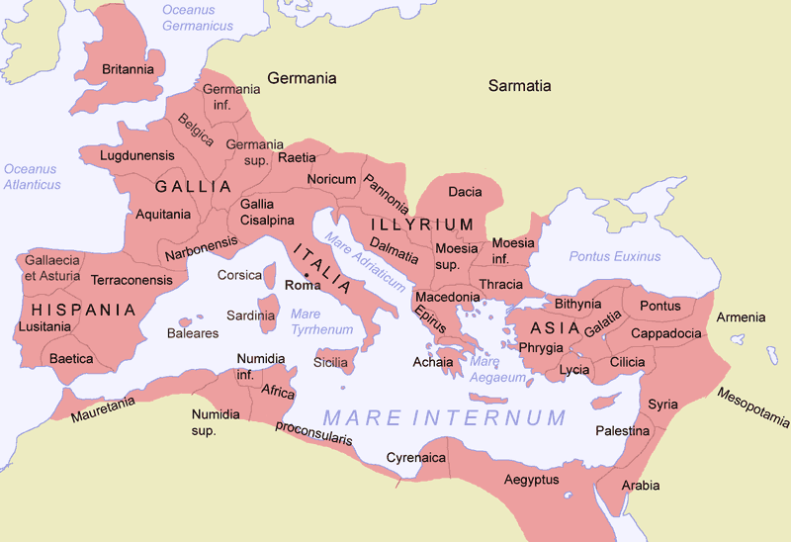
Controlling this massive territory, though, would present new problems for the Romans
ROMAN TERRITORY

